Slide 1
Bioreactor Digital Twin
Chung-Ting Tsai and Zachary Esakof
MSCV Spring 2026
Notes:
Main title: 40 pt. Arial
Presenter Name: 16 pt. Arial
Presenters Title: 16 pt. Arial Italic

Slide 2
Presentation Outline
Motivation
Problem Setting
Technical Approach
Results
Conclusion

Slide 3
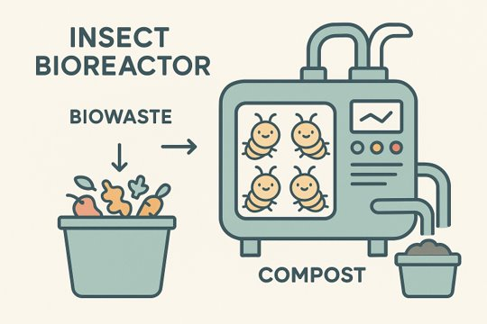
Motivation
What is a bioreactor?
  Definition
  Examples
  Insect bioreactor for waste
Why are we studying worms?
  Sustainable waste management
  Convert biowaste into valuable resources
Notes:
What is a bioreactor?
- Controlled environment where organisms can grow. Examples in sewage treatment, brewing beer, and composting
- Convert what would otherwise be organic waste into carbon credits or compost
- Mostly only makes sense to do at scale
Why study worms?
- Counting life stages to understand population
- Pose estimation to understand behavior, alive vs. Dead
- Create digital twin (explain this in detail of simulation -> shadow twin -> digital twin)
- Additional phenotyping
- Focusing on adult stage only, but value in identifying all growth stages

Slide 4
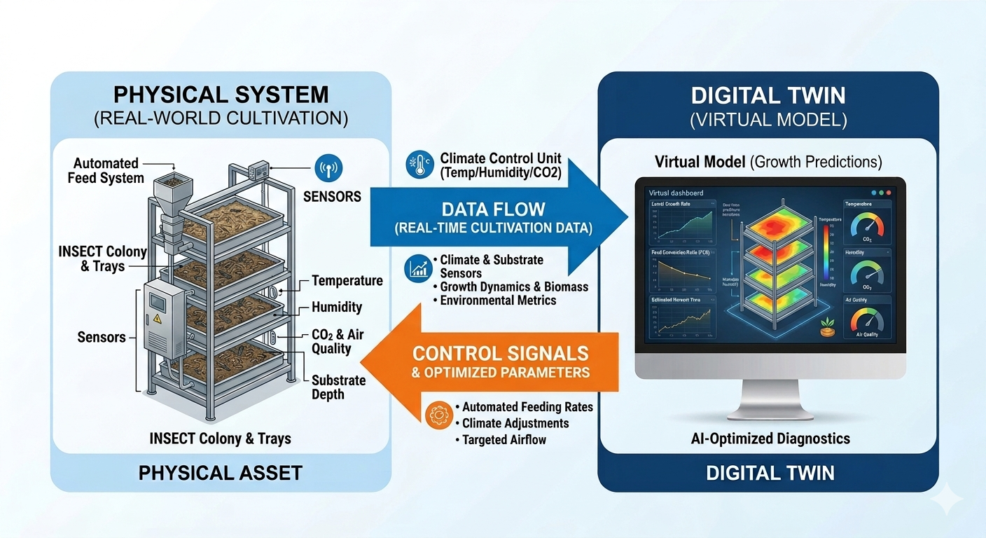
Motivation (cont.)
What are digital twins?
  Digital simulation
  Digital shadow
  Digital twin
Notes:
What is a bioreactor?
- Controlled environment where organisms can grow. Examples in sewage treatment, brewing beer, and composting
- Convert what would otherwise be organic waste into carbon credits or compost
- Mostly only makes sense to do at scale
Why study worms?
- Counting life stages to understand population
- Pose estimation to understand behavior, alive vs. Dead
- Create digital twin (explain this in detail of simulation -> shadow twin -> digital twin)
- Additional phenotyping
- Focusing on adult stage only, but value in identifying all growth stages

Slide 5
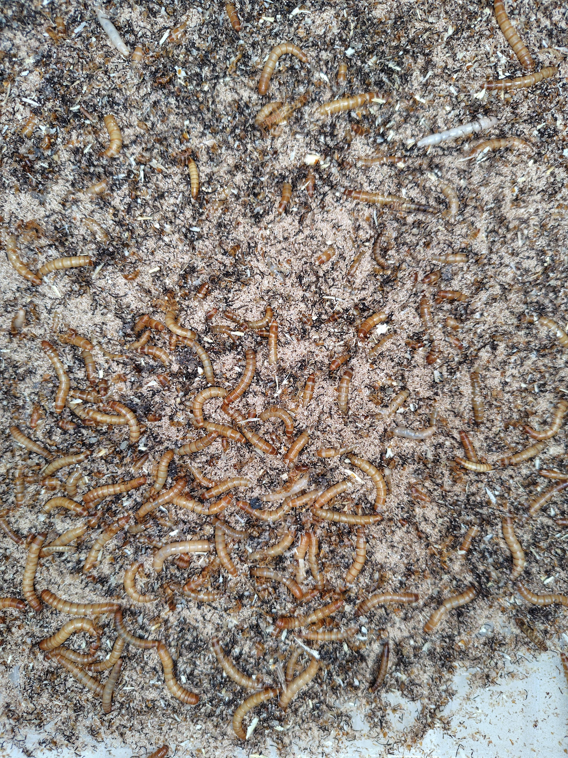
Problem Setting
What will we do?
  Perception monitoring system
    Segmentation
    Pose estimation
Why is this difficult?
  Many instances
  Occlusion
  Deformation
  Methods work really well on humans due to more attention and data
Notes:
Why is this difficult?
- Occlusion with other worms and the feed
- Many species, ideally universal across insect types
- Mealworm (tenebrio molitor), black soldier flies, and earthworms to start
- Other more specialized insects as necessary for unique biowaste
- Much fewer resources on animals in general and insects especially

Slide 6
Technical Approach - Overview
Inspiration from existing works
Notes:
Why is this difficult?
- Occlusion with other worms and the feed
- Many species, ideally universal across insect types
- Mealworm (tenebrio molitor), black soldier flies, and earthworms to start
- Other more specialized insects as necessary for unique biowaste
- Much fewer resources on animals in general and insects especially

Slide 7
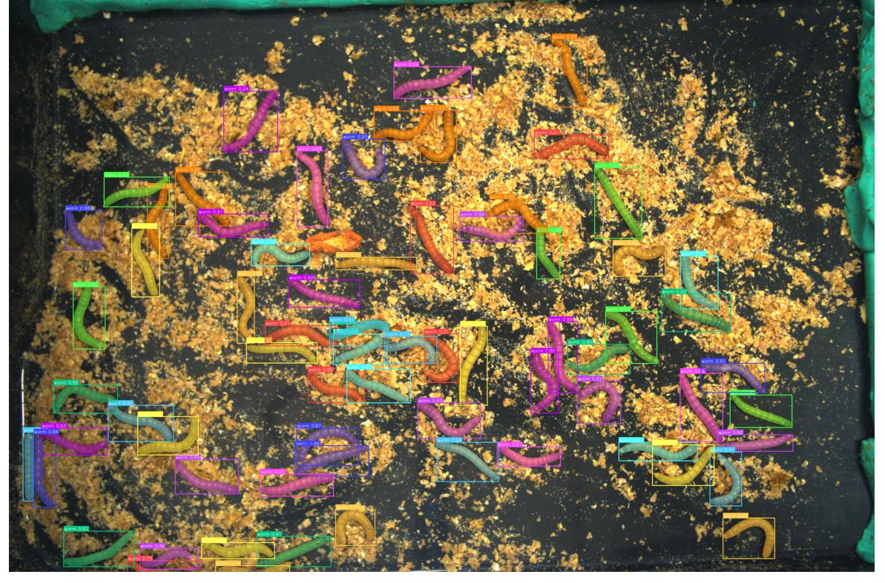
Technical Approach - Data
TenebrioVision
High density and rich annotation
  10-100 instances per image
  53,600+ total annotated instances including instance segmentation masks
High resolution frames: 3088 x 2076 pixels
Diverse images with 30-second interval sampling
Notes:
Why is this difficult?
- Occlusion with other worms and the feed
- Many species, ideally universal across insect types
- Mealworm (tenebrio molitor), black soldier flies, and earthworms to start
- Other more specialized insects as necessary for unique biowaste
- Much fewer resources on animals in general and insects especially

Slide 8
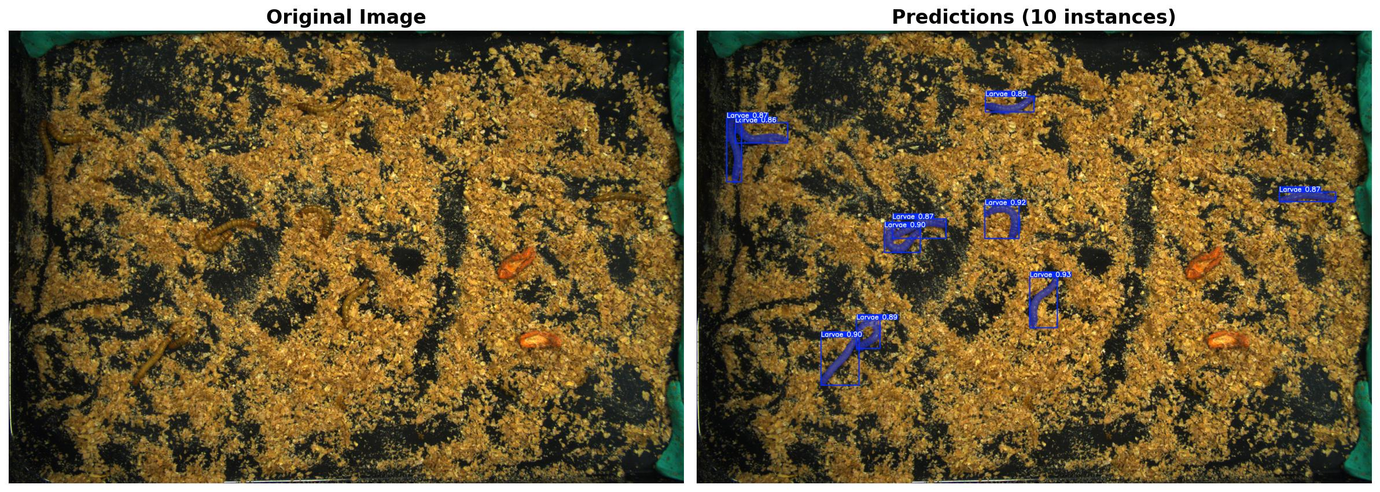
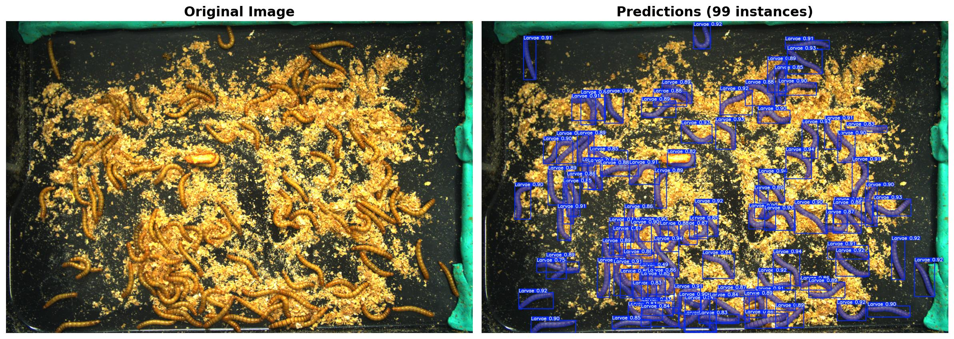
Results - Segmentation
Original images
YOLO inference
Notes:
Why is this difficult?
- Occlusion with other worms and the feed
- Many species, ideally universal across insect types
- Mealworm (tenebrio molitor), black soldier flies, and earthworms to start
- Other more specialized insects as necessary for unique biowaste
- Much fewer resources on animals in general and insects especially

Slide 9
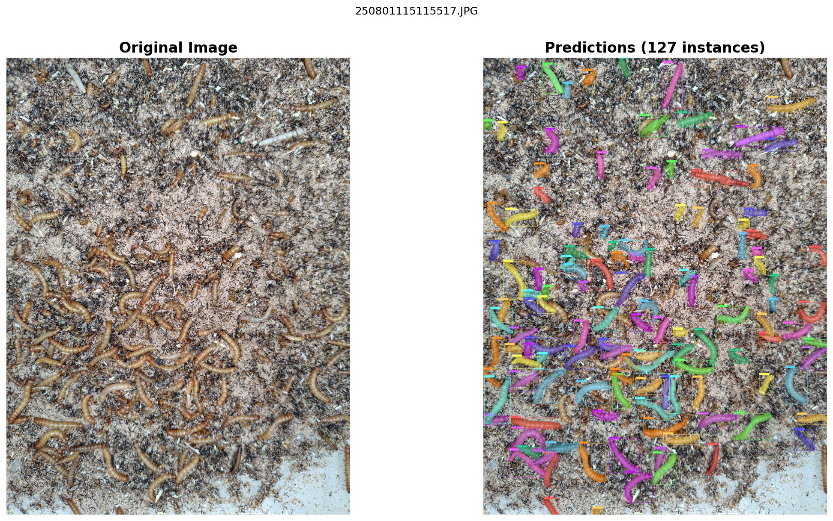
Results - Segmentation
Segment Anything Model 3
  Introduces semantic concepts to segment instances
  Significantly slower than YOLO for real-time usage

Slide 10
Results – Pose Estimation
Fine-tuned DeepLabCut on TenebrioVision dataset
Used PCA to identify worm head + tail as proof-of-concept
  Fails on highly deformed worms
Next steps include using skeletonization models to increase head + tail accuracy
  Add body parts along the body
Notes:
Why is this difficult?
- Occlusion with other worms and the feed
- Many species, ideally universal across insect types
- Mealworm (tenebrio molitor), black soldier flies, and earthworms to start
- Other more specialized insects as necessary for unique biowaste
- Much fewer resources on animals in general and insects especially

Slide 11
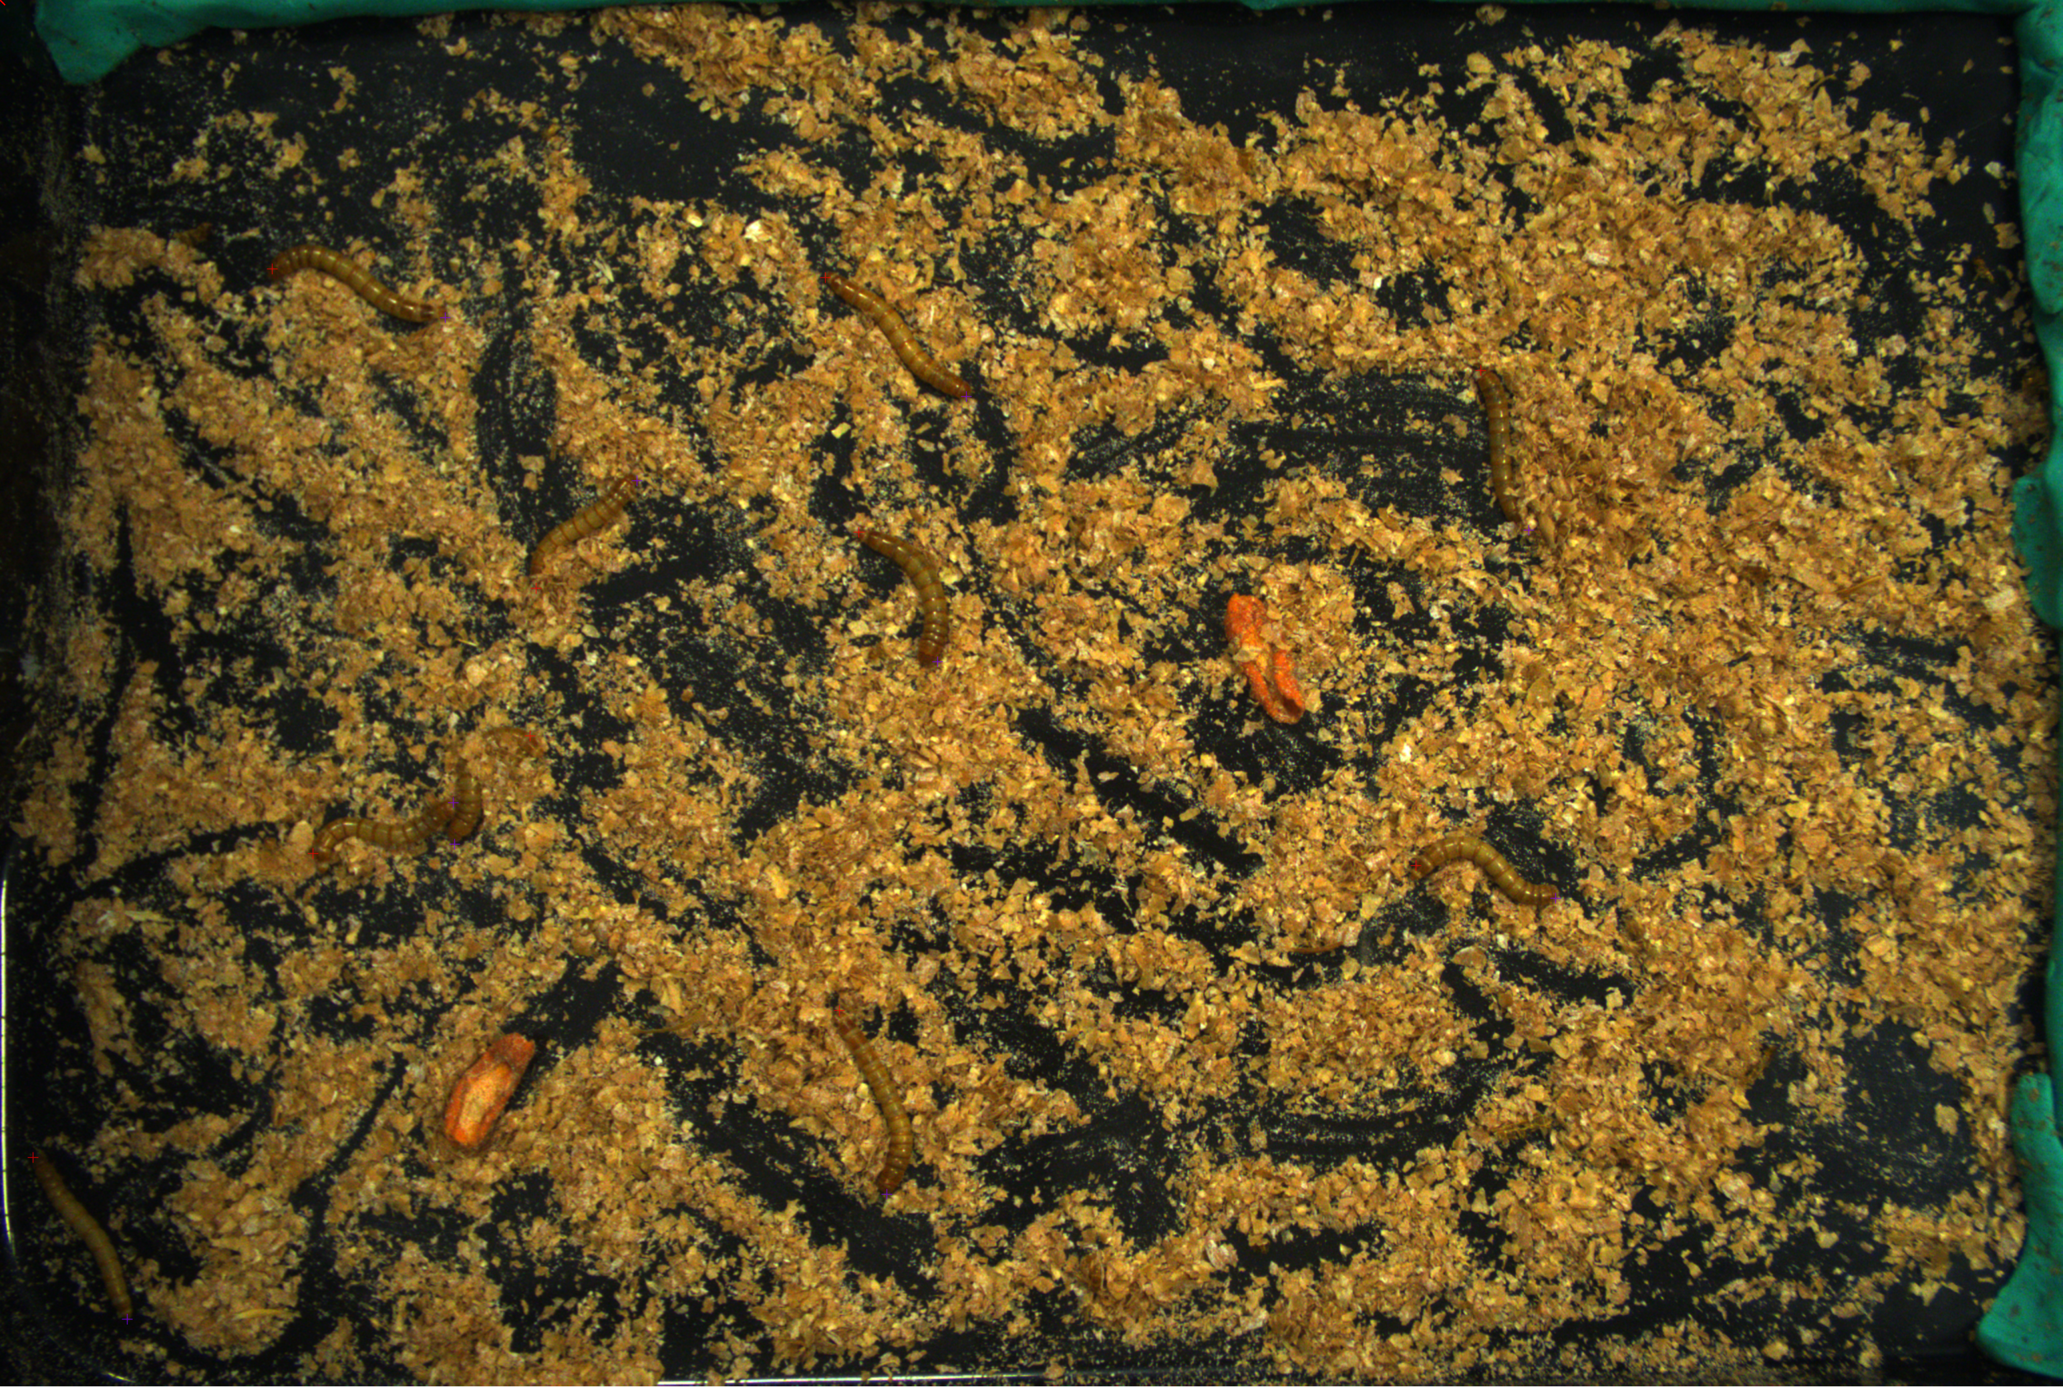
Results - Pose Estimation
Head
Inspiration from existing works
Tail
Notes:
Why is this difficult?
- Occlusion with other worms and the feed
- Many species, ideally universal across insect types
- Mealworm (tenebrio molitor), black soldier flies, and earthworms to start
- Other more specialized insects as necessary for unique biowaste
- Much fewer resources on animals in general and insects especially

Slide 12
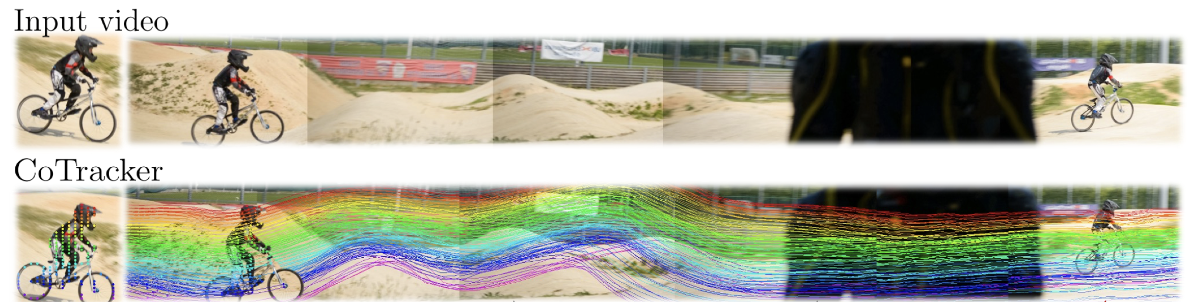
Next Step
Improve tracking quality by utilizing optical flow methods such as RAFT
  Dense tracking frameworks like CoTracker and SpatialTracker.
To mitigate the lack of training data, we will develop a fast auto-labeling system and employ domain adaptation methods to ensure robust monitoring.
[1] Karaev, Nikita, et al. "Cotracker3: Simpler and better point tracking by pseudo-labelling real videos.” 2025.
[2] Xiao, Yuxi, et al. "Spatialtrackerv2: 3d point tracking made easy." 2025.
Notes:
Why is this difficult?
- Occlusion with other worms and the feed
- Many species, ideally universal across insect types
- Mealworm (tenebrio molitor), black soldier flies, and earthworms to start
- Other more specialized insects as necessary for unique biowaste
- Much fewer resources on animals in general and insects especially

Slide 13
Conclusion
Biowaste is valuable!
Building perception stack for insect monitoring
Technical approach
  TenebrioVision
    End-to-end example of similar work and dataset
  SAM3
    Cutting-edge segmentation foundation model
  DeepLabCut
    Framework for pose estimation on non-human animals
Results and next steps

Slide 14
Thank you!

