Slide 1
Bioreactor Digital Twin
Chung-Ting Tsai and Zachary Esakof
MSCV Spring 2026
Notes:
Main title: 40 pt. Arial
Presenter Name: 16 pt. Arial
Presenters Title: 16 pt. Arial Italic

Slide 2
Presentation Outline
Introduction
Paper 1: TenebrioVision
Paper 2: Segment Anything Model 3
Paper 3: DeepLabCut
Conclusion

Slide 3
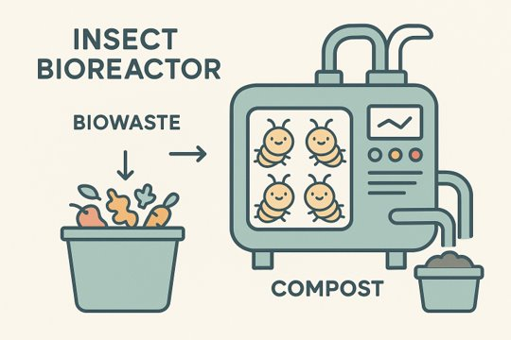
Introduction
What is a bioreactor?
  Definition
  Examples
  Insect bioreactor
Why are we studying worms?
  Sustainable waste management
  Convert biowaste into valuable resources
Notes:
What is a bioreactor?
- Controlled environment where organisms can grow. Examples in sewage treatment, brewing beer, and composting
- Convert what would otherwise be organic waste into carbon credits or compost
- Mostly only makes sense to do at scale
Why study worms?
- Counting life stages to understand population
- Pose estimation to understand behavior, alive vs. Dead
- Create digital twin (explain this in detail of simulation -> shadow twin -> digital twin)
- Additional phenotyping
- Focusing on adult stage only, but value in identifying all growth stages

Slide 4
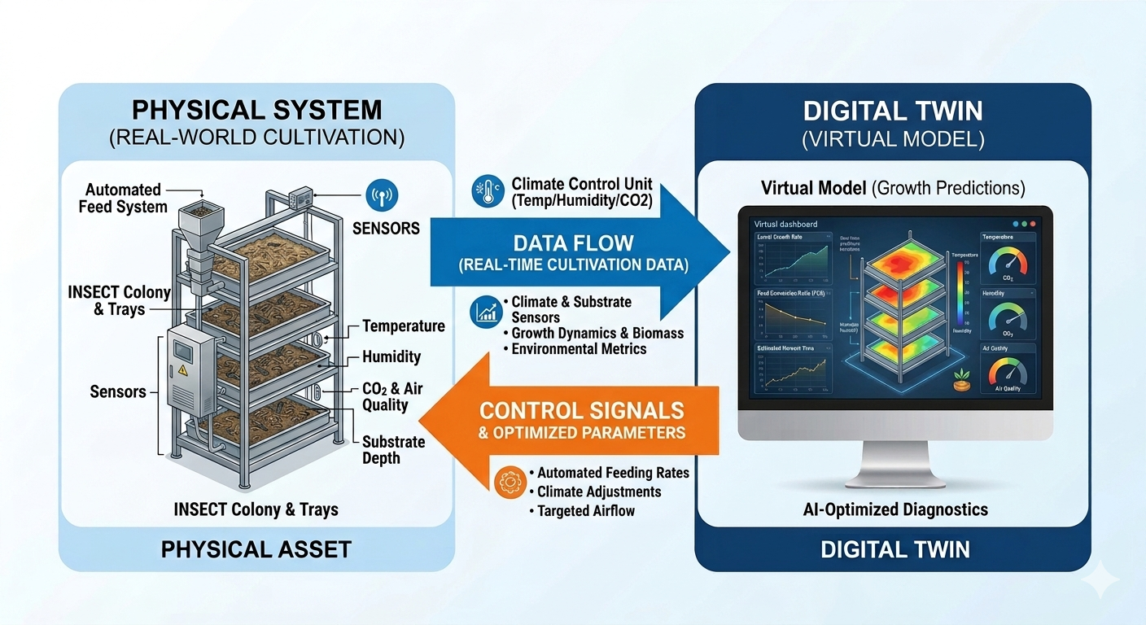
Introduction (cont.)
What are digital twins?
  Digital simulation
  Digital shadow
  Digital twin
Notes:
What is a bioreactor?
- Controlled environment where organisms can grow. Examples in sewage treatment, brewing beer, and composting
- Convert what would otherwise be organic waste into carbon credits or compost
- Mostly only makes sense to do at scale
Why study worms?
- Counting life stages to understand population
- Pose estimation to understand behavior, alive vs. Dead
- Create digital twin (explain this in detail of simulation -> shadow twin -> digital twin)
- Additional phenotyping
- Focusing on adult stage only, but value in identifying all growth stages

Slide 5
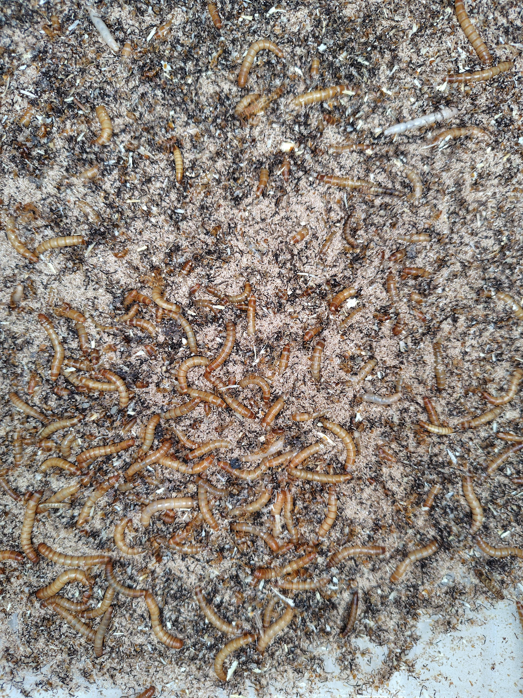
Introduction (cont.)
What will we do?
  Perception monitoring system
    Segmentation
    Pose estimation
Why is this difficult?
  Many instances
  Occlusion
  Deformation
  Methods work really well on humans due to more attention and data
Notes:
Why is this difficult?
- Occlusion with other worms and the feed
- Many species, ideally universal across insect types
- Mealworm (tenebrio molitor), black soldier flies, and earthworms to start
- Other more specialized insects as necessary for unique biowaste
- Much fewer resources on animals in general and insects especially

Slide 6
Introduction (cont.)
Literature review
  TenebrioVision
    End-to-end example of similar work
  SAM3
    Cutting-edge segmentation foundation model
  DeepLabCut
    Framework for pose estimation on non-human animals
Notes:
Why is this difficult?
- Occlusion with other worms and the feed
- Many species, ideally universal across insect types
- Mealworm (tenebrio molitor), black soldier flies, and earthworms to start
- Other more specialized insects as necessary for unique biowaste
- Much fewer resources on animals in general and insects especially

Slide 7
Introduction (cont.)
Literature review
Notes:
Why is this difficult?
- Occlusion with other worms and the feed
- Many species, ideally universal across insect types
- Mealworm (tenebrio molitor), black soldier flies, and earthworms to start
- Other more specialized insects as necessary for unique biowaste
- Much fewer resources on animals in general and insects especially

Slide 8
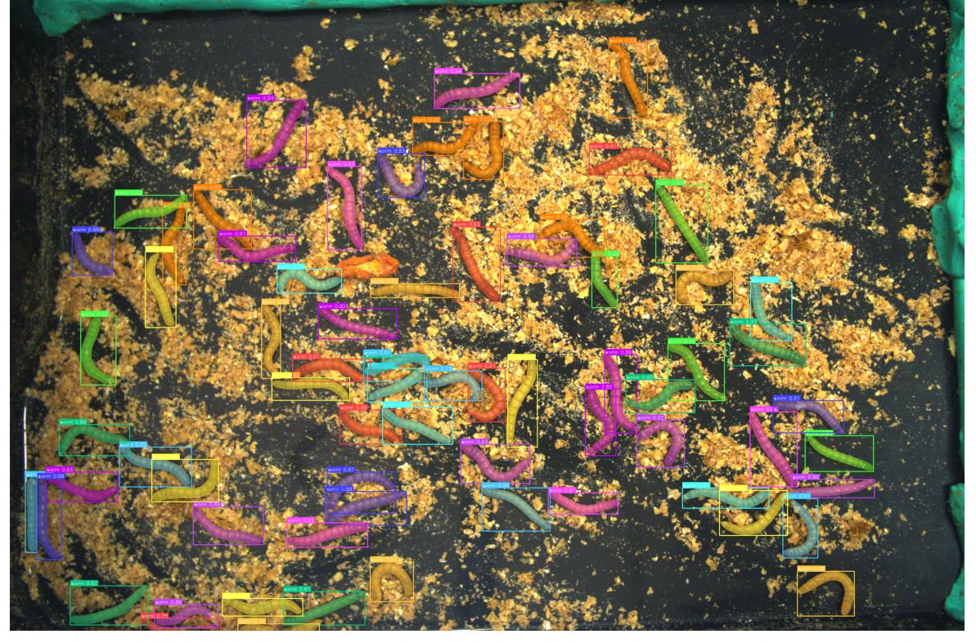
TenebrioVision
High Density & Rich Annotation
  From 10 to 100 instances per image
  53,600+ annotated instances with BBox & Mask
High-res frames: 3088 x 2076 pixels
Diverse images with 30-second interval sampling
[1] Papadopoulos, Angelos-Michael, et al. "TenebrioVision: A Fully Annotated Dataset of Tenebrio Molitor Larvae Worms in a Controlled Environment for Accurate Small Object Detection and Segmentation." Icpram. 2024.
Notes:
Tenebrio molitor is known as mealworm, could be used as waste decomposer and human food for energy and protein

Slide 9
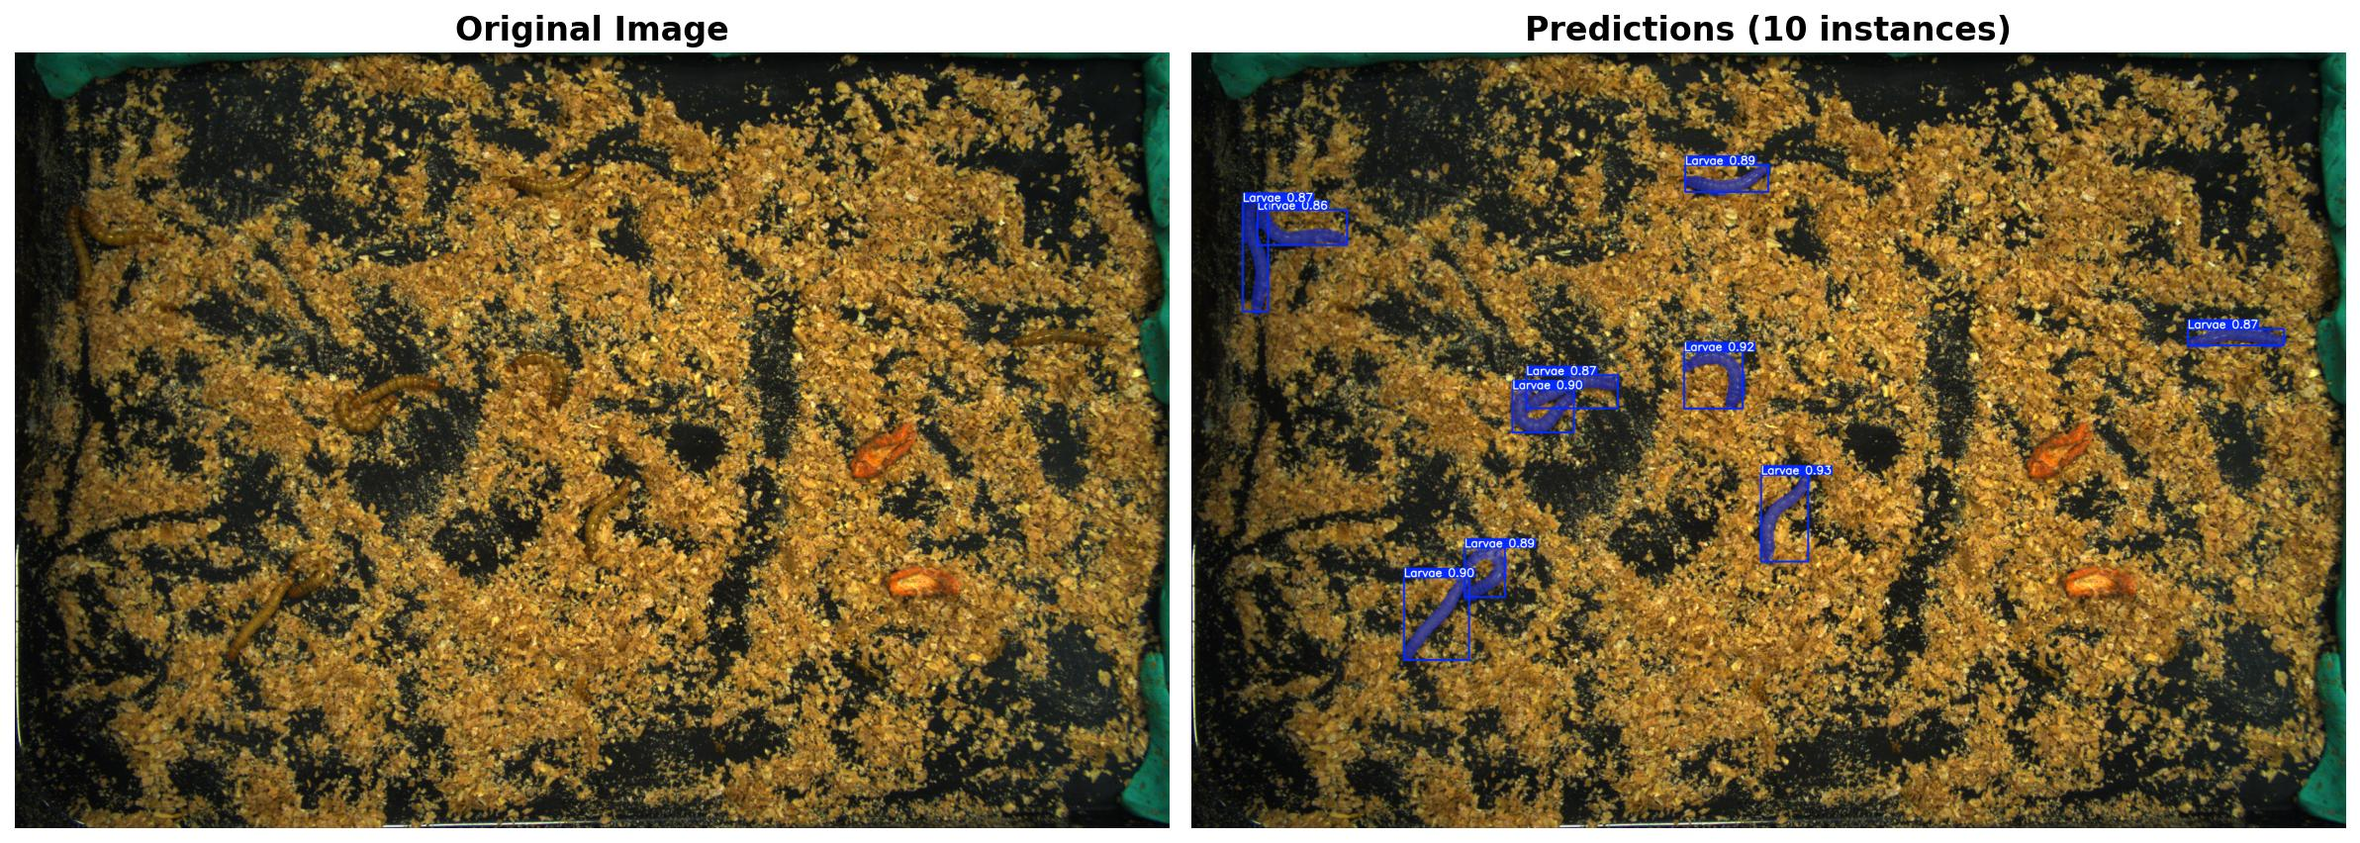
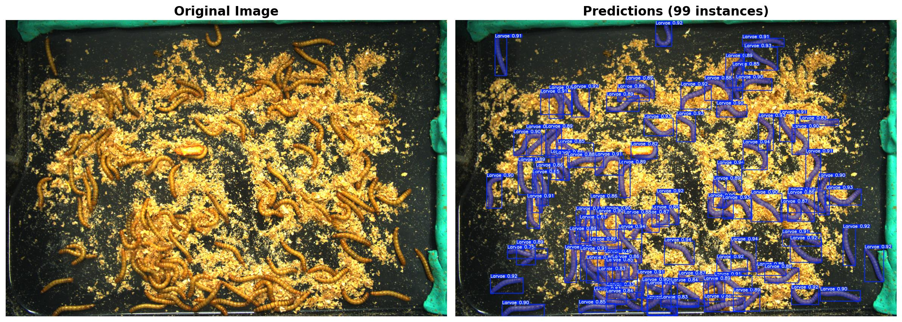
Original images
YOLO inference

Slide 10
Quantitative Evaluation
Method | mAP-bbox | mAP@75-bbox | mAP-mask | mAP@75-mask
Mask R-CNN | 0.781 | 0.954 | 0.654 | 0.776
EfficientDet | 0.787 | 0.926 | – | –
YOLO‑V7‑OD | 0.842 | 0.930 | – | –
YOLO‑V7‑IS | 0.848 | 0.930 | 0.632 | 0.802
YOLO‑V8‑OD | 0.874 | 0.960 | – | –
YOLO‑V8‑IS | 0.880 | 0.965 | 0.729 | 0.830
YOLO‑NAS | 0.892 | 0.972 | – | –
Notes:
Mention overfitting problem

Slide 11
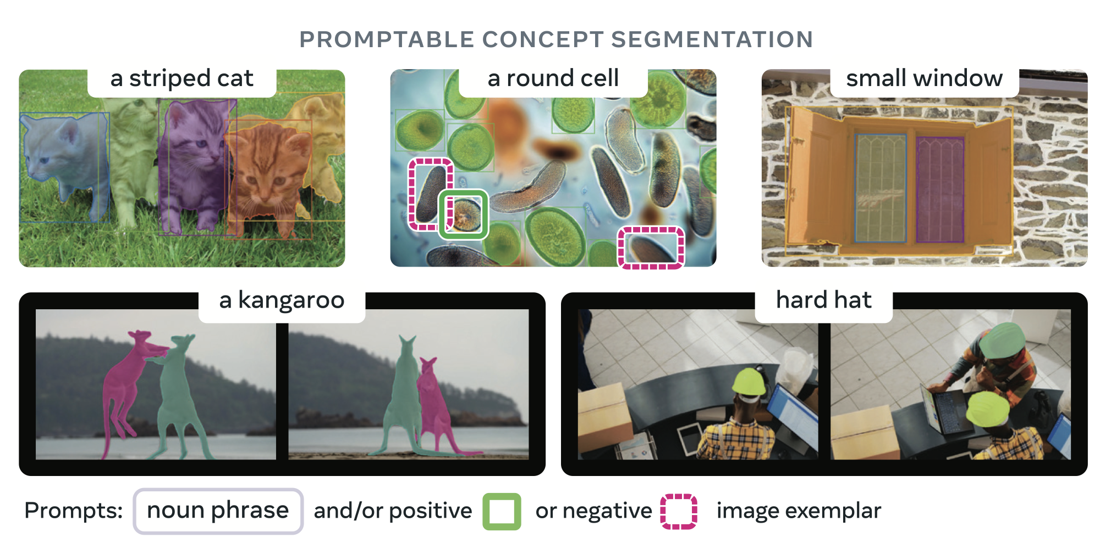
SAM 3: Segment Anything with Concepts
[2] Carion, Nicolas, et al. "Sam 3: Segment anything with concepts." arXiv preprint arXiv:2511.16719 (2025).

Slide 12
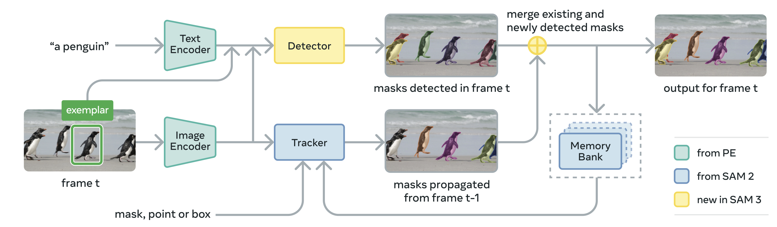
SAM 3: Segment Anything with Concepts
Change backbone model
New detector module
New data comes with text

Slide 13
SAM 3: Segment Anything with Concepts
Change backbone model
New detector module
New data comes with text

Slide 14
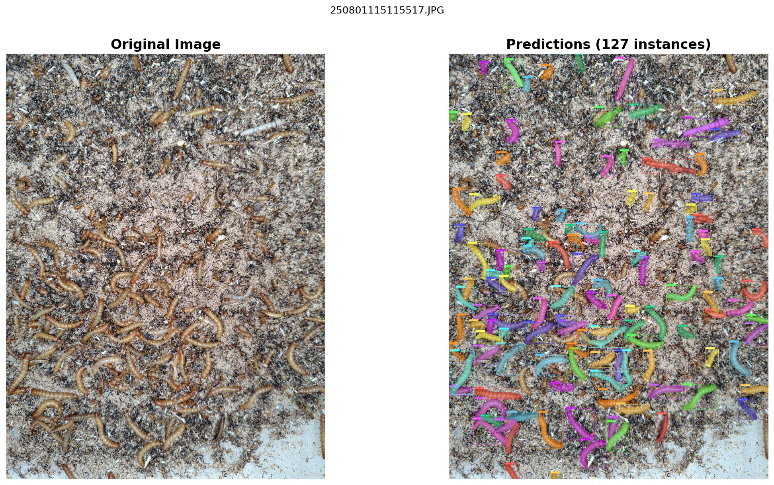
SAM 3: Segment Anything with Concepts

Slide 15
Limitation
Significantly slower than YOLO models
GPU memory intensive in dense object video, goes OOM even on H200 GPU

Slide 16
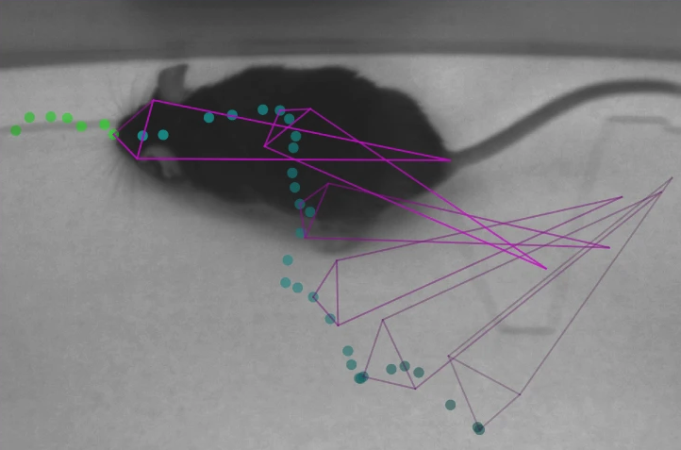
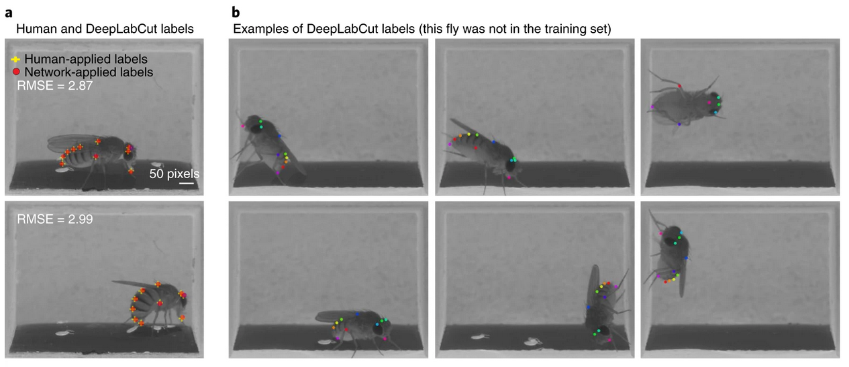
Paper 3: DeepLabCut
Markerless pose estimation
Inspiration from neuroscience
Fine-tune DeeperCut on very few images of non-human animals
Well-supported open source project
[3] Mathis, Alexander, et al. "DeepLabCut: markerless pose estimation of user-defined body parts with deep learning." Nature neuroscience 21.9 (2018): 1281-1289.

Slide 17
DeepLabCut – A Brief History
Pose estimation with markers
DeepCut
  Joint detection + pose estimation model
  Optimization problem to associate body part candidates to individuals
DeeperCut
  ResNet provides larger receptive field
  Image-conditioned pairing and new loss function
DeepLabCut
  Adapt DeeperCut to non-human animals
  Transfer learning and efficient labeling
Notes:
DeepCut
- Joint model to get person detection + body part candidates, but still post processing to optimize and align body parts with individuals
- Generally pose estimation comprises body part detection and pairing between body parts and individuals
DeeperCut
- ImageNet pretraining
- Image conditioned pairing instead of linear programming optimization. Combines losses for body part detectors, location regression, and pairwise regression

Slide 18
DeepLabCut – A Brief History
June 2016: ResNet architecture published^{[6]}
2009: ImageNet dataset released^{[4]}
2018: DeepLabCut transfers to non-human animals^{[3]}
Nov 2016: DeeperCut leverages ResNets and image-conditioned pairing^{[7]}
Apr 2016: DeepCut combines object detection + pose estimation^{[5]}
[4] J. Deng, W. Dong, R. Socher, L. -J. Li, Kai Li and Li Fei-Fei, "ImageNet: A large-scale hierarchical image database," 2009 IEEE Conference on Computer Vision and Pattern Recognition, Miami, FL, USA, 2009, pp. 248-255, doi: 10.1109/CVPR.2009.5206848
[5] Pishchulin, L., Insafutdinov, E., Tang, S., Andres, B., Andriluka, M., Gehler, P., & Schiele, B. (2016). DeepCut: Joint subset partition and labeling for multi-person pose estimation. In Proceedings of the IEEE Conference on Computer Vision and Pattern Recognition (CVPR), pp. 4929–4937.
[6] He, K., Zhang, X., Ren, S., & Sun, J. (2016). Deep residual learning for image recognition. Proceedings of the IEEE Conference on Computer Vision and Pattern Recognition (CVPR), pp. 770–778.
[7] Insafutdinov, E., Pishchulin, L., Andres, B., Andriluka, M., & Schiele, B. (2016). DeeperCut: A deeper, stronger, and faster multi-person pose estimation model. In Proceedings of the European Conference on Computer Vision (ECCV), pp. 34–50.
Notes:
DeepCut
- Joint model to get person detection + body part candidates, but still post processing to optimize and align body parts with individuals
- Generally pose estimation comprises body part detection and pairing between body parts and individuals
DeeperCut
- ImageNet pretraining
- Image conditioned pairing instead of linear programming optimization. Combines losses for body part detectors, location regression, and pairwise regression (each body part distance to all other body parts)
DeepLabCut
- End-to-end training with labeled animal joints with ImageNet pretrained starting point. Not freezing weights but leveraging what ImageNet model already knows about objects
- Deconvolutional layers upsample the image by introducing gaps in the image so that the CNN stride produces larger "images" than the input. Still convolution operation so a slight misnomer
ResNet
- Resolves vanishing gradient problem through skip connections, enabling much deeper networks than prior
- Larger receptive field (owing to deeper network) enables better body part localization

Slide 19
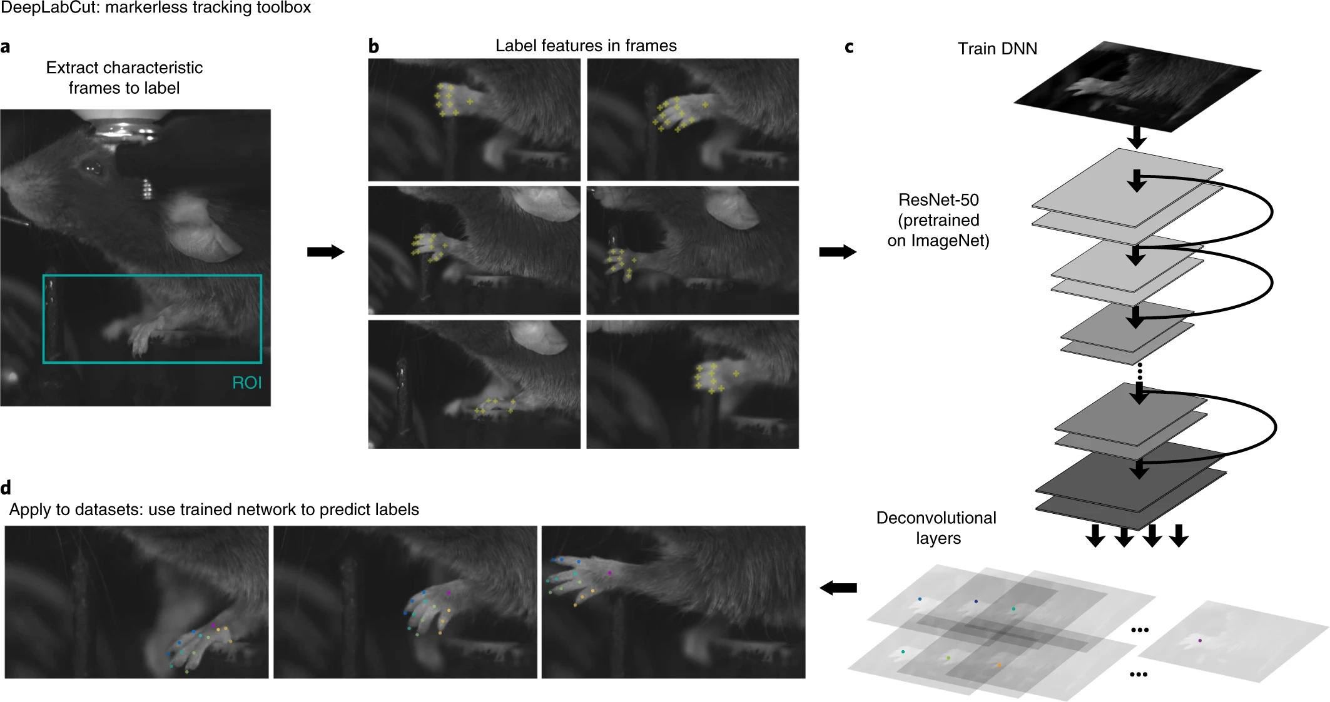
DeepLabCut – Architecture
Pretrained ResNets + deconvolutional layers
  ImageNet
Notes:
Decon layers actually just conv layers that result in larger instead of smaller resolution. Add gaps in images so that upsampling instead of downsampling
Classification (e.g. on ImageNet) ends up with probabilitiy vector for each class, but this produces score map that localizes body part in image

Slide 20
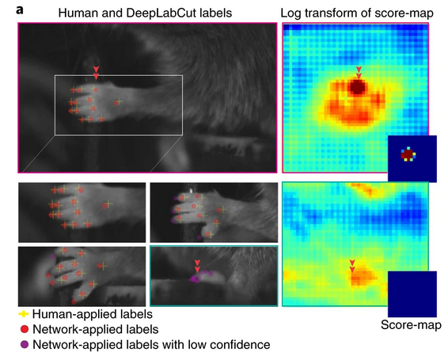
DeepLabCut – Evaluation
Notes:
Decon layers actually just conv layers that result in larger instead of smaller resolution

Slide 21
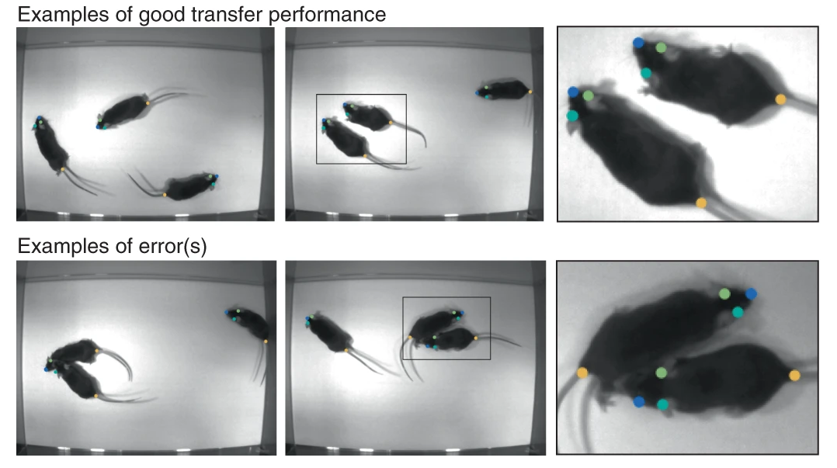
DeepLabCut – Evaluation
Notes:
Decon layers actually just conv layers that result in larger instead of smaller resolution

Slide 22
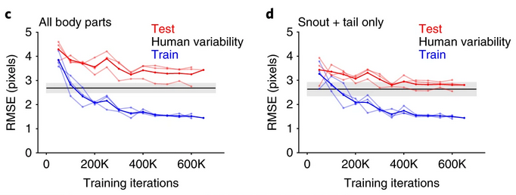
DeepLabCut – Evaluation
Notes:
Decon layers actually just conv layers that result in larger instead of smaller resolution

Slide 23
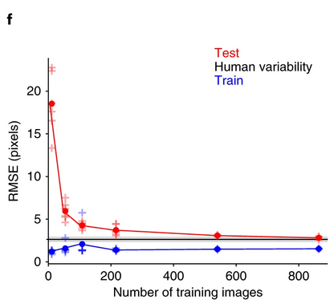
DeepLabCut – Evaluation
Notes:
Decon layers actually just conv layers that result in larger instead of smaller resolution

Slide 24
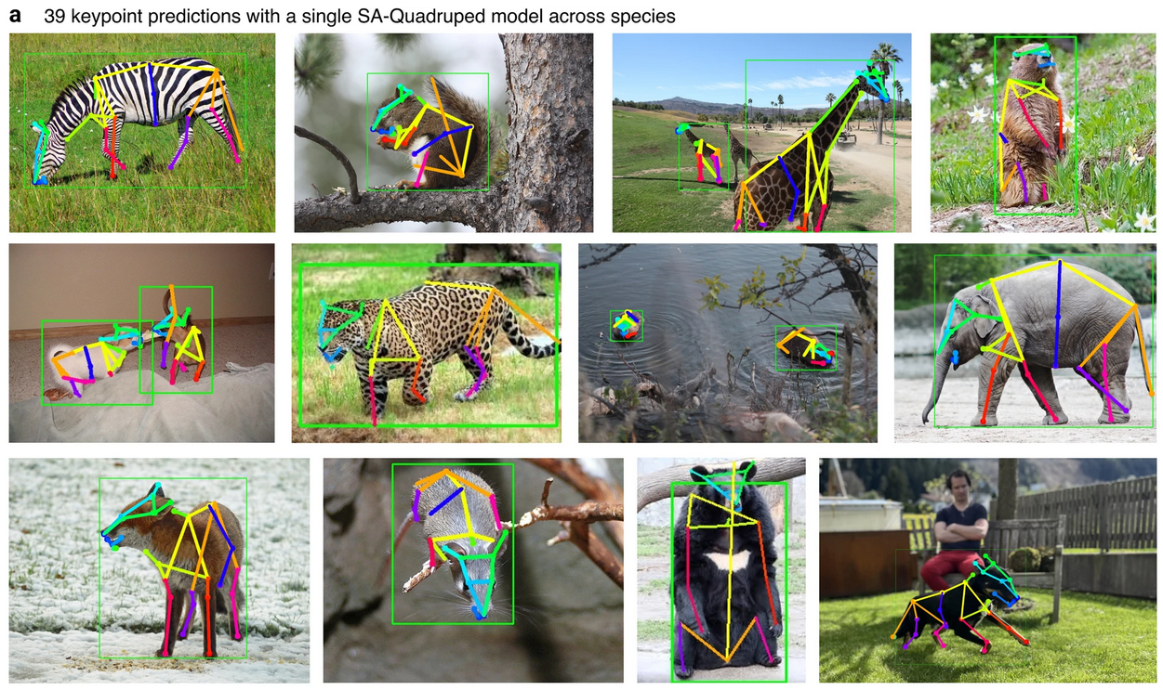
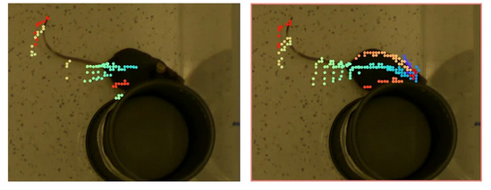
DeepLabCut – The Future
"SuperAnimal" foundation model for 45 species^{[8]}
  Quadrupeds, mice, and humans ... not insects
  Minimize + unify independent labeling efforts
[8] Ye, S., Filippova, A., Lauer, J. et al. SuperAnimal pretrained pose estimation models for behavioral analysis. Nat Commun 15, 5165 (2024). https://doi.org/10.1038/s41467-024-48792-2
Notes:
Even DeepLabCut with all its efficiencies still requires a labeling set-up, image capture, fine-tuning, etc. Big leap but still non-trivial
Addresses inconsistencies in labeling between labs (e.g. snout, nose, mouse1_nose, etc)

Slide 25
Conclusion
Biowaste is valuable!
Building perception stack for insect monitoring
Literature review
  TenebrioVision
    End-to-end example of similar work
  SAM3
    Cutting-edge segmentation foundation model
  DeepLabCut
    Framework for pose estimation on non-human animals

Slide 26
Questions?

Slide 27
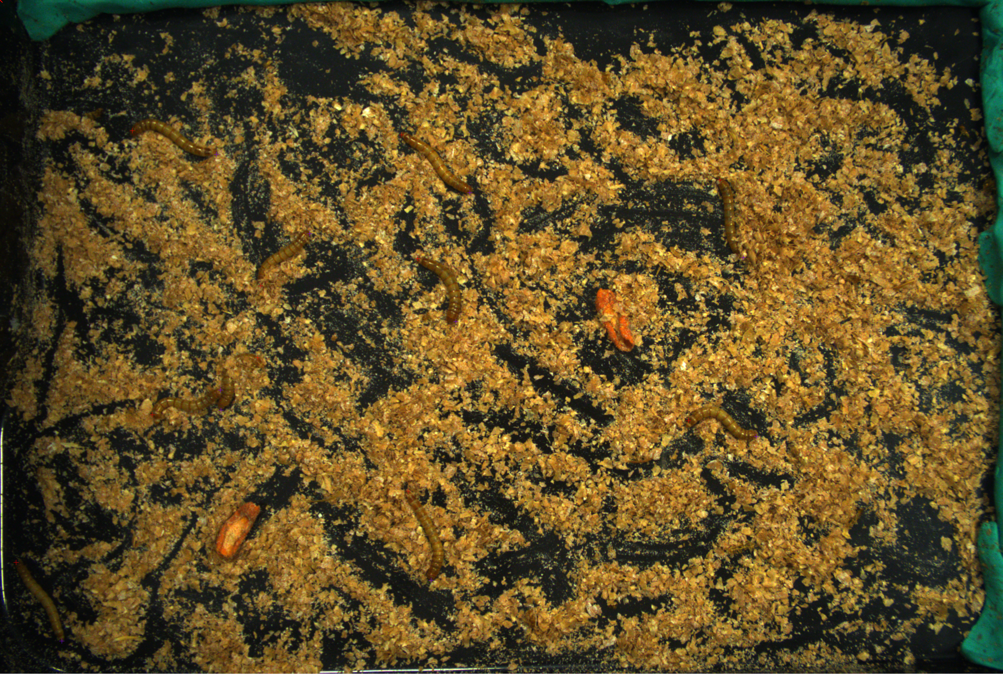
Head
Tail

