Slide 1
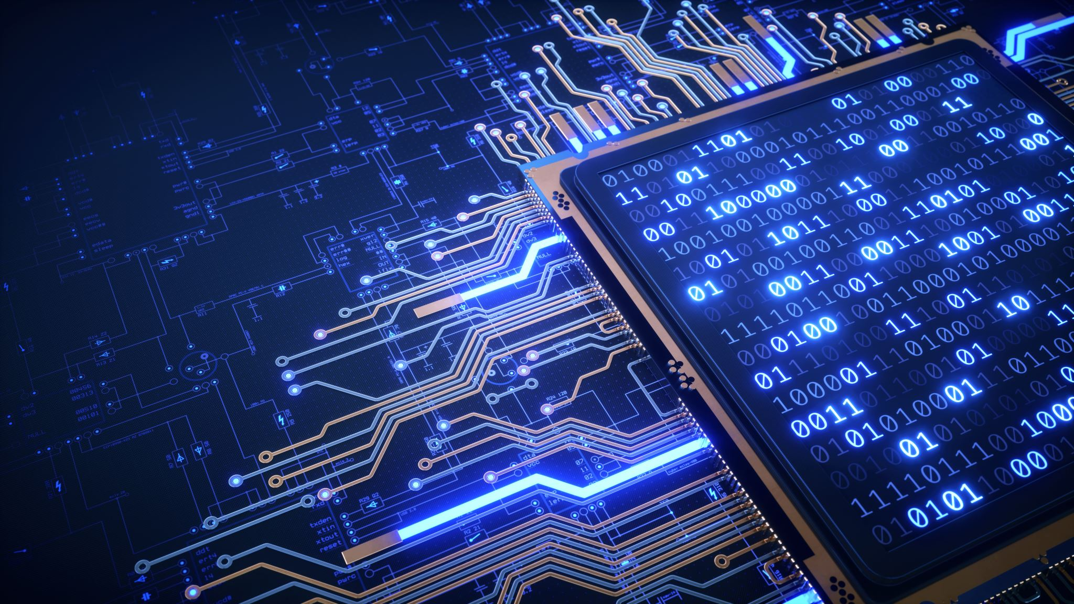
An IOT Application area: smart cities
95-733 Internet of Things

Slide 2
Smart cities
Smart cities is about more than technology.
Must often include partnering with government agencies.
In general, the goal of smart cities is to improve the quality of life of its citizens.
In many cities, populations are increasing, weather events are more severe, and infrastructure is aging.

Slide 3
Smart City application : transportation
Goal: Reduce traffic congestion and improve air quality
Consider EZPass adopted by several states
Sensors may be placed in roads
Cameras installed in traffic lights may be used as sensors
Dashboard cameras mounted in garbage trucks monitor road conditions (initiating early repair)
Monitor the traffic with intelligent traffic lights (counting cars passing and regulate light signaling)
May involve lights working independently or in collaboration with each other
Metro 21 at CMU reduced congestion by 26% and improved air quality by %34.

Slide 4
Smart city application: human services
Calls for help (disabled people, people who are sick)
The data for each call is logged in a database
Decision support systems may utilize these data for improved decision making
For example, based on the call, prescription information might be made available to first responders

Slide 5
Smart city applications : Safety
Data from shot sensing technology
Data from 9-11 calls
Police force deployment strategies in traditional hotspots
Police force deployment strategies in temporary hotspots
Locations can be targeted rather than individuals

Slide 6
Smart city applications : Conservation
An example from IBM
A city wide application
Water conservation needs the smart sprinkler to be connected as well as smart.

Slide 7
Smart city applications : Conservation
Govt. regulations
Sensor reading water level
Weather API
Rasberry Pi
Running Edgent
Sprinkler controller
IBM Watson-IoT (MQTT)
Streaming analytics
https://www.youtube.com/watch?v=Rvc1CqNJkOA&feature=youtu.be&list=PLhZR82i0P9NqrksME13f2t8tDMIhxUtCH

