Slide 1
Flow Programming – Centralized and on the Edge

Slide 2
Central vs Edge processing
A central system may have access to systems of record as well as a much wider variety of data over many devices and types of data.
A central system may also have access to the web and its API’s
Edge systems provide selective communication to the backend.
Edge systems make local decisions (valuable especially when disconnected).
We will look at Node-Red and Apache Edgent – two tools from IBM

Slide 3
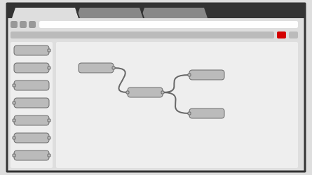
Node-Red is a browser based flow language – runs on a pi or a server

Slide 4
Node-Red

Slide 5
Node Red
Visual flow based tool based on Node.js.
Each black box does one thing well. >750 boxes available.
Built for programmers and non-programmers.
No or little programming. Hmmm.
Two videos:
https://developer.ibm.com/tv/an-introduction-to-node-red/
https://www.youtube.com/watch?v=f5o4tIz2Zzc

Slide 6
Quarks – Now Called Edgent
IBM Quarks launched in February 2016.
Became Edgent and open sourced to Apache.
Designed for edge analytics on a constrained device.
IBM’s Node Red, Apache Spark Streaming and Apache Flink are typically found on the back end.
Front end selectivity very important
Edgent is a Java SDK for the edge (you pick and choose what to deploy).
You may run on the edge with no communications or only intermittent connectivity.

Slide 7
Edge analytics Central Analytics
From http://edgent.incubator.apache.org

Slide 8
Edgent programming in Java
See http://edgent.incubator.apache.org/docs/streaming-concepts
Filter code in Edgent: (Filter is a method of Tstream )
TStream<Integer> filtered = stream.filter(t -> t >= 5);
Split code in Edgent: (getVal() decides the stream with an integer)
List<TStream<String>> streams = stream.split(2, tuple -> tuple.getVal());
Union code in Edgent
TStream<String> stream = stream1.union(stream2);
Windowing code in Edgent:
TWindow<Integer> window = stream.last(5, TimeUnit.SECONDS, tuple -> 0);

