Slide 1
95-733 Internet of Things Week 4 MQTT Qualities of Service

Slide 2
Internet Protocol Suite
Where are we?
We are here!
HTTP, Websockets, DNS, XMPP, MQTT, CoAp | Application layer
TLS, SSL | Application Layer (Encryption)
TCP, UDP | Transport
IP(V4, V6), 6LowPAN | Internet Layer
Ethernet, 802.11 WiFi, 802.15.4 | Link Layer

Slide 3
MQTT Qualities of Service
QoS defines how hard the two parties will work to ensure that messages arrive.
Three qualities of service: at most once, at least once, once and only once. These qualities of service exist between the client and a broker. More quality implies more resources.
Recall that MQTT has two types of clients: publishers and subscribers.
From publishing client to broker, use the QoS in the message sent by the publishing client.
From broker to subscribing client, use the QoS established by the client’s original subscription. A QoS may be downgraded if the subscribing client has a lower QoS than a publishing client.
If a client has a subscription and the client disconnects, if the subscription is durable it will be available on reconnect.

Slide 4
MQTT QoS 0
QoS 0 implies at most once. This is fire and forget messaging.
With fire and forget messaging, there is no acknowledgement from the broker. There is no client storage or redelivery. It may still be used over TCP.
Use QoS 0 when you have a stable connection and do not mind losing an occasional packet. You are more interested in performance than reliability.
From HiveMQ

Slide 5
MQTT QoS 1
QoS 1 implies “at least once”. Works well if the service is idempotent.
Client will perform retries if no acknowledgement from the broker.
Use QoS 1 when you cannot lose an occasional message and can tolerate duplicate messages arriving at the broker. And you do not want the performance hit associated with QoS 2.
The client needs to hold on to messages. Why?
Suppose a subscribing client is subscribing with QoS 1.
Will the broker need to hold onto messages?
Yes. Why? The cient may not receive the message and so a retry will need to be performed.
Downstream clients may receive duplicate messages.
From HiveMQ

Slide 6
MQTT QoS 2
PUBREC = publish received
PUBREL = publish released
PUBCOMP = publish complete
QoS 2 implies exactly once
Client will save and retry and server will discard duplicates.
Use this if it is critical that every message be received once and you do not mind the drop in performance.
QoS 1 and QoS 2 messages will also be queued for offline subscribers - until they become available again. This happens only for clients requesting persistent connections when subscribing.
From HiveMQ

Slide 7
MQTT QoS 2
See top right. If Msg lost then client will
keep sending. It will only stop when it
receives PUBREC.
See middle left. If PUBREC is lost then
the client keeps sending Msg. It will only
stop when it receives PUBREC.
See middle right. The client has seen
PUBREC and tells the server PUBREL. It
will only stop when the PUBREL is
acknowledged with PUBCOMP.
See bottom. Upon receiving PUBCOMP
the client is free to move on. Otherwise
it continues with PUBREL.
Both the client and the server can free
conversational state. The assumption
here is that all messages will eventually
arrive.

Slide 8
MQTT QoS Levels with two clients
The publisher
publishes with a
QoS specified.
QOS PUBLISH | QOS SUBSCRIBE | OVERALL QOS
0 | 0 or 1 or 2 | 0
1 | 0 | 0
1 | 1 or 2 | 1
2 | 0 | 0
2 | 1 | 1
2 | 2 | 2
The subscriber requests
a particular QoS when
subscribing

Slide 9
MQTT From OASIS
MQTT is being used in sensors communicating to a broker via satellite links, Supervisory Control and Data Acquisition (SCADA), over occasional dial-up connections with healthcare providers (medical devices), and in a range of home automation and small device scenarios. MQTT is also ideal for mobile applications because of its small size, minimized data packets, and efficient distribution of information to one or many receivers (subscribers).

Slide 10
MQTT from Oracle (a drone application)
MD
MQTT
#1
#2
Another party
is sending get
altitude requests.

Slide 11
MQTT From IBM
The IBM Bluemix Internet of Things (IoT) service provides a simple but powerful capability to interconnect different kinds of devices and applications all over the world. What makes this possible? The secret behind the Bluemix IoT service is MQTT, the Message Queue Telemetry Transport.

Slide 12
MQTT From AWS
The AWS IoT message broker is a publish/subscribe broker service that enables the sending and receiving of messages to and from AWS IoT. When communicating with AWS IoT, a client sends a message addressed to a topic like Sensor/temp/room1. The message broker, in turn, sends the message to all clients that have registered to receive messages for that topic. The act of sending the message is referred to as publishing.
MQTT is a widely adopted lightweight messaging protocol designed for constrained devices.
Although the AWS IoT message broker implementation is based on MQTT version 3.1.1, it deviates from the specification as follows: (several deviations from the standard are listed.)

Slide 13
MQTT and Microsoft Azure
IoT Hub enables devices to communicate with the IoT Hub device endpoints using the MQTT v3.1.1 protocol on port 8883 or MQTT v3.1.1 over WebSocket protocol on port 443.
IoT Hub requires all device communication to be secured using TLS/SSL (hence, IoT Hub doesn’t support non-secure connections over port 1883).
Microsoft lists several deviations from the standard.

Slide 14
MQTT and Facebook Messenger
One of the problems we experienced was long latency when sending a message. The method we were using to send was reliable but slow, and there were limitations on how much we could improve it. With just a few weeks until launch, we ended up building a new mechanism that maintains a persistent connection to our servers. To do this without killing battery life, we used a protocol called MQTT that we had experimented with in Beluga. MQTT is specifically designed for applications like sending telemetry data to and from space probes, so it is designed to use bandwidth and batteries sparingly. By maintaining an MQTT connection and routing messages through our chat pipeline, we were able to often achieve phone-to-phone delivery in the hundreds of milliseconds, rather than multiple seconds.
From Facebook

Slide 15
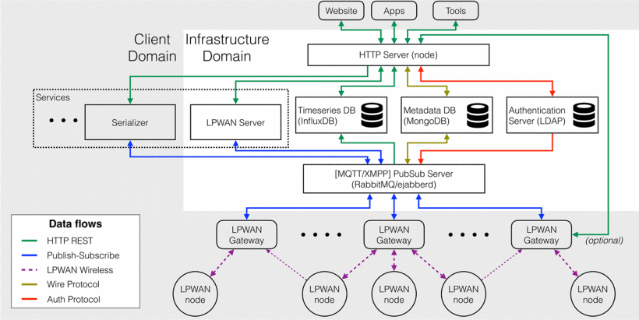
MQTT and CMU’s OpenChirp Architecture

