Slide 1
Overview of Microcontrollers and Wireless PAN and WAN protocolS
Constrained devices and networks

Slide 3
Microcontroller from Wikipedia
A microcontroller (or MCU for microcontroller unit) is a small computer on a single integrated circuit. In modern terminology, it is a system on a chip or SoC. A microcontroller contains one or more CPUs (processor cores) along with memory and programmable input/output peripherals.
Microcontrollers are used in automatically controlled products and devices, such as automobile engine control systems, implantable medical devices, remote controls, office machines, appliances, power tools, toys and other embedded systems.
By reducing the size and cost compared to a design that uses a separate microprocessor, memory, and input/output devices, microcontrollers make it economical to digitally control even more devices and processes. Mixed signal microcontrollers are common, integrating analog components needed to control non-digital electronic systems.
In bulk, may be purchased for .25 USD. These are constrained devices.

Slide 4
Microcontroller from Wikipedia
A microcontroller can be considered a self-contained system with a processor, memory and peripherals and can be used as an embedded system.^{[13]} The majority of microcontrollers in use today are embedded in other machinery, such as automobiles, telephones, appliances, and peripherals for computer systems.
Many use Advanced RISC Machine (ARM) processors. British company ARM holdings develops the architecture and licenses it to product design companies.
Over 100 billion ARM processors produced as of 2017.

Slide 5
AN EXAMPLE MICROCONTROLLER THE Particle Photon
Advanced RISC machine (ARM) Cortex M3 Microcontroller
Broadcom Wi-Fi chip
18 GPIO pins
Web based IDE at particle.build.io (develop code and flash to Photon)
Particle is an open source platform
Has example code for connecting to MQTT , see mqtttest.ino

Slide 6
Particle Microcontroller advertisement
We made more progress on our first day with Particle than we had in months without them, and within six months we began collecting data from thousands of connected brewers in the hands of consumers. Michael Cunningham, CIO, Keurig
This is “usage data”.
Quiz why is “usage data” valuable?
It can be used to impact future product designs.
We are moving from smart products to smart
connected products.

Slide 7
Particle Photon Maker Kit With Photon

Slide 8
PAN from Wikipedia
A personal area network (PAN) is a computer network for interconnecting devices centered on an individual person's workspace. A PAN provides data transmission amongst devices such as computers, telephones, tablets and personal digital assistants. PANs can be used for communication amongst the personal devices themselves, or for connecting to a higher level network and the Internet (an uplink) where one master device takes up the role as gateway. A PAN may be carried over wired computer buses such as USB.
A wireless personal area network (WPAN) is a low-powered PAN carried over a short-distance wireless network technology such as IrDA, Wireless USB, Bluetooth and ZigBee. The reach of a WPAN varies from a few centimeters to a few meters.

Slide 9
Important WPAN Protocols
Name | Battery Usage | Indoor Range | Mesh networking | Openness | Internet Integration | Comment
EnOcean | Very low energy harvesting | < 30 m | No | Low | No | Full stack. Buildings and industrial solutions
ZigBee | low | < 50 m | Yes | Low | No | Full stack. Based on 802.15.4
Thread | low | < 50 m | Yes | Medium (used by Google Nest) | Yes | 6LoWPAN over 802.15.4
Bluetooth | Low with BLE | < 50 m | Yes pub/sub mesh networking over BLE | Medium | No but coming | Full stack. Not based on 802.15.4
Wi-Fi | High and Low variations | < 30 m | No (Star topology) | High | Yes | LAN
From “Building the Web of Things by Guinard and Trifa. If your device will be plugged in, use Ethernet or Wi-Fi or both.

Slide 10
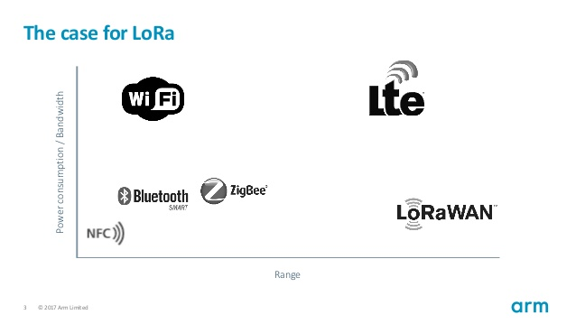
Low Power Wide Area Networks (LPWAN)
LoRa (short for Long Range) is an important player – many others exist
LoRa is at the physical layer and for long range communications
Very low bandwidth 250 bps – 11 kbps (not JSON or ASCII but perhaps Google’s Protobuf)
Low battery use – transmit rarely
May be mobile
Talks to a gateway that connects to the internet
LoRaWAN is a communications protocol above LoRa
128 bit end to end encryption
Adopted at CMU, see OpenChirp
From ARM presentation 2017

