Slide 1
MQTT
Publish subscribe for IoT

Slide 2
Internet Protocol Suite
Where are we?
We are here!
HTTP, Websockets, DNS, XMPP, MQTT, CoAp | Application layer
TLS, SSL | Application Layer (Encryption)
TCP, UDP | Transport
IP(V4, V6), 6LowPAN | Internet Layer
Ethernet, 802.11 WiFi, 802.15.4 | Link Layer
2
2

Slide 3
An Example: Amazon IoT
Ask Amazon Alexa to turn on the car and heat until 70 degrees.

Slide 4
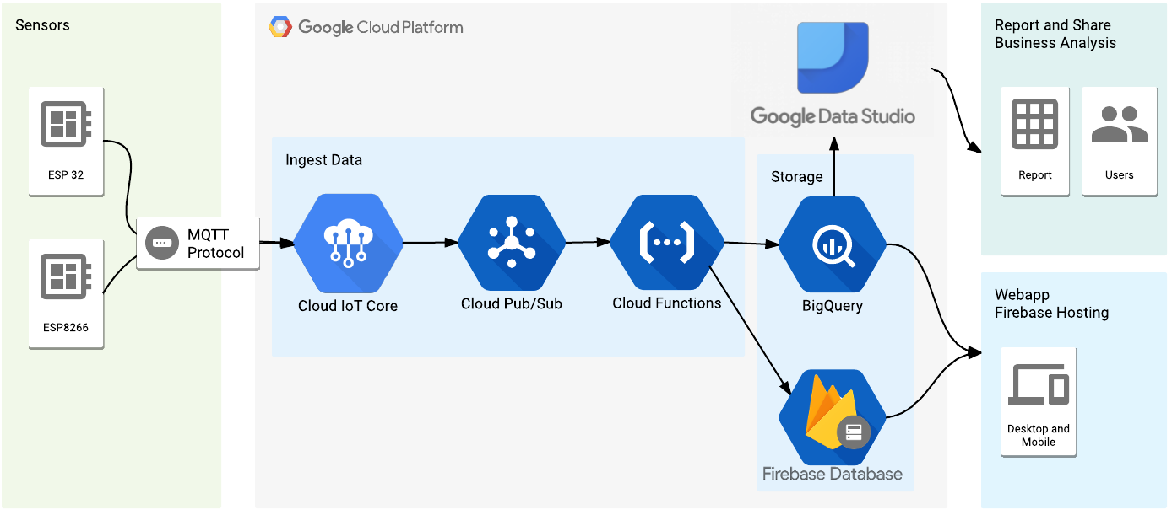
Another Example: Google and MQTT

Slide 5
Google IoT-Core

Slide 6
Another Example: IBM and MQTT

Slide 7
MQTT: Sensor readings with pub/sub
Decoupled in space and time.
The clients do not need each other’s
IP address and port (space) and
They do not need to be running at
the same time (time).
The broker’s IP and port must be
known by clients.
Namespace hierarchy used for
topic filtering.
It may be the case that a published
message is never consumed by any
subscriber.
From MQTT Essentials at HiveMQ

Slide 8
Actuators too!
publish
subscribe
commands
browser
actuator
In the picture, replace the laptop
with an actuator, subscribing to
a command topic, say, device3/commands.
Replace the sensor with a browser
sending commands to device3/commands.
If my toaster is a command subscriber,
I can control it over the web!
Modified from MQTT Essentials at HiveMQ

Slide 9
From Enterprise Integration Patterns Book Hohpe and Woolf

Slide 10
MQTT
Message Queuing Telemetry Transport (old acronym) since the 1990’s
“Telemetry” is from the Greek remote measure
Created by Andy Stanford-Clark (IBM) and Alan Nipper - now part of OASIS
Version 3.1 released royalty free in 2010 (IBM)
Originally built for oil pipeline monitoring over satellite connections.
Satellites appropriate because pipelines are remote

Slide 11
MQTT
Built for a proprietary imbedded system now shifting to IoT
You can send anything as a message. Up to 256 MB.
Built for unreliable networks
Enterprise scale implementations down to hobby projects
Decouples readers and writers
Message have a topic, quality of service and retain status associated with them.

Slide 12
MQTT
MQTT Runs over TCP or TLS. May use Websockets from within a browser.
MQTT–SN uses UDP packets or serial communication rather than TCP. MQTT-SN may run over Bluetooth Low Energy (BLE).
Open, industry agnostic, no polling. What does it mean to be open?
Hierarchical topic namespace and subscriptions with wildcards. MQTT-SN has simpler topics.
As soon as you subscribe you may receive the most recently published message. One message per topic may be retained by the broker. This featuer provides for devices that transmit messages only on occasion. A newly connected subscriber does not need to wait. Instead, it receives the most recent message.

Slide 13
MQTT Last Will and Testament
Publishing clients may connect with a last will and testament message.
If publishing client has no data to send, it sends ping requests to the broker to inform the broker that it is still alive.
If a publisher disconnects in a faulty manner (the broker will miss the ping requests), the broker tells all subscribers the last will and testament. This is for an ungraceful disconnect. How could this happen? Battery failure, network down, out of reach, etc.
In the case of graceful disconnect, the publisher sends a DISCONNECT message to the broker – the broker will discard the LWT message.

Slide 14
MQTT Clients
A client may publish or subscribe or do both.
An MQTT client is any device from a micro controller up to a full fledged server, that has an MQTT library running and is connecting to an MQTT broker over any kind of network. (from HiveMQ MQTT Essentials)
A client is any device that has a TCP/IP stack and speaks MQTT. MQTT-SN does not require TCP.
Client libraries widely available (Android, Arduino, iOS, Java, Javascript, etc.)
No client is connected directly to any other client

Slide 15
MQTT Broker
The broker is primarily responsible for receiving all messages, filtering them, decide who is interested in it and then sending the message to all subscribed clients. (From HiveMQ MQTT Essentials)
May authenticate and authorize clients.
Maintains sessions and missed messages
Maintains a hierarchical namespace for topics and allows subscribers (but not publishers) to use wildcards (+ and #).

Slide 16
Topics are organized into a hierarchical namespace
Suppose a client publishes to mm6House/Kitchen/Sensor/Temperature
Another client might subscribe to:
mm6House/Kitchen/Sensor/Temperature
Or, using a single level wildcard (+)
mm6House/Kitchen/+/Temperature // All children of Kitchen that
// have a child called Temperature
Or, using a multi level wildcard (#)
mm6House/Kitchen/# // Goes deep
The octothorp (#) must be the last character.
To see every message, subscribe to #.

