Slide 1

95-733 Internet of Things
Enabling the Internet Of Things
Week 2
Michael J. McCarthy
mm6@andrew.cmu.edu
Associate Teaching Professor
Carnegie Mellon University

Slide 2
Summary From Last Week: Smart and Connected Products
IT is revolutionizing products.
Once, solely mechanical and electrical parts.
Now, complex systems with connectivity.
Smart, connected products are unleashing a new era of competition.
Some companies will ask “What business am I in ?”
Many products will contain a computer or microcontroller and have a representation in the
cloud (Digital Twin).
This changes product design, marketing, manufacturing, and after sales service.
This creates opportunities for rich data analytics and machine learning.
Security and privacy concerns are significant but will probably not be a show stopper.
Lessons learned from the WWW may help us achieve a more interoperable IOT.
We can build a Web of Things.

Slide 3
Building a web of things
It’s about more than smart, connected products.

Slide 4
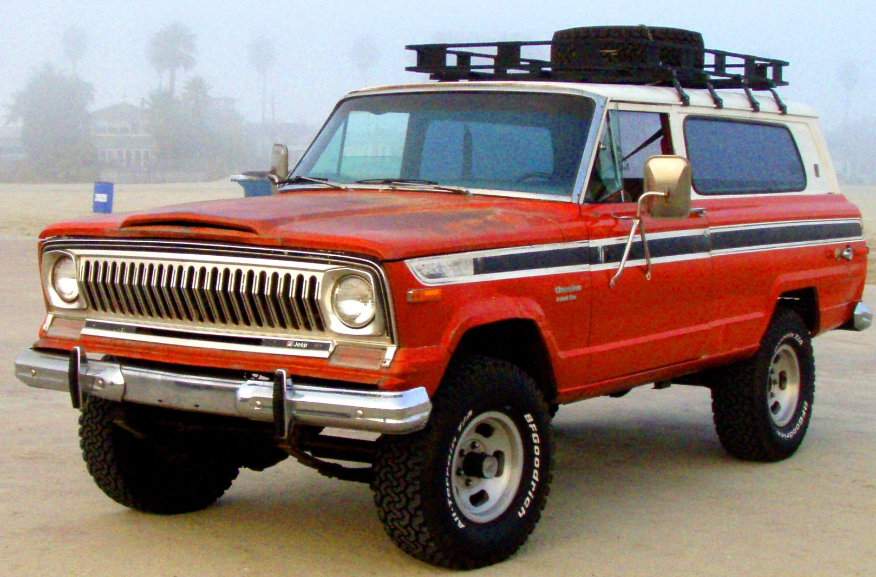

Let’s revisit our traditional objects
BLE Tag
BLE Tag
NFC Tag
QR Code
URL
URL
URL
URL
What good are the URL’s?
Each URL can be dereferenced and used to request additional information.
A web service will exist at the URL, allowing us to, say, purchase a ticket for a concert.
Of course, these objects may be smart and connected as well.
Quiz: in the video that follows, identify the objects that use tags.
https://www.youtube.com/watch?v=1yaLPRgtlR0&feature=youtu.be

Slide 5
The BLE beacons shown in the video have not taken off to the degree that Google once hoped. But URL transmission through NFC and QR-Codes is widely used.

Slide 6
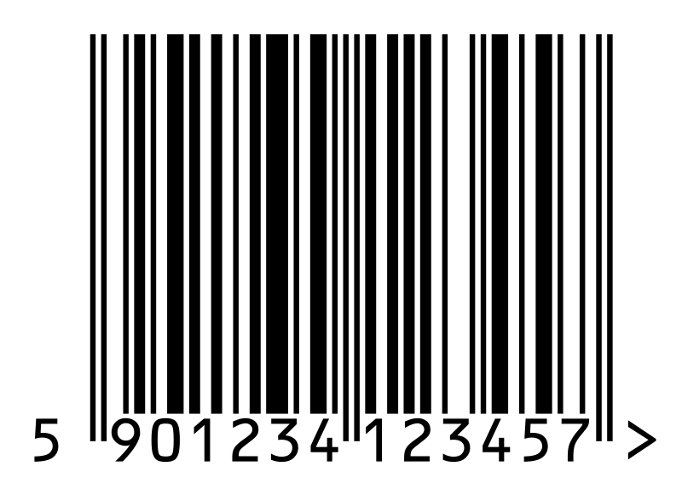
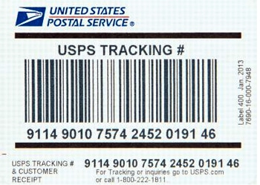
Tagging Passive Things (1)
Passive things may not be suitable for direct wired or wireless connections to the internet.
For these things, we need perhaps a tag, a smartphone and a proxy web service.
See the NFC tag on the movie poster in the video.
Three popular approaches to passive tagging
(1) UHF RFID < 10 ft not successful in practice
NFC is a form of RFID (the user must be very close to engage)
(2) Optical tags (Quick Response Codes) and barcodes
Require a camera and an application. That may be a drawback.
They may yield text, numbers, or URIs.
May also be used to hold a public key.
Why might a person or thing
advertise a public key?
Ransomware – pay a bad guy.
Pay a device for usage.
See GS1 Digital Link: using bar codes to provide URL’s.
Are we interested in from farm to table tracking?
See https://www.youtube.com/watch?v=jrgr7A6jBbo

Slide 7
Tagging Passive Things (2)
(3) Bluetooth Low Energy (BLE)
Uses less energy than Bluetooth classic
A BLE device might last weeks or years without a new battery or recharge
The BLE protocol optimized for small bursts of data exchange – ideal for
sensors or actuators.
Bluetooth classic provides high bandwidth for audio streaming.
All modern smart phones support
Advertise a packet, perhaps a URL, every second
BLE is used by iBeacon (Apple) and Eddystone (Google, deprecated)
See Web Bluetooth to interact with BLE device from Javascript
May be used with Geo Fencing applications

Slide 8
GeoFencing and BLE
The user has a mobile application installed on a phone.
The application may be running in the background.
The application detects user locations based on:
Native positioning (20 to 50 meters)
GPS signals and WiFi and cellular data
Bluetooth positioning (2 meters)
BLE Beacons in the local environment or indoors
The phone detects any crossings of a virtual fence.
The phone triggers actions: alert the user, notify a business owner,
notify a government, notify a competitor etc..

Slide 9
CovidSafe (Australia) and BLE contact tracing
Install government application from Apple or Google.
Register some PII with the cloud service (AWS).
The PII is encrypted and stored by the service.
The app uses Bluetooth to detect others with the application.
The two applications exchange anonymized ID’s.
If someone is infected, they receive a unique code from health
official. This code allows the application to upload the list of
anonymized ID’s.
Those others are notified of the past contact.

Slide 10
From New South Wales Government
Helping customers to use the NSW Government QR Code
Download and display your unique NSW Government QR Code poster. You must not alter the poster in any way.
Display the QR Code where it’s easy to see and easy for customers to scan.
Confirm the customer has successfully checked in (look for the green tick on the confirmation screen).
https://www.nsw.gov.au/covid-19/rules/check-in/service-nsw-app

Slide 11
Edible Tags to solve a major worldwide problem
It is estimated that as many as 250,000 children die per year due to counterfeit drugs.
Edible 'Security Tag' to Protect Drugs From Counterfeit January 16, 2020
Purdue University News
Kayla Wiles
Purdue University researchers have developed a consumable "security tag" that can be embedded into medications to thwart drug counterfeiters. The tag serves as a digital signature for each pill or tablet, using physical unclonable functions (PUF). The researchers created an edible PUF, in the form of a thin, transparent film of genetically combined silk and fluorescent proteins; illuminating the tag with a light-emitting diode (LED) causes fluorescent silk microparticles to glow in a distinct random pattern in cyan, green, yellow, or red. The resulting image contains digital bits that form a security key to confirm the drug's authenticity. Purdue's Jung Woo Leem said, "Our concept is to use a smartphone to shine an LED light on the tag and take a picture of it. The app then identifies if the medicine is genuine or fake.”
I

Slide 12
Physical Unclonable Functions (PUFs)
PUF Circuit A
PUF Circuit A
Challenge C
R1
R2
SOC
SOC
R1 != R2
The manufacturing process introduces small variations in the product.
The PUF Circuit is able to measure the variations.

Slide 13
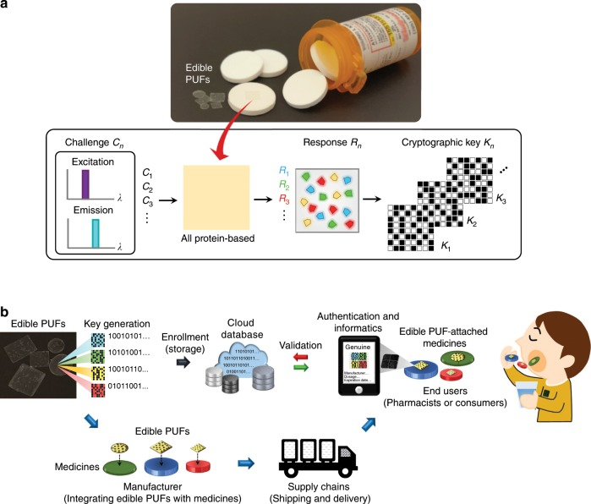
Edible Tags
One Time
Authentication
Four challenges at
64 bits per challenge =
256 bit key
Enrollment
Delete the key from the
secure database after a
scan. Database stores
challenge, response pairs.
Authentication

Slide 14
Norman Joseph Woodland (1921-2012)
Developed the format which became the ubiquitous
the Universal Product Code (UPC) of product labeling and
check-out stands.
UPC is a bar code used for fast identification.
The bar codes are placed on nearly every product sold.
Also used on labels for shipping and tracking applications.
An estimated 5 billion bar codes are scanned every day.

Slide 15

Apple AirTag
AirTags don’t contain cellular or wi-fi internet connections. They are able to communicate locally with Bluetooth or Ultra Wide Band.
An iPhone knows where it is. A Bluetooth signal can be pinpointed within about 5 meters from the iPhone. Using Ultra Wide Band technology, the tag can be pinpointed within 5 to 10 centimeters.
The connected device (an iPhone) sends the AirTag and location information to Apple. Apple tells the owner where the Airtag is.
Location reports go back only to the AirTag’s owner; nobody else sees them.
AirTags work everywhere there’s a nearby iPhone.
If you have only an Android, you can read NFC from
the device and return the lost dog.

Slide 16
Apple AirTag and Stalking
Stalker places an AirTag in your backpack.
Off you go.
Stalker views your location on a map.
Your iPhone may notice an AirTag nearby with no local owner and provide reports to you.
Suppose that you only own an Android - your Android will not notice the stalker’s AirTag.

Slide 17
Short Course on Networks
Any device, in practice, that connects directly to the internet requires a physical Ethernet, Wi-Fi radio, or cellular modem. All of these increase cost and power consumption.
The wireless coverage of a cell tower is measured in miles.
The wireless coverage of Wi-Fi is measured in yards.
We can use constrained networks for low or no power devices.
We can use one bridging device that supports Wi-Fi and enables simple peripheral IoT devices to talk to the bridge.
UWB (not Verizon 5G) coverage is measured in 10’s of yards. Not new.
BLE wireless coverage is measured in feet.
NFC wireless coverage is measured in centimeters.
NFC requires user attention and engagement. BLE does not.
BLE Beacons continually transmit a discovery signal to be received by a
BLE enabled device - Smartphone
NFC Tags communicate only when close to an NFC enabled device - Smartphone
BLE beacons have been around since 2006
NFC is based on RFID and RFID has been around since the 1940’s.
From: Mobile Payements Today

Slide 18
Building the Web of Things
Things need to be identified.
At a low level, IPV6 supports 128-bit addresses.
That’s a lot of addresses.
At a higher level, identify things with Web URI’s (URL’s and URN’s).
URI = Uniform Resource Identifier = Location and/or name
URN = Uniform Resource Names = Name
URL = Uniform Resource Locators = Location
URN’s and URL’s are URI’s.
URL’s in conjunction with DNS route and connect to services.

Slide 19
Building the Web of Things
Design the IoT as an extension of the World Wide Web.
Build a physical web = web technologies + IoT.
Web technologies include URL’s, XML, JSON, HTTP, Websockets,
REST, CoAp, and TLS .
To overcome scale and complexity, preferentially discover things
nearby.
Useful processing may be performed on the edge.
Consider peer to peer connections and cloudlets.
Consider the integration of devices that have little or no processing
capabilities.

Slide 20
The Physical Web
The Physical Web associates People, Places, and Things with web pages or services.
Take seriously the use of proximity beacons or tags.

Slide 21
The Physical Web
An Eddystone Beacon using BLE
RadBeacon Dot for The Physical Web
From the advertisement:
“Simply include the PhysicalWebURL you will
like your beacon configured for, and we will
get the beacon configured prior to shipping.
To place an order for beacons with
different URLs, please follow the steps below:”
Waze use Eddystone and iBeacon for GPS inside tunnels.

Slide 22
The Web of Things
Smart phone or browser client interaction
with services
Fitbit.com
Proxy web service for poster
Phone or
gateway
Low level peer to
Peer – Bluetooth
or wi-fi
Identification data
Status and Control
URI
NFC Tag on Poster
Smart and
connected
FitBit
Figure 1
Bluetooth LE Tag

Slide 23
Edge Computing
An innovative solution to latency problems (using the cloud) is edge computing.
Cloudlets (from CMU) are an important example:
A cloudlet is dynamically provisioned with software and services.
Is nearby and holds only soft state.
Is more powerful than local devices.
An important edge API is IBM’s Apache Edgent. Apache Edgent is a lightweight
and embedded streaming analytics runtime that analyze events locally, on the edge
of your system, sending only relevant events downstream. (From Apache Edgent)
Node-RED might also be appropriate running in a cloudlet or on the edge.

Slide 24
Client Server or Peer to Peer
Simple device and powerful cloud service. (a centralized model)
Complex device on its own (perhaps involved in a peer to peer network)
Tradeoffs Complex Device Simple Device Cloudlet
Latency Low High Low
Security Low Higher Higher
Privacy High Lower Lower
Cost High Lower Lower
Management High Low Low
Autonomy High Low Low
With respect to security, the use of cloud providers is no guarantee. There is a possible false sense of risk transfer with cloud provider or outsourcing.

Slide 25
Proximity Sharing
One nearby device has a capability needed by another (need a big screen?)
Companies may not adopt standards so they can lock you in and dominate.
European banking PSD2 regulates API’s in order to increase competition.
Not easy. For proximity sharing we need:
Discovery,
Trust,
Connection through standard data formats and protocols.

Slide 26
The Physical Web
What if a Thing is not smart, connected, or tagged?
San Francisco bans facial recognition technology. May 14, 2019

Slide 27
The Physical Web
What if a Thing is not smart, connected, or tagged?
When the Clearview app looks for matches, it includes
photos from the web. This is a privacy concern. You no
longer need to have a prior arrest.
One reason that Clearview is catching on is that its service is
unique. That’s because Facebook and other social media sites
prohibit people from scraping users’ images — Clearview is
violating the sites’ terms of service.
“It’s creepy what they’re doing, but there will be many more of
these companies. There is no monopoly on math,” said Al
Gidari, a privacy professor at Stanford Law School. “Absent a
very strong federal privacy law, we’re all screwed.”
Facial recognition application
From New York Times January 2020

Slide 28
Summary
The World Wide Web is an excellent guide to building an interoperable IoT.
Interoperability, context awareness and machine learning will lead to very smart devices
and many things being web present.
Security and privacy problems will continue but will not stop the show.
Bibliography:
“How Smart Connected Products are Transforming Competition”
Harvard Business Review
https://hbr.org/2014/11/how-smart-connected-products-are-transforming-competition
“Enabling the Internet of Things”
IEEE 2015
http://www.andrew.cmu.edu/user/mm6/95-733/iot/Enabling_the_Internet_of_Things.pdf

