Slide 1

95-733 Internet of Things
Week 1
Michael J. McCarthy
mm6@andrew.cmu.edu
Associate Teaching Professor
Carnegie Mellon University

Slide 2
“Some have suggested that the internet of things ‘changes everything’, but that is a dangerous oversimplification. As with the internet itself, smart, connected products reflect a whole new set of technological possibilities that have emerged.”
Smart and Connected Products
From: “How Smart Connected Products are Transforming Competition” Harvard Business Review

Slide 3


A few products: not smart or connected
https://en.wikipedia.org/wiki/Jeep_Cherokee#/media/File:1974_Jeep_Cherokee_S_-_Beach_(cropped).jpg
Let’s add some “smarts” to the products…

Slide 4
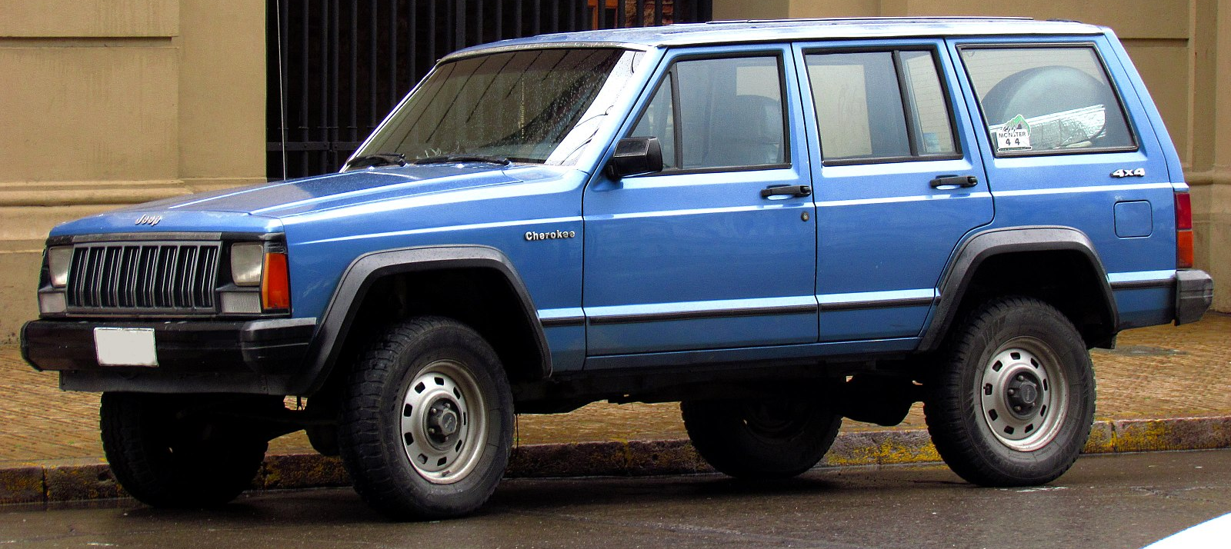
Smarts added to the products
https://en.wikipedia.org/wiki/Jeep_Cherokee#/media/File:1974_Jeep_Cherokee_S_-_Beach_(cropped).jpg
https://en.wikipedia.org/wiki/File:Jeep_Cherokee_2.5_1988_(15289674633)_(cropped).jpg
https://www.amazon.com/Keurig-B60-Special-Brewing-System/dp/B000AQSMPO
Talking doll
Power brakes on the jeep
Microcontrollers
in the coffee pot
No elevator operator needed
Let’s connect these things to the internet…

Slide 5
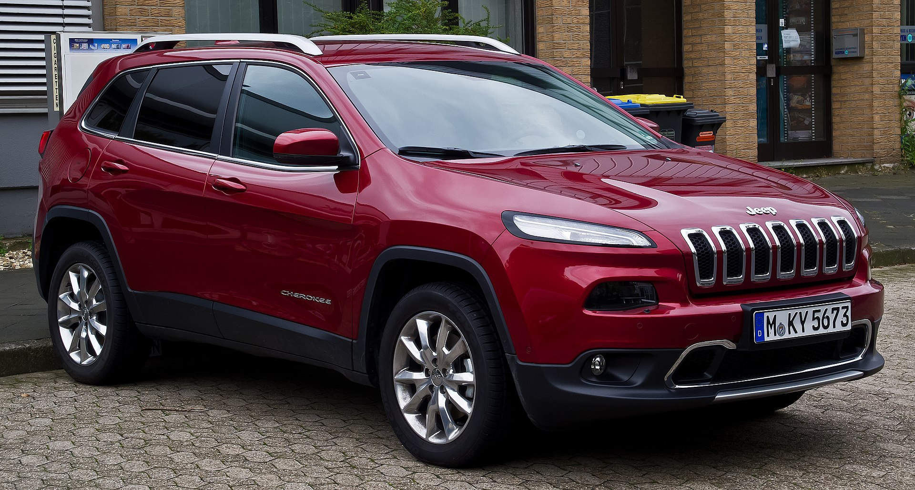
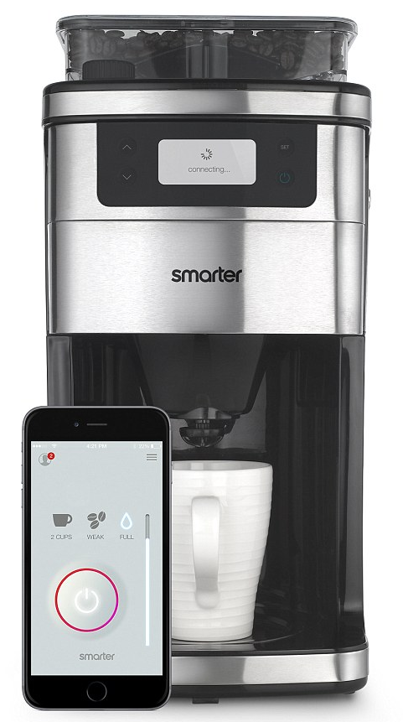
Connectivity added to smart products
https://en.wikipedia.org/wiki/Jeep_Cherokee#/media/File:1974_Jeep_Cherokee_S_-_Beach_(cropped).jpg
https://en.wikipedia.org/wiki/File:Jeep_Cherokee_2.5_1988_(15289674633)_(cropped).jpg
https://www.amazon.com/Keurig-B60-Special-Brewing-System/dp/B000AQSMPO
https://en.wikipedia.org/wiki/Jeep_Cherokee#/media/File:1974_Jeep_Cherokee_S_-_Beach_(cropped).jpg
https://www.engadget.com/2015/01/02/smarter-wifi-coffee-machine/
Notes:
https://www.cbsnews.com/news/your-kids-toys-could-be-spying-on-your-family/
Last doll – parents are worried this kid toy could be spying on your family, it listens and connects to wifi
Cathedral of Learning – all the elevators are connected to a network so they are integrated together

Slide 6
Smart and Connected
My Friend Cayla, which costs $59.93 at Walmart.com, is billed as “a wonderful choice for
a young child who needs a companion.”
The Electronic Privacy Information Center (EPIC) claims the toys allegedly send
recordings to speech-to-text software company Nuance Communications, which
the complaint notes has contracts with military and law enforcement agencies.
Notes:
https://www.cbsnews.com/news/your-kids-toys-could-be-spying-on-your-family/
Last doll – parents are worried this kid toy could be spying on your family, it listens and connects to wifi
Cathedral of Learning – all the elevators are connected to a network so they are integrated together

Slide 7
Smart and Connected
“Connect your vehicle to Alexa via an Amazon Echo that syncs
with any Uconnect®- equipped Jeep®Cherokee. Use your voice
to start your vehicle, check fuel levels, send an address directly
to your Navigation system and more, all from your home.” From
An advertisement describing connected Jeeps at
https://www.jeep.com/uconnect.html/
Modern cars collect as much as 25 gigabytes of data per hour, the consulting firm
McKinsey estimates, and it’s about much more than performance and maintenance.
NYT May 20, 2019. Data is collected about a driver’s performance. That data can be sold.
“Though I hadn't touched the dashboard, the vents in the Jeep
Cherokee started blasting cold air at the maximum setting,
chilling the sweat on my back through the in-seat climate
control system. Next the radio switched to the local hip hop
station and began blaring Skee-lo at full volume. I spun the
control knob left and hit the power button, to no avail. Then
the windshield wipers turned on, and wiper fluid blurred the
glass.” From Wired https://www.wired.com/2015/07/hackers-remotely-kill-jeep-highway/
One thing they found
were a bunch of
unauthenticated RPC
services in Lua…
ready to be called.
Notes:
https://www.cbsnews.com/news/your-kids-toys-could-be-spying-on-your-family/
Last doll – parents are worried this kid toy could be spying on your family, it listens and connects to wifi
Cathedral of Learning – all the elevators are connected to a network so they are integrated together

Slide 8
Smart and Connected
“It’s great for the person who is looking to buy smarter; it monitors your supply
of coffee, and sends push notifications to your phone when it is time to pick up
fresh beans or ground coffee.”
From https://ideaing.com/ideas/best-smart-coffee-makers
“A coffee-machine hack may seem harmless, but the Dyn attack proved how easily
IoT devices can cause damage at a grand scale.”
From https://qz.com/901823/the-easy-way-your-smart-coffee-machine-could-get-hacked-and-ruin-your-life/
The attack caused major Internet platforms and services to be unavailable to
large swathes of users in Europe and North America.^{Wikipedia}
David Fidler, adjunct senior fellow for cybersecurity at the Council on Foreign Relations,
said he couldn’t recall a DDoS attack even half as big as the one that hit Dyn.
From https://www.theguardian.com/technology/2016/oct/26/ddos-attack-dyn-mirai-botnet
Notes:
https://www.cbsnews.com/news/your-kids-toys-could-be-spying-on-your-family/
Last doll – parents are worried this kid toy could be spying on your family, it listens and connects to wifi
Cathedral of Learning – all the elevators are connected to a network so they are integrated together

Slide 9
Smart and Connected
Proactive maintenance is available. Dashboards showing location and status
of elevator fleet. A rules engine is used to detect and respond to emergency
conditions. API’s and SDK’s are provided for developers. Users are able to
find an appropriate elevator within a bank of elevators using a smart phone.
Improve operating capabilities and efficiency to obtain real-time accurate
information remotely.
“The idea of a hackable elevator, where someone can trap and move around
its occupants on a whim, maybe while watching the whole thing via the
security camera, is just horrifying.”
From https://www.infosecurity-magazine.com/slackspace/connected-elevators-iot-doomsday/
Notes:
https://www.cbsnews.com/news/your-kids-toys-could-be-spying-on-your-family/
Last doll – parents are worried this kid toy could be spying on your family, it listens and connects to wifi
Cathedral of Learning – all the elevators are connected to a network so they are integrated together

Slide 10
What does Bruce Schneier say about security and IoT?
“Our problem right now isn’t that we don’t know how to secure these
devices, it’s that there is no economic or regulatory incentive to do
so.”
“Fast, cheap, or secure ? Choose two.”
Some tools include encryption, signatures, key management, device inspection and the credentialing of devices, two factor authentication, frequent firmware updates, monitoring of the device for potential compromise, changing passwords, disabling unused features, etc.
Probably not “deploy and walk away.”

Slide 11
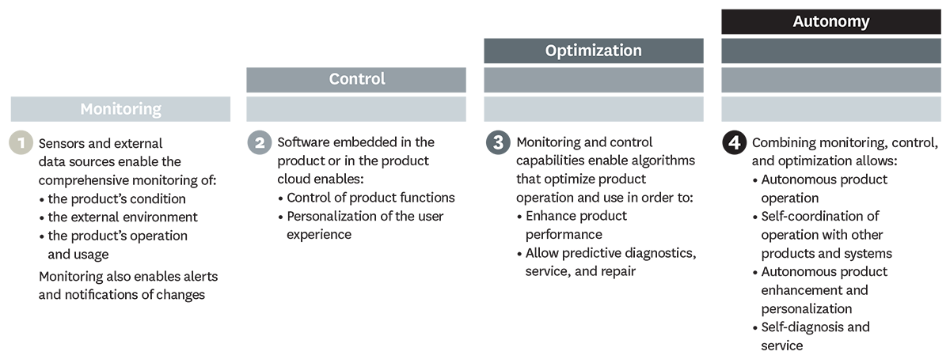
What Can Smart, Connected Products Do?
From HBR article by Porter and Heppelmann

Slide 12
Monitoring
In some cases, such as medical devices, monitoring is the core element of value creation. Medtronic’s digital blood-glucose meter uses a sensor inserted under the patient’s skin to measure glucose levels in tissue fluid and connects wirelessly to a device that alerts patients and clinicians up to 30 minutes before a patient reaches a threshold blood-glucose level, enabling appropriate therapy adjustments.
From HBR article by Porter and Heppelmann

Slide 13
Control
Users can adjust their Philips Lighting Hue lightbulbs via smartphone, turning them on and off, programming them to blink red if an intruder is detected, or dimming them slowly at night.
Doorbot, a smart, connected doorbell and lock, allows customers to give visitors access to the home remotely after screening them on their smartphones.
From HBR article by Porter and Heppelmann

Slide 14
Optimization
The rich flow of monitoring data from smart, connected products, coupled with the capacity to control product operation, allows companies to optimize product performance in numerous ways, many of which have not been previously possible.
Diebold, for example, monitors many of its automated teller machines for early signs of trouble. After assessing a malfunctioning ATM’s status, the machine is repaired remotely if possible, or the company deploys a technician who has been given a detailed diagnosis of the problem, a recommended repair process, and, often, the needed parts.
TinyML provides machine learning with TensorFlow Lite on microcontrollers. Training is done on the cloud and the model is deployed to the device. Example usage: detect a barking dog or a machine that is about to fail.
From HBR article by Porter and Heppelmann

Slide 15
Autonomy
More-sophisticated products are able to learn about their environment, self-diagnose their own service needs, and adapt to users’ preferences. Autonomy not only can reduce the need for operators but can improve safety in dangerous environments and facilitate operation in remote locations.
Joy Global’s Longwall Mining System, for example, is able to operate autonomously far underground, overseen by a mine control center on the surface. Equipment is monitored continuously for performance and faults, and technicians are dispatched underground to deal with issues requiring human intervention.
From HBR article by Porter and Heppelmann

Slide 16
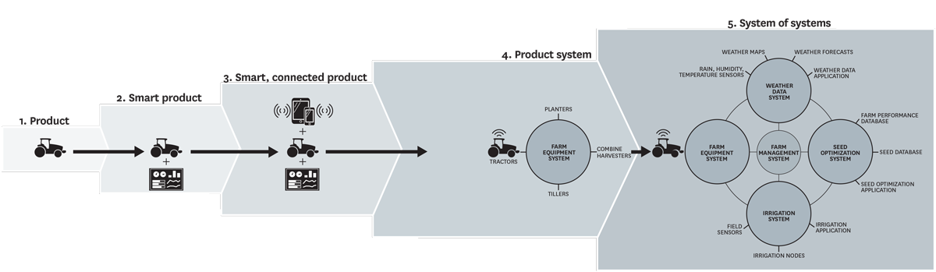
We Used to Make Tractors!
From HBR article by Porter and Heppelmann
To build such system of systems, systems need to interoperate well with others.
Principles from the World Wide Web, provide us with guidance on the construction of interoperable systems.

Slide 17
Digital Twins - A Key Architectural Idea
An important idea for the IoT architecture is to register every device with a cloud service and communicate with that service alone. From the article on “Enabling the Internet of Things“
Users or other computers would then interact with this service to determine the device’s status or control its behavior.
This approach provides economics of scale, automatic backup of data, and security provided by providers on the cloud.
See General Electric’s PREDIX platform. Digital Twins are described as :
- providing a software representation of a physical asset.
- providing a single source of truth about the asset
- holding data about past and present state, condition, and performance of
the asset and providing analytics

Slide 18
Types of Connectivity
One-to-one: An individual product connects to the user, manufacturer or another product.
Examples: a car connected to a diagnostic machine, a light sensor communicates with a
window shade.
One-to-many: A central system collects data from many products simultaneously. For example,
a Tesla car makes reports to a single manufacturer system – monitoring performance, provide
remote services and upgrades.
Many-to-many: Multiple products connected to many other types of products and to the cloud
as well. For example, automated tillers inject nitrogen fertilizer at precise depths and intervals,
and seeders follow, placing corn seeds directly in the fertilized soil.

Slide 19
Summary: Smart and Connected Products
IT is revolutionizing products.
Once, solely mechanical and electrical parts.
Now, complex systems with connectivity.
Smart, connected products are unleashing a new era of competition.
Some companies will ask “What business am I in ?”
Many products will contain a computer or microcontroller and have a representation in the
cloud (Digital Twin).
This changes product design, marketing, manufacturing, and after sales service.
This creates opportunities for rich data analytics and machine learning.
Security and privacy concerns are significant but will probably not be a show stopper.
Lessons learned from the WWW may help us achieve a more interoperable IOT.
We can build a Web of Things.

