Slide 1
Distributed Systems
CS 15-440
Networks- Part I
Lecture 2, January 12, 2022
Mohammad Hammoud

Slide 2
Today…
Last Session:
  Introduction
Today’s Session:
  Network Types
  Networking Principles: Layering and Encapsulation
Announcements:
  PS1 will be released tomorrow. It will be due on Jan 23
  In tomorrow’s recitation, we will practice on Java programming (Projects I and II will be in Java)

Slide 3
Introduction to Networks –
Learning Outcomes
After two lectures on networks, you will be able to:
  Identify different types of networks
  Describe various networking principles such as layering, encapsulation, and packet-switching, among others
  Examine how packets are routed
  Realize how congestion is controlled
  Analyze the performance, scalability, and reliability of networks

Slide 4
Networks in Distributed Systems
A distributed system is a collection of components that communicate to solve a problem
Why should designers of distributed systems know about networks?
  Networking issues severely affect performance, fault-tolerance, and security of distributed systems
  E.g., Gmail outage on Sep 1, 2010 – Google Spokesman said “we had slightly underestimated the load which some recent changes placed on the request routers. … . few of the request routers became overloaded… causing a few more of them to also become overloaded, and within minutes nearly all of the request routers were overloaded.”

Slide 5
A Primer: Latency and Bandwidth
Case 1
Case 2
B
B
L
L
Case 3
B
L
B = Bandwidth (or Capacity) and L = Latency (or Delay)
B × L gives approximately the number of bits in flight
As B × L increases, uncertainty increases (more bits might get lost)
High value of B × L leads to “Buffer Bloat”

Slide 6

Networks in Distributed Systems
Networking Issue | Comments on a Distributed System Design
Performance
Scalability
Reliability
Security
Mobility
Quality-of-service
Affects choices of whether to optimize for network or other resources
Size of Internet is increasing; expect greater traffic and latency in future
Detect communication errors and perform error-checks at the application layer (end-to-end argument!)
Install firewalls at gateways; deploy end-to-end authentication; employ encryption, etc.,
Expect intermittent connection for mobile devices
Internet is best-effort. It is hard to ensure strict QoS guarantees for, say, multimedia data

Slide 7
Network Classification
Important ways to classify networks
  Based on size
    Body Area Networks (BAN)
    Personal Area Networks (PAN)
    Local Area Networks (LAN)
    Wide Area Networks (WAN)
  Based on technology
    Ethernet Networks
    Wireless Networks
    Cellular Networks

Slide 8
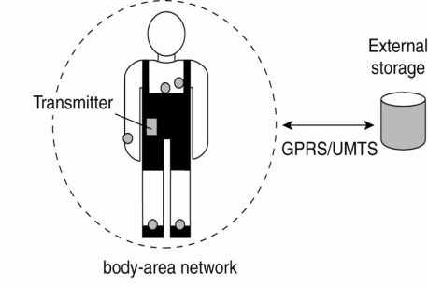
Network Classification – BANs and PANs
Body Area Networks (BAN):
  Devices form wearable computing units
  Several Body Sensor Units (BSUs) communicate with Body Central Unit (BCU)
  Typically, low-cost and low-energy networking
Personal Area Networks (PAN):
  PAN connects various digital devices carried by a user (mobile phones, tablets, cameras)
  Low-cost and low-energy networking
  e.g., Bluetooth
Notes:
8
The types of networks can be classified based on size:
Personal Area Networks: Various digital devices carried by the user is connected using a low-cost, low-energy network. e.g. Bluetooth

Slide 9


Network Classification – LAN
Computers connected by single communication medium
  e.g., Twisted copper wire, optical fiber
High data-transfer-rate and low latency
LAN consists of
  Segment
    Usually within a department/floor of a building
    Shared bandwidth, no routing necessary
  Local Networks
    Serves campus/office building
    Many segments connected by a switch/hub
    Typically, represents a network within an organization
Notes:
9
Local Area Networks: High speed computers connected through a single communication medium (optical, wired or wireless) . “Segment” is a part of the network that is connected by a single medium (e.g. ethernet cable). When a hosts inside a LAN transmits a packet, all other hosts can receive the packet. Hence, there is no need for routing. The bandwidth available is shared between all the hosts. A LAN can be made up of many segments. There is generally a host, which is called as switch or the hub, that helps to connect two or more segments. Communication between hosts in a LAN generally provides high bandwidth and low-delay. But most popularly used LANs, such as Ethernet-based LAN, does not not guarantee bandwidth or delay.

Slide 10

Network Classification – WAN
Generally, covers a wider area (cities, countries,...)
Consists of networks of different organizations
Traffic is routed from one organization to another
  Routers
Bandwidth and latency
  Vary
  Worse than a LAN
Largest WAN = Internet

Slide 11




Brief Summary of Important Networks
(Based on Size)
A Segment
A Point-to-point link
Local Area Network (LAN)
A network of networks
A Network
Wide Area Network (WAN)
Notes:
11

Slide 12
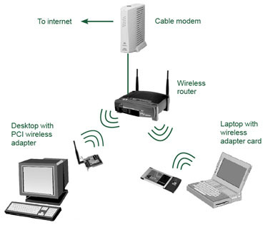
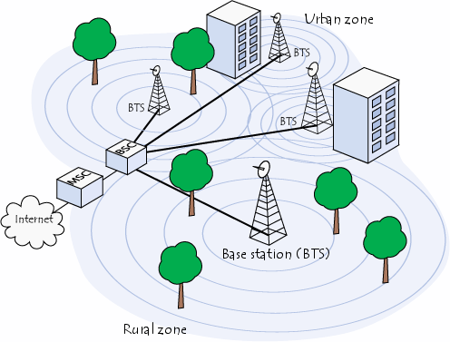
Types of Networks – Based on Technology
Ethernet Networks
  Predominantly used in the wired Internet
Wireless LANs
  Primarily designed to provide wireless access to
  the Internet
  Low-range (100s of m), high-bandwidth
Cellular networks (2G/3G/4G/5G)
  Initially, designed to carry voice
  Large range (few kms)
  Low-bandwidth

Slide 13
Typical Performance for Different Types of Networks
Network | Example | Range | Bandwidth (Mbps) | Latency (ms)
Wired LAN | Ethernet | 1-2 km | 10 – 10,000 | 1 – 10
Wired WAN | Internet | Worldwide | 0.5 – 600 | 100 – 500
Wireless PAN | Bluetooth | 10 – 30 m | 0.5 – 2 | 5 – 20
Wireless LAN | WiFi | 0.15 – 1.5 km | 11 – 108 | 5 – 20
Cellular | 2G – GSM | 100m – 20 km | 0.270 – 1.5 | 5
Cellular | 3G | 1 – 5 km | 348 – 14.4 | 100 – 500
Cellular | 4G | 16 km | 10- 100 | 36-48
Modern Cellular | 5G | 2 km | 50- 1000 | 10-30

Slide 14
Latency and Bandwidth
Case 1
Case 2
B
B
(WiFi)
(Ethernet)
L
L
Case 3
(WAN)
B
L
B = Bandwidth (or Capacity) and L = Latency (or Delay)
B × L gives approximately the number of bits in flight
As B × L increases, uncertainty increases (more bits might get lost)
High value of B × L leads to “Buffer Bloat”

Slide 15
Networking Principles
Network Protocols
Packet Transmission
Network Layers
  Physical layer
  Data-link layer
  Network layer and routing
  Transport layer and congestion control

Slide 16
Networking Protocols
If two entities want to communicate on a network, pre-defined agreements are necessary
  How a message will be formatted?
  How does the receiver know the last bit in the message?
  How can a receiver detect if the message is damaged?
“Protocol” is a well-known set of rules and formats to be used for communication between the entities
Standardizing a well-known set of protocols supports communication among heterogeneous entities
Notes:
Networks allow an entity on one machine to communicate with another entity on another machine

Slide 17

Packet Transmission
Messages are broken up into packets
  A packet is the unit of data that is transmitted
  between an origin and a destination
  Packets can be of arbitrary lengths
Maximum size of the packet is known as Maximum Transmission Unit (MTU)
  MTU prevents one host from sending a very long message
Each packet has two main fields
  Header: Contains meta-information about the packet
    e.g., Length of the packet, receiver ID
  Data
Header
Data

Slide 18



Network Layers
Network software is arranged into a hierarchy of layers
  Protocols in one layer perform one specific functionality
  Layering is a scalable & modular design for complex software
Typical functionalities in a network software:
011100011 0011 011
Src
Functionality | Layer
Transmits bits over a transmission medium
Physical
Dest
Coordinates transmissions from multiple hosts that are directly connected over a common medium
Data link
Routes the packets through intermediate networks
Network
Destination machine
Handles messages – rather than packets – between sender and receiver processes
P1
P2
P3
Transport
Satisfies communication requirements for specific applications
Application

Slide 19
OSI Reference Model
Open Systems Interconnection (OSI) Reference Model
  A layered networking model standardized by ISO
  The model identifies various layers and their functionalities
Functionality | Layer | Example Protocols
Satisfy communication requirements for specific applications | Application | HTTP, FTP
Transmit data in network representation that is independent of representation in individual computers | Presentation | CORBA data representation
Support reliability and adaptation, such as failure detection and automatic recovery | Session | SIP
Handle messages – rather than packets – between sender and receiver processes | Transport | TCP, UDP
Route the packet through intermediate networks | Network | IP, ATM
Coordinate transmissions from multiple hosts that are directly connected over a common medium | Data-link | Ethernet MAC
Transmit bits over a transmission medium | Physical | Ethernet

Slide 20
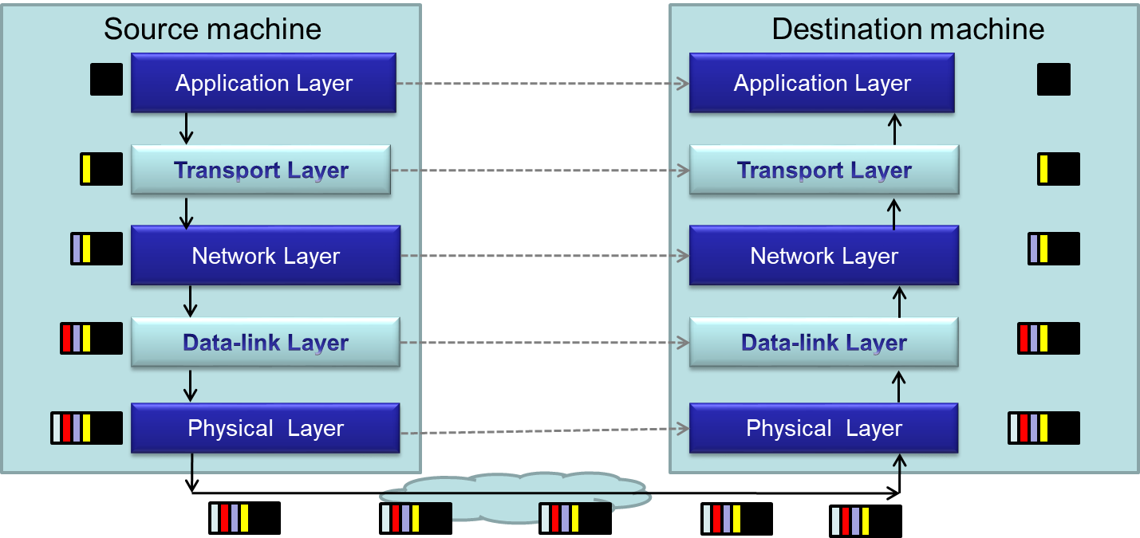
Packet Encapsulation
Encapsulation is a technique to pack and unpack data packets in a layered architecture

Slide 21
Layers that We Will Study Today
Physical layer
Data-link layer
Network layer

Slide 22
Layers that We Will Study Today
Physical layer
Data-link layer
Network layer

Slide 23
Physical Layer
Physical layer protocols transmit a sequence of bits over a transmission medium
  Modulate the bits into signals that can be transmitted over the medium
Transmission Medium | Type of signal transmitted
Twisted-pair (Ethernet cable) | Electrical signal
Fiber Optic Circuits | Light signal
Wireless channel | Electro-magnetic signal
Data-link layer protocol
Bits
A physical layer protocol
Signal
Transmission Medium

Slide 24
Layers that We Will Study Today
Physical layer
Data-link layer
Network layer

Slide 25
Data-link Layer
Protocols in data-link layer ensure that the packets are delivered from one host to another within a local network
Data-link layer protocols provide two main functionalities:
  How to coordinate between the transmitters such that packets are successfully received?
    Coordination
  How to identify another host on the local network?
    Addressing over local networks

Slide 26

Coordination at Data-link Layer
A packet is not received successfully at the receiver if a sender transmits the data when another sender’s transmission is active
  The packet is said to have experienced collision if it is not successfully received at the receiver
Collision is avoided by sensing the medium before transmission

Slide 27


Addressing over Local Networks
Each device that is connected to a network has a unique address called Medium Access Control (MAC) address
  MAC addresses are six bytes long
    e.g., 2A:D4:AB:FD:EF:8D
Approach:
  Data-link layer broadcasts the packet over the medium
  Receiver reads the packet header and checks if the packet is addressed to it
x
x

Slide 28
Layers that We Will Study Today
Physical layer
Data-link layer
Network layer

Slide 29

Network Layer
Network layer protocols perform the role of routing
  They ensure that a packet is routed from the source machine to the destination machine
  Packets may traverse different LANs to reach the destination
Internet Protocol (IP) is a
widely-used network layer
protocol
  IP addresses are typically
  used to identify machines
Router
Source
Destination

Slide 30
Router
A router is a device that forwards the packets between multiple networks
Routers are connected to two or more networks
  Each network interface is connected to a LAN or a host
Packet travels up until the network layer on the router
Source machine
Router
Dest machine
A Router
Application
Application
LAN-1
LAN-3
Transport
Transport
Int-1
Int-2
Int-3
Network
Network
Network
Data-link
Data-link
Data-link
LAN-2
Physical
Physical
Physical

Slide 31
Routing Algorithm
Packets have to be transmitted in a series of hops through the routers
  The series of hops that a packet takes is known as a route
Routing algorithm is responsible for determining the routes for the transmission of packets
Challenges for designing routing algorithms in the Internet:
  Performance: The traffic across different networks vary
  Router failures: Routers in the Internet may fail
R2
S
R1
R4
D
R4

Slide 32
Routing Algorithm (Cont’d)
Routing algorithms have two activities
  Determine the next-hop taken by each packet
    The algorithm should be fast and efficient
  Dynamically update connectivity information
    Maintain the knowledge of the network by monitoring routers and traffic
The above activities are distributed throughout the network
  Routing decisions are made on an hop-by-hop basis
  Information about possible next-hop routers is stored locally
  Information is updated periodically
We will study in the next lecture a simple routing algorithm called “Distance Vector Algorithm”

Slide 33
Next class
Networking- Part II

