Slide 1
Distributed Systems
CS 15-440
Replication – Part I
Lecture 22, November 23, 2023
Mohammad Hammoud

Slide 2
Today
Last Session:
  Caching – Part II
Today’s Session:
  Replication – Part I
Announcements:
  PS5 is due on Nov 27
  P4 is due on Nov 30

Slide 3
Course Map
Applications
Programming Models
Fast & Reliable
or Efficient DS
Replication & Consistency
Fault-tolerance
Communication Paradigms
Architectures
Naming
Synchronization
Correct or
Effective DS
Networks

Slide 4
Course Map
Applications
Programming Models
Replication & Consistency
Fault-tolerance
Communication Paradigms
Architectures
Naming
Synchronization
Networks

Slide 5
Why Replication?
Replication is necessary for:
  Improving performance
    A client can access nearby replicas and save latency
  Increasing the availability of services
    Replication can mask failures like server crashes and network disconnections
  Enhancing the scalability of systems
    Requests to data can be distributed across many servers that host replicas of the data
  Securing against malicious attacks
    Even if some replicas are malicious, security of data can be guaranteed by relying on the replicas at non-compromised servers

Slide 6

Replication for Improving Performance: Example
Replication at secondary servers in Content Delivery Networks (CDNs)
Main Server
Secondary Servers

Slide 7
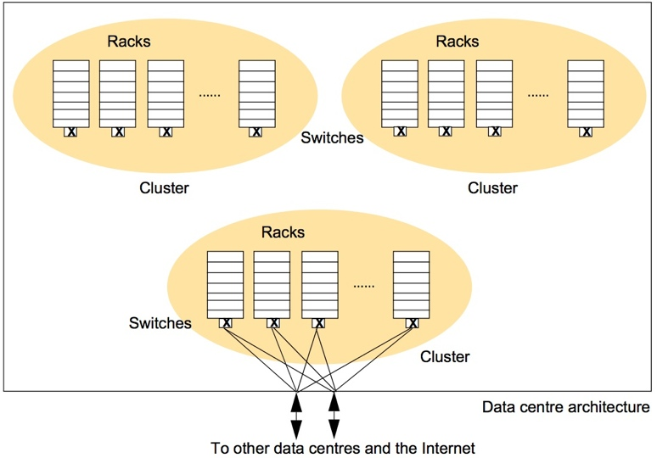
Replication for High-Availability: Example
Google File-System replicates data blocks at computers across different racks, clusters, and data-centers
If one computer or a rack or a cluster crashes, blocks can still be accessed from other sources

Slide 8
Replication for Enhancing Scalability: Example
Distributing data across replicated servers can help in precluding performance bottlenecks
For example, CDNs can decrease load at main (primary) servers
Main Server
Replicated Servers

Slide 9
Replication for Securing Against Malicious Attacks: Example
If a minority of servers in a system are malicious, the non-malicious servers can outvote the malicious ones
  This technique can be also used to provide fault-tolerance against non-malicious but faulty servers
  For instance, in a peer-to-peer system, peers can coordinate to prevent delivering faulty data to the requester
Server 2 requests & receives data
1
5
6
3
7
0
4
2
Server 2 accepts the copy found at servers 3, 4, 5, & 7 and ignores the copies found at 0 and 6
The number of servers with correct data outvote the faulty servers
n
= Servers that do not
have the requested data
n
= Servers with correct data
n
= Servers with faulty data

Slide 10
Why Consistency?
But replication comes with a cost, which is the necessity for maintaining consistency (or more precisely consistent ordering of updates)
Example:
  A Bank Database
Event 1 = Add $1000
Event 2 = Add interest of 5%
1
2
Bal=2000
4
Bal=2100
Bal=1000
3
Bal=1000
Bal=1050
Bal=2050
Replicated Database

Slide 11
How to Maintain Consistency?
Before updates at replicas are committed, all replicas shall reach an agreement on a global ordering of the updates
  That is, replicas in a distributed data-store should agree on a consistent ordering of updates
What consistent ordering of updates can replicas agree on?

Slide 12
Types of Ordering
Below are three major types of orderings:
  Total Ordering
  Sequential Ordering
    Sequential Consistency Model
  Causal Ordering
    Causal Consistency Model

Slide 13
Types of Ordering
Below are three major types of orderings:
  Total Ordering
  Sequential Ordering
    Sequential Consistency Model
  Causal Ordering
    Causal Consistency Model

Slide 14
Total Ordering
  What is total ordering?
    If process P_{i} sends a message m_{i} and P_{j} sends m_{j}, and if one correct process delivers m_{i} before m_{j} then every other correct process delivers m_{i} before m_{j}
Messages can denote replica updates
  In the example Ex1, if P₁ issues the operation m_{(1,1)}: x=x+1; and
  If P₃ issues m_{(3,1)}: print(x); and
  P₁ or P₂ or P₃ delivers m_{(3,1)} before m_{(1,1)}
  Then, at all replicas P_{1,} P_{2,} P₃, the operations are executed in the following order
  print(x);
  x=x+1;
P1
P2
P3
m_{(1,1)}
m_{(3,1)}
Ex1: Total Order
P1
P2
P3
m_{(1,1)}
m_{(3,1)}
Ex2: Not in Total Order

Slide 15
Types of Ordering
Below are three major types of orderings:
  Total Ordering
  Sequential Ordering
    Sequential Consistency Model
  Causal Ordering
    Causal Consistency Model

Slide 16

Sequential Ordering
  What is sequential ordering?
    If a process Pi sends a sequence of messages m_{(i,1)},...., m_{(i,ni)}, and
    Process Pj sends a sequence of messages m_{(j,1)},...., m_{(j,nj)},
    Then:
      At any process, the set of messages received are in some sequential order
      Messages from each individual process should appear in the same order sent by that process
        At every process, m_{i,1} should be delivered before m_{i,2}, which should be delivered before m_{i,3} and so on...
        At every process, m_{j,1} should be delivered before m_{j,2}, which should be delivered before m_{j,3} and so on...
P1
P2
P3
m(1,1)
m(3,1)
m(3,2)
m(1,2)
m(3,3)
Valid Sequential Orders
P1
P2
P3
m(1,1)
m(3,1)
m(3,2)
m(1,2)
m(3,3)
Invalid Sequential Orders, but Valid Total Order

Slide 17
Sequential Consistency (Cont’d)
Consider three processes P₁, P₂ and P₃ executing multiple instructions on three shared variables x, y and z
  Assume that x, y and z are set to zero at start
There are many valid sequences in which operations can be executed, respecting sequential consistency (or program order)
  How can a program identify the wrong sequence among the following sequences:
P1
P2
P3
x = 1
print (y,z)
y = 1
print (x,z)
z = 1
print (x,y)
x = 1
print (y,z)
y = 1
print (x,z)
z = 1
print (x,y)
x = 1
y = 1
print (x,z)
print (y,z)
z = 1
print (x,y)
print (y,z)
y = 1
print (x,y)
x = 1
print (x,z)
z = 1
y = 1
z = 1
print (x,y)
print (x,z)
x = 1
print (y,z)
Output
001011
101011
000110
010111
Signature
001011
101011
001001
110101

Slide 18

Implications of Adopting A Sequential Consistency Model for Applications
There might be several different sequentially consistent combinations of ordering
  Number of combinations for a total of n instructions =
The contract between the process and the distributed data-store is that the process must accept all of the sequential orderings as valid results
  A process that works for some of the sequential orderings and not for others is INCORRECT
$$O(n!)$$

Slide 19
Types of Ordering
Below are three major types of orderings:
  Total Ordering
  Sequential Ordering
    Sequential Consistency Model
  Causal Ordering
    Causal Consistency Model

Slide 20
Causal vs. Concurrent events
Consider an interaction between processes P₁ and P₂ operating on replicated data x and y
P1
W(x)a
P1
W(x)a
P2
R(x)a
W(y)b
P2
W(y)b
R(x)a
Events are causally related
Events are not concurrent
Computation of y at P₂ may have depended on the value of x written by P₁
Events are not causally related
Events are concurrent
Computation of y at P₂ does not depend on the value of x written by P₁
P1
=Process P1
=Timeline at P1
R(x)b
=Read variable x;
Result is b
W(x)b
= Write variable x;
Result is b

Slide 21
Causal Ordering
  What is causal ordering?
    If process P_{i} sends a message m_{i} and P_{j} sends m_{j}, and if m_{i}→m_{j} (operator ‘→’ is Lamport’s happened-before relation), then any correct process that delivers m_{j} will deliver m_{i} before m_{j}
    In Ex1:
      m_{(1,1)} and m_{(3,1)} are in Causal Order
      m_{(1,1)} and m_{(1,2)} are in Causal Order
    In Ex2:
      m_{(1,1)} and m_{(3,1)} are NOT in Causal Order
P1
P2
P3
m_{(1,1)}
m_{(3,1)}
m_{(1,2)}
Ex1: Valid Causal Orders
P1
P2
P3
m_{(1,1)}
m_{(3,1)}
m_{(1,2)}
Ex2: Invalid Causal Order

Slide 22
Causal Consistency Model
A data-store is causally consistent if:
  Writes that are potentially causally related are seen by all the processes in the same order
  But concurrent writes may be seen in different orders on different machines

Slide 23
Implications of adopting a Causally Consistent Data-store for Applications
Processes have to keep track of which processes have seen which writes
This requires maintaining a dependency graph between write and read operations
  Vector clocks provide a way to maintain causally consistent data-stores

Slide 24
Next Lecture…
Replication – Part II

