Slide 1
Distributed Systems
CS 15-440
MapReduce & the Transformer Model
Lecture 17, October 31, 2023
Mohammad Hammoud

Slide 2
Today
Last Session:
  MPI – Part II
Today’s Session:
  MapReduce & the Transformer Model
Announcements:
  P3 is due on Nov 16
  PS4 is released and due on Nov 12
  Quiz II is on Nov 5

Slide 3
Course Map
Applications
Programming Models
Fast & Reliable
or Efficient DS
Replication & Consistency
Fault-tolerance
Communication Paradigms
Architectures
Naming
Synchronization
Correct or
Effective DS
Networks

Slide 4
Course Map
Applications
Programming Models
Replication & Consistency
Fault-tolerance
Communication Paradigms
Architectures
Naming
Synchronization
Networks

Slide 5
Overview
Modern Programming Models
& Applications
MapReduce
The Transformer Model
Ray

Slide 6
We Live in a World of Big Data
A few examples (all per day):
  333.22 billion emails sent
  129.89 billion crypto purchased
  8.5 billion Google searches
  1.44 billion hours streamed
  637.92 million USD spent on Amazon
  150.62 million hours spent in Zoom meetings
  110.02 million USD spent on DoorDash
  Etc.,

Slide 7
How to Store Big Data?
We can employ a storage system that is either a distributed file system or a distributed database system
The storage system partitions and distributes data, using certain striping (or partitioning) and placement techniques
  This allows for concurrent accesses to data
  & improves fault-tolerance
Logical File
Striping Unit
Stripe Size
0
1
2
3
4
5
6
7
8
9
10
11
12
13
14
15
Server 1
Server 2
Server 3
Server 4
0
4
8
12
1
5
9
13
2
6
10
14
3
7
11
15

Slide 8
Example: The Google File System
GFS partitions large files into fixed-size blocks and distributes them randomly across cluster machines
Blk 2
Blk 3
Large File
Blk 0
Blk 1
Blk 4
Blk 5
Blk 6
Server 0
(Writer)
Server 1
Server 2
Server 3
0M
Blk 0
Blk 0
Blk 1
Blk 0
64M
Blk 1
Blk 2
Blk 2
Blk 1
128M
Blk 2
Blk 3
Blk 4
Blk 4
192M
Blk 3
Blk 3
Blk 5
Blk 5
256M
Blk 4
Blk 6
Blk 6
320M
Blk 5
384M
Blk 6

Slide 9
Example: The Google File System
GFS adopts a master-slave architecture
File name
GFS client
Master
Contact address
Chunk Id, range
Chunk Server
Chunk Server
Chunk Server
Chunk data
Linux File System
Linux File System
Linux File System

Slide 10
How to Process Big Data?
We can create a custom distributed system (or program) for each new algorithm
    Cumbersome!
Or utilize modern distributed frameworks, which:
  Relieve programmers from worrying about the many difficult aspects of distributed systems
  Allow programmers to focus on ONLY the sequential parts of their programs
  E.g., MapReduce (or Hadoop) & Ray

Slide 11

Hadoop: HDFS + MapReduce
Hadoop is one of the most successful realizations of large-scale “data-parallel” distributed frameworks
Hadoop MapReduce is an open-source implementation of Google’s MapReduce
Hadoop uses Hadoop Distributed File System (HDFS), which is is an open-source implementation of GFS, as a storage layer

Slide 12

Hadoop MapReduce: A Bird’s Eye View
Hadoop MapReduce incorporates two phases, Map and Reduce phases, which encompass multiple Map and Reduce tasks
Map Task
Split 0
HDFS BLK
Partition
Partition
Reduce Task
Partition
Partition
Map Task
Partition
Partition
Split 1
HDFS BLK
Dataset
Partition
Reduce Task
Partition
Partition
Partition
To HDFS
Split 2
Map Task
HDFS BLK
HDFS
Partition
Partition
Reduce Task
Partition
Partition
Split 3
Map Task
Partition
HDFS BLK
Partition
Partition
Merge & Sort
Stage
Shuffle Stage
Reduce Stage
Map Phase
Reduce Phase

Slide 13
Architecture and Scheduler
Hadoop MapReduce adopts a master-slave architecture
A pull-based task scheduling mechanism is used, whereby:
  Map tasks are scheduled in proximity of HDFS blocks
  Reduce tasks are scheduled anywhere
Core Switch
A slave
The master
Rack Switch 1
Rack Switch 2
TaskTracker1
TaskTracker2
TaskTracker3
TaskTracker4
TaskTracker5
JobTracker
MT2
MT3
MT1
MT2
MT3
Request a Map Task
Schedule a Map Task at an Empty Map Slot on TaskTracker1

Slide 14
Architecture and Scheduler
Hadoop MapReduce adopts a master-slave architecture
With the above setup, how many Map tasks can run in parallel?
  Each Task Tracker (TT) has 2 Map slots, thus can run 2 Map tasks concurrently
  With 5 TTs and 2 Map slots on each TT, 10 Map tasks can run in parallel
    The maximum number of Map tasks that can run in parallel is denoted as Map wave
Core Switch
A slave
The master
Rack Switch 1
Rack Switch 2
TaskTracker1
TaskTracker2
TaskTracker3
TaskTracker4
TaskTracker5
JobTracker
MT1
MT2
MT3
MT2
MT3
Request a Map Task
Schedule a Map Task at an Empty Map Slot on TaskTracker1

Slide 15
Architecture and Scheduler
Hadoop MapReduce adopts a master-slave architecture
For a 1024MB dataset, how many Map waves are needed?
  The size of each HDFS block is by default 64MB and each split encompasses by default 1 HDFS block
  Hence, there will be a total of 1024/64 = 16 HDFS blocks or 16 splits
  The input to each Map task is a single split, thus there will be a total of 16 Map tasks
  Consequently, we would need 16 tasks/10 slots = 2 Map waves (the 2nd wave will have only 6 tasks!)
Core Switch
A slave
The master
Rack Switch 1
Rack Switch 2
TaskTracker1
TaskTracker2
TaskTracker3
TaskTracker4
TaskTracker5
JobTracker
MT1
MT2
MT3
MT2
MT3
Request a Map Task
Schedule a Map Task at an Empty Map Slot on TaskTracker1

Slide 16
Overview
Modern Programming Models
& Applications
MapReduce
The Transformer Model
Ray

Slide 17
Overview
Modern Programming Models
& Applications
MapReduce
The Transformer Model
Ray
Representations
The Attention Process
The Core Architecture

Slide 18
Syntactical Representation
 | W₁ | W₂ | W₃ | . . . |  |  | W_{n}
W₁ | 1 | 0 | 0 |  | . . . |  | 0
W₂ | 0 | 1 | 0 |  | . . . |  | 0
W₃ | 0 | 0 | 1 |  | . . . |  | 0
W_{n} | 0 | 0 | 0 |  | . . . |  | 1
A vocabulary
of n words
.
.
.
.
.
.
.
.
.
.
.
.
.
.
.
A one-hot representation using
an n (say, 50,000) dimensional vector

Slide 19
Syntactical Representation
 | W₁ | Orange | Apple | . . . |  |  | W_{n}
W₁ | 1 | 0 | 0 |  | . . . |  | 0
W₂ | 0 | 1 | 0 |  | . . . |  | 0
W₃ | 0 | 0 | 1 |  | . . . |  | 0
W_{n} | 0 | 0 | 0 |  | . . . |  | 1
A vocabulary
of n words
.
.
.
.
.
.
.
.
.
.
.
.
.
.
.
Not similar (when you pursue their dot product)
although they’re both fruits!

Slide 20
Semantical Representation
 | King | Orange | Apple | . . . |  |  | Queen
Royal | o.93 | 0.0 | 0.0 |  | . . . |  | 0.95
Size | 0.78 | 0.08 | 0.076 |  | . . . |  | 0.77
Fruit | 0.0 | 0.99 | 0.94 |  | . . . |  | 0.0
Age | 0.51 | 0.1 | 0.09 |  | . . . |  | 0.6
Features
.
.
.
.
.
.
.
.
.
.
.
.
.
.
.
A feature representation (also known as word embedding) using
an m (say, 300) dimensional vector

Slide 21
Semantical Representation
 | King | Orange | Apple | . . . |  |  | Queen
Royal | o.93 | 0.0 | 0.0 |  | . . . |  | 0.95
Size | 0.78 | 0.08 | 0.076 |  | . . . |  | 0.77
Fruit | 0.0 | 0.99 | 0.94 |  | . . . |  | 0.0
Age | 0.51 | 0.1 | 0.09 |  | . . . |  | 0.6
Features
.
.
.
.
.
.
.
.
.
.
.
.
.
.
.
Similar (when you pursue their dot product),
capturing the fact that they’re both fruits!

Slide 22
Semantical Representation
 | King | Orange | Apple | . . . |  |  | Queen
Royal | o.93 | 0.0 | 0.0 |  | . . . |  | 0.95
Size | 0.78 | 0.08 | 0.076 |  | . . . |  | 0.77
Fruit | 0.0 | 0.99 | 0.94 |  | . . . |  | 0.0
Age | 0.51 | 0.1 | 0.09 |  | . . . |  | 0.6
Features
.
.
.
.
.
.
.
.
.
.
.
.
.
.
.
King & Queen are more similar to each other

Slide 23
Semantical Representation
 | King | Orange | Apple | . . . |  |  | Queen
Royal | o.93 | 0.0 | 0.0 |  | . . . |  | 0.95
Size | 0.78 | 0.08 | 0.076 |  | . . . |  | 0.77
Fruit | 0.0 | 0.99 | 0.94 |  | . . . |  | 0.0
Age | 0.51 | 0.1 | 0.09 |  | . . . |  | 0.6
Features
.
.
.
.
.
.
.
.
.
.
.
.
.
.
.
than, say, King & Apple

Slide 24
Contextual Representation
Word (or static) embeddings can be learnt using algorithms like Word2vec and Glove
Static embeddings are more effective than one-hot representations, but might still miss on capturing many syntactic and semantic properties of words under diverse linguistic contexts
  The word ‘apple’ has multiple word senses, one referring to a fruit and another to a device, which cannot be inferred outside its context
Incorporating context into static embeddings (known as contextual embeddings) has proven to be a watershed idea in Natural Language Processing (NLP)

Slide 25
Contextual Representation
Contextual embeddings are more of dynamic embeddings
They move beyond word-level semantics via associating each word with a representation that is a function of the entire input sequence
They are exemplified by GPT and BERT, which capitalize on a state-of-the-art NLP model known as the Transformer Model
We will study first the Transformer Model and how to parallelize it, then describe how GPT and BERT build upon it

Slide 26
Overview
Modern Programming Models
& Applications
MapReduce
The Transformer Model
Ray
Representations
The Attention Process
The Core Architecture

Slide 27
Hard or Boolean Lookups over Key-Value Stores
Keys
Values
The query matches
only 1 key
a
v₁
Query
b
v₂
d
c
v₃
d
v₄
v₄
e
v₅
A key-value store

Slide 28

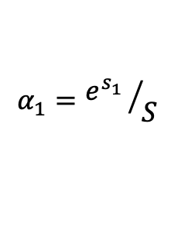
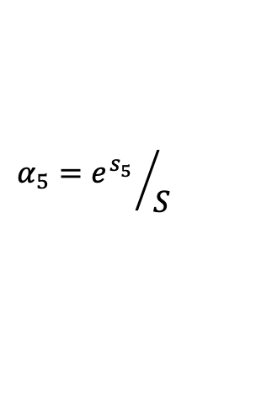

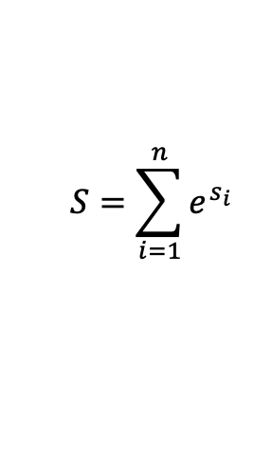
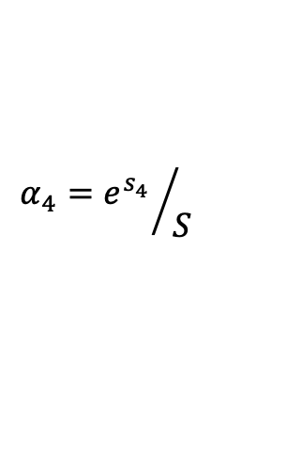

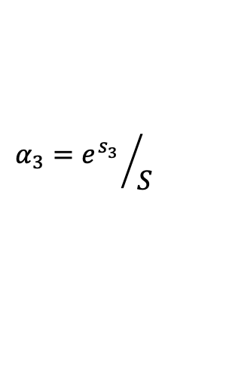

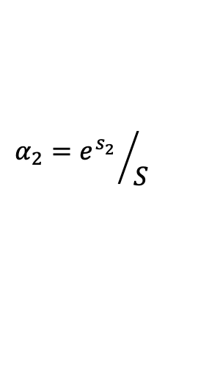

Soft or Fuzzy Lookups over Key-Value Stores
Softmax
The query matches all
keys softly through
a similarity function
Similarity
Scores
Keys
Values
a
v₁
$$α_{1}={e^{s_{1}^{}}}/S$$
$α_{1}$× v₁
s₁
e^{s1}
Query
b
v₂
s₂
e^{s2}
$${{α_{2}=e}^{s_{2}^{}}}/S$$
$α_{2}$× v₂
d
c
v₃
s₃
e^{s3}
$${{α_{3}=e}^{s_{3}^{}}}/S$$
$α_{3}$× v₃
This whole process is known as attention
d
v₄
s₄
e^{s4}
$${{α_{4}=e}^{s_{4}^{}}}/S$$
$α_{4}$× v₄
e
v₅
s₅
e^{s5}
$${{α_{5}=e}^{s_{5}^{}}}/S$$
$α_{5}$× v₅
$$S=\sum_{i=1}^{n}{e^{s_{i}}}$$
A key-value store

Slide 29
Overview
Modern Programming Models
& Applications
MapReduce
The Transformer Model
Ray
Representations
The Attention Process
The Core Architecture

Slide 30
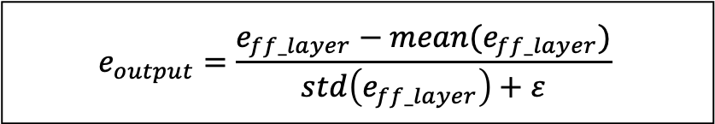
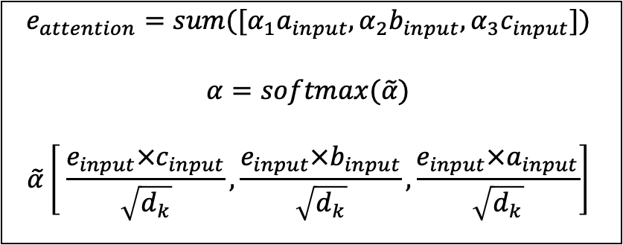
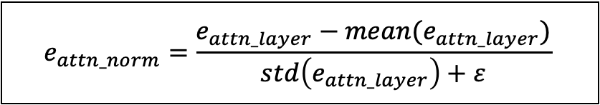
The Core Architecture
$$e_{output}=\frac{e_{ff_layer}−mean(e_{ff_layer})}{std\left(e_{ff_layer}\right)+ε}$$
a_{output}
b_{output}
c_{output}
e_{output}
$$e_{ff_layer}=e_{attn_norm}+Dropout(e_{feed_forward})$$
normalize
a_{ff_layer}
b_{ff_layer}
c_{ff_layer}
e_{ff_layer}
$$e_{feed_forward}=ReLU(e_{attn_norm}W_{1}+b_{1})W_{2}+b_{2}$$
+
+
+
+
$$e_{attn_norm}=\frac{e_{attn_layer}−mean(e_{attn_layer})}{std\left(e_{attn_layer}\right)+ε}$$
a_{feed_forward}
b_{feed_forward}
c_{feed_froward}
e_{feed_forward}
a_{attn_norm}
b_{attn_norm}
c_{attn_norm}
e_{attn_norm}
$$e_{attn_layer}=Dropout(e_{attention}+e_{input})$$
normalize
$$e_{attention}=sum([α_{1}a_{input},α_{2}b_{input},α_{3}c_{input}])$$
$$α=softmax(\tilde{α})$$
$$\tilde{α}\left[ \frac{e_{input}×c_{input}}{\sqrt{d_{k}}},\frac{e_{input}×b_{input}}{\sqrt{d_{k}}},\frac{e_{input}×a_{input}}{\sqrt{d_{k}}}\right]$$
a_{attn_layer}
b_{attn_layer}
c_{attn_layer}
e_{attn_layer}
+
+
+
+
a_{attention}
b_{attention}
c_{attention}
e_{attention}
a_{input}
b_{input}
c_{input}
e_{input}
+
+
+
+
x₂₃
P₁
x₂₇
P₂
x₅
P₃
x₇₈
P₄
$$e_{input}=x_{78}+P_{4}$$
Distributed
1
Systems
2
is
3
fun
4

Slide 31
The Core Architecture
$$e_{output}=\frac{e_{ff_layer}−mean(e_{ff_layer})}{std\left(e_{ff_layer}\right)+ε}$$
How to Parallelize the Transformer’s Architecture?
a_{output}
b_{output}
c_{output}
e_{output}
$$e_{ff_layer}=e_{attn_norm}+Dropout(e_{feed_forward})$$
normalize
a_{ff_layer}
b_{ff_layer}
c_{ff_layer}
e_{ff_layer}
$$e_{feed_forward}=ReLU(e_{attn_norm}W_{1}+b_{1})W_{2}+b_{2}$$
+
+
+
+
$$e_{attn_norm}=\frac{e_{attn_layer}−mean(e_{attn_layer})}{std\left(e_{attn_layer}\right)+ε}$$
a_{feed_forward}
b_{feed_forward}
c_{feed_froward}
e_{feed_forward}
a_{attn_norm}
b_{attn_norm}
c_{attn_norm}
e_{attn_norm}
$$e_{attn_layer}=Dropout(e_{attention}+e_{input})$$
normalize
$$e_{attention}=sum([α_{1}a_{input},α_{2}b_{input},α_{3}c_{input}])$$
$$α=softmax(\tilde{α})$$
$$\tilde{α}\left[ \frac{e_{input}×c_{input}}{\sqrt{d_{k}}},\frac{e_{input}×b_{input}}{\sqrt{d_{k}}},\frac{e_{input}×a_{input}}{\sqrt{d_{k}}}\right]$$
a_{attn_layer}
b_{attn_layer}
c_{attn_layer}
e_{attn_layer}
+
+
+
+
a_{attention}
b_{attention}
c_{attention}
e_{attention}
a_{input}
b_{input}
c_{input}
e_{input}
+
+
+
+
x₂₃
P₁
x₂₇
P₂
x₅
P₃
x₇₈
P₄
$$e_{input}=x_{78}+P_{4}$$
Distributed
1
Systems
2
is
3
fun
4

Slide 32
T₁
T₂
T₃
T₄
a_{output}
b_{output}
c_{output}
e_{output}
normalize
a_{ff_layer}
b_{ff_layer}
c_{ff_layer}
e_{ff_layer}
+
+
+
+
a_{feed_forward}
b_{feed_forward}
c_{feed_froward}
e_{feed_forward}
All these verticals can go in parallel
a_{attn_norm}
b_{attn_norm}
c_{attn_norm}
e_{attn_norm}
normalize
a_{attn_layer}
b_{attn_layer}
c_{attn_layer}
e_{attn_layer}
+
+
+
+
a_{attention}
b_{attention}
c_{attention}
e_{attention}
But, how to handle the attention
interactions?
a_{input}
b_{input}
c_{input}
e_{input}
+
+
+
+
x₂₃
P₁
x₂₇
P₂
x₅
P₃
x₇₈
P₄
Distributed
1
Systems
2
is
3
fun
4

Slide 33
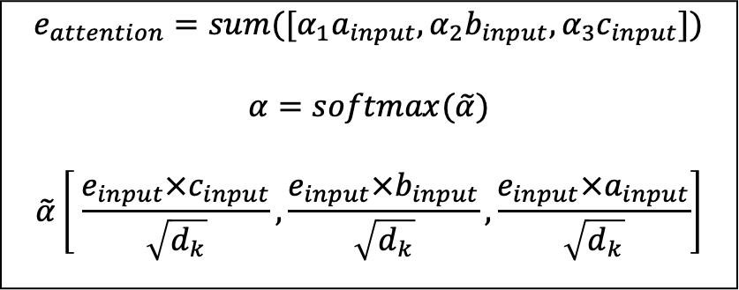
T₁
T₂
T₃
T₄
$$e_{attention}=sum([α_{1}a_{input},α_{2}b_{input},α_{3}c_{input}])$$
$$α=softmax(\tilde{α})$$
$$\tilde{α}\left[ \frac{e_{input}×c_{input}}{\sqrt{d_{k}}},\frac{e_{input}×b_{input}}{\sqrt{d_{k}}},\frac{e_{input}×a_{input}}{\sqrt{d_{k}}}\right]$$
a_{output}
b_{output}
c_{output}
e_{output}
normalize
a_{ff_layer}
b_{ff_layer}
c_{ff_layer}
e_{ff_layer}
+
+
+
+
a_{feed_forward}
b_{feed_forward}
c_{feed_froward}
e_{feed_forward}
a_{attn_norm}
b_{attn_norm}
c_{attn_norm}
e_{attn_norm}
normalize
a_{attn_layer}
b_{attn_layer}
c_{attn_layer}
e_{attn_layer}
+
+
+
+
a_{attention}
b_{attention}
c_{attention}
e_{attention}
a_{input}
b_{input}
c_{input}
e_{input}
+
+
+
+
x₂₃
P₁
x₂₇
P₂
x₅
P₃
x₇₈
P₄
Distributed
1
Systems
2
is
3
fun
4

Slide 34
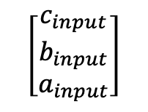
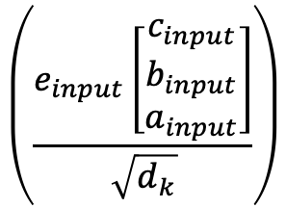
T₁
T₂
T₃
T₄
$$e_{attention}=sum([α_{1}a_{input},α_{2}b_{input},α_{3}c_{input}])$$
$$α=softmax(\tilde{α})$$
$$\tilde{α}\left[ \frac{e_{input}×c_{input}}{\sqrt{d_{k}}},\frac{e_{input}×b_{input}}{\sqrt{d_{k}}},\frac{e_{input}×a_{input}}{\sqrt{d_{k}}}\right]$$
a_{output}
b_{output}
c_{output}
e_{output}
normalize
a_{ff_layer}
b_{ff_layer}
c_{ff_layer}
e_{ff_layer}
+
+
+
+
a_{feed_forward}
b_{feed_forward}
c_{feed_froward}
e_{feed_forward}
a_{attn_norm}
b_{attn_norm}
c_{attn_norm}
e_{attn_norm}
In matrix format
normalize
a_{attn_layer}
b_{attn_layer}
c_{attn_layer}
e_{attn_layer}
$$\left(\frac{e_{input}\left[\begin{aligned}c_{input} \\ b_{input} \\ a_{input}\end{aligned}\right]}{\sqrt{d_{k}}}\right)$$
$$\left[\begin{aligned}c_{input} \\ b_{input} \\ a_{input}\end{aligned}\right]$$
+
+
+
+
softmax
a_{attention}
b_{attention}
c_{attention}
e_{attention}
a_{input}
b_{input}
c_{input}
e_{input}
+
+
+
+
x₂₃
P₁
x₂₇
P₂
x₅
P₃
x₇₈
P₄
Distributed
1
Systems
2
is
3
fun
4

Slide 35
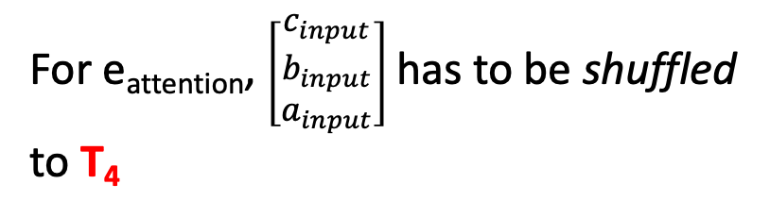
T₁
T₂
T₃
T₄
$$e_{attention}=sum([α_{1}a_{input},α_{2}b_{input},α_{3}c_{input}])$$
$$α=softmax(\tilde{α})$$
$$\tilde{α}\left[ \frac{e_{input}×c_{input}}{\sqrt{d_{k}}},\frac{e_{input}×b_{input}}{\sqrt{d_{k}}},\frac{e_{input}×a_{input}}{\sqrt{d_{k}}}\right]$$
a_{output}
b_{output}
c_{output}
e_{output}
normalize
a_{ff_layer}
b_{ff_layer}
c_{ff_layer}
e_{ff_layer}
+
+
+
+
a_{feed_forward}
b_{feed_forward}
c_{feed_froward}
e_{feed_forward}
a_{attn_norm}
b_{attn_norm}
c_{attn_norm}
e_{attn_norm}
In matrix format
normalize
a_{attn_layer}
b_{attn_layer}
c_{attn_layer}
e_{attn_layer}
$$\left(\frac{e_{input}\left[\begin{aligned}c_{input} \\ b_{input} \\ a_{input}\end{aligned}\right]}{\sqrt{d_{k}}}\right)$$
$$\left[\begin{aligned}c_{input} \\ b_{input} \\ a_{input}\end{aligned}\right]$$
+
+
+
+
softmax
a_{attention}
b_{attention}
c_{attention}
e_{attention}
a_{input}
b_{input}
c_{input}
e_{input}
For e_{attention}, $\left[\begin{aligned}c_{input} \\ b_{input} \\ a_{input}\end{aligned}\right]$ has to be shuffled
to T₄
+
+
+
+
x₂₃
P₁
x₂₇
P₂
x₅
P₃
x₇₈
P₄
Distributed
1
Systems
2
is
3
fun
4

Slide 36
T₁
T₂
T₃
T₄
$$e_{attention}=sum([α_{1}a_{input},α_{2}b_{input},α_{3}c_{input}])$$
$$α=softmax(\tilde{α})$$
$$\tilde{α}\left[ \frac{e_{input}×c_{input}}{\sqrt{d_{k}}},\frac{e_{input}×b_{input}}{\sqrt{d_{k}}},\frac{e_{input}×a_{input}}{\sqrt{d_{k}}}\right]$$
a_{output}
b_{output}
c_{output}
e_{output}
normalize
a_{ff_layer}
b_{ff_layer}
c_{ff_layer}
e_{ff_layer}
+
+
+
+
a_{feed_forward}
b_{feed_forward}
c_{feed_froward}
e_{feed_forward}
a_{attn_norm}
b_{attn_norm}
c_{attn_norm}
e_{attn_norm}
In matrix format
normalize
a_{attn_layer}
b_{attn_layer}
c_{attn_layer}
e_{attn_layer}
$$\left(\frac{e_{input}\left[\begin{aligned}c_{input} \\ b_{input} \\ a_{input}\end{aligned}\right]}{\sqrt{d_{k}}}\right)$$
$$\left[\begin{aligned}c_{input} \\ b_{input} \\ a_{input}\end{aligned}\right]$$
+
+
+
+
softmax
a_{attention}
b_{attention}
c_{attention}
e_{attention}
a_{input}
b_{input}
c_{input}
e_{input}
+
+
+
+
Similarly for other attentions
x₂₃
P₁
x₂₇
P₂
x₅
P₃
x₇₈
P₄
Distributed
1
Systems
2
is
3
fun
4

Slide 37
T₁
T₂
T₃
T₄
$$e_{attention}=sum([α_{1}a_{input},α_{2}b_{input},α_{3}c_{input}])$$
$$α=softmax(\tilde{α})$$
$$\tilde{α}\left[ \frac{e_{input}×c_{input}}{\sqrt{d_{k}}},\frac{e_{input}×b_{input}}{\sqrt{d_{k}}},\frac{e_{input}×a_{input}}{\sqrt{d_{k}}}\right]$$
a_{output}
b_{output}
c_{output}
e_{output}
normalize
a_{ff_layer}
b_{ff_layer}
c_{ff_layer}
e_{ff_layer}
+
+
+
+
a_{feed_forward}
b_{feed_forward}
c_{feed_froward}
e_{feed_forward}
a_{attn_norm}
b_{attn_norm}
c_{attn_norm}
e_{attn_norm}
In matrix format
normalize
a_{attn_layer}
b_{attn_layer}
c_{attn_layer}
e_{attn_layer}
$$\left(\frac{e_{input}\left[\begin{aligned}c_{input} \\ b_{input} \\ a_{input}\end{aligned}\right]}{\sqrt{d_{k}}}\right)$$
$$\left[\begin{aligned}c_{input} \\ b_{input} \\ a_{input}\end{aligned}\right]$$
+
+
+
+
softmax
a_{attention}
b_{attention}
c_{attention}
e_{attention}
a_{input}
b_{input}
c_{input}
e_{input}
After which, all computations across
all machines can proceed in an
embarrassingly parallel manner
+
+
+
+
x₂₃
P₁
x₂₇
P₂
x₅
P₃
x₇₈
P₄
Distributed
1
Systems
2
is
3
fun
4

Slide 38
Multi-head Attention
a_{attention}
b_{attention}
c_{attention}
e_{attention}
a_{input}
b_{input}
c_{input}
e_{input}
+
+
+
+
x₂₃
P₁
x₂₇
P₂
x₅
P₃
x₇₈
P₄
Distributed
1
Systems
2
is
3
fun
4

Slide 39
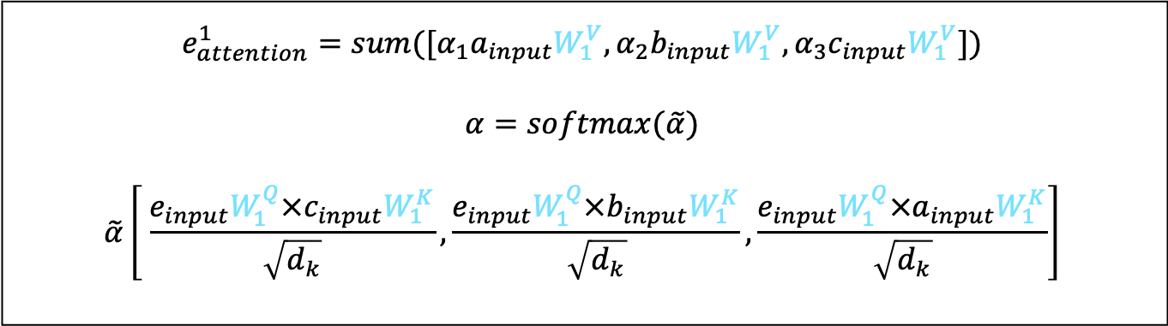
Multi-head Attention
$$e_{attention}^{1}=sum([α_{1}a_{input}W_{1}^{V},α_{2}b_{input}W_{1}^{V},α_{3}c_{input}W_{1}^{V}])$$
$$α=softmax(\tilde{α})$$
$$\tilde{α}\left[ \frac{e_{input}W_{1}^{Q}×c_{input}W_{1}^{K}}{\sqrt{d_{k}}},\frac{e_{input}W_{1}^{Q}×b_{input}W_{1}^{K}}{\sqrt{d_{k}}},\frac{e_{input}W_{1}^{Q}×a_{input}W_{1}^{K}}{\sqrt{d_{k}}}\right]$$
a¹_{attention}
b¹_{attention}
c¹_{attention}
e¹_{attention}
a_{input}
b_{input}
c_{input}
e_{input}
+
+
+
+
x₂₃
P₁
x₂₇
P₂
x₅
P₃
x₇₈
P₄
Distributed
1
Systems
2
is
3
fun
4

Slide 40
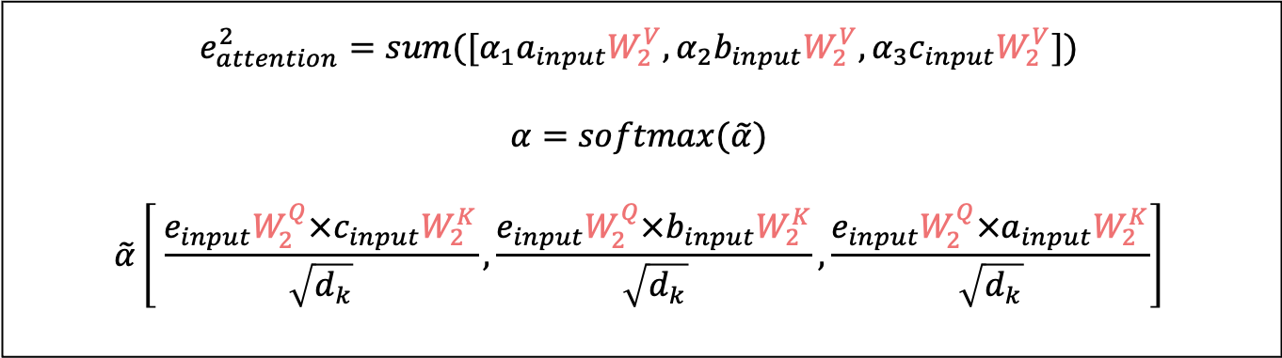
Multi-head Attention
$$e_{attention}^{2}=sum([α_{1}a_{input}W_{2}^{V},α_{2}b_{input}W_{2}^{V},α_{3}c_{input}W_{2}^{V}])$$
$$α=softmax(\tilde{α})$$
$$\tilde{α}\left[ \frac{e_{input}W_{2}^{Q}×c_{input}W_{2}^{K}}{\sqrt{d_{k}}},\frac{e_{input}W_{2}^{Q}×b_{input}W_{2}^{K}}{\sqrt{d_{k}}},\frac{e_{input}W_{2}^{Q}×a_{input}W_{2}^{K}}{\sqrt{d_{k}}}\right]$$
a²_{attention}
b²_{attention}
c²_{attention}
e²_{attention}
a_{input}
b_{input}
c_{input}
e_{input}
+
+
+
+
x₂₃
P₁
x₂₇
P₂
x₅
P₃
x₇₈
P₄
Distributed
1
Systems
2
is
3
fun
4

Slide 41
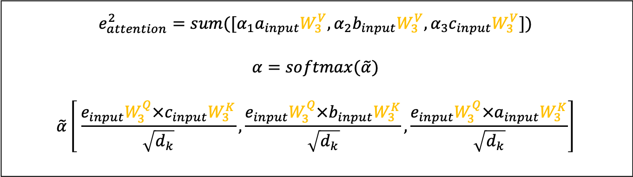
Multi-head Attention
$$e_{attention}^{2}=sum([α_{1}a_{input}W_{3}^{V},α_{2}b_{input}W_{3}^{V},α_{3}c_{input}W_{3}^{V}])$$
$$α=softmax(\tilde{α})$$
$$\tilde{α}\left[ \frac{e_{input}W_{3}^{Q}×c_{input}W_{3}^{K}}{\sqrt{d_{k}}},\frac{e_{input}W_{3}^{Q}×b_{input}W_{3}^{K}}{\sqrt{d_{k}}},\frac{e_{input}W_{3}^{Q}×a_{input}W_{3}^{K}}{\sqrt{d_{k}}}\right]$$
a³_{attention}
b³_{attention}
c³_{attention}
e³_{attention}
a_{input}
b_{input}
c_{input}
e_{input}
+
+
+
+
x₂₃
P₁
x₂₇
P₂
x₅
P₃
x₇₈
P₄
Distributed
1
Systems
2
is
3
fun
4

Slide 42
Multi-head Attention
Each head can
go in parallel
a¹_{attention}
a²_{attention}
a³_{attention}
a_{attention}
b_{attention}
c_{attention}
e_{attention}
a_{input}
b_{input}
c_{input}
e_{input}
+
+
+
+
x₂₃
P₁
x₂₇
P₂
x₅
P₃
x₇₈
P₄
Distributed
1
Systems
2
is
3
fun
4

Slide 43
Multi-head Attention
Each head can
go in parallel
b¹_{attention}
b²_{attention}
b³_{attention}
a_{attention}
b_{attention}
c_{attention}
e_{attention}
a_{input}
b_{input}
c_{input}
e_{input}
+
+
+
+
x₂₃
P₁
x₂₇
P₂
x₅
P₃
x₇₈
P₄
Distributed
1
Systems
2
is
3
fun
4

Slide 44
Multi-head Attention
Each head can
go in parallel
c¹_{attention}
c²_{attention}
c³_{attention}
a_{attention}
b_{attention}
c_{attention}
e_{attention}
a_{input}
b_{input}
c_{input}
e_{input}
+
+
+
+
x₂₃
P₁
x₂₇
P₂
x₅
P₃
x₇₈
P₄
Distributed
1
Systems
2
is
3
fun
4

Slide 45
Multi-head Attention
Each head can
go in parallel
While still all computations across
all machines proceed concurrently
e¹_{attention}
e²_{attention}
e³_{attention}
a_{attention}
b_{attention}
c_{attention}
e_{attention}
a_{input}
b_{input}
c_{input}
e_{input}
+
+
+
+
x₂₃
P₁
x₂₇
P₂
x₅
P₃
x₇₈
P₄
Distributed
1
Systems
2
is
3
fun
4

Slide 46
Repeated Transformer Blocks
a_{output}
b_{output}
c_{output}
e_{output}
normalize
a_{ff_layer}
b_{ff_layer}
c_{ff_layer}
e_{ff_layer}
+
+
+
+
a_{feed_forward}
b_{feed_forward}
c_{feed_froward}
e_{feed_forward}
Repeated N times with c_{out} serving as c_{input} at each successive block
a_{attn_norm}
b_{attn_norm}
c_{attn_norm}
e_{attn_norm}
normalize
a_{attn_layer}
b_{attn_layer}
c_{attn_layer}
e_{attn_layer}
+
+
+
+
a_{attention}
b_{attention}
c_{attention}
e_{attention}
a_{input}
b_{input}
c_{input}
e_{input}
Includes multi-head attention
+
+
+
+
x₂₃
P₁
x₂₇
P₂
x₅
P₃
x₇₈
P₄
Distributed
1
Systems
2
is
3
fun
4

Slide 47
Repeated Transformer Blocks
  Transformer blocks will proceed sequentially, but
    Whenever a task is done, it can shuffle right away its output vector to other tasks
    Each time a done task receives an output vector from another task, it immediately computes the dot product between its output vector and the received vector
      E.g., When T₀ is done and it receives the output vector of T₄, it computes the dot product between its output vector and T₄’s vector immediately
This is a manifestation of a more general parallel model known as the Valiant’s Bulk Synchronous Parallel (BSP) model
Block 0
Block 1
T₀
Can start immediately
T₁
T₂
…
T₃
T₄
Can start immediately

Slide 48
The BSP Model
Iterations or Super-steps
Data
Data
Data
Data
CPU 1
CPU 1
CPU 1
Data
Data
Data
Data
The BSP model is stricter than the way we parallelized the Transformer blocks since it requires every task to wait for every other task before a new super-step is started!
Data
Data
Data
Data
CPU 2
CPU 2
CPU 2
Data
Data
Data
Data
Data
Data
Data
Data
CPU 3
CPU 3
CPU 3
Data
Data
Data
Data
Data
Data
Data
Data
Barrier
Barrier
Barrier
Super-step 1
Super-step 2
Super-step 3

Slide 49
Next Lecture …
Modern Programming Models
& Applications
MapReduce
The Transformer Model
Ray
Representations
The Attention Process
The Core Architecture
GPT
BERT

Slide 50
Reference
  The illustrations and equations for the Transformer’s core architecture were inspired and mostly taken from the “Natural Language Understanding” course by Christopher Potts at Stanford

