Slide 1
Distributed Systems
CS 15-440
MPI - Part II
Lecture 16, October 29, 2023
Mohammad Hammoud

Slide 2
Today
Last Session:
  MPI – Part I
Today’s Session:
  MPI – Part II
Announcement:
  P3 is out. It is due on Nov 16

Slide 3
Course Map
Applications
Programming Models
Fast & Reliable
or Efficient DS
Replication & Consistency
Fault-tolerance
Communication Paradigms
Architectures
Naming
Synchronization
Correct or
Effective DS
Networks

Slide 4
Course Map
Applications
Programming Models
Replication & Consistency
Fault-tolerance
Communication Paradigms
Architectures
Naming
Synchronization
Networks

Slide 5




Information Retrieval
Information Retrieval (IR) is concerned with searching over and ranking (large) data collections

Slide 6
Information Retrieval
More precisely, IR is concerned with:
  Finding material (usually documents)
  of an unstructured nature (usually text)
  that satisfies an information need from within large collections (usually stored on computers)
Example: Which web pages include “thirst and fatigue but not dizziness”?
  One way of doing this is to exhaustively search the Web, looking up each page and figuring out which pages contain thirst and fatigue but not dizziness
  Each page can be referred more generically to as a document

Slide 7


Exhaustively Searching the Text of Each Page
…
thirst and fatigue but not dizziness
Query
…
…
Large Page (or Document) Collection

Slide 8



Exhaustively Searching the Text of Each Page
Lookup (e.g., grep in Unix)
…
thirst and fatigue but not dizziness
Query
…
Very Slow!
…
Large Page (or Document) Collection

Slide 9
Binary Term-Document Incidence Matrix
Alternatively, we can use a binary term-document incidence matrix
Documents
 | Doc 1 | Doc 2 | Doc 3 | Doc 4 | Doc 5 | Doc 6
Thirst | 1 | 0 | 0 | 1 | 0 | 0
Fatigue | 1 | 0 | 0 | 1 | 0 | 0
Dizziness | 1 | 0 | 0 | 0 | 1 | 0
Fever | 0 | 1 | 0 | 0 | 0 | 0
Cough | 0 | 0 | 0 | 0 | 0 | 1
Headache | 0 | 1 | 1 | 0 | 0 | 0
Terms
1 if the document (e.g., Doc 2) contains the term (e.g., Headache)
0 if the document (e.g., Doc 4) does not contain
the term (e.g., Headache)

Slide 10
Binary Term-Document Incidence Matrix
Alternatively, we can use a binary term-document incidence matrix
 | Doc 1 | Doc 2 | Doc 3 | Doc 4 | Doc 5 | Doc 6
Thirst | 1 | 0 | 0 | 1 | 0 | 0
Fatigue | 1 | 0 | 0 | 1 | 0 | 0
Dizziness | 1 | 0 | 0 | 0 | 1 | 0
Fever | 0 | 1 | 0 | 0 | 0 | 0
Cough | 0 | 0 | 0 | 0 | 0 | 1
Headache | 0 | 1 | 1 | 0 | 0 | 0
Query: Which documents include thirst and fatigue but not dizziness?
Answer: Apply bitwise AND on the vectors of thirst, fatigue, and dizziness (complemented)

Slide 11
Binary Term-Document Incidence Matrix
Alternatively, we can use a binary term-document incidence matrix
 | Doc 1 | Doc 2 | Doc 3 | Doc 4 | Doc 5 | Doc 6
Thirst | 1 | 0 | 0 | 1 | 0 | 0
Fatigue | 1 | 0 | 0 | 1 | 0 | 0
Dizziness | 1 | 0 | 0 | 0 | 1 | 0
Fever | 0 | 1 | 0 | 0 | 0 | 0
Cough | 0 | 0 | 0 | 0 | 0 | 1
Headache | 0 | 1 | 1 | 0 | 0 | 0
Incidence
Vector
Query: Which documents include thirst and fatigue but not dizziness?
100100

Slide 12
Binary Term-Document Incidence Matrix
Alternatively, we can use a binary term-document incidence matrix
 | Doc 1 | Doc 2 | Doc 3 | Doc 4 | Doc 5 | Doc 6
Thirst | 1 | 0 | 0 | 1 | 0 | 0
Fatigue | 1 | 0 | 0 | 1 | 0 | 0
Dizziness | 1 | 0 | 0 | 0 | 1 | 0
Fever | 0 | 1 | 0 | 0 | 0 | 0
Cough | 0 | 0 | 0 | 0 | 0 | 1
Headache | 0 | 1 | 1 | 0 | 0 | 0
Incidence
Vector
Query: Which documents include thirst and fatigue but not dizziness?
100100 AND 100100

Slide 13
Binary Term-Document Incidence Matrix
Alternatively, we can use a binary term-document incidence matrix
 | Doc 1 | Doc 2 | Doc 3 | Doc 4 | Doc 5 | Doc 6
Thirst | 1 | 0 | 0 | 1 | 0 | 0
Fatigue | 1 | 0 | 0 | 1 | 0 | 0
Dizziness | 1 | 0 | 0 | 0 | 1 | 0
Fever | 0 | 1 | 0 | 0 | 0 | 0
Cough | 0 | 0 | 0 | 0 | 0 | 1
Headache | 0 | 1 | 1 | 0 | 0 | 0
Incidence
Vector
Query: Which documents include thirst and fatigue but not dizziness?
100100 AND 100100 AND 011101

Slide 14
Binary Term-Document Incidence Matrix
Alternatively, we can use a binary term-document incidence matrix
 | Doc 1 | Doc 2 | Doc 3 | Doc 4 | Doc 5 | Doc 6
Thirst | 1 | 0 | 0 | 1 | 0 | 0
Fatigue | 1 | 0 | 0 | 1 | 0 | 0
Dizziness | 1 | 0 | 0 | 0 | 1 | 0
Fever | 0 | 1 | 0 | 0 | 0 | 0
Cough | 0 | 0 | 0 | 0 | 0 | 1
Headache | 0 | 1 | 1 | 0 | 0 | 0
100100
100100
011101
Query: Which documents include thirst and fatigue but not dizziness?
100100 AND 100100 AND 011101 =
000100
000100

Slide 15
Boolean Queries
The type of the “thirst and fatigue but not dizziness” query is Boolean
  Documents either match or do not match
Boolean queries often produce too few or too many results (1000s)
  AND gives too few; OR gives too many
This is not good for the majority of users, who usually do not want to wade through 1000s of results
To address this issue, ranked retrieval models can be utilized

Slide 16
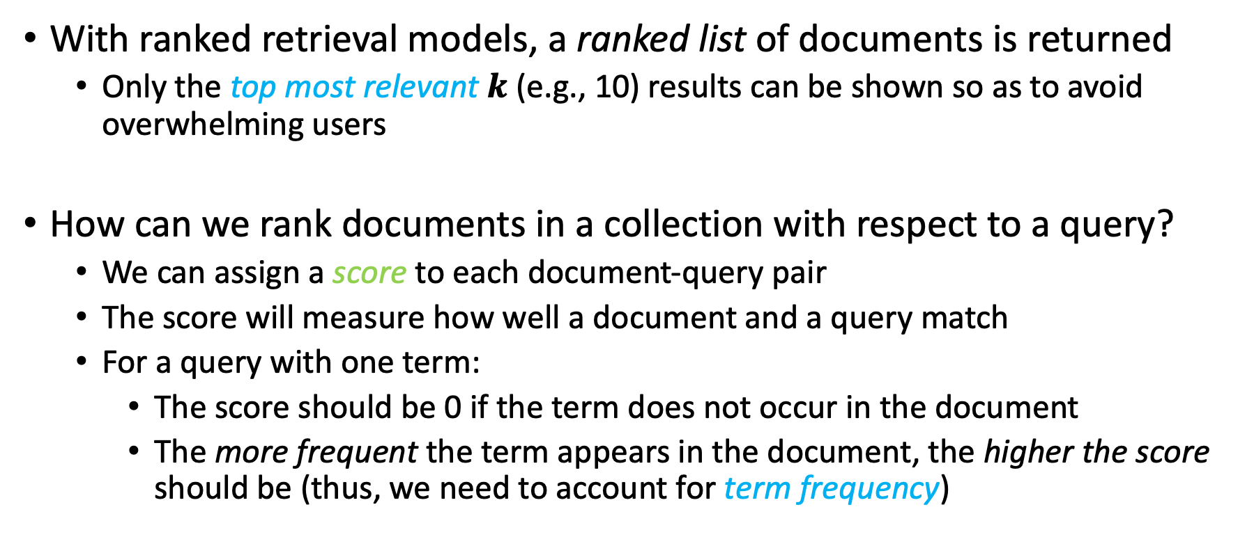
Ranked Retrieval Models
With ranked retrieval models, a ranked list of documents is returned
  Only the top most relevant $k$ (e.g., 10) results can be shown so as to avoid overwhelming users
How can we rank documents in a collection with respect to a query?
  We can assign a score to each document-query pair
  The score will measure how well a document and a query match
  For a query with one term:
    The score should be 0 if the term does not occur in the document
    The more frequent the term appears in the document, the higher the score should be (thus, we need to account for term frequency)

Slide 17
Term-Document Count Matrix
To account for term frequency, we can use a term-document count matrix
 | Doc 1 | Doc 2 | Doc 3 | Doc 4 | Doc 5 | Doc 6
Thirst | 1 | 0 | 0 | 1 | 0 | 0
Fatigue | 1 | 0 | 0 | 1 | 0 | 0
Dizziness | 1 | 0 | 0 | 0 | 1 | 0
Fever | 0 | 1 | 0 | 0 | 0 | 0
Cough | 0 | 0 | 0 | 0 | 0 | 1
Headache | 0 | 1 | 1 | 0 | 0 | 0
Our previous binary term-document incidence matrix

Slide 18
Term-Document Count Matrix
To account for term frequency, we can use a term-document count matrix
 | Doc 1 | Doc 2 | Doc 3 | Doc 4 | Doc 5 | Doc 6
Thirst | 4 | 0 | 0 | 3 | 0 | 0
Fatigue | 1 | 0 | 0 | 1 | 0 | 0
Dizziness | 2 | 0 | 0 | 0 | 4 | 0
Fever | 0 | 5 | 0 | 0 | 0 | 0
Cough | 0 | 0 | 0 | 0 | 0 | 5
Headache | 0 | 2 | 3 | 0 | 0 | 0
A term-document count matrix

Slide 19
Term-Document Count Matrix
To account for term frequency, we can use a term-document count matrix
 | Doc 1 | Doc 2 | Doc 3 | Doc 4 | Doc 5 | Doc 6
Thirst | 4 | 0 | 0 | 3 | 0 | 0
Fatigue | 1 | 0 | 0 | 1 | 0 | 0
Dizziness | 2 | 0 | 0 | 0 | 4 | 0
Fever | 0 | 5 | 0 | 0 | 0 | 0
Cough | 0 | 0 | 0 | 0 | 0 | 5
Headache | 0 | 2 | 3 | 0 | 0 | 0
Headache appeared 3 times in Doc 3

Slide 20
Term Frequency
The term frequency, tf_{t,d}, of term t in document d is defined as the number of times that t occurs in d
But how to use tf_{t,d} when computing query-document match scores?
  A document with 10 occurrences of a term is more relevant than a document with 1 occurrence of the term, but not necessarily 10 times more relevant!
  Relevance does not increase proportionally with term frequency
  To this end, we can use log-frequency weighting

Slide 21
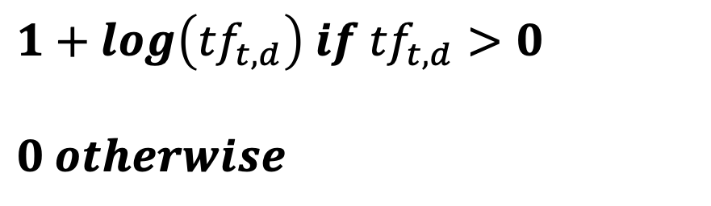
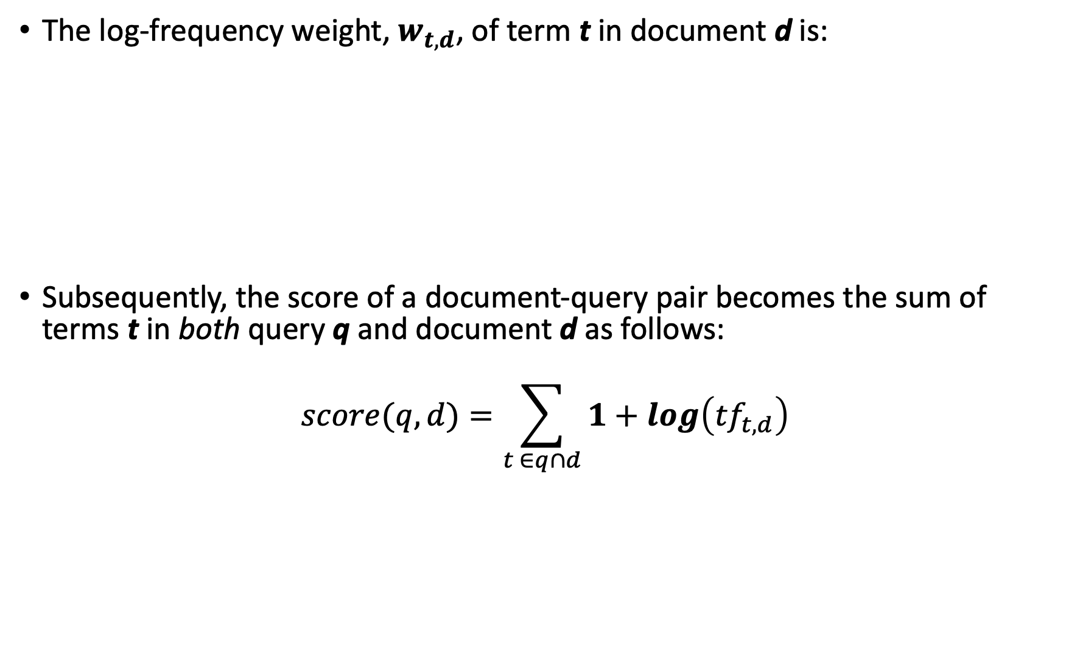

Log-Frequency Weighting
The log-frequency weight, $w_{t,d}$, of term t in document d is:
Subsequently, the score of a document-query pair becomes the sum of terms t in both query q and document d as follows:
$$score(q, d)=\sum_{t ∈q∩d}{1+log\left({tf}_{t,d}\right)}$$
$$1+log\left({tf}_{t,d}\right) if {tf}_{t,d}>0$$
$$0 otherwise$$
$$w_{t,d}=$$

Slide 22


Log-Frequency Weighting: Example
Here is our previous term-document count matrix
 | Doc 1 | Doc 2 | Doc 3 | Doc 4 | Doc 5 | Doc 6
Thirst | 4 | 0 | 0 | 3 | 0 | 0
Fatigue | 1 | 0 | 0 | 1 | 0 | 0
Dizziness | 2 | 0 | 0 | 0 | 4 | 0
Fever | 0 | 5 | 0 | 0 | 0 | 0
Cough | 0 | 0 | 0 | 0 | 0 | 5
Headache | 0 | 2 | 3 | 0 | 0 | 0
$${tf}_{Headache, Doc 3}=3>0$$
$${tf}_{Headache, Doc 5}=0$$

Slide 23

Log-Frequency Weighting: Example
Here is the corresponding term-document log frequency matrix
 | Doc 1 | Doc 2 | Doc 3 | Doc 4 | Doc 5 | Doc 6
Thirst | 1.60205999 | 0 | 0 | 1.47712125 | 0 | 0
Fatigue | 1 | 0 | 0 | 1 | 0 | 0
Dizziness | 1.30103 | 0 | 0 | 0 | 1.60205999 | 0
Fever | 0 | 0 | 0 | 0 | 1 | 0
Cough | 0 | 1.69897 | 0 | 0 | 0 | 1.69897
Headache | 0 | 1.30103 | 1.47712125 | 0 | 0 | 0
$$w_{Headache, Doc 3}={1+log(tf}_{Headache, Doc 3})=1+log\left(3\right)=1.477$$
$$w_{Headache, Doc 5}=0$$

Slide 24
Log-Frequency Weighting: Example
Here is the corresponding term-document log frequency matrix
 | Doc 1 | Doc 2 | Doc 3 | Doc 4 | Doc 5 | Doc 6
Thirst | 1.60205999 | 0 | 0 | 1.47712125 | 0 | 0
Fatigue | 1 | 0 | 0 | 1 | 0 | 0
Dizziness | 1.30103 | 0 | 0 | 0 | 1.60205999 | 0
Fever | 0 | 0 | 0 | 0 | 1 | 0
Cough | 0 | 1.69897 | 0 | 0 | 0 | 1.69897
Headache | 0 | 1.30103 | 1.47712125 | 0 | 0 | 0
Rank
Note 1
Query: Cough and headache

Slide 25
Log-Frequency Weighting: Example
Here is the corresponding term-document log frequency matrix
 | Doc 1 | Doc 2 | Doc 3 | Doc 4 | Doc 5 | Doc 6
Thirst | 1.60205999 | 0 | 0 | 1.47712125 | 0 | 0
Fatigue | 1 | 0 | 0 | 1 | 0 | 0
Dizziness | 1.30103 | 0 | 0 | 0 | 1.60205999 | 0
Fever | 0 | 0 | 0 | 0 | 1 | 0
Cough | 0 | 1.69897 | 0 | 0 | 0 | 1.69897
Headache | 0 | 1.30103 | 1.47712125 | 0 | 0 | 0
Rank
Doc 1
Query: Cough and headache
$$Score\left(\left[Cough, Headache\right],Doc 1\right)=0+0=0$$

Slide 26
Log-Frequency Weighting: Example
Here is the corresponding term-document log frequency matrix
 | Doc 1 | Doc 2 | Doc 3 | Doc 4 | Doc 5 | Doc 6
Thirst | 1.60205999 | 0 | 0 | 1.47712125 | 0 | 0
Fatigue | 1 | 0 | 0 | 1 | 0 | 0
Dizziness | 1.30103 | 0 | 0 | 0 | 1.60205999 | 0
Fever | 0 | 0 | 0 | 0 | 1 | 0
Cough | 0 | 1.69897 | 0 | 0 | 0 | 1.69897
Headache | 0 | 1.30103 | 1.47712125 | 0 | 0 | 0
Rank
Doc 2
Doc 1
Query: Cough and headache
$$Score\left(\left[Cough, Headache\right],Doc 2\right)=1.69+1.3=2.99$$

Slide 27
Log-Frequency Weighting: Example
Here is the corresponding term-document log frequency matrix
 | Doc 1 | Doc 2 | Doc 3 | Doc 4 | Doc 5 | Doc 6
Thirst | 1.60205999 | 0 | 0 | 1.47712125 | 0 | 0
Fatigue | 1 | 0 | 0 | 1 | 0 | 0
Dizziness | 1.30103 | 0 | 0 | 0 | 1.60205999 | 0
Fever | 0 | 0 | 0 | 0 | 1 | 0
Cough | 0 | 1.69897 | 0 | 0 | 0 | 1.69897
Headache | 0 | 1.30103 | 1.47712125 | 0 | 0 | 0
Rank
Doc 2
Doc 3
Doc 1
Query: Cough and headache
$$Score\left(\left[Cough, Headache\right],Doc 3\right)=0+1.47=1.47$$

Slide 28
Log-Frequency Weighting: Example
Here is the corresponding term-document log frequency matrix
 | Doc 1 | Doc 2 | Doc 3 | Doc 4 | Doc 5 | Doc 6
Thirst | 1.60205999 | 0 | 0 | 1.47712125 | 0 | 0
Fatigue | 1 | 0 | 0 | 1 | 0 | 0
Dizziness | 1.30103 | 0 | 0 | 0 | 1.60205999 | 0
Fever | 0 | 0 | 0 | 0 | 1 | 0
Cough | 0 | 1.69897 | 0 | 0 | 0 | 1.69897
Headache | 0 | 1.30103 | 1.47712125 | 0 | 0 | 0
Rank
Doc 2
Doc 3
Doc 1
Doc 4
Query: Cough and headache
$$Score\left(\left[Cough, Headache\right],Doc 4\right)=0+0=0$$

Slide 29
Log-Frequency Weighting: Example
Here is the corresponding term-document log frequency matrix
 | Doc 1 | Doc 2 | Doc 3 | Doc 4 | Doc 5 | Doc 6
Thirst | 1.60205999 | 0 | 0 | 1.47712125 | 0 | 0
Fatigue | 1 | 0 | 0 | 1 | 0 | 0
Dizziness | 1.30103 | 0 | 0 | 0 | 1.60205999 | 0
Fever | 0 | 0 | 0 | 0 | 1 | 0
Cough | 0 | 1.69897 | 0 | 0 | 0 | 1.69897
Headache | 0 | 1.30103 | 1.47712125 | 0 | 0 | 0
Rank
Doc 2
Doc 3
Doc 1
Doc 4
Doc 5
Query: Cough and headache
$$Score\left(\left[Cough, Headache\right],Doc 5\right)=0+0=0$$

Slide 30
Log-Frequency Weighting: Example
Here is the corresponding term-document log frequency matrix
 | Doc 1 | Doc 2 | Doc 3 | Doc 4 | Doc 5 | Doc 6
Thirst | 1.60205999 | 0 | 0 | 1.47712125 | 0 | 0
Fatigue | 1 | 0 | 0 | 1 | 0 | 0
Dizziness | 1.30103 | 0 | 0 | 0 | 1.60205999 | 0
Fever | 0 | 0 | 0 | 0 | 1 | 0
Cough | 0 | 1.69897 | 0 | 0 | 0 | 1.69897
Headache | 0 | 1.30103 | 1.47712125 | 0 | 0 | 0
Rank
Doc 2
Doc 6
Doc 3
Doc 1
Doc 4
Doc 5
Query: Cough and headache
$$Score\left(\left[Cough, Headache\right],Doc 6\right)=1.69+0=1.69$$

Slide 31
Rare vs. Common Terms
But, rare terms are more informative than frequent terms
  E.g., Stop words like “a”, “the”, “to”, “of”, etc., are frequent but not very informative
  E.g., A document containing the word “arrhythmias” is very likely to be relevant to the query “arrhythmias”
  We want higher weights for rare terms than for more frequent terms
  This can be achieved using document frequency

Slide 32
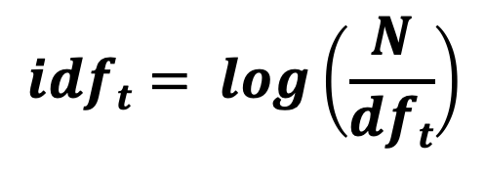
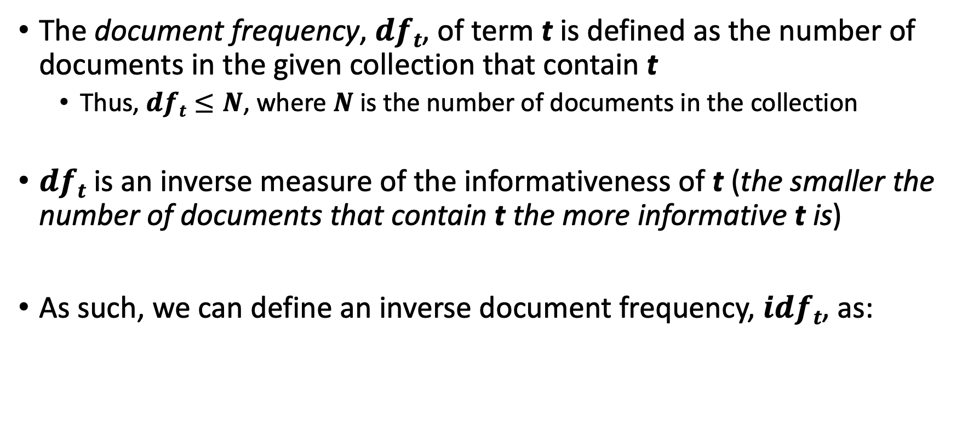
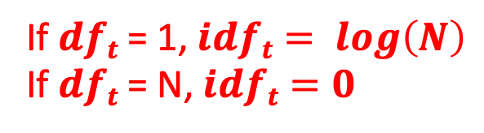
Document Frequency
The document frequency, $dft$, of term t is defined as the number of documents in the given collection that contain t
  Thus, $dft≤N$, where $N$ is the number of documents in the collection
$dft$ is an inverse measure of the informativeness of t (the smaller the number of documents that contain t the more informative t is)
As such, we can define an inverse document frequency, $idft$, as:
$$idft= log\left(\frac{N}{dft}\right)$$
If $dft$ = 1, $idft= log\left(N\right)$
If $dft$ = N, $idft=0$

Slide 33
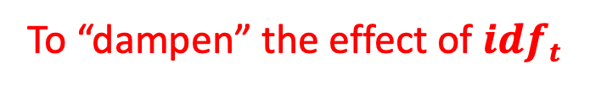
Document Frequency
The document frequency, $dft$, of term t is defined as the number of documents in the given collection that contain t
  Thus, $dft≤N$, where $N$ is the number of documents in the collection
$dft$ is an inverse measure of the informativeness of t (the smaller the number of documents that contain t the more informative t is)
As such, we can define an inverse document frequency, $idft$, as:
$$idft= log\left(\frac{N}{dft}\right)$$
To “dampen” the effect of $idft$

Slide 34

Document Frequency
The document frequency, $dft$, of term t is defined as the number of documents in the given collection that contain t
  Thus, $dft≤N$, where $N$ is the number of documents in the collection
$dft$ is an inverse measure of the informativeness of t (the smaller the number of documents that contain t the more informative t is)
As such, we can define an inverse document frequency, $idft$, as:
$$idft= log\left(\frac{N}{dft}\right)$$
Note: There is only one value of
$idft$ for each t in the collection

Slide 35
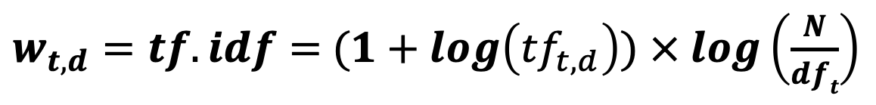
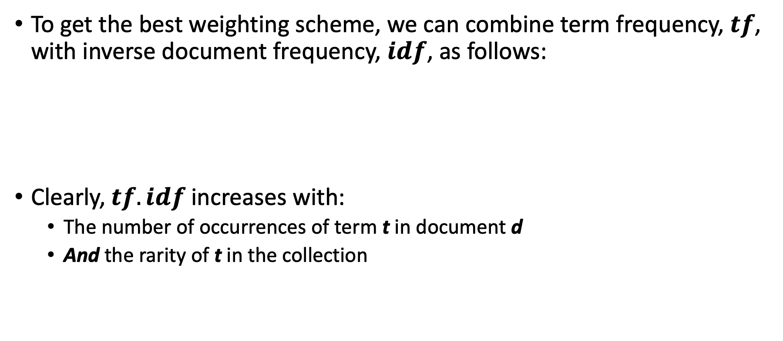
TF.IDF (or TF-IDF) Weighting
To get the best weighting scheme, we can combine term frequency, $tf$, with inverse document frequency, $idf$, as follows:
Clearly, $tf.idf$increases with:
  The number of occurrences of term t in document d
  And the rarity of t in the collection
$w_{t,d}=tf.idf=$ $(1+log\left({tf}_{t,d}\right))$ $× log\left(\frac{N}{dft}\right)$

Slide 36
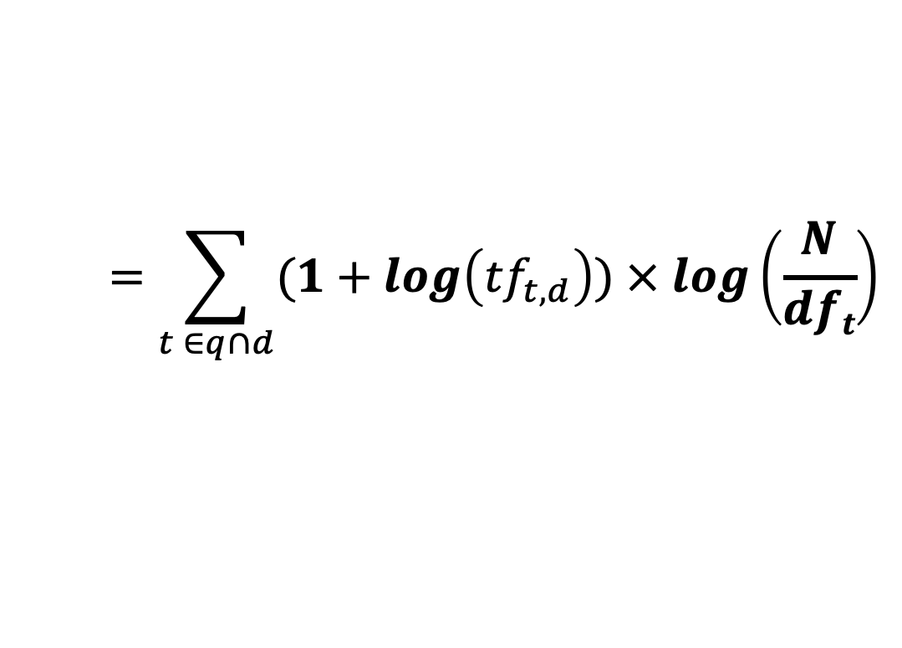
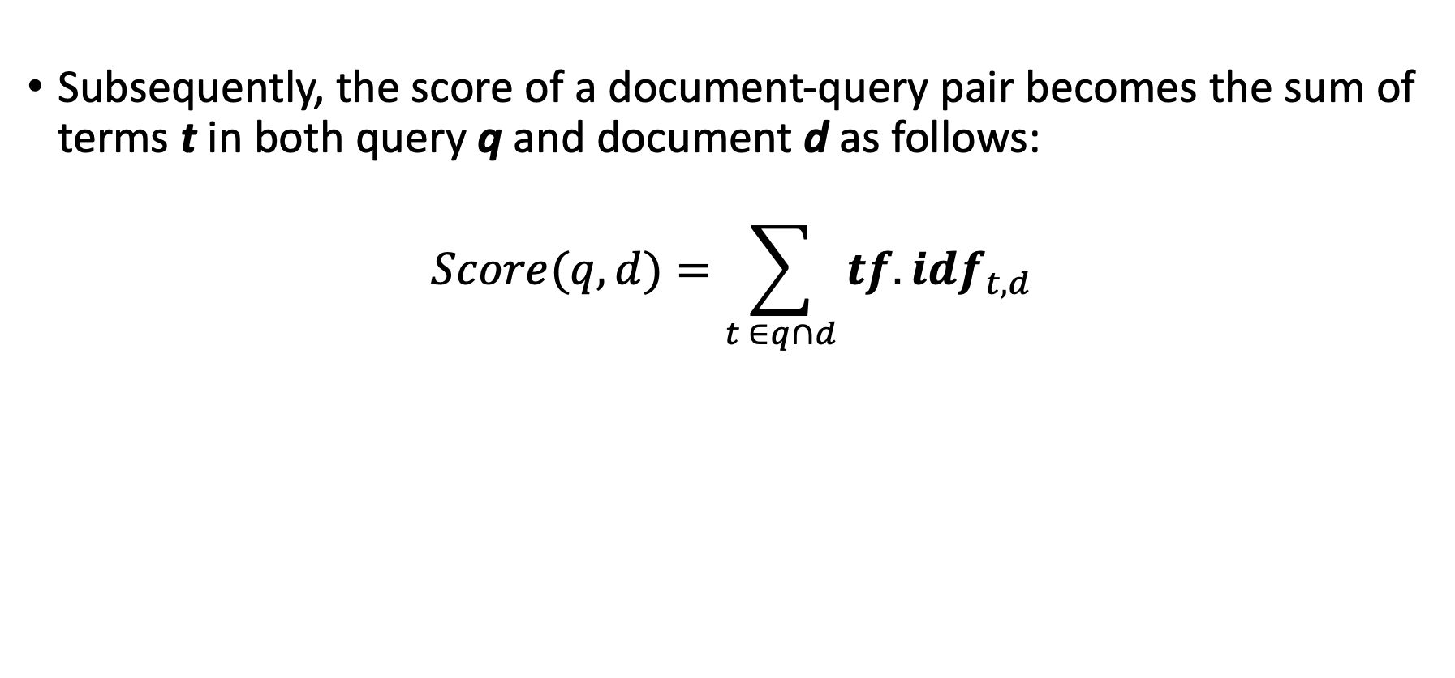
TF.IDF (or TF-IDF) Weighting
Subsequently, the score of a document-query pair becomes the sum of terms t in both query q and document d as follows:
$$Score(q,d)=\sum_{t ∈q∩d}{{tf.idf}_{t,d}}$$
$$=\sum_{t ∈q∩d}{(1+log\left({tf}_{t,d}\right)) × log\left(\frac{N}{dft}\right)}$$

Slide 37
TF.IDF: Example
Here is the term-document count matrix of our earlier example
 | Doc 1 | Doc 2 | Doc 3 | Doc 4 | Doc 5 | Doc 6
Thirst | 4 | 0 | 0 | 3 | 0 | 0
Fatigue | 1 | 0 | 0 | 1 | 0 | 0
Dizziness | 2 | 0 | 0 | 0 | 4 | 0
Fever | 0 | 5 | 0 | 0 | 0 | 0
Cough | 0 | 0 | 0 | 0 | 0 | 5
Headache | 0 | 2 | 3 | 0 | 0 | 0
$${tf}_{Headache, Doc 3}=3>0$$
$${tf}_{Headache, Doc 5}=0$$

Slide 38
TF.IDF: Example
And, here is the corresponding term-document log frequency matrix
 | Doc 1 | Doc 2 | Doc 3 | Doc 4 | Doc 5 | Doc 6
Thirst | 1.60205999 | 0 | 0 | 1.47712125 | 0 | 0
Fatigue | 1 | 0 | 0 | 1 | 0 | 0
Dizziness | 1.30103 | 0 | 0 | 0 | 1.60205999 | 0
Fever | 0 | 0 | 0 | 0 | 1 | 0
Cough | 0 | 1.69897 | 0 | 0 | 0 | 1.69897
Headache | 0 | 1.30103 | 1.47712125 | 0 | 0 | 0
$$w_{Headache, Doc 3}={1+log(tf}_{Headache, Doc 3})=1+log\left(3\right)=1.477$$
$$w_{Headache, Doc 5}=0$$

Slide 39
TF.IDF: Example
And, here is the respective term-document TF.IDF matrix
 | Doc 1 | Doc 2 | Doc 3 | Doc 4 | Doc 5 | Doc 6
Thirst | 0.76437687 | 0 | 0 | 0.70476595 | 0 | 0
Fatigue | 0.47712125 | 0 | 0 | 0.47712125 | 0 | 0
Dizziness | 0.62074906 | 0 | 0 | 0 | 0.76437687 | 0
Fever | 0 | 0 | 0 | 0 | 0.77815125 | 0
Cough | 0 | 0.8106147 | 0 | 0 | 0 | 0.8106147
Headache | 0 | 0.62074906 | 0.70476595 | 0 | 0 | 0
$$w_{Headache, Doc 3}={[1+log(tf}_{Headache, Doc 3})]× log\left(\frac{N}{{df}_{Headache}}\right)=1.477× log\left(\frac{6}{2}\right)=0.7$$

Slide 40
TF.IDF: Example
And, here is the respective term-document TF.IDF matrix
 | Doc 1 | Doc 2 | Doc 3 | Doc 4 | Doc 5 | Doc 6
Thirst | 0.76437687 | 0 | 0 | 0.70476595 | 0 | 0
Fatigue | 0.47712125 | 0 | 0 | 0.47712125 | 0 | 0
Dizziness | 0.62074906 | 0 | 0 | 0 | 0.76437687 | 0
Fever | 0 | 0 | 0 | 0 | 0.77815125 | 0
Cough | 0 | 0.8106147 | 0 | 0 | 0 | 0.8106147
Headache | 0 | 0.62074906 | 0.70476595 | 0 | 0 | 0
Query: Cough and headache
$$Score\left(\left[Cough, Headache\right],Doc 3\right)=0+0. 7=0. 7$$

Slide 41
Motivation for PageRank
But, as people started to use search engines to find their ways around the Web, hackers saw an opportunity to fool search engines
For instance, if you are selling “shirts” online, all you care about is that people see your page, regardless of what they are looking for
  If they look for “movies”, you want them to see your “shirts” page
  Consequently, you can add the term “movie” to your page 1000 times so that a search engine will assume that you are an important page about movies
  And to hide it from users, you can give the term the same color as the background of your page!

Slide 42
Motivation for PageRank
To this end, Google introduced two innovations:
  The content of your page will not be judged by only the terms on your page, but also by the terms in the pages that link to your page
    It is easy to add false terms to your page, but it might not be easy to add false terms to your neighboring pages
  An algorithm known as PageRank to capture this intuition

Slide 43
PageRank
PageRank is a function that assigns a real number to each Web page
Intuition: The higher the PageRank of a page, the more “important” it is
Simulating random surfers (or walkers) on the Web allows approximating the intuitive notion of the “importance” of pages
  Walkers start at random pages and tend to congregate at important ones
    Pages with larger numbers of walkers are more “important” than pages with smaller numbers of walkers

Slide 44
PageRank
The Web can be represented as a directed graph, with pages as nodes and links between pages as edges
A random walker starting at A, will next be at A, B, C, and D with probabilities of 0, 1/3, 1/3, and 1/3, respectively
A random walker starting at B, will next be at A, B, C and D with probabilities of ½, 0, 0, and ½, respectively
A
B
A hypothetical example of the Web
C
D

Slide 45
PageRank
The Web can be represented as a directed graph, with pages as nodes and links between pages as edges
A random walker starting at A, will next be at A, B, C, and D with probabilities of 0, 1/3, 1/3, and 1/3, respectively
A random walker starting at B, will next be at A, B, C and D with probabilities of ½, 0, 0, and ½, respectively
A B C D
A
B
0 ½ 1 0
1/3 0 0 ½
1/3 0 0 ½
1/3 ½ 0 0
A
B
M =
C
C
D
D
A transition matrix of the Web, which describes what happens to random walkers after one step

Slide 46
PageRank
The probability distribution for the location of a random walker can be described by a column vector (say, v) whose j^{th} element is the probability that the walker is at page j
  This probability is the (idealized) PageRank function
We can start a random walker at any of the 4 pages of our tiny Web graph, with equal probabilities
1/4
1/4
1/4
1/4
A
v =
B
C
D

Slide 47
PageRank
If M is the transition matrix of the Web, after one step, the distribution of the walker will be Mv
After two steps it will be M(Mv) = M²v, and so on
  In general, multiplying the initial vector v by M a total of i times will give the distribution of the surfer after i steps
0 ½ 1 0
1/3 0 0 ½
1/3 0 0 ½
1/3 ½ 0 0
1/4
1/4
1/4
1/4
9/24
5/24
5/24
5/24
=

Slide 48



PageRank Using MPI
How can PageRank be implemented with MPI?
  Step 1: Partition M at the master
r0 and v
x₀ = $\sum_{j=0}^{3}{m0j}$
Machine
0
r0
0 ½ 1 0
1/3 0 0 ½
1/3 0 0 ½
1/3 ½ 0 0
r1 and v
x₁ = $\sum_{j=0}^{3}{m1j}$
r1
Machine
1
r2
r2 and v
x₂ = $\sum_{j=0}^{3}{m2j}$
r3
Machine
2
r3 and v
x₃ = $\sum_{j=0}^{3}{m3j}$
Machine
3

Slide 49
PageRank Using MPI
How can PageRank be implemented with MPI?
  Step 2: Distribute M’s partitions to the machines (e.g., using MPI-Scatter())
r0 and v
x₀ = $\sum_{j=0}^{3}{m0j}$
Machine
0
r0
0 ½ 1 0
1/3 0 0 ½
1/3 0 0 ½
1/3 ½ 0 0
r1 and v
x₁ = $\sum_{j=0}^{3}{m1j}$
r1
Machine
1
r2
r2 and v
x₂ = $\sum_{j=0}^{3}{m2j}$
r3
Machine
2
r3 and v
x₃ = $\sum_{j=0}^{3}{m3j}$
Machine
3

Slide 50
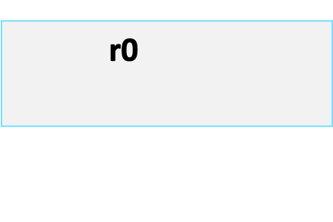
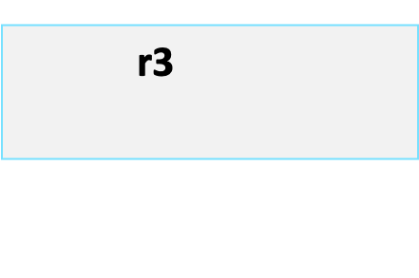
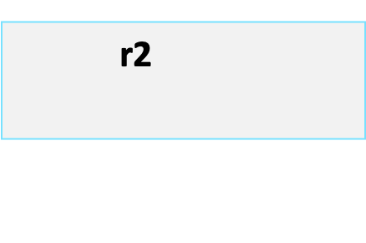
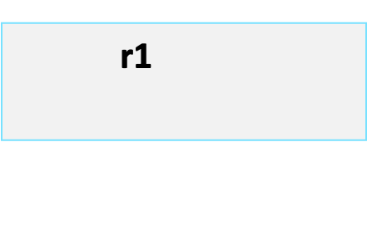
PageRank Using MPI
How can PageRank be implemented with MPI?
  Step 2: Distribute M’s partitions to the machines (e.g., using MPI-Scatter())
r0 and v
x₀ = $\sum_{j=0}^{3}{m0j}$
Machine
0
r0
0 ½ 1 0
1/3 0 0 ½
1/3 0 0 ½
1/3 ½ 0 0
r1 and v
x₁ = $\sum_{j=0}^{3}{m1j}$
r1
Machine
1
r2
r2 and v
x₂ = $\sum_{j=0}^{3}{m2j}$
r3
Machine
2
r3 and v
x₃ = $\sum_{j=0}^{3}{m3j}$
Machine
3

Slide 51


PageRank Using MPI
How can PageRank be implemented with MPI?
  Step 3: Copy v to each machine (e.g., using MPI-Bcast())– Iteration 1 starts here
r0 and v
x₀ = $\sum_{j=0}^{3}{m0j}$
Machine
0
1/4
1/4
1/4
1/4
r1 and v
x₁ = $\sum_{j=0}^{3}{m1j}$
Machine
1
r2 and v
x₂ = $\sum_{j=0}^{3}{m2j}$
Machine
2
r3 and v
x₃ = $\sum_{j=0}^{3}{m3j}$
Machine
3

Slide 52
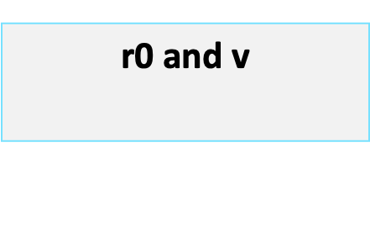
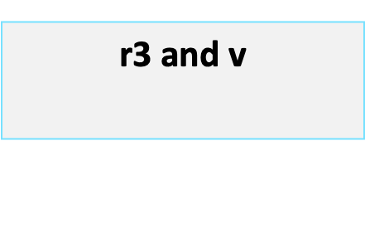
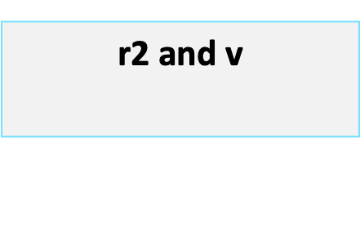
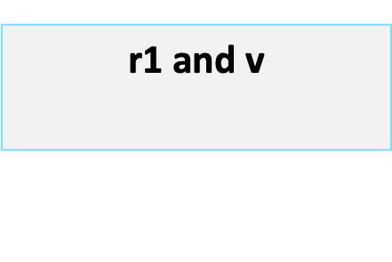
PageRank Using MPI
How can PageRank be implemented with MPI?
  Step 3: Copy v to each machine (e.g., using MPI-Bcast())– Iteration 1 starts here
r0 and v
x₀ = $\sum_{j=0}^{3}{m0j}$
Machine
0
1/4
1/4
1/4
1/4
r1 and v
x₁ = $\sum_{j=0}^{3}{m1j}$
Machine
1
r2 and v
x₂ = $\sum_{j=0}^{3}{m2j}$
Machine
2
r3 and v
x₃ = $\sum_{j=0}^{3}{m3j}$
Machine
3

Slide 53
PageRank Using MPI
How can PageRank be implemented with MPI?
  Step 4: Apply the Mv multiplication logic at each machine
r0 and v
x₀ = $\sum_{j=0}^{3}{m0j}$
Machine
0
r1 and v
x₁ = $\sum_{j=0}^{3}{m1j}$
Machine
1
r2 and v
x₂ = $\sum_{j=0}^{3}{m2j}$
Machine
2
r3 and v
x₃ = $\sum_{j=0}^{3}{m3j}$
Machine
3

Slide 54
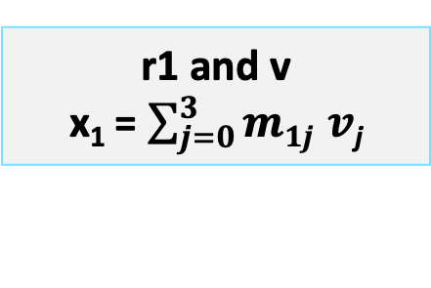
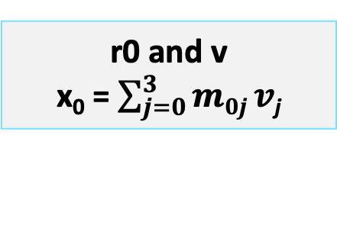
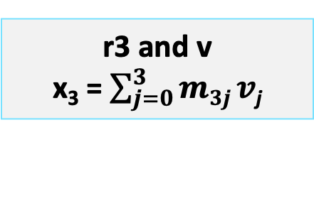
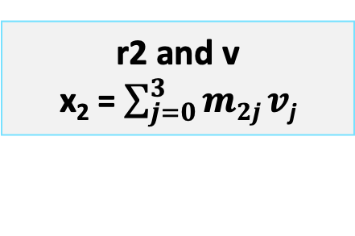
PageRank Using MPI
How can PageRank be implemented with MPI?
  Step 4: Apply the Mv multiplication logic at each machine
r0 and v
x₀ = $\sum_{j=0}^{3}{m0j}v$_{j}
Machine
0
r1 and v
x₁ = $\sum_{j=0}^{3}{m1j }v\text{j}$
Machine
1
r2 and v
x₂ = $\sum_{j=0}^{3}{m2j}v\text{j}$
Machine
2
r3 and v
x₃ = $\sum_{j=0}^{3}{m3j}v\text{j}$
Machine
3

Slide 55
PageRank Using MPI
How can PageRank be implemented with MPI?
  Step 5: Each machine sends back its element to the master
r0 and v
x₀ = $\sum_{j=0}^{3}{m0j}v$_{j}
Machine
0
x₀
x₁
x₂
x₃
9/24
5/24
5/24
5/24
r1 and v
x₁ = $\sum_{j=0}^{3}{m1j }v\text{j}$
Machine
1
r2 and v
x₂ = $\sum_{j=0}^{3}{m2j}v\text{j}$
Machine
2
This concludes iteration 1.
To perform a new iteration, repeat steps 3, 4, and 5
r3 and v
x₃ = $\sum_{j=0}^{3}{m3j}v\text{j}$
Machine
3

Slide 56
Next Lecture…
MapReduce and the Transformer Model

Slide 57
References
Schütze, Hinrich, Christopher D. Manning, and Prabhakar Raghavan. Introduction to information retrieval. Vol. 39. Cambridge: Cambridge University Press, 2008.
Rajaraman, Anand and Ullman, Jeffrey David. Mining of massive datasets. Cambridge University Press, 2011.

