Slide 1
Distributed Systems
CS 15-440
Synchronization - Part I
Lecture 11, October 01, 2023
Mohammad Hammoud

Slide 2
Today…
Last Session:
  Naming- Part II
    Structured and attribute-based namings
Today’s Session:
  Synchronization - Part I
    Physical clock synchronization
Announcements:
  Project 1 is due today by midnight
  Midterm is on October 15th (open books, open notes)
  PS3 is out and due on October 19

Slide 3
Course Map
Applications
Programming Models
Fast & Reliable
or Efficient DS
Replication & Consistency
Fault-tolerance
Communication Paradigms
Architectures
Naming
Synchronization
Correct or
Effective DS
Networks

Slide 4
Course Map
Applications
Programming Models
Replication & Consistency
Fault-tolerance
Communication Paradigms
Architectures
Naming
Synchronization
Networks

Slide 5
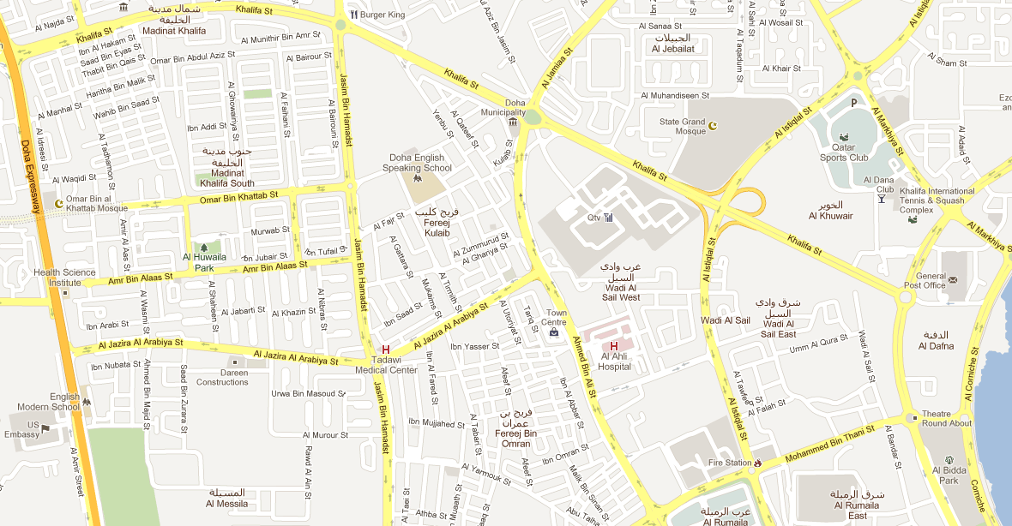

Need for Synchronization – Example 1
Vehicle tracking in a city surveillance system using a distributed network of cameras
  Objective: To keep track of suspicious vehicles
  Cameras are deployed over the city
  Upon detecting a vehicle, a camera reports the time to a central server
  The server tracks the movement of any suspicious vehicle
1:12 PM:
Car spotted
1:08 PM:
Car spotted
1:05 PM:
Car spotted
1:16 PM:
Car spotted
If the cameras do not have a consistent view of the time, the vehicle cannot be reliably tracked
1:15 PM:
Car spotted
1:25 PM:
Car spotted
3:00 PM:
Car spotted
1:00 PM:
Car spotted
1:17 PM:
Car spotted
1:18 PM:
Car spotted

Slide 6
Need for Synchronization – Example 2
Writing a file in a distributed file system
Client A
Write data1 to file abc.txt at offset 0
Server
Client C
Distributed
File
abc.txt
Write data3 to file abc.txt at offset 1
Client B
Write data2 to file abc.txt at offset 1
  If concurrent writes to shared data are not synchronized, the data can be corrupted

Slide 7
A Broad Taxonomy of Synchronization
Reason for synchronization and cooperation
Examples
Requirement for entities
Topics we will study
Entities have to agree on ordering of events
Entities have to share common resources
E.g., Vehicle tracking in a Camera Sensor Network; Financial transactions in Distributed E-commerce Systems
E.g., Reading and writing in a Distributed File System
Entities should have a common understanding of time across different computers
Entities should coordinate and agree on when and how to access resources
Time Synchronization
Mutual Exclusion

Slide 8
Overview
Time Synchronization
  Physical Clock Synchronization
    Here, actual times on computers are synchronized
  Logical Clock Synchronization
    Computers are synchronized based on relative ordering of events
Mutual Exclusion
  How to coordinate between processes that access the same resource?
Election Algorithms
  Here, a group of entities elect one entity as the coordinator for solving a problem

Slide 9
Overview
Today’s lecture
Time Synchronization
  Physical Clock Synchronization
    Here, actual times on computers are synchronized
  Logical Clock Synchronization
    Computers are synchronized based on relative ordering of events
Mutual Exclusion
  How to coordinate between processes that access the same resource?
Election Algorithms
  Here, a group of entities elect one entity as the coordinator for solving a problem
Next two lectures

Slide 10
Overview
Synchronization
Clock Synchronization
Distributed Mutual Exclusion
Physical Clock Synchronization
Logical Clock Synchronization
Election Algorithms

Slide 11
Physical Clock Synchronization
Physical clock synchronization is a mechanism to synchronize the physical times of all the computers in a DS
We will study:
  Coordinated Universal Time (UTC)
  Tracking Time on a Computer
  Three Algorithms
    Cristian’s Algorithm
    Berkeley Algorithm
    Network Time Protocol

Slide 12
Physical Clock Synchronization
Coordinated Universal Time
Tracking Time on a Computer
Three Algorithms
  Cristian’s Algorithm
  Berkeley Algorithm
  Network Time Protocol

Slide 13
Coordinated Universal Time (UTC)
All the computers are generally synchronized to a standard time called Coordinated Universal Time (UTC)
  UTC is the primary time standard by which the world regulates clocks
UTC is broadcasted via the satellites
Computer servers and online services with UTC receivers can be synchronized by satellite broadcasts
  Many popular synchronization protocols in distributed systems use UTC as a reference time to synchronize clocks of computers
Notes:
UTC is based on International Atomic Time (TAI) with leap seconds added at irregular intervals to compensate for the accumulated difference between TAI and time measured by Earth's rotation

Slide 14
Physical Clock Synchronization
Coordinated Universal Time
Tracking Time on a Computer
Three Algorithms
  Cristian’s Algorithm
  Berkeley Algorithm
  Network Time Protocol

Slide 15
Tracking Time on a Computer
How does a computer keep track of its time?
  Each computer has a hardware timer
    The timer is a quartz crystal
    When kept under tension, the crystal oscillates at a well-defined frequency
    A counter and a holding register are associated with the crystal
    After each oscillation, the crystal decrements the counter by 1
    When the counter gets to 0, an interrupt is generated, and the counter is reloaded from the holding register
    In this way, it is possible to program a timer to generate an interrupt ‘H’ times (i.e., says, 60) a second
    Each interrupt is called a clock tick
    At every clock tick, the interrupt handler adds 1 to its software clock, C

Slide 16
Tracking Time on a Computer
With a single computer and a single clock, it does not matter much if the software clock, C, is off by a small amount
  All processes on the computer will use the same C, hence, they will be internally consistent
  E.g., If input.c has time 2151 and input.o has time 2150, the Unix make program will recompile input.c even if C is off by 2
  All that really matters, are the relative times
With multiple computers, it is impossible to guarantee that their crystals all run at exactly the same frequency
  The n crystals of a DS with n computers will run at slightly different rates causing the n software clocks, Cs, to gradually get out of sync
  The difference in time values across Cs is called clock skew

Slide 17

Clock Skew
When the UTC time is t, let the software clock of a computer have a time C(t)
Three types of clocks are possible
  Perfect clock:
    The timer generates an interrupt ‘H’ times a second
    dC/dt = 1
  Fast clock:
    The timer generates an interrupt more than ‘H’ times a second
    dC/dt > 1
  Slow clock:
    The timer generates an interrupt less than ‘H’ times a second
    dC/dt < 1
dC/dt > 1
dC/dt = 1
15
Perfect clock
10
Fast Clock
Clock time, C_{p}(t)
Slow Clock
7
dC/dt < 1
0
10
UTC, t

Slide 18
Clock Skew
The frequency of a software clock is defined as the ratio of the number of times counted by the clock for every UTC second
  Frequency = dC/dt
The skew of the clock is defined as the extent to which the frequency differs from that of a perfect clock
  Skew = dC/dt – 1
Hence,
dC/dt > 1
dC/dt = 1
Perfect clock
Fast Clock
Clock time, C_{p}(t)
Slow Clock
dC/dt < 1
UTC, t

Slide 19
Maximum Drift Rate of a Clock
The manufacturer of the timer specifies the upper and the lower bound that the clock skew may fluctuate. This value is known as maximum drift rate (ρ)
How far can two clocks drift apart?
  If two clocks are drifting from UTC in the opposite direction, at a time Δt after they were synchronized, they may be as much as 2ρΔt seconds apart
If maximum drift permissible in a DS is δ seconds, then clocks of every computer must be resynchronized at least every δ/2ρ seconds
1 – ρ <= dC/dt <= 1 + ρ

Slide 20
Physical Clock Synchronization
Coordinated Universal Time
Tracking Time on a Computer
Three Algorithms
  Cristian’s Algorithm
  Berkeley Algorithm
  Network Time Protocol

Slide 21
Cristian’s Algorithm
Flaviu Cristian (in 1989) provided an algorithm to synchronize networked computers with a time server
The basic idea:
  Identify a network time server that has an accurate source for time (e.g., the time server has a UTC receiver)
  All the clients contact the network time server for synchronization
However, the network delays incurred when the client contacts the time server results in outdated time
  The algorithm estimates the network delays and compensates for it

Slide 22
Cristian’s Algorithm – Approach
Client Cli sends a request to Time Server Ser, time stamped its local clock time T1
Ser will record the time of receipt T2 according to its local clock
  dTreq is network delay for request transmission
Time Server Ser
T2
T3
T1
T1, T2, T3
Client Cli
T1
T4
dTreq
dTres
Ser replies to Cli at its local time T3, piggybacking T1 and T2
Cli receives the reply at its local time T4
  dTres is the network delay for response transmission
Now Cli has the information T1, T2, T3 and T4
Assuming that the transmission delay from Cli→Ser and Ser→Cli are the same
T2-T1 ≈ T4–T3

Slide 23
Christian’s Algorithm – Synchronizing Client Time
Client C estimates its offset θ relative to Time Server S
θ = T3 + dTres – T4
= T3 + ((T2-T1)+(T4-T3))/2 – T4
= ((T2-T1)+(T3-T4))/2
If θ > 0 or θ < 0, then the client time should be incremented or decremented by θ seconds
T2
T3
S
C
T1
T4
dTreq
dTres
Gradual Time Synchronization at the client
Instead of changing the time drastically by θ seconds, typically the time is gradually synchronized
The software clock is updated at a lesser/greater rate whenever timer interrupts
Note: Setting clock backward (say, if θ < 0)is not allowed in a DS since decrementing a clock at any computer has adverse effects on several applications (e.g., make program)

Slide 24
Cristian’s Algorithm – Discussion
1. Assumption about packet transmission delays
Cristian’s algorithm assumes that the round-trip times for messages exchanged over the network are reasonably short
The algorithm assumes that the delay for the request and response are equal
  Will the trend of increasing Internet traffic decrease the accuracy of the algorithm?
  Can the algorithm handle delay asymmetry that is prevalent in the Internet?
  Can the clients be mobile entities with intermittent connectivity?
Cristian’s algorithm is intended for synchronizing computers within intranets
2. A probabilistic approach for calculating delays
  There is no tight bound on the maximum drift between clocks of computers
3. Time server failure or faulty server clock
  Faulty clock on the time server leads to inaccurate clocks in the entire DS
  Failure of the time server will render synchronization impossible

Slide 25
Physical Clock Synchronization
Coordinated Universal Time
Tracking Time on a Computer
Three Algorithms
  Cristian’s Algorithm
  Berkeley Algorithm
  Network Time Protocol

Slide 26

Berkeley Algorithm
Berkeley algorithm is a distributed approach for time synchronization
Approach:
  A time server periodically (approx. once in 4 minutes) sends its time to all the computers and polls them for the time difference
  The computers compute the time difference and then reply
  The server computes an average time difference for each computer
  The server commands all the computers to update their time (by gradual time synchronization)
3:05
3:00
3:00
3:00
Time server
+0:00
+0:05
+0:15
-0:20
-0:10
+0:25
3:05
2:50
3:05
3:25

Slide 27
Berkeley Algorithm – Discussion
1. Assumption about packet transmission delays
  Berkeley’s algorithm predicts network delay (similar to Cristian’s algorithm)
  Hence, it is effective in intranets, and not accurate in wide-area networks
2. No UTC Receiver is necessary
  The clocks in the system synchronize by averaging all the computer’s times
3. Decreases the effect of faulty clocks
  Fault-tolerant averaging, where outlier clocks are ignored, can be easily performed in Berkeley Algorithm
4. Time server failures can be masked
  If a time server fails, another computer can be elected as a time server

Slide 28
Physical Clock Synchronization
Coordinated Universal Time
Tracking Time on a Computer
Three Algorithms
  Cristian’s Algorithm
  Berkeley Algorithm
  Network Time Protocol

Slide 29
Network Time Protocol (NTP)
NTP defines an architecture for a time service and a protocol to distribute time information over the Internet
In NTP, servers are connected in a logical hierarchy called synchronization subnet
The levels of synchronization subnet are called strata
  Stratum 1 servers have most accurate time information (connected to a UTC receiver)
  Servers in each stratum act as time servers to the servers in the lower stratum

Slide 30
Hierarchical organization of NTP Servers
Stratum 1
This stratum contains the primary servers that are directly connected to the UTC receivers
Stratum 2
Stratum 2 are secondary servers that are synchronized directly with primary servers
Stratum 3
Stratum 3 synchronizes with Stratum 2 servers
Last stratum
End user computers synchronize with the servers in the upper layer stratum
More accurate time

Slide 31
Operation of NTP Protocol
When a time server A contacts time server B for synchronization
  If stratum(A) <= stratum(B), then A does not synchronize with B
  If stratum(A) > stratum(B), then:
    Time server A synchronizes with B
    An algorithm similar to Cristian’s algorithm is used to synchronize. However, larger statistical samples are taken before updating the clock
    Time server A updates its stratum (A’s stratum level will become one higher than that of B – it could have been much higher before)
      stratum(A) = stratum(B) + 1

Slide 32
Discussion of NTP Design
Accurate synchronization to UTC time
Large and variable message delays are tolerated through statistical filtering of timing data from different servers
NTP enables clients across the Internet to be synchronized accurately to the UTC
Scalability
NTP servers are hierarchically organized to speed up synchronization, and to scale to a large number of clients and servers
There are redundant time servers, and redundant paths between the time servers
Reliability and Fault-tolerance
A synchronization subnet can reconfigure as servers become unreachable. For example, if Stratum 1 server fails, then it can become a Stratum 2 secondary server
The architecture provides reliable service that can tolerate lengthy losses of connectivity
Security
NTP protocol uses authentication to check of the timing message originated from the claimed trusted sources

Slide 33
Summary of Physical Clock Synchronization
Physical clocks on computers are not accurate
Clock synchronization algorithms provide mechanisms to synchronize clocks on networked computers in a DS
  Computers on a local network use various algorithms for synchronization
    Some algorithms (e.g, Cristian’s algorithm) synchronize time by contacting centralized time servers
    Some algorithms (e.g., Berkeley algorithm) synchronize in a distributed manner by exchanging the time information on various computers
  NTP provides architecture and protocol for time synchronization over wide-area networks such as the Internet

Slide 34
Overview
Synchronization
Clock Synchronization
Distributed Mutual Exclusion
Physical Clock Synchronization
Logical Clock Synchronization
Election Algorithms
Next Lecture…

