Slide 1
Distributed Systems
CS 15-440
Naming- Part II
Lecture 10, September 26, 2023
Mohammad Hammoud

Slide 2
Today…
Last Session:
  Quiz I
Today’s Session:
  Naming- Part II
    Structured and attribute-based namings
Announcements:
  PS2 is due today by midnight
  Quiz 1 grades are out
  Project 1 is due on October 1st
  Midterm is on October 15th

Slide 3
Course Map
Applications
Programming Models
Fast & Reliable
or Efficient DS
Replication & Consistency
Fault-tolerance
Communication Paradigms
Architectures
Naming
Synchronization
Correct or
Effective DS
Networks

Slide 4
Course Map
Applications
Programming Models
Replication & Consistency
Fault-tolerance
Communication Paradigms
Architectures
Naming
Synchronization
Networks

Slide 5
Classes of Naming
Flat
Structured
Attribute-based

Slide 6
Structured Naming
Structured names are composed of simple human-readable names, with certain structures based on the contexts
Examples:
  In the context of a file-system
    /home/userid/work/dist-systems/naming.txt is the structured name of the file naming.txt
  In the context of a website
    https://web2.qatar.cmu.edu/~mhhammou/15440-f23/ is the structured name of the 15440 webpage

Slide 7
Name Spaces
Structured names are organized into name spaces
A name space is a directed graph (referred to as a naming graph) consisting of:
  Leaf nodes
    Represent entities (e.g., files or webpages)
    Generally store the addresses (e.g., as in DNS), the states (e.g., contents of files in file systems), or the absolute path names (e.g., to other nodes) of the entities they represent
  Directory nodes
    Each directory node refers to other leaf or directory node(s)
    Each outgoing edge is represented by (edge label, destination node identifier)

Slide 8

Example: The Unix Naming Graph
In the naming graph of Unix
  A directory node represents a file directory
  A leaf node represents a file
  There is a single root directory, represented by the root node
n0
home
keys
The root node
A file directory
n1
n5
elke
steen
max
A file
keys
n2
n3
n4
twmrc
mbox
n6
n7

Slide 9
Example: The Unix Naming Graph
The implementation (or the physical representation) of the Unix naming graph consists of a contiguous series of blocks in a disk
Superblock
File Data Blocks
 |  | 0 | 1 | 2 | 3 | 4 | 5 | 6 | 7 | 8 | 9 | 10 | 11 | 12 | 13 | 14 | 15 | 16 | 17 | 18 | 19 | 20 | 21
Index
Numbers
Boot Block
Index Nodes (called Inodes)
Disk Block

Slide 10
Example: The Unix Naming Graph
The implementation (or the physical representation) of the Unix naming graph consists of a contiguous series of blocks in a disk
Superblock
File Data Blocks
 |  | 0 | 1 | 2 | 3 | 4 | 5 | 6 | 7 | 8 | 9 | 10 | 11 | 12 | 13 | 14 | 15 | 16 | 17 | 18 | 19 | 20 | 21
Index
Numbers
Boot Block
Index Nodes (called Inodes)
Disk Block
The Boot Block is a special block of data and instructions that are automatically loaded into
main memory when the system is booted
It is used to load the OS into main memory

Slide 11
Example: The Unix Naming Graph
The implementation (or the physical representation) of the Unix naming graph consists of a contiguous series of blocks in a disk
Superblock
File Data Blocks
 |  | 0 | 1 | 2 | 3 | 4 | 5 | 6 | 7 | 8 | 9 | 10 | 11 | 12 | 13 | 14 | 15 | 16 | 17 | 18 | 19 | 20 | 21
Index
Numbers
Boot Block
Index Nodes (called Inodes)
Disk Block
The Superblock contains information on the entire file system (e.g., its size, which blocks on disk
are not yet allocated, which Inodes are not yet used, etc.,)

Slide 12
Example: The Unix Naming Graph
The implementation (or the physical representation) of the Unix naming graph consists of a contiguous series of blocks in a disk
Superblock
File Data Blocks
The root directory
 |  | 0 | 1 | 2 | 3 | 4 | 5 | 6 | 7 | 8 | 9 | 10 | 11 | 12 | 13 | 14 | 15 | 16 | 17 | 18 | 19 | 20 | 21
Index
Numbers
Boot Block
Index Nodes (called Inodes)
Disk Block
The Inodes are referred to by index numbers, starting at zero, which is reserved for the Inode
representing the root directory
Each Inode contains information on where the data of its associated file can be found on disk
Besides, an Inode contains information on its owner, time of creation and last modification,
protection, etc.,

Slide 13
The Unix Naming Graph: Putting it Altogether
n0
home
keys
Inode 0 Contains:
n1
n5
n1 | home
n5 | keys
elke
steen
Logical to Physical
Mapping
max
keys
n2
n3
n4
twmrc
mbox
n6
n7
Superblock
File Data Blocks
 |  | 0 | 1 | 2 | 3 | 4 | 5 | 6 | 7 | 8 | 9 | 10 | 11 | 12 | 13 | 14 | 15 | 16 | 17 | 18 | 19 | 20 | 21
Index
Numbers
Boot Block
Index Nodes (called Inodes)
Disk Block

Slide 14
The Unix Naming Graph: Putting it Altogether
n0
home
keys
Inode 1 Contains:
n1
n5
n2 | elke
n3 | max
n4 | steen
elke
steen
Logical to Physical
Mapping
max
keys
n2
n3
n4
twmrc
mbox
n6
n7
Superblock
File Data Blocks
 |  | 0 | 1 | 2 | 3 | 4 | 5 | 6 | 7 | 8 | 9 | 10 | 11 | 12 | 13 | 14 | 15 | 16 | 17 | 18 | 19 | 20 | 21
Index
Numbers
Boot Block
Index Nodes (called Inodes)
Disk Block

Slide 15
The Unix Naming Graph: Putting it Altogether
n0
home
keys
Inode 4 Contains:
n1
n5
n6 | twmrc
n7 | mbox
n5 | keys
elke
steen
Logical to Physical
Mapping
max
keys
n2
n3
n4
twmrc
mbox
n6
n7
Superblock
File Data Blocks
 |  | 0 | 1 | 2 | 3 | 4 | 5 | 6 | 7 | 8 | 9 | 10 | 11 | 12 | 13 | 14 | 15 | 16 | 17 | 18 | 19 | 20 | 21
Index
Numbers
Boot Block
Index Nodes (called Inodes)
Disk Block

Slide 16
The Unix Naming Graph: Putting it Altogether
n0
Lookup /home/steen/mbox
home
keys
n1
n5
elke
steen
Logical to Physical
Mapping
The process of looking up a name (e.g., /home/steen/mbox) is called name resolution
max
keys
n2
n3
n4
twmrc
mbox
n6
n7
Superblock
File Data Blocks
 |  | 0 | 1 | 2 | 3 | 4 | 5 | 6 | 7 | 8 | 9 | 10 | 11 | 12 | 13 | 14 | 15 | 16 | 17 | 18 | 19 | 20 | 21
Index
Numbers
Boot Block
Index Nodes (called Inodes)
Disk Block

Slide 17
The Unix Naming Graph: Putting it Altogether
n0
Lookup /home/steen/mbox
home
keys
Inode 0 Contains:
n1
n5
n1 | home
n5 | keys
elke
steen
Logical to Physical
Mapping
max
keys
n2
n3
n4
Through “home” we
get to n1 (from n0)
twmrc
mbox
n6
n7
Superblock
File Data Blocks
 |  | 0 | 1 | 2 | 3 | 4 | 5 | 6 | 7 | 8 | 9 | 10 | 11 | 12 | 13 | 14 | 15 | 16 | 17 | 18 | 19 | 20 | 21
Index
Numbers
Boot Block
Index Nodes (called Inodes)
Disk Block

Slide 18
The Unix Naming Graph: Putting it Altogether
n0
Lookup /home/steen/mbox
home
keys
Inode 0 Contains:
n1
n5
n1 | home
n5 | keys
elke
steen
Logical to Physical
Mapping
max
keys
n2
n3
n4
Through “home” we
get to n1 (from n0)
twmrc
mbox
n6
n7
Superblock
File Data Blocks
 |  | 0 | 1 | 2 | 3 | 4 | 5 | 6 | 7 | 8 | 9 | 10 | 11 | 12 | 13 | 14 | 15 | 16 | 17 | 18 | 19 | 20 | 21
Index
Numbers
Boot Block
Index Nodes (called Inodes)
Disk Block

Slide 19
The Unix Naming Graph: Putting it Altogether
n0
Lookup /home/steen/mbox
home
keys
Inode 1 Contains:
n1
n5
n2 | elke
n3 | max
n4 | steen
elke
steen
Logical to Physical
Mapping
max
keys
n2
n3
n4
Through “steen” we
get to n4 (from n1)
twmrc
mbox
n6
n7
Superblock
File Data Blocks
 |  | 0 | 1 | 2 | 3 | 4 | 5 | 6 | 7 | 8 | 9 | 10 | 11 | 12 | 13 | 14 | 15 | 16 | 17 | 18 | 19 | 20 | 21
Index
Numbers
Boot Block
Index Nodes (called Inodes)
Disk Block

Slide 20
The Unix Naming Graph: Putting it Altogether
n0
Lookup /home/steen/mbox
home
keys
Inode 1 Contains:
n1
n5
n2 | elke
n3 | max
n4 | steen
elke
steen
Logical to Physical
Mapping
max
keys
n2
n3
n4
Through “steen” we
get to n4 (from n1)
twmrc
mbox
n6
n7
Superblock
File Data Blocks
 |  | 0 | 1 | 2 | 3 | 4 | 5 | 6 | 7 | 8 | 9 | 10 | 11 | 12 | 13 | 14 | 15 | 16 | 17 | 18 | 19 | 20 | 21
Index
Numbers
Boot Block
Index Nodes (called Inodes)
Disk Block

Slide 21
The Unix Naming Graph: Putting it Altogether
n0
Lookup /home/steen/mbox
home
keys
Inode 4 Contains:
n1
n5
n6 | twmrc
n7 | mbox
n5 | keys
elke
steen
Logical to Physical
Mapping
max
keys
n2
n3
n4
Through “mbox” we
get to n7 (from n4)
twmrc
mbox
n6
n7
Superblock
File Data Blocks
 |  | 0 | 1 | 2 | 3 | 4 | 5 | 6 | 7 | 8 | 9 | 10 | 11 | 12 | 13 | 14 | 15 | 16 | 17 | 18 | 19 | 20 | 21
Index
Numbers
Boot Block
Index Nodes (called Inodes)
Disk Block

Slide 22
The Unix Naming Graph: Putting it Altogether
n0
Lookup /home/steen/mbox
home
keys
Inode 4 Contains:
n1
n5
n6 | twmrc
n7 | mbox
n5 | keys
elke
steen
Logical to Physical
Mapping
max
keys
n2
n3
n4
Through “mbox” we
get to n7 (from n4)
twmrc
mbox
n6
n7
Superblock
File Data Blocks
 |  | 0 | 1 | 2 | 3 | 4 | 5 | 6 | 7 | 8 | 9 | 10 | 11 | 12 | 13 | 14 | 15 | 16 | 17 | 18 | 19 | 20 | 21
Index
Numbers
Boot Block
Index Nodes (called Inodes)
Disk Block

Slide 23
The Unix Naming Graph: Putting it Altogether
n0
Lookup /home/steen/mbox
home
keys
n1
n5
n7 is an Inode that contains
information on where the
data of its associated file
can be found on disk (say,
at n14)
elke
steen
Logical to Physical
Mapping
max
keys
n2
n3
n4
twmrc
mbox
n6
n7
Superblock
File Data Blocks
 |  | 0 | 1 | 2 | 3 | 4 | 5 | 6 | 7 | 8 | 9 | 10 | 11 | 12 | 13 | 14 | 15 | 16 | 17 | 18 | 19 | 20 | 21
Index
Numbers
Boot Block
Index Nodes (called Inodes)
Disk Block

Slide 24
Name Linking
Strongly related to name resolution is the use of aliases
  An alias is another name for the same entity
  E.g., An environment variable is an example of an alias
In terms of naming graphs, there are essentially two ways to implement aliases
  Via using hard links
  Via using symbolic links

Slide 25
Hard Links
  Hard links allow multiple names to refer to the same node in the graph
  Name resolution:
    Similar to the general name resolution
  Constraint:
    There should be no cycles in the graph
“/home/steen/keys” and “/keys” are hard links to n5
n0
home
keys
n1
n5
elke
steen
max
keys
n2
n3
n4
twmrc
mbox
Notes:
$ ls -id .
1069765 ./
$ mkdir tmp ; cd tmp
$ ls -id ..
1069765 ../
The –id option to ls makes it give the inode number of the file/dir. On Unix filesystems .. is a real directory entry; it is a hard link pointing back to the previous directory. To this end, hard links are the tendons that tie the filesystem's directories together.

Slide 26
Symbolic Links
“/home/steen/keys” is a symbolic link to n5
  Instead of storing in a leaf node an address or a state, symbolic links suggest storing an absolute path name
  Name resolution for a symbolic link, SL:
    First resolve SL’s name
    Read the content of SL
    Name resolution continues with the content of SL
  Constraint:
    No cyclic references should be present
n0
home
keys
n1
n5
elke
steen
max
n2
n3
n4
keys
twmrc
mbox
n6
Data stored in n6
“/keys”

Slide 27
Mounting of Name Spaces
Two or more name spaces can be merged transparently by a technique known as mounting
With mounting, a directory node in one name space will store the identifier of a directory node of another name space
The Network File System (NFS) is an example where different name spaces are mounted
  NFS enables transparent access to remote files

Slide 28
Example of Mounting Name Spaces in NFS
Lookup “/remote/vu/home/steen/mbox”
Machine A
Machine B
Name Server for
foreign name space
Knowing from where to start is referred to as a closure mechanism
Name Space 1
Name Space 2
remote
home
vu
steen
“nfs://flits.cs.vu.nl/home/steen/mbox”
mbox
OS
OS

Slide 29
How to Distribute the Unix Naming Graph?
n0
home
keys
n1
n5
elke
steen
Logical Representation
max
keys
n2
n3
n4
Physical Representation
twmrc
mbox
n6
n7
Superblock
File Data Blocks
 |  | 0 | 1 | 2 | 3 | 4 | 5 | 6 | 7 | 8 | 9 | 10 | 11 | 12 | 13 | 14 | 15 | 16 | 17 | 18 | 19 | 20 | 21
Index
Numbers
Boot Block
Index Nodes (called Inodes)
Disk Block

Slide 30
How to Distribute the Unix Naming Graph?
n0
Map this to a master machine
home
keys
n1
n5
elke
steen
max
Map this to a worker machine
keys
n2
n3
n4
twmrc
mbox
n6
n7
Map this to a worker machine

Slide 31
How to Distribute the Unix Naming Graph?
n0
Master
home
keys
n0
home
keys
Master
n1
n5
Address to
Worker 1
n1
n5
elke
steen
max
Worker 1
keys
n2
n3
n4
twmrc
mbox
n0
n0
Worker 2
n6
n7
elke
steen
twmrc
max
mbox
n2
n3
n4
n6
n7
Addresses to
Worker 2 &
Master
Worker 1
Worker 2

Slide 32
How to Distribute the Unix Naming Graph?
n0
home
keys
Master
Lookup “/home/steen/mbox”
n1
n5
n0
n0
elke
steen
twmrc
max
mbox
n2
n3
n4
n6
n7
Worker 1
Worker 2

Slide 33
How to Distribute the Unix Naming Graph?
n0
home
keys
Master
Lookup “/home/steen/keys”
n1
n5
You can also distribute the Unix naming graph using a peer-to-peer architecture
(left as an exercise)
n0
n0
elke
steen
twmrc
max
mbox
n2
n3
n4
n6
n7
Worker 1
Worker 2

Slide 34
Classes of Naming
Flat
Structured
Attribute-based

Slide 35
Attribute-based Naming
In many cases, it is much more convenient to name, and look up entities by means of their attributes
  Similar to traditional directory services (e.g., yellow pages)
However, the lookup operations can be extremely expensive
  They require to match requested attribute values, against actual attribute values, which might require inspecting all entities
Idea:
  Implement basic directory service as a database, and combine it with traditional structured naming

Slide 36
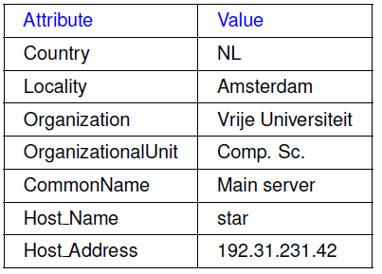
Example: Lightweight Directory Access Protocol
Lightweight Directory Access Protocol (LDAP) directory service consists of a number of records called “directory entries”
  Each record is made of (attribute, value) pairs
  LDAP standard specifies five attributes for each record
Directory Information Base (DIB) is a collection of all directory entries
  Each record in a DIB is unique
  Each record is represented by a distinguished name
  E.g., /C=NL/O=Vrije Universiteit/OU=Comp. Sc.

Slide 37
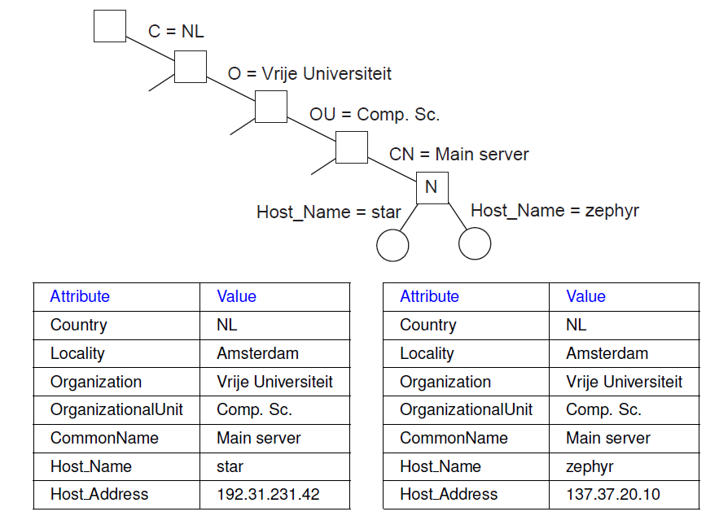
Directory Information Tree in LDAP
All the records in the DIB can be organized into a hierarchical tree called the Directory Information Tree (DIT)
LDAP provides advanced search mechanisms based on attributes by traversing the DIT
  Example syntax for searching all Main_Servers in Vrije Universiteit:
search("&(C = NL) (O = Vrije Universiteit) (OU = *) (CN = Main server)")

Slide 38
Summary
Naming allows locating entities in a distributed system
Three types of naming:
  Flat Naming
    Broadcasting, forwarding pointers, home-based approach, Distributed Hash Table (DHT)
  Structured Naming
    Organizes names into name spaces (or naming graphs)
    Distributes name spaces across machines
  Attribute-based Naming
    Entities are looked up using their attributes

Slide 39
Next Lecture…
Synchronization – Part I

