Slide 1
Distributed Systems CS 15-440
Networks – Part I
Lecture 2, August 22, 2023
Mohammad Hammoud

Slide 2
Today…
Last Session:
Introduction
Today’s Session :
Network Types (Sections 3.1 and 3.2 in Coulouris et al.)
Networking Principles: Layering and Encapsulation (Section 3.3 in Coulouris et al.)
Announcements:
PS1 will be released on Thursday. It is due on September 03
In Thursday’s recitation, we will practice on Java programming (Projects I and II will be in Java)

Slide 3
Most Used Programming Languages Among Developers Worldwide As of 2023

Slide 4
Course Map
Applications
Programming Models
Fast & Reliable or Efficient DS
Replication & Consistency
Fault-tolerance
Communication Paradigms
Architectures
Naming
Synchronization
Correct or
Effective DS
Networks

Slide 5
Course Map
Applications
Programming Models
Replication & Consistency
Fault-tolerance
Communication Paradigms
Architectures
Naming
Synchronization
Networks

Slide 6
Introduction to Networks – Learning Outcomes
After two lectures on networks, you will be able to:
Identify different types of networks
Describe various networking principles such as layering, encapsulation, and packet-switching, among others
Examine how packets are routed
Realize how congestion is controlled
Analyze the performance, scalability, and reliability of networks

Slide 7
Outline
A Primer
Network Considerations and Types
Network Principles

Slide 8
Networks in Distributed Systems
A distributed system is a collection of components that communicate to solve a problem
Why should designers of distributed systems know about networks?
Networking issues severely affect performance, fault-tolerance, and security of distributed systems
E.g., Gmail outage on Sep 1, 2010 – Google Spokesman said “we had slightly underestimated the load which some recent changes placed on the request routers. … . few of the request routers became overloaded… causing a few more of them to also become overloaded, and within minutes nearly all of the request routers were overloaded.”

Slide 9
Networks in Distributed Systems
A distributed system is a collection of components that communicate to solve a problem
Why should designers of distributed systems know about networks?
Networking issues severely affect performance, fault-tolerance, and security of distributed systems
E.g., YouTube outage on Oct 16, 2018: “There was a problem with the network”
E.g., AWS outage on Dec 7, 2021: ”An impairment of several network devices in the US-EAST-1 Region caused widespread errors in all AWS services”

Slide 10
Amdahl’s Law
To being with, why do we need distributed systems?
To run our programs faster (or more efficient)
Sometimes we have no option but to go distributed (Big Data applications)
How much faster will a distributed program run compared to its sequential counterpart?
Suppose that the sequential execution of the program takes T₁ time units and the distributed execution on m machines takes T_{m} time units
Suppose that out of the entire execution of the program, s fraction of it is not parallelizable while 1-s fraction is parallelizable

Slide 11
Amdahl’s Law
Amdahl’s Law formula:
Example:
Assume, 80% of your program is parallelizable
You run your program on 4 machines
Why did we get a sub-linear (i.e., 2.5x) and not a linear (i.e., 4x) speedup?
$$Speedup= \frac{T_{1}}{T_{m}}=\frac{T_{1}}{(T_{1}×s+T_{1}×\frac{1−s}{m})}=\frac{1}{s+\frac{1−s}{m}}$$
$$Speedup=\frac{1}{s+\frac{1−s}{m}}=\frac{1}{0.2+\frac{0.8}{4}}=2.5$$

Slide 12
Amdahl’s Law
Amdahl’s argument is too simplified
There is not only a part of the program that is not parallelizable, but also some critical systems aspects that are not captured in the law and may slow down the program
20
80
20
80
Serial
20
20
20
20
Machine 1
Distributed
Machine 2
Cannot be parallelized
Machine 3
Cannot be parallelized
Can be parallelized
Machine 4
Can be parallelized
Communication overhead
Load Imbalance
Ideal
Real-World

Slide 13
Guidelines
How to improve the efficiency of your distributed program?
Maximize the fraction of the program that can be parallelized
Typically, inherent to the program
Maximize the efficiency of each machine
Scale up resources and/or optimize operations
Fully utilize (do not underutilize or overutilize) each machine
Choose the right number of machines (or cluster size)
Balance the workload across machines
Heterogeneity is not only caused by differences in the underlying platform, but also by resource availability (most critical on shared machines like on the Cloud)
Minimize the time spent on communication
Latency and bandwidth

Slide 14
Guidelines
In summary, be aware of:
The parallel structures in your program
The efficiency of each machine in your cluster
The utilization of each machine in your cluster
The heterogeneity across machines in your cluster
The latency and bandwidth of your network

Slide 15
Latency and Bandwidth
Case 1
Case 2
B
B
L
L
Case 3
B
L
B = Bandwidth (or Capacity) and L = Latency (or Delay)
B × L gives approximately the number of bits in flight
As B × L increases, uncertainty increases (more bits might get lost)
High value of B × L leads to “Buffer Bloat”
Notes:
Think of network connection as a highway; the cars driving along it are data packets. A five-lane highway typically has a bigger bandwidth than a two-lane local road because the former can accommodate a greater number of cars. Because of this, there’s a smaller chance of vehicles getting stuck in traffic jams.
However, having a wide highway will tell you nothing about how fast the cars are going, similar to how bandwidth alone can’t determine the internet speed. It simply tells how much data can be received at a given time.

Slide 16
Outline
A Primer
Network Considerations and Types
Network Principles

Slide 17
Networks in Distributed Systems
Networking Issue | Comments on a Distributed System Design
Performance
Scalability
Reliability
Security
Mobility
Quality-of-service
Affects choices of whether to optimize for network or other resources
Size of Internet is increasing; expect greater traffic and latency in future
Detect communication errors and perform error-checks at the application layer (end-to-end argument!)
Install firewalls at gateways; deploy end-to-end authentication; employ encryption, etc.,
Expect intermittent connection for mobile devices
Internet is best-effort. It is hard to ensure strict QoS guarantees for, say, multimedia data
Notes:
Authentication verifies the identity of a user or a service, and authorization determines their access rights.

Slide 18
Network Classification
Important ways to classify networks
Based on size
Body Area Networks (BAN)
Personal Area Networks (PAN)
Local Area Networks (LAN)
Wide Area Networks (WAN)
Based on technology
Ethernet Networks
Wireless Networks
Cellular Networks

Slide 19
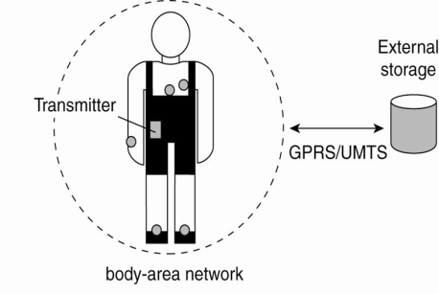
Network Classification – BANs and PANs
Body Area Networks (BAN):
Devices form wearable computing units
Several Body Sensor Units (BSUs) communicate with Body Central Unit (BCU)
Typically, low-cost and low-energy networking
Personal Area Networks (PAN):
PAN connects various digital devices carried by a user (mobile phones, tablets, cameras)
Low-cost and low-energy networking
E.g., Bluetooth
5G
Notes:
19

Slide 20
Network Classification – LAN
Computers connected by single communication medium
E.g., Twisted copper wire, optical fiber
High data-transfer-rate and low latency
LAN consists of
Segment
Usually within a department/floor of a building
Shared bandwidth, no routing necessary
Local Networks
Serves campus/office building
Many segments connected by a switch/hub
Typically, represents a network within an organization
Notes:
20
Local Area Networks: High speed computers connected through a single communication medium (optical, wired or wireless) . “Segment” is a part of the network that is connected by a single medium (e.g. ethernet cable). When a host inside a LAN transmits a packet, all other hosts can receive the packet. Hence, there is no need for routing. The bandwidth available is shared between all the hosts. A LAN can be made up of many segments. There is generally a host, which is called as switch or the hub, that helps to connect two or more segments. Communication between hosts in a LAN generally provides high bandwidth and low-delay. But most popularly used LANs, such as Ethernet-based LAN, does not not guarantee specific bandwidth or delay.

Slide 21
Network Classification – WAN
Generally, covers a wider area (cities, countries,...)
Consists of networks of different organizations
Traffic is routed from one organization to another
Routers
Bandwidth and latency
Vary
Worse than a LAN
Largest WAN = Internet

Slide 22
Brief Summary of Important Networks
(Based on Size)
A Segment
A Point-to-point link
Local Area Network (LAN)
A network of networks
A Network
Wide Area Network (WAN)
Notes:
22

Slide 23
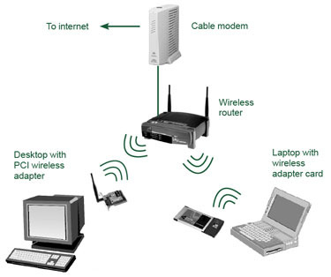
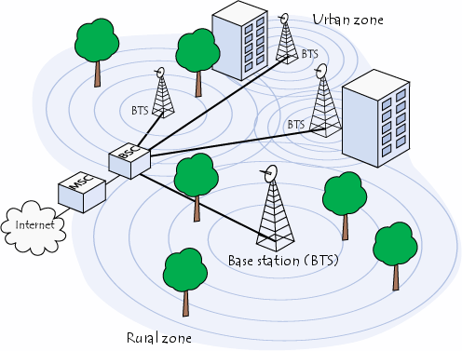
Types of Networks – Based on Technology
Ethernet Networks
Predominantly used in the wired Internet
Wireless LANs
Primarily designed to provide wireless access to the Internet
Low-range (100s of m), high-bandwidth
Cellular networks (2G/3G/4G/5G)
Initially, designed to carry voice
Large range (few kms)
Low-bandwidth

Slide 24
Typical Performance for Different Types of Networks
Network | Example | Range | Bandwidth (Mbps) | Latency (ms)
Wired LAN | Ethernet | 1-2 km | 10 – 10,000 | 1 – 10
Wired WAN | Internet | Worldwide | 0.5 – 600 | 100 – 500
Wireless PAN | Bluetooth | 10 – 30 m | 0.5 – 2 | 5 – 20
Wireless LAN | WiFi | 0.15 – 1.5 km | 11 – 108 | 5 – 20
Cellular | 2G – GSM | 100m – 20 km | 0.270 – 1.5 | 5
Cellular | 3G | 1 – 5 km | 348 – 14.4 | 100 – 500
Cellular | 4G | 16 km | 10- 100 | 36-48
Modern Cellular | 5G | 2 km | 50- 1000 | 10-30

Slide 25
Latency and Bandwidth
Case 1
WiFi
Case 2
Ethernet
B
B
L
L
WAN
Case 3
B
L
B = Bandwidth (or Capacity) and L = Latency (or Delay)
B × L gives approximately the number of bits in flight
As B × L increases, uncertainty increases (more bits might get lost)
High value of B × L leads to “Buffer Bloat”

Slide 26
Outline
A Primer
Network Considerations and Types
Network Principles

Slide 27
Networking Principles
Network Protocols
Packet Transmission
Network Layers
Physical layer
Data-link layer
Network layer and routing
Transport layer and congestion control

Slide 28
Networking Protocols
If two entities want to communicate on a network, pre-defined agreements are necessary
How a message will be formatted?
How does the receiver know the last bit in the message?
How can a receiver detect if the message is damaged?
“Protocol” is a well-known set of rules and formats to be used for communication between the entities
Standardizing a well-known set of protocols supports communication among heterogeneous entities
Notes:
Networks allow an entity on one machine to communicate with another entity on another machine

Slide 29
Packet Transmission
Messages are broken up into packets
A packet is the unit of data that is transmitted between an origin and a destination
Packets can be of arbitrary lengths
Maximum size of the packet is known as Maximum Transmission Unit (MTU)
MTU prevents one host from sending a very long message
Each packet has two main fields
Header: Contains meta-information about the packet
e.g., Length of the packet, receiver ID
Data
Header
Data

Slide 30
Network Layers
Network software is arranged into a hierarchy of layers
Protocols in one layer perform one specific functionality
Layering is a scalable & modular design for complex software
Typical functionalities in a network software:
011100011 0011 011
Src
Functionality | Layer
Transmits bits over a transmission medium
Physical
Dest
Coordinates transmissions from multiple hosts that are directly connected over a common medium
Data link
Routes the packets through intermediate networks
Network
Destination machine
Handles messages – rather than packets – between sender and receiver processes
P1
P2
P3
Transport
Satisfies communication requirements for specific applications
Application

Slide 31
OSI Reference Model
Open Systems Interconnection (OSI) Reference Model
A layered networking model standardized by ISO
The model identifies various layers and their functionalities
Functionality | Layer | Example Protocols
Satisfy communication requirements for specific applications | Application | HTTP, FTP
Transmit data in network representation that is independent of representation in individual computers | Presentation | CORBA data representation
Support reliability and adaptation, such as failure detection and automatic recovery | Session | SIP
Handle messages – rather than packets – between sender and receiver processes | Transport | TCP, UDP
Route the packet through intermediate networks | Network | IP, ATM
Coordinate transmissions from multiple hosts that are directly connected over a common medium | Data-link | Ethernet MAC
Transmit bits over a transmission medium | Physical | Ethernet

Slide 32
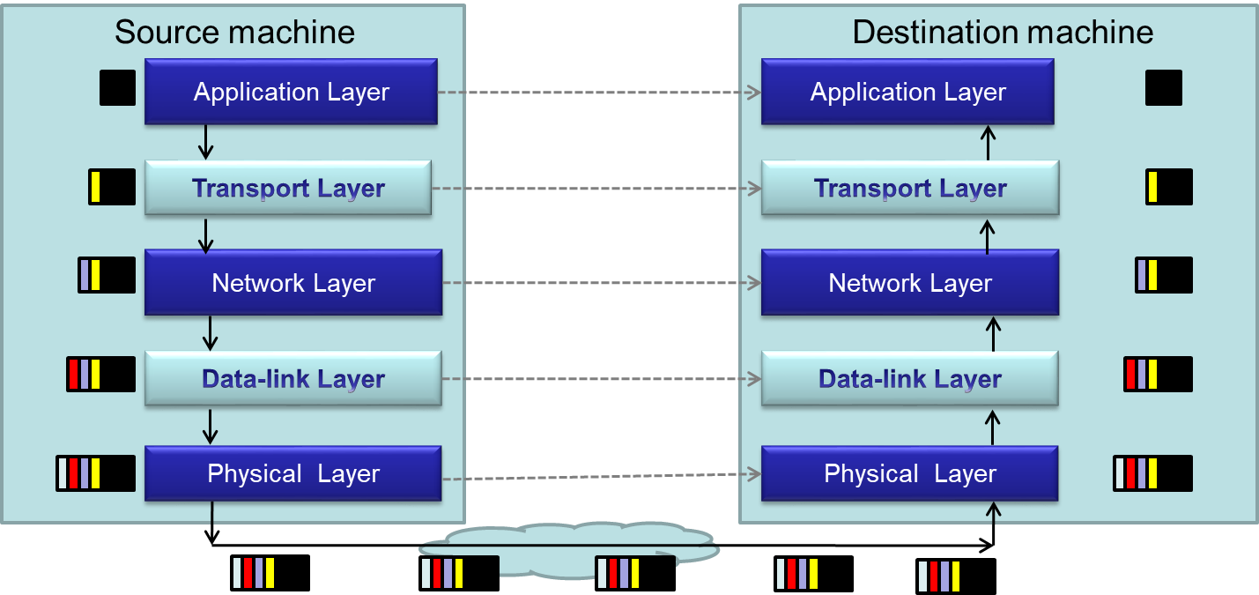
Packet Encapsulation
Encapsulation is a technique to pack and unpack data packets in a layered architecture

Slide 33
Layers that We Will Study Today
Physical layer
Data-link layer
Network layer

Slide 34
Layers that We Will Study Today
Physical layer
Data-link layer
Network layer

Slide 35
Physical Layer
Physical layer protocols transmit a sequence of bits over a transmission medium
Modulate the bits into signals that can be transmitted over the medium
Transmission Medium | Type of signal transmitted
Twisted-pair (Ethernet cable) | Electrical signal
Fiber Optic Circuits | Light signal
Wireless channel | Electro-magnetic signal
Data-link layer protocol
Bits
A physical layer protocol
Signal
Transmission Medium

Slide 36
Layers that We Will Study Today
Physical layer
Data-link layer
Network layer

Slide 37
Data-link Layer
Protocols in data-link layer ensure that the packets are delivered from one host to another within a local network
Data-link layer protocols provide two main functionalities:
How to coordinate between the transmitters such that packets are successfully received?
Coordination
How to identify another host on the local network?
Addressing over local networks

Slide 38
Coordination at Data-link Layer
A packet is not received successfully at the receiver if a sender transmits the data when another sender’s transmission is active
The packet is said to have experienced collision if it is not successfully received at the receiver
Collision is avoided by sensing the medium before transmission

Slide 39
Addressing over Local Networks
Each device that is connected to a network has a unique address called Medium Access Control (MAC) address
MAC addresses are six bytes long
e.g., 2A:D4:AB:FD:EF:8D
Approach:
Data-link layer broadcasts the packet over the medium
Receiver reads the packet header and checks if the packet is addressed to it
x
x

Slide 40
Layers that We Will Study Today
Physical layer
Data-link layer
Network layer

Slide 41
Network Layer
Network layer protocols perform the role of routing
They ensure that a packet is routed from the source machine to the destination machine
Packets may traverse different LANs to reach the destination
Internet Protocol (IP) is a widely-used network layer protocol
IP addresses are typically used to identify machines
Router
Source
Destination

Slide 42
Router
A router is a device that forwards the packets between multiple networks
Routers are connected to two or more networks
Each network interface is connected to a LAN or a host
Packet travels up until the network layer on the router
Source machine
Router
Dest machine
A Router
Application
Application
LAN-1
LAN-3
Transport
Transport
Int-1
Int-2
Int-3
Network
Network
Network
Data-link
Data-link
Data-link
LAN-2
Physical
Physical
Physical

Slide 43
Routing Algorithm
Packets have to be transmitted in a series of hops through the routers
The series of hops that a packet takes is known as a route
Routing algorithm is responsible for determining the routes for the transmission of packets
Challenges for designing routing algorithms in the Internet:
Performance: The traffic across different networks vary
Router failures: Routers in the Internet may fail
R2
S
R1
R4
D
R4

Slide 44
Routing Algorithm (Cont’d)
Routing algorithms have two activities
Determine the next-hop taken by each packet
The algorithm should be fast and efficient
Dynamically update connectivity information
Maintain the knowledge of the network by monitoring routers and traffic
The above activities are distributed throughout the network
Routing decisions are made on an hop-by-hop basis
Information about possible next-hop routers is stored locally
Information is updated periodically
We will study in the next lecture a simple routing algorithm called “Distance Vector Algorithm”

Slide 45
Next class
Networking- Part II

