Slide 1
Distributed Systems
CS 15-440
MPI
Lecture 16, October 28, 2020
Mohammad Hammoud

Slide 2
Today
Last Session:
  Distributed Mutual Exclusion
  Election Algorithms
Today’s Session:
  Programming Models: MPI
Announcements:
  P2 is due today by midnight
  We will practice together on MPI in tomorrow’s recitation

Slide 3

Models of Parallel Programming
What is a parallel programming model?
  It is an abstraction provided by a system to programmers so that they can use it to implement their algorithms
  It determines how easily programmers can translate their algorithms into parallel units of computations (i.e., tasks)
  It determines how efficiently parallel tasks can be executed on the system

Slide 4
Traditional Parallel Programming Models
Parallel Programming Models
Shared
Memory
Message Passing
Message Passing

Slide 5
Shared Memory Model
In the shared memory programming model, the abstraction provided implies that parallel tasks can access any location of the memory
Accordingly, parallel tasks can communicate through reading and writing common memory locations
This is similar to threads in a single process (in traditional OSs), which share a single address space
Multi-threaded programs (e.g., OpenMP programs) use the shared memory programming model

Slide 6
Shared Memory Model
S_{i} = Serial
P_{j} = Parallel
Single Thread
Multi-Thread
S1
S1
Time
Time
Spawn
P1
P1
P2
P3
P3
P2
P3
Join
S2
Shared Space
P4
S2
Process
Process

Slide 7
Traditional Parallel Programming Models
Parallel Programming Models
Shared
Memory
Message Passing
Shared
Memory

Slide 8
Message Passing Model
In message passing, parallel tasks have their own local memories
One task cannot access another task’s memory
Hence, tasks have to rely on explicit message passing to communicate
This is similar to the abstraction of processes in a traditional OS, which do not share an address space
Example: Message Passing Interface (MPI)

Slide 9
Message Passing Model
Single Thread
Message Passing
S_{i} = Serial
P_{j} = Parallel
Time
S1
Time
S1
S1
S1
S1
P1
P1
P1
P1
P1
P2
S2
S2
S2
S2
P3
P4
S2
Process 0
Process 1
Process 2
Process 3
Node 1
Node 2
Node 3
Node 4
Process

Slide 10
Shared Memory vs. Message Passing
Comparison between the shared memory and message passing programming models along several aspects:
Aspect | Shared Memory | Message Passing
Communication | Implicit (via loads/stores) | Explicit Messages
Synchronization | Explicit | Implicit (Via Messages)
Hardware Support | Typically Required | None
Development Effort | Lower | Higher
Tuning Effort | Higher | Lower
Aspect | Shared Memory | Message Passing
Communication | Implicit (via loads/stores) | Explicit Messages
Synchronization | Explicit | Implicit (Via Messages)
Hardware Support | Typically Required | None
Development Effort | Lower | Higher
Tuning Effort | Higher | Lower
Aspect | Shared Memory | Message Passing
Communication | Implicit (via loads/stores) | Explicit Messages
Synchronization | Explicit | Implicit (Via Messages)
Hardware Support | Typically Required | None
Development Effort | Lower | Higher
Tuning Effort | Higher | Lower
Aspect | Shared Memory | Message Passing
Communication | Implicit (via loads/stores) | Explicit Messages
Synchronization | Explicit | Implicit (Via Messages)
Hardware Support | Typically Required | None
Development Effort | Lower | Higher
Tuning Effort | Higher | Lower
Aspect | Shared Memory | Message Passing
Communication | Implicit (via loads/stores) | Explicit Messages
Synchronization | Explicit | Implicit (Via Messages)
Hardware Support | Typically Required | None
Development Effort | Lower | Higher
Tuning Effort | Higher | Lower

Slide 11
Message Passing Interface
We will focus on MPI:
  Definition
  Point-to-point communication
  Collective communication

Slide 12
Message Passing Interface
We will focus on MPI:
  Definition
  Point-to-point communication
  Collective communication

Slide 13
What is MPI?
MPI is a standard message passing model for developing message passing programs
The objective of MPI is to establish a portable, efficient, and flexible libraries for message passing
By itself, MPI is NOT a library - but rather a specification of what an MPI library should be
MPI is not an IEEE or ISO standard, but has in fact, become the industry standard for writing message passing programs on HPC platforms

Slide 14
Reasons for using MPI
Reason | Description
Standardization | MPI is the only message passing library which can be considered a standard. It is supported on virtually all HPC platforms
Portability | There is no need to modify your source code when you port your application to a different platform that supports the MPI standard
Reason | Description
Standardization | MPI is the only message passing library which can be considered a standard. It is supported on virtually all HPC platforms
Portability | There is no need to modify your source code when you port your application to a different platform that supports the MPI standard
Performance Opportunities | Vendor implementations should be able to exploit native hardware features to optimize performance
Reason | Description
Standardization | MPI is the only message passing library which can be considered a standard. It is supported on virtually all HPC platforms
Portability | There is no need to modify your source code when you port your application to a different platform that supports the MPI standard
Performance Opportunities | Vendor implementations should be able to exploit native hardware features to optimize performance
Functionality | Over 115 routines are defined
Reason | Description
Standardization | MPI is the only message passing library which can be considered a standard. It is supported on virtually all HPC platforms
Portability | There is no need to modify your source code when you port your application to a different platform that supports the MPI standard
Performance Opportunities | Vendor implementations should be able to exploit native hardware features to optimize performance
Functionality | Over 115 routines are defined
Availability | A variety of implementations are available, both vendor and public domain
Reason | Description
Standardization | MPI is the only message passing library which can be considered a standard. It is supported on virtually all HPC platforms

Slide 15
Communicators and Groups
MPI uses objects called communicators/groups to define which collection of processes may communicate with each other to solve a certain problem
Most MPI routines require you to specify a communicator as an argument
The communicator MPI_COMM_WORLD is often used in calling communication subroutines
MPI_COMM_WORLD is the predefined communicator that includes all of your MPI processes

Slide 16
Ranks
Within a communicator, every process has its own unique ID referred to as rank, assigned by the system when the processes are initialized
A rank is sometimes called a task ID-- ranks are contiguous and begin at zero
Ranks are used by the programmer to specify the source and destination of messages
Ranks are often used conditionally by programs to control execution (e.g., if rank=0 do this / if rank=1 do that)

Slide 17
Multiple Communicators
A problem can consist of several sub-problems where each can be solved independently
You can create a new communicator for each sub-problem as a subset of an existing communicator
MPI allows you to achieve that by using MPI_COMM_SPLIT

Slide 18
Example of Multiple Communicators
Consider a problem with a fluid dynamics part and a structural analysis part, where each part can be computed in parallel
MPI_COMM_WORLD
Comm_Fluid
Comm_Struct
Rank=0
Rank=0
Rank=1
Rank=1
Rank=0
Rank=4
Rank=1
Rank=5
Rank=2
Rank=2
Rank=3
Rank=3
Rank=2
Rank=6
Rank=3
Rank=7
Ranks within MPI_COMM_WORLD are printed in red
Ranks within Comm_Fluid are printed in green
Ranks within Comm_Struct are printed in blue

Slide 19
Message Passing Interface
We will focus on MPI:
  Definitions
  Point-to-point communication
  Collective communication

Slide 20
MPI Point-To-Point Communication Routines
Routine | Signature
Blocking send | int MPI_Send( void *buf, int count, MPI_Datatype datatype, int dest, int tag, MPI_Comm comm )
Non-blocking send | int MPI_Isend( void *buf, int count, MPI_Datatype datatype, int dest, int tag, MPI_Comm comm, MPI_Request *request )
Blocking receive | int MPI_Recv( void *buf, int count, MPI_Datatype datatype, int source, int tag, MPI_Comm comm, MPI_Status *status )
Non-blocking receive | int MPI_Irecv( void *buf, int count, MPI_Datatype datatype, int source, int tag, MPI_Comm comm, MPI_Request *request )
Routine | Signature
Blocking send | int MPI_Send( void *buf, int count, MPI_Datatype datatype, int dest, int tag, MPI_Comm comm )
Non-blocking send | int MPI_Isend( void *buf, int count, MPI_Datatype datatype, int dest, int tag, MPI_Comm comm, MPI_Request *request )
Blocking receive | int MPI_Recv( void *buf, int count, MPI_Datatype datatype, int source, int tag, MPI_Comm comm, MPI_Status *status )
Non-blocking receive | int MPI_Irecv( void *buf, int count, MPI_Datatype datatype, int source, int tag, MPI_Comm comm, MPI_Request *request )
Routine | Signature
Blocking send | int MPI_Send( void *buf, int count, MPI_Datatype datatype, int dest, int tag, MPI_Comm comm )
Non-blocking send | int MPI_Isend( void *buf, int count, MPI_Datatype datatype, int dest, int tag, MPI_Comm comm, MPI_Request *request )
Blocking receive | int MPI_Recv( void *buf, int count, MPI_Datatype datatype, int source, int tag, MPI_Comm comm, MPI_Status *status )
Non-blocking receive | int MPI_Irecv( void *buf, int count, MPI_Datatype datatype, int source, int tag, MPI_Comm comm, MPI_Request *request )
Routine | Signature
Blocking send | int MPI_Send( void *buf, int count, MPI_Datatype datatype, int dest, int tag, MPI_Comm comm )
Non-blocking send | int MPI_Isend( void *buf, int count, MPI_Datatype datatype, int dest, int tag, MPI_Comm comm, MPI_Request *request )
Blocking receive | int MPI_Recv( void *buf, int count, MPI_Datatype datatype, int source, int tag, MPI_Comm comm, MPI_Status *status )
Non-blocking receive | int MPI_Irecv( void *buf, int count, MPI_Datatype datatype, int source, int tag, MPI_Comm comm, MPI_Request *request )
Routine | Signature
Blocking send | int MPI_Send( void *buf, int count, MPI_Datatype datatype, int dest, int tag, MPI_Comm comm )
Non-blocking send | int MPI_Isend( void *buf, int count, MPI_Datatype datatype, int dest, int tag, MPI_Comm comm, MPI_Request *request )
Blocking receive | int MPI_Recv( void *buf, int count, MPI_Datatype datatype, int source, int tag, MPI_Comm comm, MPI_Status *status )
Non-blocking receive | int MPI_Irecv( void *buf, int count, MPI_Datatype datatype, int source, int tag, MPI_Comm comm, MPI_Request *request )

Slide 21
Message Passing Interface
We will focus on MPI:
  Definitions
  Point-to-point communication
  Collective communication

Slide 22
Collective Communication
Collective communication allows exchanging data among a group of processes
It must involve all processes in the scope of a communicator
The communicator argument in a collective communication routine should specify which processes are involved in the communication
Hence, it is the programmer's responsibility to ensure that all processes within a communicator participate in any collective operation

Slide 23
Patterns of Collective Communication
There are several patterns of collective communication:
  Broadcast
  Scatter
  Gather
  Allgather
  Alltoall
  Reduce
  Allreduce
  Scan
  Reducescatter

Slide 24
1. Broadcast
Broadcast sends a message from the process with rank root to all other processes in the group
Data
Data
P0
A
P0
A
A
A
A
Process
Broadcast
Process
P1
P1
P2
P2
P3
P3
int MPI_Bcast ( void *buffer, int count, MPI_Datatype datatype, int root, MPI_Comm comm )

Slide 25
2-3. Scatter and Gather
Scatter distributes distinct messages from a single source task to each task in the group
Gather gathers distinct messages from each task in the group to a single destination task
Data
Data
P0
A | B | C | D
P0
A
B
C
D
Process
Scatter
Process
P1
P1
P2
P2
P3
Gather
P3
int MPI_Scatter ( void *sendbuf, int sendcnt, MPI_Datatype sendtype, void *recvbuf, int recvcnt,
MPI_Datatype recvtype, int root, MPI_Comm comm )
int MPI_Gather ( void *sendbuf, int sendcnt, MPI_Datatype sendtype, void *recvbuf, int recvcount,
MPI_Datatype recvtype, int root, MPI_Comm comm )

Slide 26
4. All Gather
Allgather gathers data from all tasks and distributes them to all tasks
  Each task in the group, in effect, performs a one-to-all broadcasting operation within the group
Data
Data
P0
A
B
C
D
P0
A | B | C | D
A | B | C | D
A | B | C | D
A | B | C | D
Process
allgather
Process
P1
P1
P2
P2
P3
P3
int MPI_Allgather ( void *sendbuf, int sendcount, MPI_Datatype sendtype, void *recvbuf, int recvcount, MPI_Datatype recvtype, MPI_Comm comm )

Slide 27
6-7. Reduce and All Reduce
Reduce applies a reduction operation on all tasks in the group and places the result in one task
Allreduce applies a reduction operation and places the result in all tasks in the group. This is equivalent to an MPI_Reduce followed by an MPI_Bcast
Data
Data
Data
Data
P0
A
B
C
D
P0
A*B*C*D
P0
A
B
C
D
P0
A*B*C*D
A*B*C*D
A*B*C*D
A*B*C*D
Process
Reduce
Process
Process
Allreduce
Process
P1
P1
P1
P1
P2
P2
P2
P2
P3
P3
P3
P3
int MPI_Reduce ( void *sendbuf, void *recvbuf, int count, MPI_Datatype datatype, MPI_Op op, int root, MPI_Comm comm )
int MPI_Allreduce ( void *sendbuf, void *recvbuf, int count, MPI_Datatype datatype, MPI_Op op,
MPI_Comm comm )

Slide 28
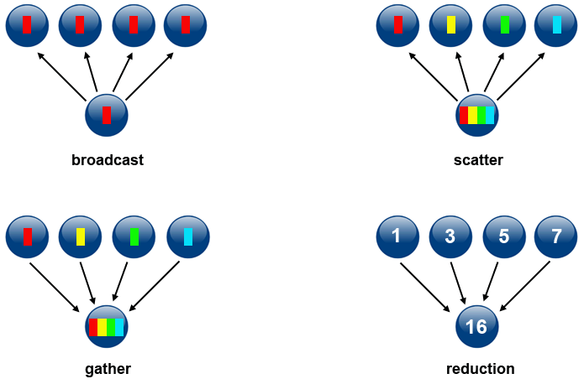
Recap

Slide 29
Example: PageRank
PageRank is a function that assigns a real number to each page in the Web
Intuition: the higher the PageRank of a page, the more “important” it is
Simulation of random surfers allows approximating the intuitive notion of the “importance” of pages
  Random surfers start at random pages and tend to congregate at important pages
    Pages with larger numbers of surfers are more “important” than pages with smaller numbers of surfers

Slide 30
Example: PageRank
The Web can be represented as a directed graph, with pages as nodes and links between pages as edges
A random surfer starting at A, will next be at A, B, C, and D with probabilities of 0, 1/3, 1/3, and 1/3, respectively
A random surfer starting at B, will next be at A, B, C and D with probabilities of ½, 0, 0, and ½, respectively
A
B
A hypothetical example of the Web
C
D

Slide 31
Example: PageRank
The Web can be represented as a directed graph, with pages as nodes and links between pages as edges
A B C D
A
B
0 ½ 1 0
1/3 0 0 ½
1/3 0 0 ½
1/3 ½ 0 0
A
B
M =
C
C
D
D
A transition matrix of the Web, which describes what happens to random surfers after one step

Slide 32
Example: PageRank
The probability distribution for the location of a random surfer can be described by a column vector (say, v) whose j^{th} element is the probability that the surfer is at page j
  This probability is the (idealized) PageRank function
We can start a random surfer at any of the 4 pages of our tiny Web graph, with equal probabilities
1/4
1/4
1/4
1/4
A
v =
B
C
D

Slide 33
Example: PageRank
If M is the transition matrix of the Web, after one step, the distribution of the surfer will be Mv
After two steps it will be M(Mv) = M²v, and so on
  In general, multiplying the initial vector v by M a total of i times will give the distribution of the surfer after i steps
0 ½ 1 0
1/3 0 0 ½
1/3 0 0 ½
1/3 ½ 0 0
1/4
1/4
1/4
1/4
9/24
5/24
5/24
5/24
=

Slide 34




Example: PageRank
How can this be implemented in MPI?
  First, partition M at the master
r0 and v
x₀ = $\sum_{j=0}^{3}{m0j}$
Machine
0
r0
0 ½ 1 0
1/3 0 0 ½
1/3 0 0 ½
1/3 ½ 0 0
r1 and v
x₁ = $\sum_{j=0}^{3}{m1j}$
r1
Machine
1
r2
r2 and v
x₂ = $\sum_{j=0}^{3}{m2j}$
r3
Machine
2
r3 and v
x₃ = $\sum_{j=0}^{3}{m3j}$
Machine
3

Slide 35
Example: PageRank
How can this be implemented in MPI?
  Second, distribute M’s partitions to the machines (e.g., using MPI-Scatter())
r0 and v
x₀ = $\sum_{j=0}^{3}{m0j}$
Machine
0
r0
0 ½ 1 0
1/3 0 0 ½
1/3 0 0 ½
1/3 ½ 0 0
r1 and v
x₁ = $\sum_{j=0}^{3}{m1j}$
r1
Machine
1
r2
r2 and v
x₂ = $\sum_{j=0}^{3}{m2j}$
r3
Machine
2
r3 and v
x₃ = $\sum_{j=0}^{3}{m3j}$
Machine
3

Slide 36
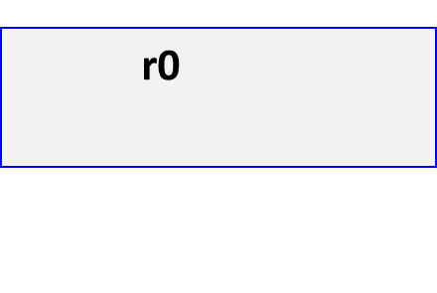


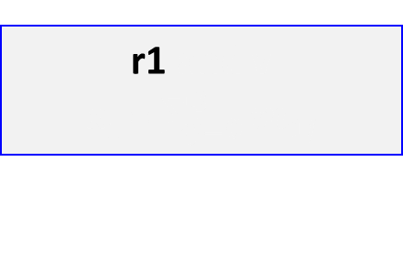
Example: PageRank
How can this be implemented in MPI?
  Second, distribute M’s partitions to the machines (e.g., using MPI-Scatter())
r0 and v
x₀ = $\sum_{j=0}^{3}{m0j}$
Machine
0
r0
0 ½ 1 0
1/3 0 0 ½
1/3 0 0 ½
1/3 ½ 0 0
r1 and v
x₁ = $\sum_{j=0}^{3}{m1j}$
r1
Machine
1
r2
r2 and v
x₂ = $\sum_{j=0}^{3}{m2j}$
r3
Machine
2
r3 and v
x₃ = $\sum_{j=0}^{3}{m3j}$
Machine
3

Slide 37



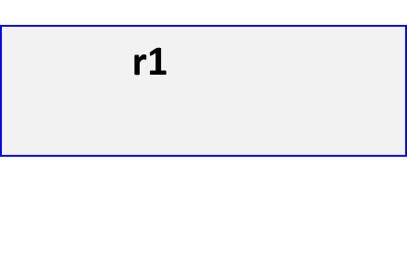
Example: PageRank
How can this be implemented in MPI?
  Third, copy v to each machine (e.g., using MPI-Bcast())– Iteration 1 starts here
r0 and v
x₀ = $\sum_{j=0}^{3}{m0j}$
Machine
0
1/4
1/4
1/4
1/4
r1 and v
x₁ = $\sum_{j=0}^{3}{m1j}$
Machine
1
r2 and v
x₂ = $\sum_{j=0}^{3}{m2j}$
Machine
2
r3 and v
x₃ = $\sum_{j=0}^{3}{m3j}$
Machine
3

Slide 38
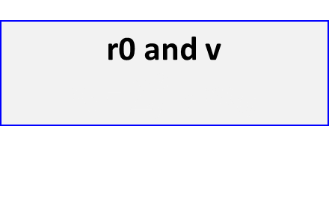
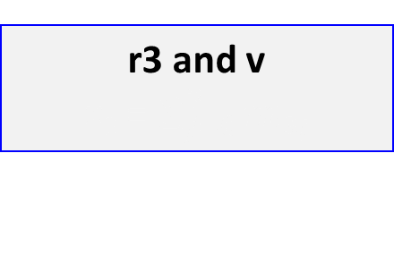
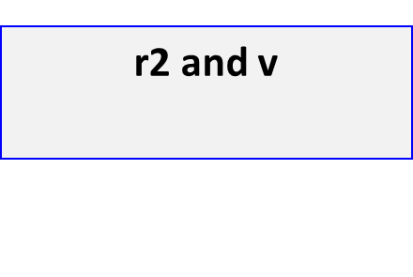
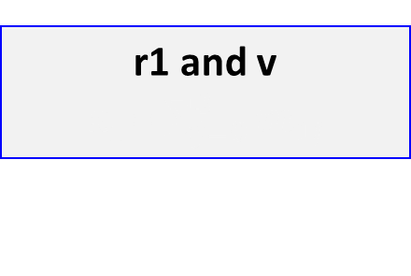
Example: PageRank
How can this be implemented in MPI?
  Third, copy v to each machine (e.g., using MPI-Bcast())– Iteration 1 starts here
r0 and v
x₀ = $\sum_{j=0}^{3}{m0j}$
Machine
0
1/4
1/4
1/4
1/4
r1 and v
x₁ = $\sum_{j=0}^{3}{m1j}$
Machine
1
r2 and v
x₂ = $\sum_{j=0}^{3}{m2j}$
Machine
2
r3 and v
x₃ = $\sum_{j=0}^{3}{m3j}$
Machine
3

Slide 39
Example: PageRank
How can this be implemented in MPI?
  Fourth, apply the Mv multiplication logic at each machine
r0 and v
x₀ = $\sum_{j=0}^{3}{m0j}$
Machine
0
r1 and v
x₁ = $\sum_{j=0}^{3}{m1j}$
Machine
1
r2 and v
x₂ = $\sum_{j=0}^{3}{m2j}$
Machine
2
r3 and v
x₃ = $\sum_{j=0}^{3}{m3j}$
Machine
3

Slide 40
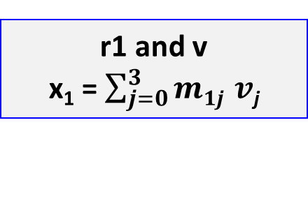
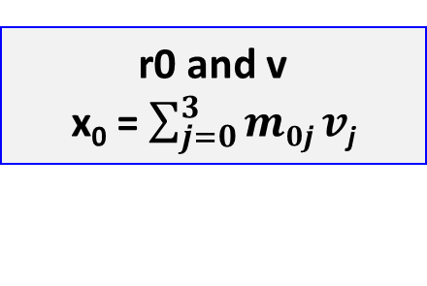
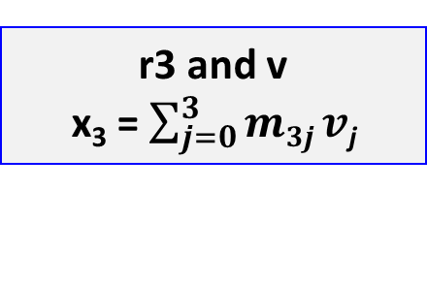
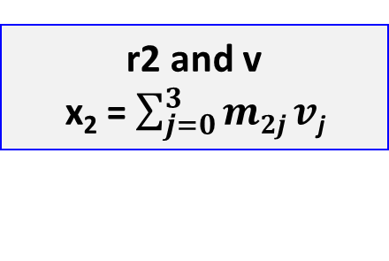
Example: PageRank
How can this be implemented in MPI?
  Fourth, apply the Mv multiplication logic at each machine
r0 and v
x₀ = $\sum_{j=0}^{3}{m0j}v$_{j}
Machine
0
r1 and v
x₁ = $\sum_{j=0}^{3}{m1j }v\text{j}$
Machine
1
r2 and v
x₂ = $\sum_{j=0}^{3}{m2j}v\text{j}$
Machine
2
r3 and v
x₃ = $\sum_{j=0}^{3}{m3j}v\text{j}$
Machine
3

Slide 41
Example: PageRank
How can this be implemented in MPI?
  Fifth, each machine sends back its element to the master
r0 and v
x₀ = $\sum_{j=0}^{3}{m0j}v$_{j}
Machine
0
x₀
x₁
x₂
x₃
9/24
5/24
5/24
5/24
r1 and v
x₁ = $\sum_{j=0}^{3}{m1j }v\text{j}$
Machine
1
r2 and v
x₂ = $\sum_{j=0}^{3}{m2j}v\text{j}$
Machine
2
This concludes iteration 1. To perform a new iteration, repeat steps 3, 4, and 5
r3 and v
x₃ = $\sum_{j=0}^{3}{m3j}v\text{j}$
Machine
3

Slide 42
Next Lecture
MapReduce

