Slide 1
Distributed Systems
CS 15-440
Naming
Lecture 9, September 21, 2020
Mohammad Hammoud

Slide 2
Today…
Last Session:
  Naming- Part I
Today’s Session:
  Naming – Part II
Announcements:
  PS2 is due on September 24 by midnight
  Quiz I is on September 28
  P1 is due on Oct 5

Slide 3
Classes of Naming
Flat naming
Structured naming
Attribute-based naming

Slide 4

4. Distributed Hash Table (DHT)
DHT is a distributed system that provides a lookup service similar to a hash table
  (key, value) pair is stored in the nodes participating in the DHT
  The responsibility for maintaining the mapping from keys to values is distributed among the nodes
  Any participating node can serve in retrieving the value for a given key
We will study a representative DHT known as Chord
DATA
KEY
DISTRIBUTED NETWORK
Pink Panther
Hash function
ASDFADFAD
Participating Nodes
cs.qatar.cmu.edu
Hash function
DGRAFEWRH
86.56.87.93
Hash function
4PINL3LK4DF

Slide 5
Chord
Entity with k
Node n (node with id=n)
000
Chord assigns an m-bit identifier (randomly chosen) to each node
  A node can be contacted through its network address
Alongside, it maps each entity to a node
  Entities can be processes, files, etc.,
Mapping of entities to nodes
  Each node is responsible for a set of entities
  An entity with key k falls under the jurisdiction of the node with the smallest identifier id >= k. This node is known as the successor of k, and is denoted by succ(k)
003
Node 000
004
008
Node 005
040
079
Node 010
Node 301
Map each entity with key k to node succ(k)

Slide 6
A Naïve Key Resolution Algorithm
The main issue in DHT is to efficiently resolve a key k to the network location of succ(k)
  Given an entity with key k, how to find the node succ(k)?
19
00
01
02
03
04
05
06
07
08
09
10
11
12
13
14
15
16
17
18
19
20
21
22
23
24
25
26
27
28
29
30
31
All nodes are arranged in a logical ring according to their IDs
Each node ‘p’ keeps track of its immediate neighbors: succ(p) and pred(p)
If ‘p’ receives a request to resolve key ‘k’:
  If pred(p) < k <=p, node p will handle it
  Else it will forward it to succ(n) or pred(n)
Solution is not scalable:
As the network grows, forwarding delays increase
  Key resolution has a time complexity of O(n)
n
= Active node with id=n
p
= No node assigned to key p

Slide 7
Key Resolution in Chord
1 | 04
2 | 04
3 | 09
4 | 09
5 | 18
  succ(p + 2^{(i-1)})
Chord improves key resolution by reducing the time complexity to O(log n)
All nodes are arranged in a logical ring according to their IDs
Each node ‘p’ keeps a table FT_{p} of at-most m entries. This table is called Finger Table
  FT_{p}[i] = succ(p + 2^{(i-1)})
  NOTE: FT_{p}[i] increases exponentially
If node ‘p’ receives a request to resolve key ‘k’:
  Node p will forward it to node q with index j in F_{p} where
  q = FT_{p}[j] <= k < FT_{p}[j+1]
    If k > FT_{p}[m], then node p will forward it to FT_{p}[m]
    If k < FT_{p}[1], then node p will forward it to FT_{p}[1]
i
1 | 01
2 | 01
3 | 01
4 | 04
5 | 14
1 | 09
2 | 09
3 | 09
4 | 14
5 | 20
00
01
02
03
04
05
06
07
08
09
10
11
12
13
14
15
16
17
18
19
20
21
22
23
24
25
26
27
28
29
30
31
26
1 | 11
2 | 11
3 | 14
4 | 18
5 | 28
1 | 28
2 | 28
3 | 28
4 | 01
5 | 09
1 | 14
2 | 14
3 | 18
4 | 20
5 | 28
1 | 21
2 | 28
3 | 28
4 | 28
5 | 04
1 | 20
2 | 20
3 | 28
4 | 28
5 | 04
1 | 18
2 | 18
3 | 18
4 | 28
5 | 01

Slide 8
Chord – Join and Leave Protocol
In large-scale distributed systems, nodes dynamically join and leave (voluntarily or due to failures)
If a node p wants to join:
  It contacts arbitrary node, looks up for succ(p+1), and inserts itself into the ring
If node p wants to leave:
  It contacts pred(p)and succ(p+1) and updates them
00
01
02
03
04
05
06
07
08
09
10
11
12
13
14
15
16
17
18
19
20
21
22
23
24
25
26
27
28
29
30
31
Node 4 is succ(2+1)
Who is succ(2+1) ?
02

Slide 9
Chord – Finger Table Update Protocol
For any node q, FT_{q}[1] should be up-to-date
  It refers to the next node in the ring
  Protocol:
    Periodically, request succ(q+1) to return pred(succ(q+1))
    If q = pred(succ(q+1)), then information is up-to-date
    Otherwise, a new node p has been added to the ring such that q < p < succ(q+1)
      FT_{q}[1] = p
      Request p to update pred(p) = q
    Similarly, node p updates each entry i by finding succ(p + 2^{(i-1)})

Slide 10
Exploiting Network Proximity in Chord
The logical organization of nodes in the overlay network may lead to inefficient message transfers
  Node k and node succ(k +1) may be far apart
Chord can be optimized by considering the network location of nodes
  Topology-Aware Node Assignment
    Two nearby nodes get identifiers that are close to each other
  Proximity Routing
    Each node q maintains ‘r’ successors for i^{th} entry in the finger table
    FT_{q}[i] now refers to r successor nodes in the range
      [p + 2^{(i-1)}, p + 2^{i} -1]
    To forward the lookup request, pick one of the r successors closest to the node q

Slide 11
Classes of Naming
Flat naming
Structured naming
Attribute-based naming

Slide 12
Structured Naming
Structured names are composed of simple human-readable names
  Names are arranged in a specific structure
Examples:
  File-systems utilize structured names to identify files
    /home/userid/work/dist-systems/naming.txt
  Websites can be accessed through structured names
    www.cs.qatar.cmu.edu

Slide 13
Name Spaces
Structured names are organized into name spaces
A name space is a directed graph consisting of:
  Leaf nodes
    Each leaf node represents an entity
    A leaf node generally stores the address of an entity (e.g., in DNS), or the state of (or the path to) an entity (e.g., in file systems)
  Directory nodes
    Directory node refers to other leaf or directory nodes
    Each outgoing edge is represented by (edge label, node identifier)
Each node can store any type of data
  I.e., State and/or address (e.g., to a different machine) and/or path

Slide 14
Name Spaces: An Example
Looking up for the entity with name “/home/steen/mbox”
Data stored in n1
n0
keys
n2: “elke”
n3: “max”
n4: “steen”
home
n1
n5
“/keys”
elke
steen
max
n2
n3
n4
Leaf node
twmrc
mbox
Directory node

Slide 15
Name Resolution
The process of looking up a name is called name resolution
Closure mechanism:
  Name resolution cannot be accomplished without an initial directory node
  The closure mechanism selects the implicit context from which to start name resolution
  Examples:
    www.qatar.cmu.edu: start at the DNS Server
    /home/steen/mbox: start at the root of the file-system

Slide 16
Name Linking
The name space can be effectively used to link two different entities
Two types of links can exist between the nodes:
  Hard Links
  Symbolic Links

Slide 17
1. Hard Links
  There is a directed link from the hard link to the actual node
  Name resolution:
    Similar to the general name resolution
  Constraint:
    There should be no cycles in the graph
“/home/steen/keys” is a hard link to “/keys”
n0
home
keys
n1
n5
“/keys”
elke
steen
max
keys
n2
n3
n4
twmrc
mbox
Notes:
$ ls -id .
1069765 ./
$ mkdir tmp ; cd tmp
$ ls -id ..
1069765 ../
The –id option to ls makes it give the inode number of the file/dir. On Unix filesystems .. is a real directory entry; it is a hard link pointing back to the previous directory. To this end, hard links are the tendons that tie the filesystem's directories together.

Slide 18
2. Symbolic Links
  Symbolic link stores the name of the original node as data
  Name resolution for a symbolic link SL
    First resolve SL’s name
    Read the content of SL
    Name resolution continues with content of SL
  Constraint:
    No cyclic references should be present
“/home/steen/keys” is a symbolic link to “/keys”
n0
home
keys
n1
n5
“/keys”
elke
steen
max
n2
n3
n4
keys
twmrc
mbox
n6
Data stored in n6
“/keys”

Slide 19
Mounting of Name Spaces
Two or more name spaces can be merged transparently by a technique known as mounting
With mounting, a directory node in one name space will store the identifier of the directory node of another name space
Network File System (NFS) is an example where different name spaces are mounted
  NFS enables transparent access to remote files

Slide 20
Example of Mounting Name Spaces in NFS
Machine A
Machine B
Name Server for
foreign name space
Name Space 1
Name Space 2
remote
home
vu
steen
“nfs://flits.cs.vu.nl/home/steen”
mbox
OS
OS
Name resolution for “/remote/vu/home/steen/mbox” in a distributed file system

Slide 21
Distributed Name Spaces
In large-scale distributed systems, it is essential to distribute name spaces over multiple name servers
  Distribute the nodes of the naming graph
  Distribute the name space management
  Distribute the name resolution mechanisms

Slide 22
Layers in Distributed Name Spaces
Distributed name spaces can be divided into three layers
Global
Layer
  Consists of high-level directory nodes
  Directory nodes are jointly managed by different administrations
Administrat-ional Layer
  Contains mid-level directory nodes
  Directory nodes grouped together in such a way that each group is managed by an administration
Managerial Layer
  Contains low-level directory nodes within a single administration
  The main issue is to efficiently map directory nodes to local name servers

Slide 23
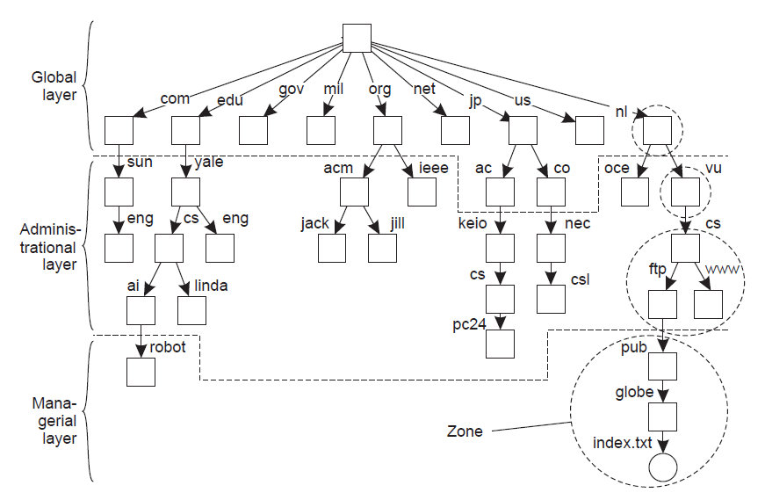
Distributed Name Spaces – An Example
Notes:
A DNS zone is any distinct, contiguous portion of the domain name space in the Domain Name System (DNS) for which administrative responsibility has been delegated to a single manager

Slide 24
Comparison of Name Servers at Different Layers
 | Global | Administrational | Managerial
Geographical scale of the network
Total number of nodes
Number of replicas
Update propagation
Is client side caching applied?
Responsiveness to lookups
Worldwide
Organization
Department
Few
Many
Vast numbers
Many
None or few
None
Lazy
Immediate
Immediate
Yes
Yes
Sometimes
Seconds
Milliseconds
Immediate

Slide 25
Distributed Name Resolution
Distributed name resolution is responsible for mapping names to addresses in a system where:
  Name servers are distributed among participating nodes
  Each name server has a local name resolver
We will study two distributed name resolution algorithms:
  Iterative Name Resolution
  Recursive Name Resolution

Slide 26
1. Iterative Name Resolution
Client hands over the complete name to root name server
Root name server resolves the name as far as it can, and returns the result to the client
  The root name server returns the address of the next-level name server (say, NLNS) if address is not completely resolved
Client passes the unresolved part of the name to the NLNS
NLNS resolves the name as far as it can, and returns the result to the client (and probably its next-level name server)
The process continues untill the full name is resolved

Slide 27
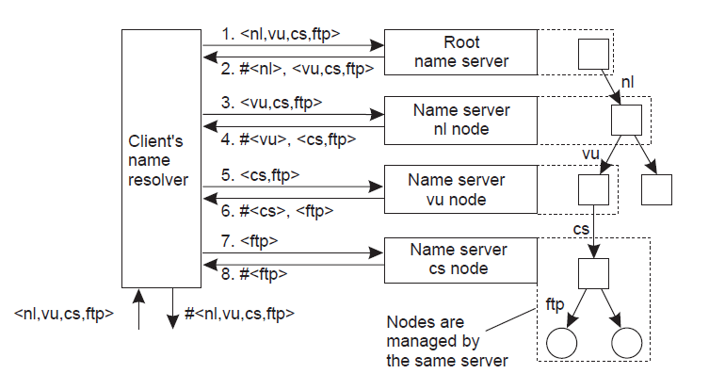
1. Iterative Name Resolution – An Example
<a,b,c> = structured name in a sequence
#<a> = address of node with name “a”
Resolving the name “ftp.cs.vu.nl”

Slide 28
2. Recursive Name Resolution
Approach:
  Client provides the name to the root name server
  The root name server passes the result to the next name server it finds
  The process continues till the name is fully resolved
Drawback:
  Large overhead at name servers (especially, at the high-level name servers)

Slide 29
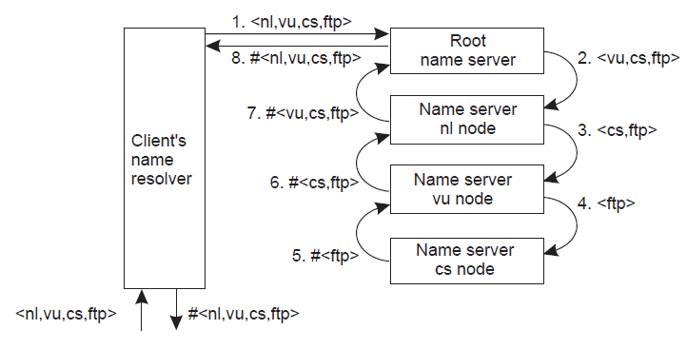
2. Recursive Name Resolution – An Example
<a,b,c> = structured name in a sequence
#<a> = address of node with name “a”
Resolving the name “ftp.cs.vu.nl”

Slide 30
Classes of Naming
Flat naming
Structured naming
Attribute-based naming

Slide 31
Attribute-based Naming
In many cases, it is much more convenient to name, and look up entities by means of their attributes
  Similar to traditional directory services (e.g., yellow pages)
However, the lookup operations can be extremely expensive
  They require to match requested attribute values, against actual attribute values, which might require inspecting all entities
Solution: Implement basic directory service as a database, and combine it with traditional structured naming system
We will study Light-weight Directory Access Protocol (LDAP); an example system that uses attribute-based naming

Slide 32
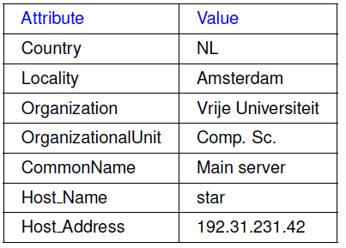
Light-weight Directory Access Protocol (LDAP)
LDAP directory service consists of a number of records called “directory entries”
  Each record is made of (attribute, value) pairs
  LDAP standard specifies five attributes for each record
Directory Information Base (DIB) is a collection of all directory entries
  Each record in a DIB is unique
  Each record is represented by a distinguished name
  E.g., /C=NL/O=Vrije Universiteit/OU=Comp. Sc.

Slide 33
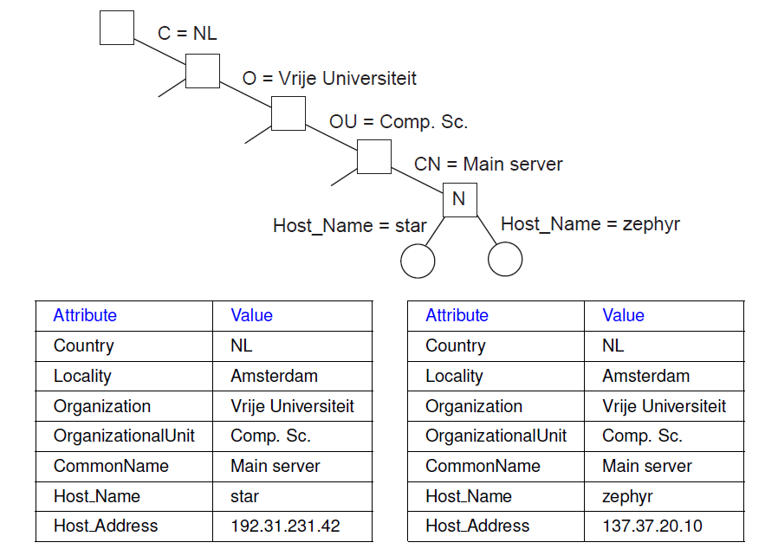
Directory Information Tree in LDAP
All the records in the DIB can be organized into a hierarchical tree called Directory Information Tree (DIT)
LDAP provides advanced search mechanisms based on attributes by traversing the DIT
Example syntax for searching all Main_Servers in Vrije Universiteit:
search("&(C = NL) (O = Vrije Universiteit) (OU = *) (CN = Main server)")

Slide 34
Summary
Naming and name resolutions enable accessing entities in a distributed system
Three types of naming:
  Flat Naming
    Broadcasting, forward pointers, home-based approaches, Distributed Hash Tables (DHTs)
  Structured Naming
    Organizes names into Name Spaces
    Distributed Name Spaces
  Attribute-based Naming
    Entities are looked up using their attributes

Slide 35
Next Class
More on Naming…

