Slide 1
Distributed Systems
CS 15-440
Pregel & GraphLab
Lecture 16, November 12, 2018
Mohammad Hammoud

Slide 2
Today…
Last Session:
  Hadoop (Cont’d)
Today’s Session:
  Pregel & GraphLab
Announcements:
  PS4 is due on November 18 by midnight
  P3 is due on November 26 by midnight

Slide 3
Distributed Analytics Frameworks
Pregel
Introduction & Execution Model
Programming Model
Architectural & Scheduling
Models

Slide 4
Google’s Pregel
MapReduce is a good fit for a wide array of large-scale applications but ill-suited for graph processing
Pregel is a large-scale “graph-parallel” distributed analytics framework
Some Characteristics:
  In-Memory across iterations (or super-steps)
  High scalability
  Automatic fault-tolerance
  Flexibility in expressing graph algorithms
  Message-Passing programming model
  Tree-style, master-slave architecture
  Synchronous
Pregel is inspired by Valiant’s Bulk Synchronous Parallel (BSP) model

Slide 5
The BSP Model
Iterations
Data
Data
Data
Data
CPU 1
CPU 1
CPU 1
Data
Data
Data
Data
Data
Data
Data
Data
CPU 2
CPU 2
CPU 2
Data
Data
Data
Data
Data
Data
Data
Data
CPU 3
CPU 3
CPU 3
Data
Data
Data
Data
Data
Data
Data
Data
Barrier
Barrier
Barrier
Super-Step 1
Super-Step 2
Super-Step 3

Slide 6

Google’s Pregel: A Bird’s Eye View
  The input to Pregel is a directed graph, which can be stored on a distributed storage layer (e.g., GFS or Bigtable)
  The input graph is partitioned (e.g., using hash partitioning) and distributed across cluster machines
  Execution is pursued in super-steps and final output can be stored again in a distributed storage layer
HDFS BLK
A Master Machine
HDFS BLK
Dataset
To HDFS
HDFS BLK
HDFS
HDFS BLK

Slide 7
Distributed Analytics Frameworks
Pregel
Introduction & Execution Model
Programming Model
Architectural & Scheduling
Models

Slide 8
Workflow and the Programming Model
  A user-defined function (say F) is executed at each vertex (say V)
  F can read messages sent to V in super-step S – 1 and send messages to other vertices, which will receive them at super-step S + 1
  F can modify the state of V and its
  outgoing edges
  F can alter the topology of the graph
  Messages in F are “explicitly” sent/received by programmers
    Hence, Pregel employs a message-passing programming model
Machines
Local
Computations
Communication
Barrier
Synchronization
Vertical Structure of a Super-Step

Slide 9
When Does a Pregel Program Terminate?
A Pregel program works as follows:
  At super-step 0, every vertex is active
  ONLY active vertices in any super-step perform computations
  A vertex deactivates itself by voting to halt
    It, subsequently, enters an inactive state
  A vertex can return to an active state if it receives an external message
A Pregel program terminates when:
  All vertices are inactive
  And, there are no messages in transit
Vote to Halt
Active
Inactive
Message Received
Vertex State Machine

Slide 10
Example: Find Max Value
3
6
2
1
Blue Arrows
are messages
3
6
6
6
2
1
2
6
Blue vertices
have voted to halt
S1
6
6
6
2
6
6
6
S2
6
6
6
6
6
S3

Slide 11
Distributed Analytics Frameworks
Pregel
Introduction & Execution Model
Programming Model
Architectural & Scheduling
Models

Slide 12
The Architectural and Scheduling Models
Pregel assumes a tree-style network topology and a master-slave architecture
Core Switch
Rack Switch
Rack Switch
Worker1
Worker2
Worker3
Worker4
Worker5
Master
Push work (i.e., partitions) to all workers
Send Completion Signals
When the master receives the completion signal from every worker in super-step S, it starts super-step S + 1

Slide 13

Google’s Pregel: Summary
Aspect | Google’s Pregel
Programming Model | Message-Passing
Execution Model | Synchronous
Architectural Model | Master-Slave
Scheduling Model | Push-Based
Suitable Applications | Strongly-Connected Applications

Slide 14
MapReduce vs. Pregel
Aspect | Hadoop MapReduce | Google’s Pregel
Programming Model | Shared-Based | Message-Passing
Execution Model | Synchronous | Synchronous
Architectural Model | Master-Slave | Master-Slave
Scheduling Model | Pull-Based | Push-Based
Suitable Applications | Loosly-Connected | Strongly-Connected

Slide 15
The GraphLab Analytics Engine
GraphLab
Motivation & Definition
Input, Output & Components
The Architectural Model
The Programming Model
The Computation Model

Slide 16
Motivation for GraphLab
  There is an exponential growth in the scale of Machine Learning and Data Mining (MLDM) algorithms
  Designing, implementing, and testing MLDM at large-scale are challenging due to:
    Synchronization
    Deadlocks
    Scheduling
    Distributed state management
    Fault-tolerance
  The interest on analytics engines that can execute MLDM algorithms automatically and efficiently is increasing
    MapReduce is inefficient with iterative jobs (common in MLDM algorithms)
    Pregel cannot run asynchronous problems (common in MLDM algorithms)

Slide 17
What is GraphLab?
  GraphLab is a large-scale graph-parallel distributed analytics engine
  Some Characteristics:
  In-Memory (opposite to MapReduce and similar to Pregel)
  High scalability
  Automatic fault-tolerance
  Flexibility in expressing arbitrary graph algorithms (more flexible than Pregel)
  Shared-based abstraction (opposite to Pregel but similar to MapReduce)
  Peer-to-peer architecture (dissimilar to Pregel and MapReduce)
  Asynchronous (dissimilar to Pregel and MapReduce)

Slide 18
The GraphLab Analytics Engine
GraphLab
Motivation & Definition
Input, Output & Components
The Architectural Model
The Programming Model
The Computation Model

Slide 19

Input, Graph Flow and Output
  GraphLab assumes problems modeled as graphs
  It adopts two phases, the initialization and the execution phases
Initialization Phase
GraphLab Execution Phase
Distributed File system
(MapReduce) Graph Builder
Distributed File system
Cluster
Distributed File system
TCP RPC Comms
Parsing + Partitioning
Raw Graph Data
Atom Index
Monitoring + Atom Placement
Atom Index
Atom File
Atom File
Atom File
Atom File
Atom Collection
GL Engine
Raw Graph Data
Atom File
Atom File
Atom File
Atom File
GL Engine
Index Construction
Atom File
Atom File
GL Engine
Atom File
Atom File
Notes:
GraphLab assumes input problems modeled as graphs, in which vertices represent computations and edges encode data dependences or communication

Slide 20
Components of the GraphLab Engine: The Data-Graph
  The GraphLab engine incorporates three main parts:
  The data-graph, which represents the user program state at a cluster machine
Vertex
Edge
Data-Graph

Slide 21
Components of the GraphLab Engine: The Update Function
  The GraphLab engine incorporates three main parts:
  The update function, which involves two main sub-functions:
    2.1- Altering data within a scope of a vertex
    2.2- Scheduling future update functions at neighboring vertices
S_{v}
The scope of a vertex v (i.e., S_{v})
is the data stored in v and in all
v’s adjacent edges and vertices
v

Slide 22
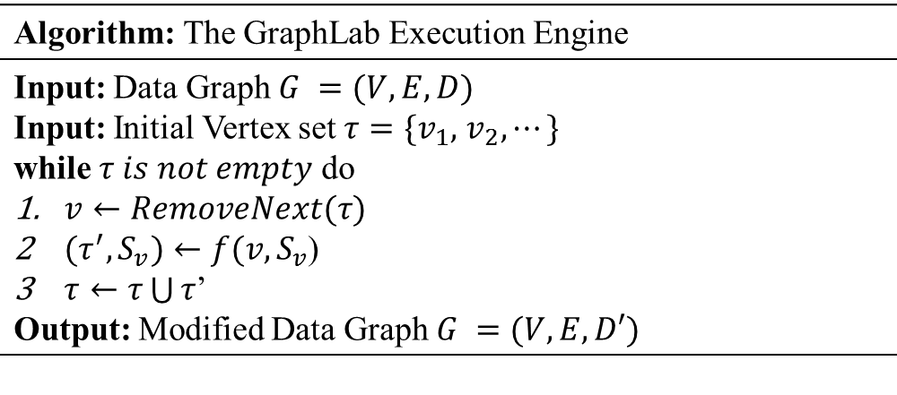
Components of the GraphLab Engine: The Update Function
  The GraphLab engine incorporates three main parts:
  The update function, which involves two main sub-functions:
    2.1- Altering data within a scope of a vertex
    2.2- Scheduling future update functions at neighboring vertices
Algorithm: The GraphLab Execution Engine
Schedule v
The update function

Slide 23
Components of the GraphLab Engine: The Update Function
  The GraphLab engine incorporates three main parts:
  The update function, which involves two main sub-functions:
    2.1- Altering data within a scope of a vertex
    2.2- Scheduling future update functions at neighboring vertices
CPU 1
b
c
d
a
b
c
Scheduler
e
f
b
e
f
g
a
i
h
i
j
h
i
j
k
CPU 2
The process repeats until the scheduler is empty

Slide 24
Components of the GraphLab Engine: The Sync Operation
  The GraphLab engine incorporates three main parts:
  The sync operation, which maintains global statistics describing data stored in the data-graph
Global values maintained by the sync operation can be written by all update functions across the cluster machines
The sync operation is similar to Pregel’s aggregators
A mutual exclusion mechanism is applied by the sync operation to avoid write-write conflicts
For scalability reasons, the sync operation is not enabled by default

Slide 25
The GraphLab Analytics Engine
GraphLab
Motivation & Definition
Input, Output & Components
The Architectural Model
The Programming Model
The Computation Model

Slide 26
The Architectural Model
  GraphLab adopts a peer-to-peer architecture
  All engine instances are symmetric
  Engine instances communicate together using Remote Procedure Call (RPC) protocol over TCP/IP
  The first triggered engine has an additional responsibility of being a monitoring/master engine
  Advantages:
  Highly scalable
  Precludes centralized bottlenecks and single point of failures
  Main disadvantage:
  Complexity

Slide 27
The GraphLab Analytics Engine
GraphLab
Motivation & Definition
Input, Output & Components
The Architectural Model
The Programming Model
The Computation Model

Slide 28
The Programming Model
  GraphLab offers a shared-based programming model
  It allows scopes to overlap and vertices to read/write from/to their scopes

Slide 29
Consistency Models in GraphLab
  GraphLab guarantees sequential consistency
    Provides the same result as a sequential execution of the computational steps
  User-defined consistency models
    Full Consistency
    Vertex Consistency
    Edge Consistency
Full Consistency
Edge Consistency
Vertex Consistency
Vertex v

Slide 30
Consistency Models in GraphLab
Read
Full
Consistency
Model
Write
1
2
3
4
5
D_{1↔2}
D_{2↔3}
D_{3↔4}
D_{4↔5}
D₁
D₂
D₃
D₄
D₅
Read
Edge
Consistency
Model
Write
1
2
3
4
5
D_{1↔2}
D_{2↔3}
D_{3↔4}
D_{4↔5}
D₁
D₂
D₃
D₄
D₅
Read
Vertex
Consistency
Model
Write
1
2
3
4
5
D_{1↔2}
D_{2↔3}
D_{3↔4}
D_{4↔5}
D₁
D₂
D₃
D₄
D₅

Slide 31
The GraphLab Analytics Engine
GraphLab
Motivation & Definition
Input, Output & Components
The Architectural Model
The Programming Model
The Computation Model

Slide 32
The Computation Model
GraphLab employs an asynchronous computation model
It suggests two asynchronous engines
  Chromatic Engine
  Locking Engine
The chromatic engine executes vertices partially asynchronous
  It applies vertex coloring (e.g., no adjacent vertices share the same color)
  All vertices with the same color are executed before proceeding to a different color
The locking engine executes vertices fully asynchronously
  Data on vertices and edges are susceptible to corruption
  It applies a permission-based distributed mutual exclusion mechanism to avoid read-write and write-write hazards
Notes:
Asynchronous systems avoid waiting at pre-determined points for the completion of a certain task/vertex. This allows MLDM algorithms to converge faster (e.g., linear systems, belief propagation, expectation maximization and stochastic optimization algorithms converge faster on asynchronous systems).

Slide 33
  How Does GraphLab Compare to MapReduce and Pregel?

Slide 34
GraphLab vs. Pregel vs. MapReduce
Aspect | Hadoop MapReduce | Pregel | GraphLab
Programming Model | Shared-Based | Message-Passing | Shared-Memory
Aspect | Hadoop MapReduce | Pregel | GraphLab
Programming Model | Shared-Based | Message-Passing | Shared-Memory
Computation Model | Synchronous | Synchronous | Asynchronous
Aspect | Hadoop MapReduce | Pregel | GraphLab
Programming Model | Shared-Based | Message-Passing | Shared-Memory
Computation Model | Synchronous | Synchronous | Asynchronous
Parallelism Model | Data-Parallel | Graph-Parallel | Graph-Parallel
Aspect | Hadoop MapReduce | Pregel | GraphLab
Programming Model | Shared-Based | Message-Passing | Shared-Memory
Computation Model | Synchronous | Synchronous | Asynchronous
Parallelism Model | Data-Parallel | Graph-Parallel | Graph-Parallel
Architectural Model | Master-Slave | Master-Slave | Peer-to-Peer
Aspect | Hadoop MapReduce | Pregel | GraphLab
Programming Model | Shared-Based | Message-Passing | Shared-Memory
Computation Model | Synchronous | Synchronous | Asynchronous
Parallelism Model | Data-Parallel | Graph-Parallel | Graph-Parallel
Architectural Model | Master-Slave | Master-Slave | Peer-to-Peer
Task/Vertex Scheduling Model | Pull-Based | Push-Based | Push-Based
Aspect | Hadoop MapReduce | Pregel | GraphLab
Programming Model | Shared-Based | Message-Passing | Shared-Memory
Computation Model | Synchronous | Synchronous | Asynchronous
Parallelism Model | Data-Parallel | Graph-Parallel | Graph-Parallel
Architectural Model | Master-Slave | Master-Slave | Peer-to-Peer
Task/Vertex Scheduling Model | Pull-Based | Push-Based | Push-Based
Application Suitability | Loosely-Connected/Embarrassingly Parallel Applications | Strongly-Connected Applications | Strongly-Connected Applications (more precisely MLDM apps)

Slide 35
Next Week…
Caching

Slide 36
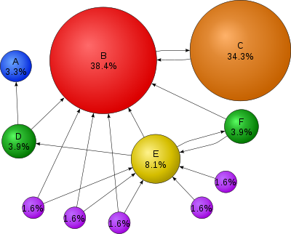
PageRank: Recap
The rank value indicates an importance of a particular web page
A hyperlink to a page counts
as a vote of support
A page that is linked to by many pages
with high PageRank receives a
high rank itself
A PageRank of 0.5 means there is a 50% chance that a person clicking on a random link will be directed to the document with the 0.5 PageRank

Slide 37
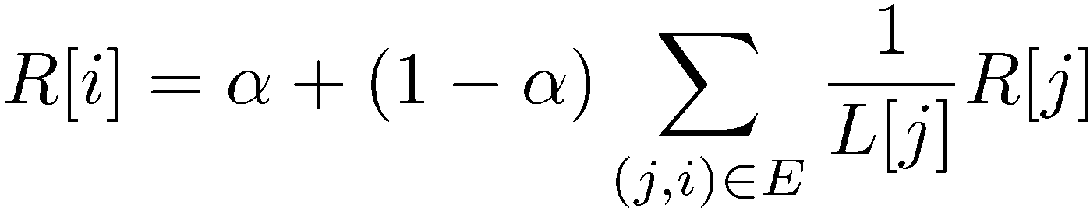
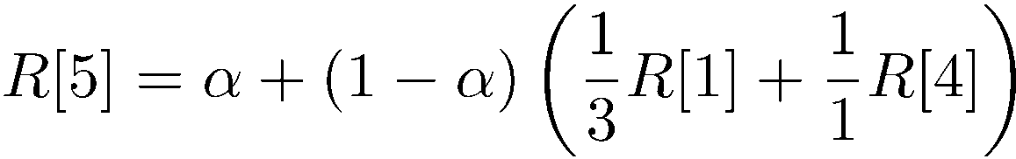
PageRank: Algorithm
Iterate:
Where:
  α is the random reset probability
  L[j] is the number of links on page j
1
2
3
4
5
6

Slide 38
PageRank Example in GraphLab
PageRank algorithm is defined as a per-vertex operation working on the scope of the vertex
pagerank(i, scope){
// Get Neighborhood data
(R[i], W_{ij}, R[j]) ←scope;
// Update the vertex data
// Reschedule Neighbors if needed
if R[i] changes then
reschedule_neighbors_of(i);
}
Dynamic
computation

