Slide 1
Distributed Systems CS 15-440
Networking- Part II
Lecture 3, August 28, 2017
Mohammad Hammoud

Slide 2
Today…
Last Session:
Networking- Part I
Network Types
Networking Principles: Layering
Today’s Session:
Networking- Part II
Networking Principles: Encapsulation, Routing, and Congestion Control
Announcements:
PS1 is out; it is due on September 11th
Eid Al Adha break is from August 31st to September 7th
No recitation on August 31st

Slide 3
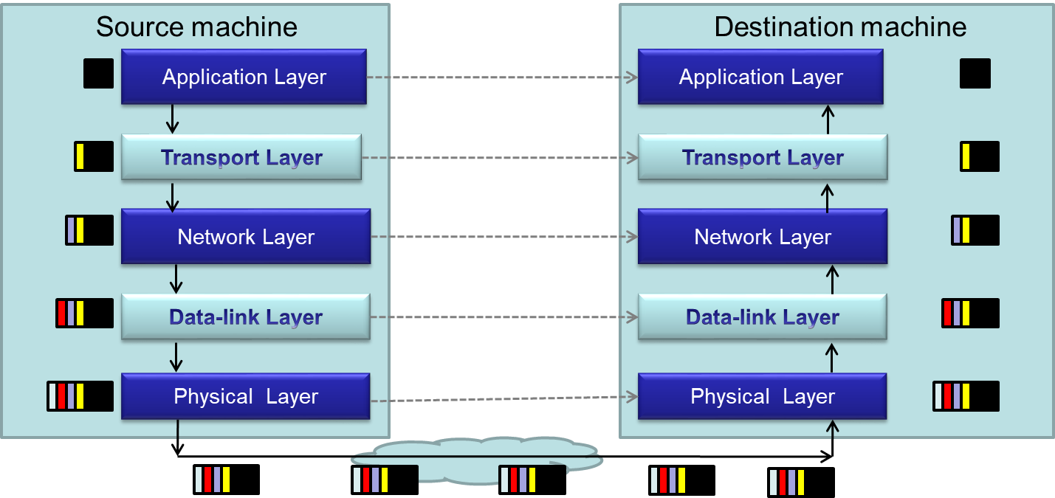
Packet Encapsulation
Encapsulation is a technique to pack and unpack data packets in a layered architecture

Slide 4
Layers that We Will Study Today
Physical layer
Data-link layer
Network layer
Transport layer

Slide 5
Layers that We Will Study Today
Physical layer
Data-link layer
Network layer
Transport layer

Slide 6
Physical Layer
Physical layer protocols transmit a sequence of bits over a transmission medium
Modulate the bits into signals that can be transmitted over the medium
Transmission Medium | Type of signal transmitted
Twisted-pair (Ethernet cable) | Electrical signal
Fiber Optic Circuits | Light signal
Wireless channel | Electro-magnetic signal
Data-link layer protocol
Bits
A physical layer protocol
Signal
Transmission Medium

Slide 7
Layers that We Will Study Today
Physical layer
Data-link layer
Network layer
Transport layer

Slide 8
Data-link Layer
Protocols in data-link layer ensure that packets are delivered from one host to another within a local network
Data-link layer protocols provide two main functionalities:
How to coordinate between the transmitters such that packets are successfully received?
Coordination
How to identify another host on the local network?
Addressing over local networks

Slide 9
Coordination at Data-link Layer
A packet is not received successfully at the receiver if a sender transmits the data when another sender’s transmission is active
The packet is said to have experienced collision if it is not successfully received at the receiver
Collision is avoided by sensing the medium before transmission

Slide 10
Addressing over Local Networks
Each device that is connected to a network has a unique address called Medium Access Control (MAC) address
MAC addresses are six bytes long
e.g., 2A:D4:AB:FD:EF:8D
Approach:
Data-link layer broadcasts the packet over the medium
Receiver reads the packet header and checks if the packet is addressed to it
x
x

Slide 11
Layers that We Will Study Today
Physical layer
Data-link layer
Network layer
Transport layer

Slide 12
Network Layer
Network layer protocols perform the role of routing
They ensure that a packet is routed from the source machine to the destination machine
Packets may traverse different LANs to reach the destination
Internet Protocol (IP) is a widely-used network layer protocol
IP addresses are typically used to identify machines
Router
Source
Destination

Slide 13
Router
A router is a device that forwards the packets between multiple networks
Routers are connected to two or more networks
Each network interface is connected to a LAN or a host
Packet travels up until the network layer on the router
Source machine
Router
Dest machine
A Router
Application
Application
LAN-1
LAN-3
Transport
Transport
Int-1
Int-2
Int-3
Network
Network
Network
Data-link
Data-link
Data-link
LAN-2
Physical
Physical
Physical

Slide 14
Routing Algorithm
Packets have to be transmitted in a series of hops through the routers
The series of hops that a packet takes is known as a route
Routing algorithm is responsible for determining the routes for the transmission of packets
Challenges for designing routing algorithms in the Internet:
Performance: The traffic across different networks vary
Router failures: Routers in the Internet may fail
R2
S
R1
R4
D
R4

Slide 15
Routing Algorithm (Cont’d)
Routing algorithms have two activities
Determine the next-hop taken by each packet
The algorithm should be fast and efficient
Dynamically update connectivity information
Maintain the knowledge of the network by monitoring routers and traffic
The above activities are distributed throughout the network
Routing decisions are made on an hop-by-hop basis
Information about possible next-hop routers is stored locally
Information is updated periodically
We will study a simple routing algorithm called “Distance Vector Algorithm”

Slide 16
Distance Vector Algorithm
Distance Vector (DV) uses graph theoretical algorithms to find the best route in the network
It uses a well-known shortest path algorithm called Bellman-Ford algorithm
Two activities for the DV routing algorithm:
Determining the best next-hop at each router
Dynamically update connectivity information at all the routers

Slide 17
Distance Vector Algorithm – Next-hop Determination
Each router maintains a routing table that consists of:
Destination: The destination IP of the packet
Link: The outgoing link on which the packet should be forwarded
Cost: The distance between the router and the destination
E.g., Cost can be estimated as the delay for the packet to reach the destination
Router looks up the table to determine the best next-hop
Routing table at a router A
Hosts or local networks
Routers
To
Link
Cost
A
local
0
A
1
B
4
E
B
1
1
C
1
2
3
Links
2
D
3
1
E
1
2
D
C

Slide 18
Routing Tables for an Example Scenario
Routings from A
Routings from B
Routings from C
To
Link
Cost
To
Link
Cost
To
Link
Cost
A
local
0
A
1
1
A
2
2
B
1
1
B
local
0
B
2
1
C
1
2
C
2
1
C
local
0
D
3
1
D
1
2
D
5
2
E
1
2
E
4
1
E
5
1
Links
Routers
A
1
B
2
Routings from D
Routings from E
3
4
C
To
Link
Cost
To
Link
Cost
5
A
3
1
A
4
2
D
6
E
B
3
2
B
4
1
Hosts or local networks
C
6
2
C
5
1
D
local
0
D
6
1
E
6
1
E
local
0

Slide 19
Distance Vector Algorithm – Updating the Connectivity Information
Connectivity is updated by exchanging routing table
Router Information Protocol (RIP) is used for sending update messages
Send routing table to neighboring routers
Periodically, or when local table changes
When a neighbor’s routing table is received:
Case | If the received routing table … | Updates to the local routing table
1 | Has a new destination that is not in the local routing table | Update the Cost and Link
2 | Has a better-cost route to a destination in the local routing table | Update the Cost
3 | Has a more recent information | Update the Cost and Link

Slide 20
Pseudocode for RIP
Send: Each t seconds or when Tl changes, send Tl on each non-faulty outgoing link
Receive: Whenever a routing table Tr is received on link n:
for all rows Rr in Tr {
if (Rr.link != n) {
Rr.cost = Rr.cost + 1; // Update cost
Rr.link = n; // Update next-hop
if (Rr.destination is not in Tl) {
add Rr to Tl; // add new destination to Tl
}
else for all rows Rl in Tl {
if (Rr.destination = Rl.destination) {
// Rr.cost < Rl.cost : remote node has better route
// Rl.link = n : information is more recent
if (Rr.cost < Rl.cost OR Rl.link = n) {
Rl = Rr;
}
}
}
}
}
A
1
B
2
3
4
C
5
D
6
E
Tl at A
Case 1
Routing table at router A
To
Link
Cost
A
local
0
Case 2
D
3
1
C
3
3
Case 3
Tr recvd @ A from B on link n=1
Routing table of router B
To
Link
Cost
A
1
1
B
local
0
C
2
1
Notes:
20
Ask:
What happens when a link is broken?
Will this surely converge even if link breaks?
How can you take care of link-quality? Say link A-B is 10Gbps Ethernet link and link A-C is 2Mbps wireless link.

Slide 21
Summary: Routing over Internet
Each machine over the Internet is identified by an IP Address
Source machine transmits the packet over its local network
Intermediate routers examine the packet, and forward it to the best next-hop router
If the destination is directly attached to the local network of a router, the router forwards the packet over the respective local network
Routers exchange information to keep an up-to-date information about the network

Slide 22
Layers that we will study today
Physical layer
Data-link layer
Network layer
Transport layer

Slide 23
Transport Layer
Transport layer protocols provide end-to-end communication for applications
This is the lowest layer where messages (rather than packets) are handled
Messages are addressed to communication ports attached to the processes
Transport layer multiplexes each
packet received to its respective port
Destination machine
P1
P2
P3
Transport layer protocol
Network layer protocol

Slide 24
Simple Transport Layer Protocols
Simple transport protocols provide the following services:
Multiplexing Service
Connection-less Communication: The sender and receiver processes do not initiate a connection before sending the message
Each message is encapsulated in a packet (also called as datagram)
Messages at the receiver can be in different order than the one sent by the sender
E.g., User Datagram Protocol (UDP)

Slide 25
Advanced Transport Layer Protocols
Advanced transport layer protocols typically provide more services than simple multiplexing
Transmission Control Protocol (TCP) is a widely-used protocol that provides three additional services:
Connection-oriented Communication
Reliability
Congestion Control

Slide 26
1. Connection-Oriented Communication
Sender and receiver will handshake before sending the messages
Handshake helps to set-up connection parameters, and to allocate resources at destination to receive packets
Destination provides in-order delivery of messages to the intended process
Destination will buffer the packets until previous packets are received
It will then deliver packets to the process in the order that the sender had used
Source machine
Destination machine
P1
P1
P3
P1
P2
P3
Shall I send?
TCP protocol
TCP protocol
OK. Start sending

Slide 27
2. Reliability
Packets may be lost in the network due to buffer overflows at the router or transmission error(s)
In TCP, destination sends an ACK to the sender
If ACK is not received at the sender, the sender will infer a packet error, and retransmit the packet

Slide 28
3. Congestion Control
The capacity of a network is limited by the individual communication links and routers
Limited buffer space and link-bandwidth
What happens if a source transmits packets at a rate that is greater than the capacity of the network?
Packets drop at intermediate routers
Corresponding ACKs will NOT be received at the source
The source retransmits
More packets build-up on the router queue
The network collapses

Slide 29
3. Congestion Control (Cont’d)
To avoid congestion, two functionalities can be adopted
Detect congestion at routers
If a router expects a buffer overflow, it typically follows one of two strategies:
It drops packets and lets sources regulate upon observing packet losses
It sends an “Explicit Congestion Notification (ECN)” packet to sources
Regulate input at sources
If the TCP-sender concludes congestion (e.g., it receives an ECN packet), then it reduces its sending rate
Notes:
What is the best layer for congestion control?
Do you know any other protocol similar to TCP that is widely used?
When/where is congestion control important, where is it not?

Slide 30
Recap: Introduction to Networking – Learning Objectives
You will identify how computers over the Internet communicate
Specifically, after the two lectures in networking you will be able to:
Identify different types of networks
Describe networking principles such as layering, encapsulation, and packet-switching
Examine how packets are routed and how congestion is controlled
Analyze scalability, reliability, and fault-tolerance over the Internet

Slide 31
Next class
Remote Procedure Calls- Part I

