Slide 1
Distributed Systems CS 15-440
Networking- Part I
Lecture 2, August 23, 2017
Mohammad Hammoud

Slide 2
Today…
Last Session:
Introduction
Today’s Session:
Network Types
Networking Principles: Layering and Encapsulation
Announcement:
In tomorrow’s recitation, we will practice on Java programming (Projects I and II will be in Java)

Slide 3
Introduction to Networking – Learning Objectives
You will identify how computers over the Internet communicate
Specifically, after today’s and next Monday’s lectures you will be able to:
Identify different types of networks
Describe networking principles such as layering, encapsulation, and packet-switching
Examine how packets are routed and how congestion is controlled
Analyze scalability, reliability, and fault-tolerance over the Internet

Slide 4
Networks in Distributed Systems
A distributed system is simply a collection of components that communicate to solve a problem
Why should programmers of distributed systems know about networks?
Networking issues severely affect performance, fault-tolerance, and security of distributed systems
E.g., Gmail outage on Sep 1, 2010 – Google Spokesman said “we had slightly underestimated the load which some recent changes placed on the request routers. … . few of the request routers became overloaded… causing a few more of them to also become overloaded, and within minutes nearly all of the request routers were overloaded.”

Slide 5
A Primer: Latency and Bandwidth
Case 1
Case 2
B
B
L
L
Case 3
B
L
B = Bandwidth (or Capacity) and L = Latency (or Delay)
B × L gives approximately the number of bits in flight
As B × L increases, uncertainty increases (more bits might get lost)
High value of B × L leads to “Buffer Bloat”

Slide 6
Networks in Distributed Systems
Networking Issue | Comments on a Distributed System Design
Performance
Scalability
Reliability
Security
Mobility
Quality-of-service
Affects latency and data-transfer-rate of messages.
Size of Internet is increasing. Expect greater traffic in future.
Detect communication errors and perform error-checks at the application layer.
Install firewalls. Deploy end-to-end authentication, privacy and security modules.
Expect intermittent connection for mobile devices.
Internet is best-effort. It is hard to ensure strict QoS guarantees for, say, multimedia messages.

Slide 7
Network Classification
Important ways to classify networks
Based on size
Body Area Networks (BAN)
Personal Area Networks (PAN)
Local Area Networks (LAN)
Wide Area Networks (WAN)
Based on technology
Ethernet Networks
Wireless Networks
Cellular Networks

Slide 8
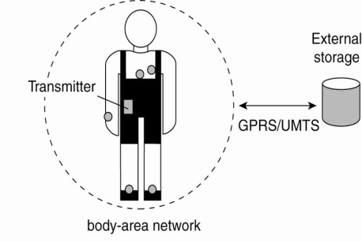
Network Classification – BANs and PANs
Body Area Networks (BAN):
Devices form wearable computing units
Several Body Sensor Units (BSUs) communicate with Body Central Unit (BCU)
Typically, low-cost and low-energy networking
Personal Area Networks (PAN):
PAN connects various digital devices carried by a user (mobile phones, tablets, cameras)
Low-cost and low-energy networking
e.g., Bluetooth
Notes:
8
The types of networks can be classified based on size:
Personal Area Networks: Various digital devices carried by the user is connected using a low-cost, low-energy network. e.g. Bluetooth

Slide 9
Network Classification – LAN
Computers connected by single communication medium
e.g., Twisted copper wire, optical fiber
High data-transfer-rate and low latency
LAN consists of
Segment
Usually within a department/floor of a building
Shared bandwidth, no routing necessary
Local Networks
Serves campus/office building
Many segments connected by a switch/hub
Typically, represents a network within an organization
Notes:
9
Local Area Networks: High speed computers connected through a single communication medium (optical, wired or wireless) . “Segment” is a part of the network that is connected by a single medium (e.g. ethernet cable). When a hosts inside a LAN transmits a packet, all other hosts can receive the packet. Hence, there is no need for routing. The bandwidth available is shared between all the hosts. A LAN can be made up of many segments. There is generally a host, which is called as switch or the hub, that helps to connect two or more segments. Communication between hosts in a LAN generally provides high bandwidth and low-delay. But most popularly used LANs, such as Ethernet-based LAN, does not not guarantee bandwidth or delay.

Slide 10
Network Classification – WAN
Generally covers a wider area (cities, countries,...)
Consists of networks of different organizations
Traffic is routed from one organization to another
Routers
Bandwidth and latency
Varies
Worse than a LAN
Largest WAN = Internet

Slide 11
Brief Summary of Important Networks
(Based on Size)
A Segment
A Point-to-point link
Local Area Network (LAN)
A network of networks
A Network
Wide Area Network (WAN)
Notes:
11

Slide 12
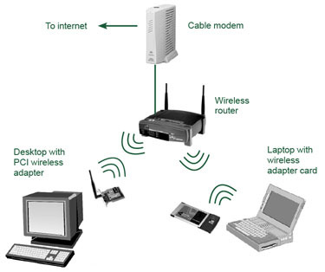
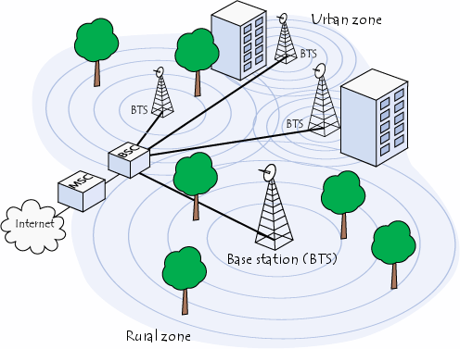
Types of Networks – Based on Technology
Ethernet Networks
Predominantly used in the wired Internet
Wireless LANs
Primarily designed to provide wireless access to the Internet
Low-range (100s of m), high-bandwidth
Cellular networks (2G/3G/4G)
Initially, designed to carry voice
Large range (few kms)
Low-bandwidth

Slide 13
Typical Performance for Different Types of Networks
Network | Example | Range | Bandwidth (Mbps) | Latency (ms)
Wired LAN | Ethernet | 1-2 km | 10 – 10,000 | 1 – 10
Wired WAN | Internet | Worldwide | 0.5 – 600 | 100 – 500
Wireless PAN | Bluetooth | 10 – 30 m | 0.5 – 2 | 5 – 20
Wireless LAN | WiFi | 0.15 – 1.5 km | 11 – 108 | 5 – 20
Cellular | 2G – GSM | 100m – 20 km | 0.270 – 1.5 | 5
Modern Cellular | 3G | 1 – 5 km | 348 – 14.4 | 100 – 500

Slide 14
Latency and Bandwidth
Case 1
Case 2
B
B
(WiFi)
(LAN)
L
L
Case 3
(WAN)
B
L
B = Bandwidth (or Capacity) and L = Latency (or Delay)
B × L gives approximately the number of bits in flight
As B × L increases, uncertainty increases (more bits might get lost)
High value of B × L leads to “Buffer Bloat”

Slide 15
Networking Principles
Network Protocols
Packet Transmission
Network Layers
Physical layer
Data-link layer
Network layer and routing
Transport layer and congestion control

Slide 16
Networking Protocols
If two entities want to communicate on a network, pre-defined agreements are necessary
How many bits should be used to signal a 0-bit or a 1-bit?
How does the receiver know the last bit in the message?
How can a receiver detect if the message is damaged?
“Protocol” is a well-known set of rules and formats to be used for communication between the entities
Standardizing a well-known set of protocols supports communication among heterogeneous entities
Notes:
Networks allow an entity on one machine to communicate with another entity on another machine

Slide 17
Packet Transmission
Messages are broken up into packets
A packet is the unit of data that is transmitted between an origin and a destination
Packets can be of arbitrary lengths
Maximum size of the packet is known as Maximum Transmission Unit (MTU)
MTU prevents one host from sending a very long message
Each packet has two main fields
Header: Contains meta-information about the packet
e.g., Length of the packet, receiver ID
Data
Header
Data

Slide 18
Network Layers
Network software is arranged into a hierarchy of layers
Protocols in one layer perform one specific functionality
Layering is a scalable and modular design for complex software
Typical functionalities in a network software:
011100011 0011 011
Src
Functionality | Layer
Transmits bits over a transmission medium
Physical
Dest
Coordinates transmissions from multiple hosts that are directly connected over a common medium
Data link
Routes the packets through intermediate networks
Network
Destination machine
Handles messages – rather than packets – between sender and receiver processes
P1
P2
P3
Transport
Satisfies communication requirements for specific applications
Application

Slide 19
OSI Reference Model
Open Systems Interconnection (OSI) Reference Model
A layered networking model standardized by ISO
The model identifies various layers and their functionalities
Functionality | Layer | Example Protocols
Satisfy communication requirements for specific applications | Application | HTTP, FTP
Transmit data in network representation that is independent of representation in individual computers | Presentation | CORBA data representation
Support reliability and adaptation, such as failure detection and automatic recovery | Session | SIP
Handle messages – rather than packets – between sender and receiver processes | Transport | TCP, UDP
Route the packet through intermediate networks | Network | IP, ATM
Coordinate transmissions from multiple hosts that are directly connected over a common medium | Data-link | Ethernet MAC
Transmit bits over a transmission medium | Physical | Ethernet

Slide 20
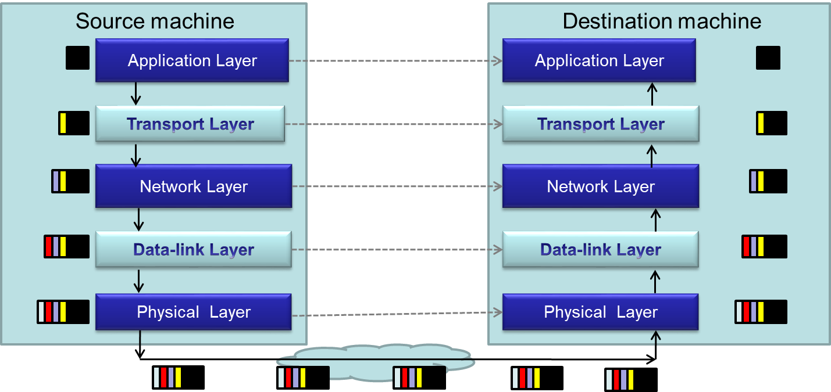
Packet Encapsulation
Encapsulation is a technique to pack and unpack data packets in a layered architecture

Slide 21
Layers that We Will Study Today
Physical layer
Data-link layer
Network layer

Slide 22
Layers that We Will Study Today
Physical layer
Data-link layer
Network layer

Slide 23
Physical Layer
Physical layer protocols transmit a sequence of bits over a transmission medium
Modulate the bits into signals that can be transmitted over the medium
Transmission Medium | Type of signal transmitted
Twisted-pair (Ethernet cable) | Electrical signal
Fiber Optic Circuits | Light signal
Wireless channel | Electro-magnetic signal
Data-link layer protocol
Bits
A physical layer protocol
Signal
Transmission Medium

Slide 24
Layers that We Will Study Today
Physical layer
Data-link layer
Network layer

Slide 25
Data-link Layer
Protocols in data-link layer ensure that the packets are delivered from one host to another within a local network
Data-link layer protocols provide two main functionalities:
How to coordinate between the transmitters such that packets are successfully received?
Coordination
How to identify another host on the local network?
Addressing over local networks

Slide 26
Coordination at Data-link Layer
A packet is not received successfully at the receiver if a sender transmits the data when another sender’s transmission is active
The packet is said to have experienced collision if it is not successfully received at the receiver
Collision is avoided by sensing the medium before transmission

Slide 27
Addressing over Local Networks
Each device that is connected to a network has a unique address called Medium Access Control (MAC) address
MAC addresses are six bytes long
e.g., 2A:D4:AB:FD:EF:8D
Approach:
Data-link layer broadcasts the packet over the medium
Receiver reads the packet header and checks if the packet is addressed to it
x
x

Slide 28
Layers that We Will Study Today
Physical layer
Data-link layer
Network layer

Slide 29
Network Layer
Network layer protocols perform the role of routing
They ensure that a packet is routed from the source machine to the destination machine
Packets may traverse different LANs to reach the destination
Internet Protocol (IP) is a widely-used network layer protocol
IP addresses are typically used to identify machines
Router
Source
Destination

Slide 30
Router
A router is a device that forwards the packets between multiple networks
Routers are connected to two or more networks
Each network interface is connected to a LAN or a host
Packet travels up until the network layer on the router
Source machine
Router
Dest machine
A Router
Application
Application
LAN-1
LAN-3
Transport
Transport
Int-1
Int-2
Int-3
Network
Network
Network
Data-link
Data-link
Data-link
LAN-2
Physical
Physical
Physical

Slide 31
Routing Algorithm
Packets have to be transmitted in a series of hops through the routers
The series of hops that a packet takes is known as a route
Routing algorithm is responsible for determining the routes for the transmission of packets
Challenges for designing routing algorithms in the Internet:
Performance: The traffic across different networks vary
Router failures: Routers in the Internet may fail
R2
S
R1
R4
D
R4

Slide 32
Routing Algorithm (Cont’d)
Routing algorithms have two activities
Determine the next-hop taken by each packet
The algorithm should be fast and efficient
Dynamically update connectivity information
Maintain the knowledge of the network by monitoring routers and traffic
The above activities are distributed throughout the network
Routing decisions are made on an hop-by-hop basis
Information about possible next-hop routers is stored locally
Information is updated periodically
We will study in the next lecture a simple routing algorithm called “Distance Vector Algorithm”

Slide 33
Next class
Networking- Part II

