Slide 1
Distributed Systems
CS 15-440
Architectural Models of Distributed Systems
Lecture 3, August 29, 2016
Mohammad Hammoud

Slide 2
Today…
Last Session:
  Trends and challenges in Distributed Systems
Today’s Session:
  Architectural Models of Distributed Systems
Announcements:
  PS1 is due on Monday, Sep 5
  In the upcoming recitation we will practice on Java Socket Programming

Slide 3
A Distributed System
A distributed system is simply a collection of hardware/software components that communicate to solve a complex problem
Each component performs a “task”
Components
performing tasks
C0
C1
Communication mechanism
C2
Notes:
Distributed System is a collection of hardware or software components – which are located at networked computers – communicate to solve a problem
Example:
Google search → Clients communicate with Google server
Bit-torrent → Clients download from multiple other clients

Slide 4
Bird’s Eye View of Some Distributed Systems
Peer 2
Google Server
Expedia
Peer 1
Peer 3
Request
Response
Reservation Client 1
Search Client 1
Reservation Client 2
Search Client 2
Reservation Client 3
Search Client 3
Peer 4
Google Search
Bit-torrent
Airline Booking
Skype
How would one classify these distributed systems?

Slide 5
Classification of Distributed Systems
What are the entities that are communicating in a DS?
  Communicating entities
How do the entities communicate?
  Communication paradigms
What roles and responsibilities do they have?
  Roles and responsibilities
How are they mapped to the physical distributed infrastructure?
  Placement of entities

Slide 6
Classification of Distributed Systems
What are the entities that are communicating in a DS?
  Communicating entities
How do the entities communicate?
  Communication paradigms
What roles and responsibilities do they have?
  Roles and responsibilities
How are they mapped to the physical distributed infrastructure?
  Placement of entities

Slide 7
Communicating Entities
What entities are communicating in a DS?
  System-oriented entities
    Processes
    Threads
    Nodes
  Problem-oriented entities
    Objects (in object-oriented programming based approaches)
Notes:
A device (like your laptop) may communicate with a google server
But there are lot of applications in your laptop. How does the server know which application to communicate with? You talk to a specific application, such as a browser, on a device.
But within an application there might be different threads. How do you know which thread to communicate with? For example, browser supports opening different tabs, and each tab has is talking to a different server (e.g., google, facebook, etc). Now when you request something to google, it should know to talk to your google thread, and not to the other.
There might be even finer granularity. There are lot of instances of objects, and you want to communicate with an object. In this fashion, you can drill down which specific module/entity you want to communicate with.
But there is another difficulty: distributed systems have heterogeneous elements. Your server might be running a web-server that runs on C++. However, your browser might be coded in Java. Then would you forbid communication between them? To abstract entities, and to enable seamless communication, we hence generalize the definition of entity.

Slide 8
Classification of Distributed Systems
What are the entities that are communicating in a DS?
  Communicating entities
How do the entities communicate?
  Communication paradigms
What roles and responsibilities do they have?
  Roles and responsibilities
How are they mapped to the physical distributed infrastructure?
  Placement of entities

Slide 9
Communication Paradigms
Three types of communication paradigms
  Inter-Process Communication (IPC)
  Remote Invocation
  Indirect Communication
Applications, Services
Remote Invocation, Indirect Communication
Middleware layers
IPC Primitives
Internet Protocols

Slide 10
Inter-Process Communication (IPC)
Relatively low-level support for communication
  e.g., Direct access to internet protocols (Socket API)
Advantages
  Enables seamless communication between processes on heterogeneous operating systems
    Well-known and tested API adopted across multiple operating systems
Disadvantages
  Increased programming effort for application developers
    Socket programming: Programmer has to explicitly write code for communication (in addition to program logic)
    Space Coupling (Identity is known in advance): Sender should know receiver’s ID (e.g., IP Address, port)
    Time Coupling: Receiver should be explicitly listening to the communication from the sender
Notes:
Space and time Coupling: Here a server will open a “socket”, as we discussed in recitation. As an example, think of a drive-in McDonalds++, where you have different windows: one window serves fries, other burger, and another coke. Think of a server as McDonald++ and a socket as a window. If McDonalds++ is ready to serve a respective item they will open this window.
Space coupling: If you don’t know where this window is, no luck.
Time coupling: Anybody who wants fries will go to the “fries” socket, If it is closed, no luck; you wont get fries. Else you ask them over the window your request of how many fries you want. In systems, an application on a host can open a socket at a “port”, and wait for requests. Anyone who wants to talk to the application will send a message to this particular socket using a well-known API.

Slide 11
Remote Invocation
An entity runs a procedure that typically executes on an another computer without the programmer explicitly coding the details for this remote interaction
  A middleware layer will take care of the raw-communication
Examples
  Remote Procedure Call (RPC) – Sun’s RPC (ONC RPC)
  Remote Method Invocation (RMI) – Java RMI

Slide 12
Remote Invocation
Advantages:
  Programmer does not have to write code for socket communication
Disadvantages:
  Space Coupling: Where the procedure resides should be
  known in advance
  Time Coupling: On the receiver, a process should be explicitly waiting to accept requests for procedure calls

Slide 13
Space and Time Coupling in RPC and RMI
The sender knows the Identity of the receiver (space coupling)
Time Coupling
doOperation
.
.
(wait)
.
.
(continuation)
Request Message
getRequest
.
Select operation
.
Execute operation
.
Send reply
Reply Message
Sender
Receiver
RMI strongly resembles RPC but in a world of distributed objects

Slide 14
Indirect Communication Paradigm
Indirect communication uses middleware to:
  Provide one-to-many communication
  Some mechanisms eliminate space and time coupling
    Sender and receiver do not need to know each other’s identities
    Sender and receiver need not be explicitly listening to communicate
Approach used: Indirection
  Sender → A middle-man → Receiver
Types of indirect communication
  Group communication
  Publish-subscribe
  Message queues
Notes:
Indirect communication uses middleware to remove space and time coupling
Senders do not need to know receivers
Senders and receivers do not need to exist
We saw IPC and RPCs. But both have the notion of sender talking to the receiver at a given point of time. What are the other communication mechanisms. Do you communicate always by talking to another person? What are the other modes of communication? Is it applicable to Distributed Systems?

Slide 15
1. Group Communication
One-to-many communication
  Multicast communication
Abstraction of a group
  Group is represented in the system by a groupId
  Recipients join the group
  A sender sends a message to the group which is received by all the recipients
Sender
Recv 2
Recv 1
Recv 3
Notes:
Group communication is a generalization of one-to-one communication to one-to-many (e.g. broadcasting football scores to interested party from fifa website).

Slide 16
1. Group Communication (cont’d)
Services provided by middleware
  Group membership
  Handling the failure of one or more group members
Advantages
  Enables one-to-many communication
  Efficient use of bandwidth
  Identity of the group members need not be available at all nodes
Disadvantages
  Time coupling

Slide 17
2. Publish-Subscribe
An event-based communication mechanism
  Publishers publish events to an event service
  Subscribers express interest in particular events
Large number of producers distribute information to large number of consumers
Publishers
Subscribers
Publish (Event1)
Subscribe (Event1)
Publish-subscribe Event Service
Subscribe (Event3)
Publish (Event2)
Subscribe (Event1, Event2)
Publish (Event3)
Notes:
Publish-subscribe: But you may be a client who is interested to hear from many servers. For example, your google reader application; you want the news feeds from many interesting football news sources delivered to your google reader page. This is handled through publish-subscribe model
Give examples: e.g., RSS Feeds, Google ad-clicks

Slide 18
2. Publish-Subscribe (cont’d)
Example: Financial trading
External
source
Dealer’s computer
Notification
Dealer process
Information providers

Slide 19
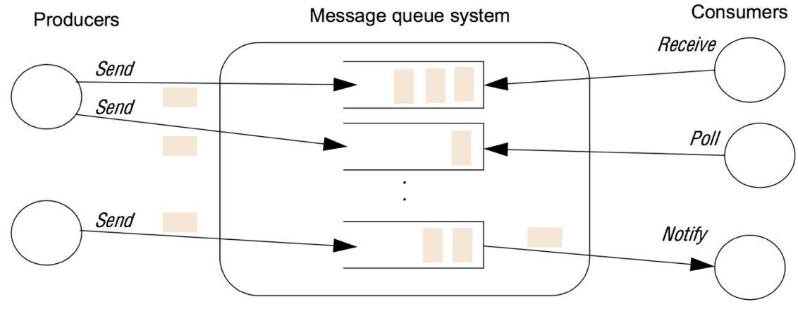
3. Message Queues
A refinement of Publish-Subscribe where
  Producers deposit the messages in a queue
  Messages are delivered to consumers through different methods
  Queue takes care of ensuring message delivery
Advantages
  Enables space decoupling
  Enables time decoupling
Notes:
There are other variations such as message-queue (Who has heard about IBM MQSeries, Java Messaging Service?) Very similar to publish-subcribe. The publisher – instead of delivering it directly to subscribers – puts a message into a queue. The messaging service will keep track of subscribers and help to deliver the messages (time decoupling)
The queue is an indirection which allows adding other functionalities. For example, now the client can either use
a traditional notify – queue delivers the message
A polling – client polls when it wants one
Receive – client waits till there is some message deposited in its queue

Slide 20
Recap: Communication Entities and Paradigms
Communicating entities (what is communicating)
System-oriented | Problem-oriented
Nodes Processes Threads | Objects
Communication Paradigms (how they communicate)
IPC | Remote Invocation | Indirect Communication
Sockets | RPC RMI | Group communication Publish-subscribe Message queues

Slide 21
Classification of Distributed Systems
What are the entities that are communicating in a DS?
  Communicating entities
How do the entities communicate?
  Communication paradigms
What roles and responsibilities do they have?
  Roles and responsibilities
How are they mapped to the physical distributed infrastructure?
  Placement of entities

Slide 22
Roles and Responsibilities
In DS, communicating entities take on roles to perform tasks
Roles are fundamental in establishing overall architecture
  Question: Does your smart-phone perform the same role as Google Search Server?
We classify DS architectures into two types based on the roles and responsibilities of the entities
  Client-Server
  Peer-to-Peer

Slide 23
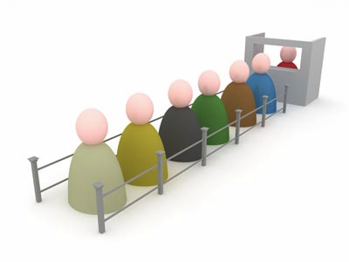
Client-Server Architecture
Approach:
  Server provides a service that is needed by a client
  Client requests to a server (invocation), the server serves (result)
Widely used in many systems
  e.g., DNS, Web-servers
Invocation
Client
Result
Server
Client

Slide 24
Client-Server Architecture: Pros and Cons
Advantages:
  Simplicity and centralized control
  Computation-heavy processing can be offloaded to a powerful server
    Clients can be “thin”
Disadvantages:
  Single-point of failure at server
  Scalability

Slide 25

Peer to Peer (P2P) Architecture
In P2P, roles of all entities are identical
  All nodes are peers
  Peers are equally privileged participants in the application
e.g.: Napster, Bit-torrent, Skype

Slide 26
Peer to Peer Architecture
Example: Downloading files from bit-torrent
Peer 1 wants a file. Parts of the file is present at peers 3,4 and 5
Peer 2
Peer 3 wants a file stored at peers 1,2 and 6
Peer 1
Peer 3
Peer 6
Peer 4
Peer 5

Slide 27
Architectural Patterns
Primitive architectural elements can be combined to form various patterns
  Tiered Architecture
  Layering
Tiered architecture and layering are complementary
  Layering = vertical organization of services
  Tiered Architecture = horizontal splitting of services

Slide 28
Tiered Architecture
A technique to:
  Organize the functionality of a service, and
  Place the functionality into appropriate servers
Airline Search Application
Display UI screen
Get user Input
Get data from database
Rank the offers

Slide 29
A Two-Tiered Architecture
How do you design an airline search application:
Tier 1
Tier 2
EXPEDIA Airline Search Application
Display user input screen
Get user Input
Airline Database
Display result to user
Rank the offers

Slide 30
A Three-Tiered Architecture
How do you design an airline search application:
Tier 1
Tier 2
Tier 3
EXPEDIA Airline Search Application
Display user input screen
Get user Input
Airline Database
Display result to user
Rank the offers

Slide 31
A Three-Tiered Architecture
Presentation Logic
Application Logic
Data Logic
User view, and controls
Application-Specific Processing
Database manager
User view, and control
Application-Specific Processing
Tier 1
Tier 2
Tier 3

Slide 32
Three-Tiered Architecture: Pros and Cons
Advantages:
  Enhanced maintainability of the software (one-to-one mapping from logical elements to physical servers)
  Each tier has a well-defined role
Disadvantages
  Added complexity due to managing multiple servers
  Added network traffic
  Added latency

Slide 33
Layering
A complex system is partitioned into layers
  Upper layer utilizes the services of the lower layer
  A vertical organization of services
Layering simplifies design of complex distributed systems by hiding the complexity of below layers
Control flows from layer to layer
Layer 3
Request
flow
Response
flow
Layer 2
Layer 1
Notes:
Examples of layering: Middleware (figure), networking,

Slide 34
Layering – Platform and middleware
Distributed Systems can be organized into three layers
Platform
  Low-level hardware and software layers
  Provides common services for higher layers
Middleware
  Mask heterogeneity and provide convenient programming models to application programmers
  Typically, it simplifies application programming by abstracting communication mechanisms
Applications
Applications
Middleware
Operating system
Platform
Computer and network hardware

Slide 35
Classification of Distributed Systems
What are the entities that are communicating in a DS?
  Communicating entities
How do the entities communicate?
  Communication paradigms
What roles and responsibilities do they have?
  Roles and responsibilities
How are they mapped to the physical distributed infrastructure?
  Placement of entities

Slide 36
Placement
Observation:
  A large number of heterogonous hardware (machines, networks)
  Smart mapping of entities (processes, objects) to hardware helps performance, security and fault-tolerance
“Placement” maps entities to underlying physical distributed infrastructure
    Placement should be decided after a careful study of application characteristics
    Example strategies:
    Mapping services to multiple servers
    Moving the mobile code to the client
Notes:
How can we improve Project 1 by designing efficient placement?
Cache files on client
Replicate (Map storage to different servers). Naming uses smart location of storage server which is near client or least loaded
Split files: Map commonly accessed data (probably from different files) on single server (e.g. Apache web-server updates /var/log/apache2/access.log. My service runs on apache and logs to /var/log/myApp/access.log. Place these files on same storage server, and issue bulk writes)

Slide 37
Placement
Entities
Web search indexing
User-interface
Mobile Code
Physical infrastructure
Hi-performance Server
Desktop
Smart-phone

Slide 38
Recap
We have covered primitive architectural elements
  Communicating entities
  Communication paradigms of entities
    IPC, RMI, RPC, Indirect Communication
  Roles and responsibilities that entities assume, and resulting architectures
    Client-Server, Peer-to-Peer, Hybrid
  Placement of entities

Slide 39
Next Class
  Identify different types of networks
Describe networking principles such as layering, encapsulation, and packet-switching
Examine how packets are routed and how congestion
is avoided
Analyze scalability, reliability, and fault-tolerance
of Internet

