Slide 1

Distributed Systems
CS 15-440
Introduction
Lecture 2, August 24, 2016
Mohammad Hammoud

Slide 2
Today…
Last Session:
  Administrivia
  Why distributed systems?
  What are the main requirements for building distributed systems?
Today’s Session:
  Part I: Some trends in distributed systems
  Part II: General challenges in building distributed systems
Announcement:
  Problem Solving Assignment 1 (PS1) will be posted on Thursday. It is due on September 5 by midnight
  Thursday’s recitation will be a preparation for Project 1

Slide 3
Today…
  Part I
  Some trends in distributed systems

Slide 4
Some Trends in Distributed Systems
Distributed systems are undergoing a period of significant changes and this can be traced back to a number of influential trends:
  The emergence of pervasive networking technology
  The emergence of ubiquitous computing coupled with the desire to support user mobility in distributed systems
  The increasing demand for multimedia services
  The view of distributed systems as utilities
  Others…

Slide 5
Some Trends in Distributed Systems
Distributed systems are undergoing a period of significant changes and this can be traced back to a number of influential trends:
  The emergence of pervasive networking technology
  The emergence of ubiquitous computing coupled with the desire to support user mobility in distributed systems
  The increasing demand for multimedia services
  The view of distributed systems as utilities
  Others…

Slide 6
Pervasive Networking
Technological advances in computer networking have led to different types of networks including but not limited to:
  WiFi
  WiMAX
  Bluetooth
  Overlay networks (e.g., BitTorrent and peer-to-peer networks)
Networking has become a pervasive resource and devices can mostly be connected at any time and in any place
Notes:
Latency: It can be measured as the time required to transfer an empty message
WiFi:
Allows you to connect to a wireless LAN (WLAN) network
Range: 0.15- 1.5 km
Bandwidth: 11-108 Mbps
Latency: 5- 20 ms
WiMAX:
Allows you to connect to a wireless MAN (WMAN) network
Range: 5- 50 km
Bandwidth: 1.5- 20 Mbps
Latency: 5- 20 ms
Bluetooth:
Allows you to connect to a wireless PAN (WPAN) network
Range: 10- 30 m
Bandwidth: 0.5-2 Mbps
Latency: 5- 20 ms
BitTorrent:
It is a peer-to-peer file sharing system, which is used to distribute data over the Internet
It is one of the most common protocols for transferring large files
Overall, peer-to-peer networks have been estimated to collectively account for approximately 43% to 70% of all Internet traffic (as of 2009)

Slide 7

The Modern Internet
The modern Internet is a vast interconnected collection of computer networks of many different types
The modern Internet allows users wherever they are, to make use of services such as World Wide Web, email and file transfer
intranet
☎
☎
ISP
☎
☎
backbone
satellite link
desktop computer:
server:
network link:
Notes:
The Internet is a very large distributed system.
The Internet backbone may be defined by the principal data routes between large, strategically interconnected computer networks and core routers on the Internet. These data routes are hosted by commercial, government, academic and other high-capacity network centers

Slide 8

Pervasive Networking and
The Modern Internet
Some important questions:
  How do programs running on networked
  heterogeneous computers interact?
  Can the set of services provided by the Internet
  be extended?
  Can programs interact reliably and securely?
Notes:
Open-ended: it can be extended by the addition of computers and new types of services.
The implementation of the Internet and the services that it supports has entailed the development of practical solutions to many distributed system issues (e.g., Security)

Slide 9
Some Trends in Distributed Systems
Distributed systems are undergoing a period of significant changes and this can be traced back to a number of influential trends:
  The emergence of pervasive networking technology
  The emergence of ubiquitous computing coupled with the desire to support user mobility in distributed systems
  The increasing demand for multimedia services
  The view of distributed systems as utilities
  Others…

Slide 10
Mobile and Ubiquitous Computing
Advances in device miniaturization and wireless networking have led to the integration of small and portable computing devices into distributed systems. These devices include:
  Laptop computers
  Handheld devices (e.g., GPS-enabled devices and PDAs)
  Wearable devices (e.g., smart watches)
  Devices embedded in appliances (e.g., washing machines and cars)
Mobile and ubiquitous computing enablers:
  Device portability
  Ease of connection
Notes:
PDA (personal digital assistant) is a term for any small mobile hand-held device that provides computing and information storage and retrieval capabilities for personal or business use, often for keeping schedule calendars and address book information handy
E.g., The Apple Watch incorporates fitness tracking and health-oriented capabilities
technologies include watching mobile TV on a phone screen, and advanced technologies such as ultra-low power (ULP) that connects the mobile phone to sports and medical devices, near field communications (NFC) that enables mobile phones to be used as wireless credit cards, ultrawideband (UWB) that transfers information at very high rates over short ranges, and WiMAX, enabling long-range broad-band connectivity.

Slide 11
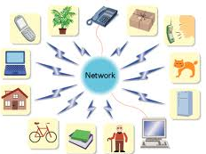
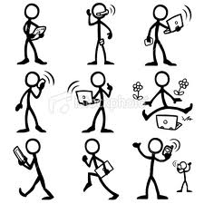
Mobile and Ubiquitous Computing
Ubiquitous computing is the availability of computational power on demand in your vicinity to such a degree that information processing becomes integrated into everyday objects and activities
Mobile computing is the ability to do computing while moving, or visiting places other than your usual environment
Notes:
The term ubiquitous is intended to suggest that small computing devices will eventually become so pervasive in everyday objects that they are scarcely noticed.
It is important to note that the mobile phone market exceeds one billion new phones per year
Mobility can happen due to several reasons: User mobility (user moving from one physical location to another), Host mobility (where a device associates itself to a new network attachment point (the interface between the network and link layer) also referred to as connection migration) or Session mobility (sessions moving to different server for load-balancing as in the case of server farms).

Slide 12
Mobile and Ubiquitous Computing
Ubiquitous computing is only realized when mobile
computing matures
Mobile and ubiquitous computing introduces (generally) a couple of challenges for distributed systems:
  Dealing with variable connectivity and disconnections
  Maintaining operation in the face of device mobility
Notes:
- Mobile devices can change network location many times during a business day, and the speed and reliability of mobile connections can vary from network to network.

Slide 13
Example
Health Care Systems:
  New devices are being developed to monitor the well-being of individuals and to automatically contact physicians when needed
  Personal health care systems are often equipped with various sensors organized in a (preferably wireless) body-area network (BAN)
  BAN should be able to operate while a person is moving, with no strings (i.e., wires) attached to immobile devices
Notes:
- HCS is essentially a sensor networks system.

Slide 14
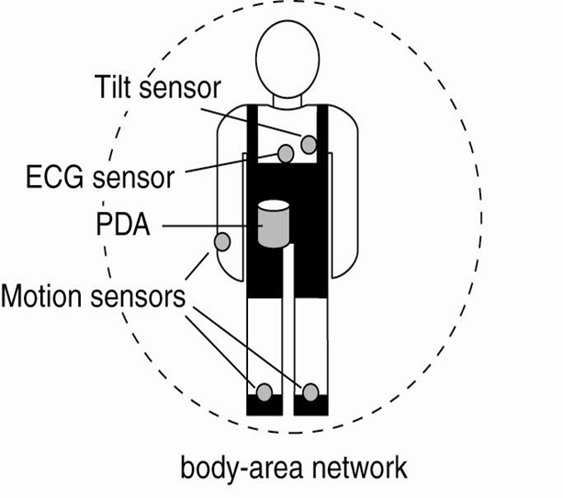
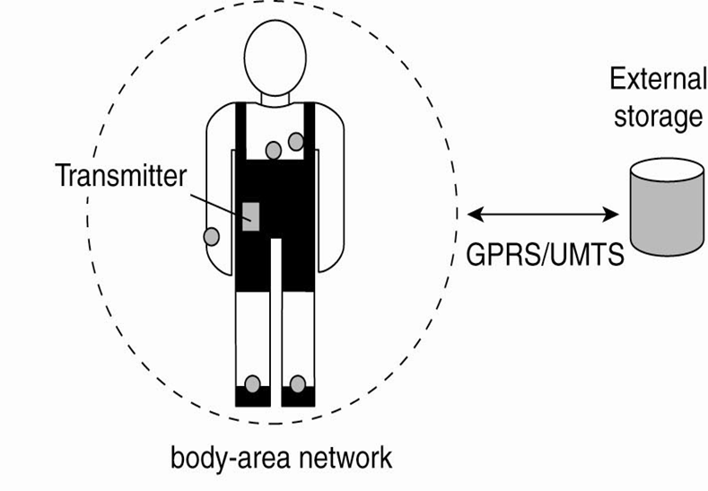

Health Care Systems (HCS)

Slide 15
Issues for HCS
  Where and how should monitored data be stored?
  How can we prevent loss of crucial data?
  What infrastructure is needed to generate and propagate alerts?
  How can physicians provide online feedback?
  How can extreme robustness of the monitoring system be realized?
  What are the security issues and how can the proper policies be enforced?

Slide 16
Trends in Distributed Systems
Distributed systems are undergoing a period of significant change and this can be traced back to a number of influential trends:
  The emergence of pervasive networking technology
  The emergence of ubiquitous computing coupled with the desire to support user mobility in distributed systems
  The increasing demand for multimedia services
  The view of distributed systems as utility

Slide 17
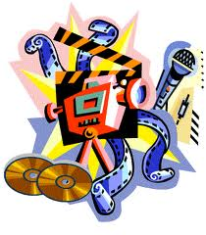
Distributed Multimedia Systems
Supporting multimedia services can be defined as the ability to support a range of discrete and continuous media
Benefits of distributed multimedia computing:
  Access to live or pre-recorded TV broadcasts
  Access to music libraries
  Webcasting
  Access to film libraries offering video-on-demand services
  The provision of audio and video conferencing facilities and integrated telephony features
Notes:
Examples of discrete media: pictures or text messages. Examples of continuous media: audio and video.
Support in this context means store, transmit, present, and share.
Webcasting = the ability to broadcast continuous media, typically audio or video, over the internet.
Examples of integrated telephony features: IP telephony and Skype.

Slide 18
Demands of a
Distributed Multimedia Systems
Distributed multimedia applications place considerable demands on the underlying distributed infrastructure in terms of:
  Providing support for an (extensible) range of encoding and encryption formats (e.g., MPEG series of standards)
  Providing a range of mechanisms to ensure that the desired quality of service (QoS) can be met
  Providing associated resource management strategies, including appropriate scheduling policies to support the desired QoS
  Providing adaptation strategies to deal with the inevitable situation in open systems where QoS cannot be met or sustained

Slide 19
Trends in Distributed Systems
Distributed systems are undergoing a period of significant change and this can be traced back to a number of influential trends:
  The emergence of pervasive networking technology
  The emergence of ubiquitous computing coupled with the desire to support user mobility in distributed systems
  The increasing demand for multimedia services
  The view of distributed systems as utility

Slide 20
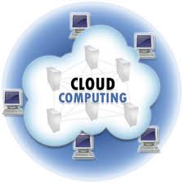
Distributed Computing As Utility
Distributed resources can be viewed as a commodity or utility similar to water and electricity
Resources are provided by appropriate service
suppliers and rented rather than owned by
an end user
The term cloud computing is used to capture this vision
Notes:
- This model applies to physical resources and logical services.
Examples of physical resources: storage and processing. Examples of logical services: distributed calendars.
Virtualization in this context implies that users may actually be provided with services by a virtual rather than a physical node. This offers greater flexibility to the service supplier (e.g., Google or Amazon) in terms of “resource management”.

Slide 21
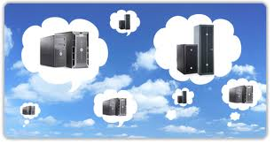
Enablers and Advantages
Clouds are generally implemented on commodity computers to provide necessary scale and performance
Virtualization is deemed a key enabler for
resource sharing, customization and
elasticity
Advantages:
  Promotes a view of everything as a service
  Allows very simple desktop or portable devices to access a potentially wide range of resources and services
  Scalability and elasticity
Notes:
A cluster computer is a set of interconnected computers that cooperate closely to provide a single, integrated high performance computing capability.

Slide 22
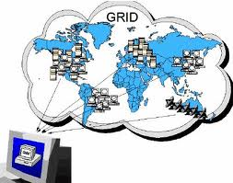
Precursor to Cloud, Grid
  Grid computing can generally be viewed as a precursor to cloud
  computing with a bias towards support for
  scientific applications
Grid computing consists of distributed
systems that are often constructed as a
federation of loosely coupled,
heterogeneous, and geographically dispersed computer systems
Notes:
Grid computing systems expose a high degree of heterogeneity: no assumptions are made concerning hardware, operating systems, networks, administrative domains, security policies, etc.
Although a grid can be dedicated to a specialized application, it is more common that a single grid will be used for a variety of different purposes.

Slide 23
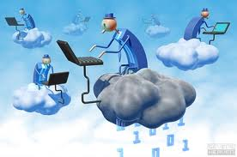
Open Challenges in
Cloud Computing
  Cloud Security
  Cloud Programming Models
  QoS in Clouds
  Energy-efficient Clouds
  Cloud Storage Systems
  Others…

Slide 24
Today…
  Part II
  Challenges When Designing Distributed Systems

Slide 25
Pitfalls when Developing
Distributed Systems
False assumptions made by a first time developer:
The network is reliable
The network is secure
The network is homogeneous
The topology does not change
Latency is zero
Bandwidth is infinite
There is one administrator

Slide 26
Challenges When Designing Distributed Systems
Many issues arise when designing distributed systems:
  Heterogeneity
  Openness
  Security
  Scalability
  Failure Handling
  Concurrency
  Transparency
  Quality of Service

Slide 27
Challenges When Designing Distributed Systems
Many issues arise when designing distributed systems:
  Heterogeneity
  Openness
  Security
  Scalability
  Failure Handling
  Concurrency
  Transparency
  Quality of Service

Slide 28
Challenge 1: Heterogeneity
Heterogeneity applies to:
  Networks
  Computer Hardware
  Operating Systems
  Programming Languages
Notes:
Heterogeneity: variety and differences.
The differences in networks are masked by the fact that all of the computers attached to them use the Internet protocols to communicate with one another.
Hardware: (1) Data types such as integers may be represented in different ways on different sorts of hardware. (2) Code suitable for running on one computer is not necessarily suitable for running on another. Virtualization provides a way of making code executable on a variety of host computers (e.g., JVM)
Operating systems: Although the operating systems of all computers on the Internet need to include an implementation of the Internet protocols, they don’t necessarily all provide the same API to these protocols (e.g., the calls for exchanging messages in UNIX are different from the calls in Windows).
Different programming languages use different representations for characters and data structures.

Slide 29
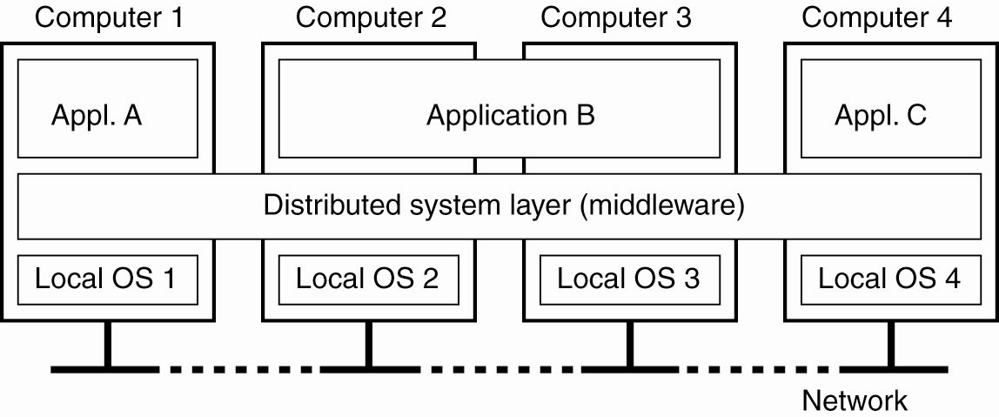
A Solution: Middleware
Middleware is a software layer that provides a programming abstraction and masks the heterogeneity of the underlying networks, hardware, operating systems and programming languages.
Notes:
The Common Object Request Broker (CORBA) is an example.
Java Remote Method Invocation (RMI) supports only a single programming language.
Most middleware is implemented over the Internet protocols, which themselves mask the differences of the underlying networks, but all middleware deals with the differences in operating systems and hardware.

Slide 30
Challenges When Designing Distributed Systems
Many issues arise when designing distributed systems:
  Heterogeneity
  Openness
  Security
  Scalability
  Failure Handling
  Concurrency
  Transparency
  Quality of Service

Slide 31
Challenge 2: Openness
The openness of a distributed system is the degree to which the system can be extended and re-implemented in various ways
Open distributed systems are:
  Characterized by the fact that their key interfaces are published
  Based on the provision of a uniform communication mechanism for access to shared resources
  (or can be) Constructed from heterogeneous hardware and software components with tested conformance to published standards
Notes:
Distributed Systems can be extended at the hardware and software levels.
Example of interfaces that are published: Requests For Comments- RFCs.
The openness of distributed systems is determined primarily by the degree to which new resource-sharing services can be added and be made available for use by a variety of client programs.
The conformance of each component in a heterogeneous environment to the published standard must be carefully tested and verified if the system is to work correctly.

Slide 32
Challenges When Designing Distributed Systems
Many issues arise when designing distributed systems:
  Heterogeneity
  Openness
  Security
  Scalability
  Failure Handling
  Concurrency
  Transparency
  Quality of Service

Slide 33

Challenge 3: Security
Many of the information resources maintained in distributed systems have a high intrinsic value to their users
Requirements are:
  To send sensitive information in a message
  over a network in a secure manner
  To recognize the identity of the user on whose behalf a message was sent
  To ensure that a process gets only those access rights it is entitled to
Notes:
Security is of considerable importance.
Knowing the identity of the user and the agent on whose behalf a message was sent can be met by using encryption techniques.

Slide 34
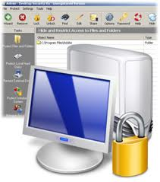
Security of Information Resources
Security for information resources includes:
  Confidentiality: protection against disclosure to
  unauthorized individuals
  Integrity: protection against alteration or corruption
  Availability: protection against interference with the means to access the resources
Some challenges have not yet been fully met in distributed systems:
  Denial of service attacks
  Security of mobile code

Slide 35
Challenges When Designing Distributed Systems
Many issues arise when designing distributed systems:
  Heterogeneity
  Openness
  Security
  Scalability
  Failure Handling
  Concurrency
  Transparency
  Quality of Service

Slide 36
Challenge 4: Scalability
A distributed system is said to be scalable if it will remain effective when the number of resources and users is significantly increased
Date | Computers | Web servers | Percentage
1993, July | 1,776,000 | 130 | 0.008
1995, July | 6,642,000 | 23,500 | 0.4
1997, July | 19,540,000 | 1,203,096 | 6
1999, July | 56,218,000 | 6,598,697 | 12
2001, July | 125,888,197 | 31,299,592 | 25
2003, July | ~200,000,000 | 42,298,371 | 21
2005, July | 353,284,187 | 67,571,581 | 19
Notes:
- The figure shows the increasing number of computers and web servers during the 12-year history of the Web up to 2005. It is interesting to note the significant growth in both computers and web servers in this period, but also that the relative percentage is flattening out- a trend that is explained by the growth of fixed and mobile personal computing.

Slide 37
Challenges for Scalability
The design of scalable distributed systems presents the following challenges:
  Controlling the cost of physical resources: In general, the quantity of physical resources required should be at most O(n) for a system with n users
  Controlling the performance loss: hierarchal structures scale better than linear ones
  Preventing software resources from running out: some problems have no long-term correct solutions
  Avoiding performance bottlenecks: decentralized algorithms are generally better than centralized ones
Notes:
Controlling the cost of physical resources: for a system with n users to be scalable, the quantity of physical resources required to support them should be at most O(n). If a single file server can support 20 users, then two such servers should be able to support 40 users. Although this sound an obvious goal, it is not necessarily easy to achieve in practice (this will be explained in detail when covering distributed file systems).
Controlling the performance loss: algorithms that use hierarchic structures scale better than those that use linear structures (running time of a tree is O(log n)).
Preventing software resources running out: some problems has no correct solutions (e.g., the numbers used as IP addresses).
Avoiding performance bottlenecks: in general, algorithms should be decentralized to avoid having performance bottlenecks (e.g., DNS decentralized name table).

Slide 38
Some Solutions to Scalability
Techniques proven to be successful:
  Replication and caching with consistency considerations
  Deployment of multiple servers to handle commonly performed tasks enabling concurrency
  Decentralized lookup tables (e.g. DNS name table)
Notes:
Replication is made by the server while caching is made by the client.
The design of effective techniques for keeping replicas of rapidly changing data up-to-date without excessive loss of performance is a big challenge.

Slide 39
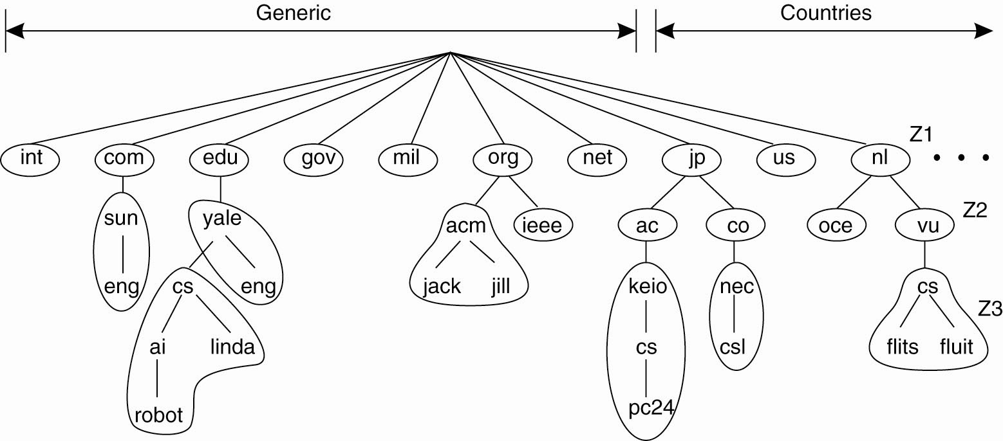
Domain Name System
Notes:
DNS example

Slide 40
Challenges When Designing Distributed Systems
Many issues arise when designing distributed systems:
  Heterogeneity
  Openness
  Security
  Scalability
  Failure Handling
  Concurrency
  Transparency
  Quality of Service

Slide 41
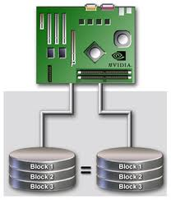
Challenge 5: Failure Handling
Whenever multiple machines are used in cooperation with one another, the probability of failures rises
Failures in a distributed system are partial
Techniques for dealing with failures:
  Detecting Failures
  Masking Failures
  Tolerating Failures
  Recovery From Failures
Notes:
Partial = some components fail while others continue to function.
Detecting Failures: (e.g., checksums can be used to detect corrupted data in a message or a file.)
Masking Failures: (e.g., file data can be written to a pair of disks so that if one is corrupted, the other may still be correct.)
Tolerating Failures: (e.g., there should be at least two different routes between any two routers in the Internet.)
Recovery From Failures: (e.g., checkpoints to roll back after a server has crashed.)

Slide 42
Challenges When Designing Distributed Systems
Many issues arise when designing distributed systems:
  Heterogeneity
  Openness
  Security
  Scalability
  Failure Handling
  Concurrency
  Transparency
  Quality of Service

Slide 43


Challenge 6: Concurrency
In distributed systems, several clients might attempt to access a shared resource concurrently
If objects do not operate correctly and synchronize with one another, inconsistencies might arise
Notes:
- e.g., A data structure that records bids for an auction might be accessed by several clients.

Slide 44
Challenges When Designing Distributed Systems
Many issues arise when designing distributed systems:
  Heterogeneity
  Openness
  Security
  Scalability
  Failure Handling
  Concurrency
  Transparency
  Quality of Service

Slide 45
Challenge 7: Transparency
Transparency | Description
Access | Hide differences in data representation and how a resource is accessed
Location | Hide where a resource is located
Migration | Hide that a resource may move to another location
Relocation | Hide that a resource may be moved to another location while in use
Replication | Hide that a resource is replicated
Concurrency | Hide that a resource may be shared by several competitive users
Failure | Hide the failure and recovery of a resource
Transparency | Description
Access | Hide differences in data representation and how a resource is accessed
Location | Hide where a resource is located
Migration | Hide that a resource may move to another location
Relocation | Hide that a resource may be moved to another location while in use
Replication | Hide that a resource is replicated
Concurrency | Hide that a resource may be shared by several competitive users
Failure | Hide the failure and recovery of a resource
Transparency | Description
Access | Hide differences in data representation and how a resource is accessed
Location | Hide where a resource is located
Migration | Hide that a resource may move to another location
Relocation | Hide that a resource may be moved to another location while in use
Replication | Hide that a resource is replicated
Concurrency | Hide that a resource may be shared by several competitive users
Failure | Hide the failure and recovery of a resource
Transparency | Description
Access | Hide differences in data representation and how a resource is accessed
Location | Hide where a resource is located
Migration | Hide that a resource may move to another location
Relocation | Hide that a resource may be moved to another location while in use
Replication | Hide that a resource is replicated
Concurrency | Hide that a resource may be shared by several competitive users
Failure | Hide the failure and recovery of a resource
Transparency | Description
Access | Hide differences in data representation and how a resource is accessed
Location | Hide where a resource is located
Migration | Hide that a resource may move to another location
Relocation | Hide that a resource may be moved to another location while in use
Replication | Hide that a resource is replicated
Concurrency | Hide that a resource may be shared by several competitive users
Failure | Hide the failure and recovery of a resource
Transparency | Description
Access | Hide differences in data representation and how a resource is accessed
Location | Hide where a resource is located
Migration | Hide that a resource may move to another location
Relocation | Hide that a resource may be moved to another location while in use
Replication | Hide that a resource is replicated
Concurrency | Hide that a resource may be shared by several competitive users
Failure | Hide the failure and recovery of a resource
Transparency | Description
Access | Hide differences in data representation and how a resource is accessed
Location | Hide where a resource is located
Migration | Hide that a resource may move to another location
Relocation | Hide that a resource may be moved to another location while in use
Replication | Hide that a resource is replicated
Concurrency | Hide that a resource may be shared by several competitive users
Failure | Hide the failure and recovery of a resource

Slide 46
Challenges When Designing Distributed Systems
Many issues arise when designing distributed systems:
  Heterogeneity
  Openness
  Security
  Scalability
  Failure Handling
  Concurrency
  Transparency
  Quality of Service

Slide 47

Challenge 8: Quality of Service
Once users are provided with the functionality that they require of a service, we can go on to ask about the quality of the service
(QoS) provided
The main nonfunctional properties of systems
that affect QoS are:
  Reliability
  Security
  Performance
  Adaptability to meet changing system configurations
  Availability of the necessary computing and network resources at the appropriate times
Notes:
- Performance in terms of responsiveness and computational throughput, or the ability to meet timeliness guarantees.

Slide 48
Next Lecture
Distributed Systems Architectures

