Slide 1
Distributed Systems CS 15-440
Project 2: FileStack Synchronization and Replication
Recitation 6, Oct. 2, 2014
Dania Abed Rabbou and Mohammad Hammoud

Slide 2
Logistics
P2_StarterCode: Copy files into your project1 folder
Project Due Date: Oct. 22, 2014
Q&A: Piazza, Office Hours, & Appointments

Slide 3
P1: FileStack
Applied the knowledge of client-server communication and Remote Method Invocation (RMI) to build a Distributed File System denoted as FileStack
Employed stubs and skeletons to mask communication, thereby transparently locating and manipulating files stored remotely at a cluster of machines

Slide 4
Entities & Architecture
Storage Servers (SSs)
Each SS stores physically files to share in a directory (denoted as temporary directory) in its local file system
Naming Server (NS)
Stores metadata about all shared files in the form of a mapping from filenames to storage servers (like DNS)
Clients
Perform operations on files (e.g., write, read etc.)
Architecture
Based on client-server architecture

Slide 5
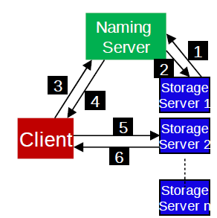
Communication between Entities
(3) CreateFile, CreateDirectory,
IsDirectory, Delete, List,
GetStorage
(4) Results, Storage Server
(1) Registration
(2) Duplicate Files,
Create,
Delete
(5) Read, Write, Size
(6) Results
Request-Reply Communication Paradigm

Slide 6
File Correctness & Consistency
Did we allow multiple clients to write on a file?
YES!
Did we allow a client to read a file under modification?
YES!!
Client C
Read from file abc.txt
Storage Server
Write to file abc.txt
Client B
P3
P2
Shared
File
abc.txt
Client A
P1
Write to file abc.txt

Slide 7
Project 2 Objectives
Devise and apply a synchronization algorithm that:
achieves correctness while sharing files
and ensures fairness to clients.
Devise and apply a replication algorithm that:
achieves load-balancing among storage servers
and ensures consistency of replicated files.

Slide 8
Logical Synchronization of Readers and Writers

Slide 9
Mutual Exclusion
Readers:
Reader is a Client who wishes to read a file at a SS
Reader first requests a read/non-exclusive/shared lock
Writer:
Writer is a Client who wishes to write to a file at a SS
Writer first requests a write/exclusive lock
Order:
Readers and writers are queued and served in the FIFO order

Slide 10
Read Locks
Readers do not modify contents of a file/directory
Readers request the NS for read locks before reading files
Readers unlock files once done
Multiple readers can acquire a read lock simultaneously

Slide 11
Write Locks
Writers can modify contents of files/directories
Writers request the NS for write locks before reading/writing to files
Writers unlock files once done
Only one writer can acquire a write lock at a time

Slide 12
Write Locks (Cont’d)
NS grants a write lock on a file if:
No reader is currently reading the file
No writer is currently writing to the file
NS uses read locks on all the directories in the parent path to prevent modifications
Assume a writer requests a write lock for project2.txt /FileStack/users/student1/work/project2.txt
NS first applies read locks to all directories in the path
NS then grants a write lock to the requestor of project2.txt

Slide 13
Service Interface
Two new operations available to Clients
LOCK(path, read/write)
UNLOCK(path, read/write)

Slide 14
Dynamic Replication of Files

Slide 15
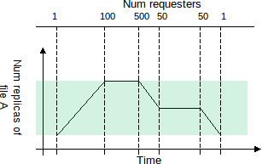
Number of Replicas
Num_requests: number of read requests to
a file
Num_requests_coarse:
num_requests rounded to
the nearest multiple of 20
Num_replicas =
min (α * num_requests_coarse, UPPER_BOUND)
where α & UPPER_BOUND are constants

Slide 16
When to Replicate?
NS stores num_requests as file metadata
However, we know that Clients invoke read operations on storage servers
So, how can the NS learn about read operations & hence update num_requests?

Slide 17
When to Replicate? (Cont’d)
NS deems a Client’s request for a read lock on a file as a read operation
Hence, NS increments num_requests associated with the file and re-evaluates num_replicas

Slide 18
How to Replicate?
NS first elects SSs to store the replicas
NS commands each SS to copy the file from the original SS
Hence, the metadata of a file now contains a set of SSs

Slide 19
How to Update Replicas?
When a Client requests a write lock on a file, it causes the NS to invalidate all the replicas except the locked one
Invalidation is achieved by commanding those SSs hosting replicas to delete the file
When the Client unlocks the file, the NS commands SSs to copy the modified file

Slide 20
Command Interface
The new operation available to the NS:
Copy(path, StorageStub)

