Slide 1
15440 Distributed Systems Recitation 1
Objected-Oriented Java Programming

Slide 2
User-defined Classes
Default and over-loaded constructors
Static/non-static attributes & methods
Access modifiers (public, private, protected)
Encapsulation (getters and setters)
ToString, Equals, CompareTo, HashCode methods
Overloaded methods (same name, diff. parameters)
Declaring and instantiating objects (new, superclass Object)

Slide 3
Package
Is a collection of related classes that can be imported into projects
Allows reusing classes in multiple projects without physically storing them in a project’s source code
E.g.: java.io.*, java.util.*

Slide 4
Objected-Oriented Programming Concepts

Slide 5
Inheritance
Organizes related classes in a hierarchy allowing reusability extensibility of common code
Subclasses extend the functionality of a superclass
Subclasses inherit all the methods of the superclass (excluding constructors and privates)
Subclasses can override methods from the superclass
Subclass declaration:
accessModifier class subclassName extends superclassName

Slide 6
Polymorphism
A concept which simplifies the processing of objects in the same hierarchy
Allows to use the same method call for different objects that implement the method in the hierarchy

Slide 7
Abstract
A class that is not completely implemented.
Contains one or more abstract methods (methods with no bodies; only signatures) that subclasses must implement
Can not be used to instantiate objects
Abstract class header:
accessModifier abstract class className
Abstract method signature:
accessModifier abstract returnType methodName ( args );
Subclass signature:
accessModifier class subclassName extends className

Slide 8
Interface
A special abstract class in which all the methods are abstract
Contains only abstract methods that subclasses must implement
Interface header:
accessModifier interface interName
Abstract method signature:
accessModifier abstract returnType methodName ( args );
Subclass signature:
accessModifier class subclassName implements interName1, interName2, ..

Slide 9
Java Generic Collections

Slide 10
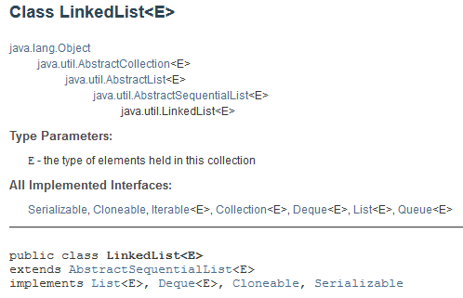
Generic Collections
Classes that represent data-structures
Generic or parameterized since the elements’ data-type is given as a parameter*
E.g.: LinkedList, Queue, ArrayList, HashMap, Tree
Provide methods for:
Iteration
Bulk operations
Conversion to/from arrays
*The data-type passed as parameter to a collection’s constructor can not be of the type Object, the unknown type ?, or a primitive data-type. The data-type must be a Class.

Slide 11
ArrayList Class
Is a subclass of Collection
Implements a resizable array
Provides methods for array manipulation
Generic or parameterized
Declaration and Instantiation:
ArrayList<ClassName> arrayListName = New ArrayList<ClassName>();

Slide 12
ArrayList Methods
Add, Get, Set, Clear, Remove, Size, IsEmpty, Contains, IndexOf, LastIndexOf, AsList etc.
Basic Iterator:
for (int i = 0; i < arrayListName.size(); i++) {
// Get object at index i
ClassName obj = arrayListName.get(i)
// Process obj
}
Advanced Iterator:
for (ClassName obj : arrayListName) { // Process obj }
Iterator Object

Slide 13
Generic Methods
Generic or parameterized methods receive the data-type of elements as a parameter
E.g.: a generic method for sorting elements in an array (be it Integers, Doubles, Objects etc.)

Slide 14
Why Generic Methods?
Consider writing a method that takes an array of objects, a collection, and puts all objects in the array into the collection
Generic Method

Slide 15
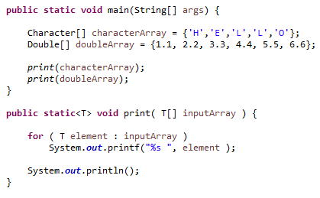
Why Generic Methods? (contd.)
Consider writing a print method that takes arrays of any data-type

Slide 16
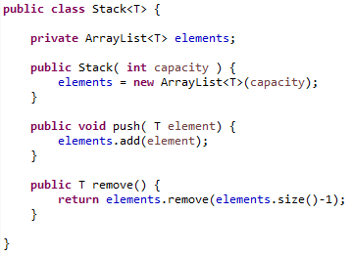
Generic Classes
Provide a means for describing a class in a type-independent manner

Slide 17
Generic Classes with Wildcards
Wildcards <?> denote “unknown” or “any’ type (resembles <T>)
Wildcards can restrict the data-type to a particular hierarchy

