Slide 1
Entrepreneurship for Computer Science CS 15-390
Beachhead Markets & Revenue Projections
Lecture 8, February 10, 2020
Mohammad Hammoud

Slide 2
Today…
Last Session:
Market research
Today’s Session:
Beachhead markets & revenue projections
Announcements:
Project milestone 2 presentations will take place on Monday, Feb 17
Quiz I is on Wed, Feb 19

Slide 3
Beachhead Market
In military operations, if an army wants to invade an enemy territory, the army may employ a beachhead strategy
A beachhead strategy entails planning and focusing all time and resources on wining a small strategic boarder area
This small area is called beachhead
The beachhead market then becomes the stronghold to land troops and supplies for the bigger invasion to the enemy territory
The 1944 invasion of Nazi-controlled Europe by the Allied forces is one of the most famous examples of a beachhead strategy

Slide 4
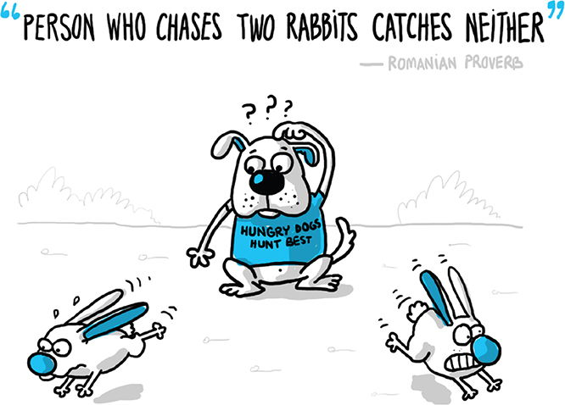
How to Select a Beachhead Market?
Select a beachhead market via selecting just ONE market opportunity from your market segmentation matrix

Slide 5
How to Select a Beachhead Market?
In many cases, there are multiple paths to success, hence, it is not imperative to choose the absolute best market
Alongside, it is better to avoid selecting the largest or very large markets, even if they seem to be the best markets
The first market you attack will be a significant learning experience (with perhaps a lot of failures) for you, so you are better off learning, persevering or pivoting in a smaller market
But, what are the criteria to select a beachhead market?

Slide 6
How to Select a Beachhead Market?
Some criteria that may prove useful in choosing your beachhead market:
Is the target customer well-funded? (affordability metric)
Is the target customer readily accessible to your sales force? (accessibility metric)
Does the target customer have a compelling reason to buy? (motivational level)
Can you today, with the help of partners, deliver a whole product? (readiness level)
Is there entrenched competition that could block you? (competition level)
Are there entrenched legalities that can block you? (legality barrier)
If you win this segment, can you leverage it to enter additional segments (i.e., proceed to the bigger invasion)? (scale-up metric)
Is the market consistent with your passions, values, and goals? (adherence level)
What is the Total Addressable Market (TAM) size of this market? (TAM size)

Slide 7
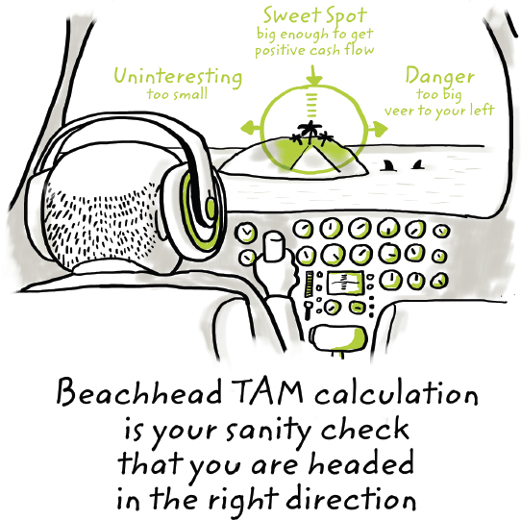
What is TAM?
TAM is the amount of annual revenue (in dollars) your company would earn if you achieved 100% market share in the chosen market
Sweet Spot
big enough to get positive cash flow
Danger
too big;
veer to your left
Uninteresting
too small
Beachhead TAM calculation is your sanity check that you are headed in the right direction

Slide 8
Calculating TAM
To calculate TAM, you need to figure out and multiply the following two factors:
The estimated number of customers who will use your product or service
The estimated total revenue each customer is worth per year
The first factor and part of the second factor can be determined using primary and/or secondary market research
The final value of the second factor can be determined using your business model, which is a framework by which you extract from your customers some portion of the value your product creates for them (more on this later)

Slide 9
Example: A Shoe E-Commerce Platform
Assume a specialized e-commerce platform for selling shoes online
The platform does not own any inventory, but rather partners with existing shoe stores
The platform does not own any delivery company (or department), but rather partners with existing delivery companies
Simple business model:
8% of any package cost as a transaction fee from any shoe store
$5 convenience fee from any customer for delivering her/his package
Total Revenue Per Package = 0.08 × package cost + $5

Slide 10
Example: A Shoe E-Commerce Platform
Two required factors:
The estimated number of transactions over this shoe e-commerce platform (say, 1000, 000)
The estimated cost of per package/transaction (say, $35)
The first factor is equal to the total number of people who buy shoes in the selected market (if they ALL buy shoes via ONLY this e-commerce platform) $×$buying frequency
This is an upper-bound, which is used in calculating TAM
A conservative percentage can be assumed for more realistic revenue projections
A sensitivity analysis can be performed assuming a range of percentages (more on this shortly)

Slide 11
Example: A Shoe E-Commerce Platform
TAM = Estimated # of transactions × Estimated revenue per transaction
= 1000,000 × ((0.08 × 35) + 5))
= $7800,000
General Hints:
If TAM < $5 million, it is possible that your venture has not identified a big enough beachhead market
$5 million < TAM < $100 million is usually a reasonable TAM
Anything over $1 billion certainly raises flags
Important Note:
Your advisors, partners, and investors know that these projections are only estimations (and most probably inaccurate), but they do still accept them because they give a good sense of your target market
Note that the business model was used in determining
the final value of the second factor

Slide 12
Example: A Shoe E-Commerce Platform
The revenue projection process can be fully formalized (via developing a mathematical model) and conducted over multiple years
Assume:
Estimated # of transactions = N
Market Share = α
Transaction Cost = C
Transaction Fee = β
Convenience Fee = δ
Mathematical Model = (α × N) × (β × C + δ)

Slide 13
Example: A Shoe E-Commerce Platform
Alongside, you can vary the market share (α) and observe how the projected revenue will change accordingly
In fact, you can vary any variable in your model and observe how the projected revenue will change accordingly
This study is called sensitivity analysis
 | Number of Transactions (N) | Market Share (α) | Transaction Fee (β) | Package Cost (C ) | Convenience Fee (δ) | Revenue Projection Model ((α × N) × (β × C + δ))
TAM | 1,000,000 | 1 | 0.08 | 35 | 5 | $7,800,000
 | 1,000,000 | 0.01 | 0.08 | 35 | 5 | $78,000
 | 1,000,000 | 0.02 | 0.08 | 35 | 5 | $156,000
 | 1,000,000 | 0.05 | 0.08 | 35 | 5 | $390,000
 | Number of Transactions (N) | Market Share (α) | Transaction Fee (β) | Package Cost (C ) | Convenience Fee (δ) | Revenue Projection Model ((α × N) × (β × C + δ))
TAM | 1,000,000 | 1 | 0.08 | 35 | 5 | $7,800,000
 | 1,000,000 | 0.01 | 0.08 | 35 | 5 | $78,000
 | 1,000,000 | 0.02 | 0.08 | 35 | 5 | $156,000
 | 1,000,000 | 0.05 | 0.08 | 35 | 5 | $390,000
 | Number of Transactions (N) | Market Share (α) | Transaction Fee (β) | Package Cost (C ) | Convenience Fee (δ) | Revenue Projection Model ((α × N) × (β × C + δ))
TAM | 1,000,000 | 1 | 0.08 | 35 | 5 | $7,800,000
 | 1,000,000 | 0.01 | 0.08 | 35 | 5 | $78,000
 | 1,000,000 | 0.02 | 0.08 | 35 | 5 | $156,000
 | 1,000,000 | 0.05 | 0.08 | 35 | 5 | $390,000
 | Number of Transactions (N) | Market Share (α) | Transaction Fee (β) | Package Cost (C ) | Convenience Fee (δ) | Revenue Projection Model ((α × N) × (β × C + δ))
TAM | 1,000,000 | 1 | 0.08 | 35 | 5 | $7,800,000
 | 1,000,000 | 0.01 | 0.08 | 35 | 5 | $78,000
 | 1,000,000 | 0.02 | 0.08 | 35 | 5 | $156,000
 | 1,000,000 | 0.05 | 0.08 | 35 | 5 | $390,000

Slide 14
Example: A Shoe E-Commerce Platform
Sensitivity Analysis:
You can also do revenue projections over multiple years (typically you would increase your market share every year by a certain %)

Slide 15
The China Syndrome
You might be inclined to choose a huge existing market, assuming that you can easily acquire a tiny fraction of it, and reap the rewards!
This is referred to as the “China Syndrome”
For instance, if you can acquire 0.1% of the toothbrush market in China (population 1.3 billion), would not you make a lot of money?
How would the logic go?

Slide 16
The China Syndrome
The logic goes as follows:
A reputable site on the Internet says that China has over 1.3 billion people
If all these people have teeth, the market size would be 1.3 billion customers
I can build a toothbrush for the Chinese market, and maybe I will get 0.1% market share in the first year
If each person buys 3 toothbrushes a year, I could sell 3.9 million toothbrushes per year
If I sell each toothbrush for $1, I would have $3.9 million in sales the first year, with lots of room to grow!
Is there any problem with this logic?

Slide 17
The China Syndrome
This logic has several problems such as:
It did not demonstrate in a compelling manner why people will buy your toothbrush
It did not show why your market share would increase over time
It did not validate any of your assumptions by learning directly and/or indirectly from/about your market
Perhaps, you have never been to China!
After all, if entrepreneurship were this easy, would not everyone sell toothbrushes to China?
Do not get ensnared by “The China Syndrome”
Do your revenue projections ONLY after you do market segmentation, and primary and secondary market research

Slide 18
Next Class
Business Models

