Slide 1
Entrepreneurship for Computer Science
CS 15-390
Market Segmentation
Lecture 6, February 03, 2020
Mohammad Hammoud

Slide 2
Today…
Last Session:
  Project presentations
Today’s Session:
  Market segmentation
Announcement:
  PS1 grades will be out by tomorrow

Slide 3
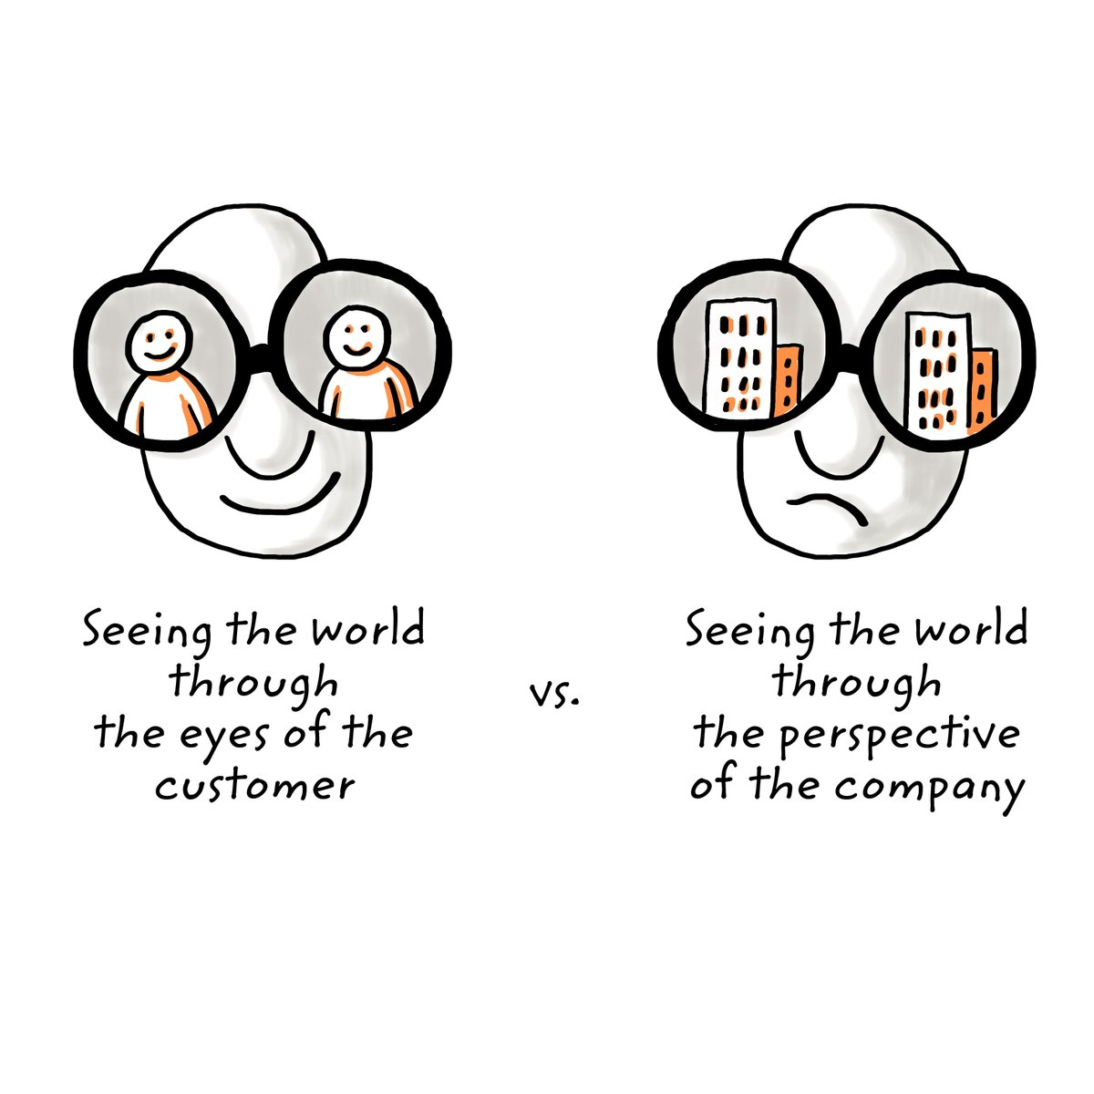
Market Segmentation
Market segmentation is the process of dividing a “broad” consumer or business market into sub-groups (or segments) in an aim to identify high yield segments.
It may also help you come up with an idea!

Slide 4
The Segmentation Process (1 Way of Doing it)
Step 0: Identify your passion
  E.g., Technology (i.e., expertise) & Education (i.e., domain/market)
Step 1: Start with a “generic” idea
  E.g., I want to improve education through technology
Step 2: Identify potential “industries” of your selected domain
  E.g., Universities, schools, centers, etc.,
Step 3: Identify all “end-users” in your industries
  End-users are potential people who will use your potential product
    E.g., Teachers, Students, Administrators, Parents, etc.,

Slide 5
The Segmentation Process (1 Way of Doing it)
Step 3 (Cont’d): Identify all “end-users” in your industries
  End-users are not necessarily “economic buyers”
    E.g., Schools do not use course or advising systems, but teachers do
Step 4: Identify different “tasks” your end-users perform
  E.g., Teachers teach, grade, advise, etc.,
Step 5: Identify different “specialties” of your end-users
...
You can follow different
segmentation methods
(e.g., characteristics
of customers, benefits
sought, interaction
channels, etc.),
pursue any logical order
and go as deep as you like

Slide 6
Example
Improve Education through Technology
Generic Idea
Universities
Schools
….
Education Centers
Industries
Students
Professors
….
Administrators
End-Users
Business
Computer Science
….
Sociology
Specialties
Teaching
Grading
….
Advising
Tasks
.
.
.

Slide 7
Market Segmentation
Technique:
  Start somewhere (passion can lead)
    One of the key things in founding a startup is to start; it is right there in the name!
  Come up with a generic idea and segment its domain (or market) constituents, following a logical order
  Open the aperture as wide as possible
    This helps in expanding the boundaries of possibilities to where some of the most interesting opportunities might exist

Slide 8
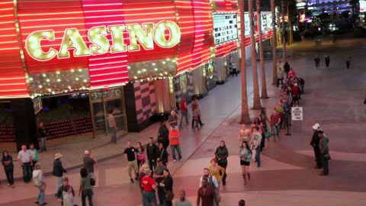
Market Segmentation
Technique:
  Identify the “sub-tree” on the tree that intrigues you the most and try to tap into your expertise to solve a seemingly (i.e., not yet confirmed) “pain” there
    No idea is too crazy at this point (and even later)! If you insist and prove it, people will follow

Slide 9
Market Segmentation
Technique:
  Identify the “sub-tree” on the tree that intrigues you the most and try to tap into your expertise to solve a seemingly (i.e., not yet confirmed) “pain” there
    No idea is too crazy at this point (and even later)! If you insist and prove it, people will follow
    In fact, in the startup world, most good ideas are hidden down deep in the tree and/or “seem” bad initially. If they were “obviously” visible and good, someone would have already be doing them!
  Do not combine segments that seem similar without knowing more about your potential customers
  Build a “market segmentation matrix”

Slide 10
Market Segmentation Matrix: Row Definitions
 | Row | Definition
1 | Market Segment Name | This is the market opportunity that you will identify for your product
2 | End User | This is the person who will use your product and not the economic buyer. Even if you will sell to a company, list here the people who will use your product in that company
3 | Task | What exactly is it that the end users do that you will significantly affect or allow them to do that they could not do before?
4 | Benefit | What is the benefit that you believe the end users will get?
5 | Urgency of Need | What is the level of urgency to solve the problem or capture the new opportunity for the end user?
6 | Example End Users | Who are examples of end users that you can, have, or will talk to, so as to validate your perceptions of this market segment
7 | Lead Customers | Who are the influential customers (i.e., lighthouse customers) where, if they buy your product, others will take note and likely follow?
 | Row | Definition
1 | Market Segment Name | This is the market opportunity that you will identify for your product
2 | End User | This is the person who will use your product and not the economic buyer. Even if you will sell to a company, list here the people who will use your product in that company
3 | Task | What exactly is it that the end users do that you will significantly affect or allow them to do that they could not do before?
4 | Benefit | What is the benefit that you believe the end users will get?
5 | Urgency of Need | What is the level of urgency to solve the problem or capture the new opportunity for the end user?
6 | Example End Users | Who are examples of end users that you can, have, or will talk to, so as to validate your perceptions of this market segment
7 | Lead Customers | Who are the influential customers (i.e., lighthouse customers) where, if they buy your product, others will take note and likely follow?
 | Row | Definition
1 | Market Segment Name | This is the market opportunity that you will identify for your product
2 | End User | This is the person who will use your product and not the economic buyer. Even if you will sell to a company, list here the people who will use your product in that company
3 | Task | What exactly is it that the end users do that you will significantly affect or allow them to do that they could not do before?
4 | Benefit | What is the benefit that you believe the end users will get?
5 | Urgency of Need | What is the level of urgency to solve the problem or capture the new opportunity for the end user?
6 | Example End Users | Who are examples of end users that you can, have, or will talk to, so as to validate your perceptions of this market segment
7 | Lead Customers | Who are the influential customers (i.e., lighthouse customers) where, if they buy your product, others will take note and likely follow?
 | Row | Definition
1 | Market Segment Name | This is the market opportunity that you will identify for your product
2 | End User | This is the person who will use your product and not the economic buyer. Even if you will sell to a company, list here the people who will use your product in that company
3 | Task | What exactly is it that the end users do that you will significantly affect or allow them to do that they could not do before?
4 | Benefit | What is the benefit that you believe the end users will get?
5 | Urgency of Need | What is the level of urgency to solve the problem or capture the new opportunity for the end user?
6 | Example End Users | Who are examples of end users that you can, have, or will talk to, so as to validate your perceptions of this market segment
7 | Lead Customers | Who are the influential customers (i.e., lighthouse customers) where, if they buy your product, others will take note and likely follow?
 | Row | Definition
1 | Market Segment Name | This is the market opportunity that you will identify for your product
2 | End User | This is the person who will use your product and not the economic buyer. Even if you will sell to a company, list here the people who will use your product in that company
3 | Task | What exactly is it that the end users do that you will significantly affect or allow them to do that they could not do before?
4 | Benefit | What is the benefit that you believe the end users will get?
5 | Urgency of Need | What is the level of urgency to solve the problem or capture the new opportunity for the end user?
6 | Example End Users | Who are examples of end users that you can, have, or will talk to, so as to validate your perceptions of this market segment
7 | Lead Customers | Who are the influential customers (i.e., lighthouse customers) where, if they buy your product, others will take note and likely follow?
 | Row | Definition
1 | Market Segment Name | This is the market opportunity that you will identify for your product
2 | End User | This is the person who will use your product and not the economic buyer. Even if you will sell to a company, list here the people who will use your product in that company
3 | Task | What exactly is it that the end users do that you will significantly affect or allow them to do that they could not do before?
4 | Benefit | What is the benefit that you believe the end users will get?
5 | Urgency of Need | What is the level of urgency to solve the problem or capture the new opportunity for the end user?
6 | Example End Users | Who are examples of end users that you can, have, or will talk to, so as to validate your perceptions of this market segment
7 | Lead Customers | Who are the influential customers (i.e., lighthouse customers) where, if they buy your product, others will take note and likely follow?
 | Row | Definition
1 | Market Segment Name | This is the market opportunity that you will identify for your product
2 | End User | This is the person who will use your product and not the economic buyer. Even if you will sell to a company, list here the people who will use your product in that company
3 | Task | What exactly is it that the end users do that you will significantly affect or allow them to do that they could not do before?
4 | Benefit | What is the benefit that you believe the end users will get?
5 | Urgency of Need | What is the level of urgency to solve the problem or capture the new opportunity for the end user?
6 | Example End Users | Who are examples of end users that you can, have, or will talk to, so as to validate your perceptions of this market segment
7 | Lead Customers | Who are the influential customers (i.e., lighthouse customers) where, if they buy your product, others will take note and likely follow?

Slide 11
Market Segmentation Matrix: Row Definitions
 | Row | Definition
8 | Willingness to Change | How conservative is this market segment? How open are they to change? Is there something to force change (e.g., impending crisis)?
9 | Frequency of Buying | How often do they buy new products? What does their buying cycle look like at high level?
10 | Concentration of Buyers | How many different buyers are there in this market segment? Is it a monopoly? Oligopoly (a small number of buyers)? Or may competitive buyers?
11 | Other Relative Market Considerations | This allows for customization of your segment for your relevant considerations such as “high employee turnover”, “very low margins/commodity”, “high-growth industry”, “high virality effect” (i.e., word of mouth), etc.
12 | Size of Market (# of End Users) | Estimation of the number of end users to a relevant range (10s, 100s, 1Ks, 10Ks, 100Ks, 1Ms, etc.).
13 | Est. Value of End User ($1, $10, $100, $1K, etc.) | A first-pass estimate of the value of each end user, again to a relevant order of magnitude so you can make some relative decisions now (you will do a deep dive into this and other numbers later).
 | Row | Definition
8 | Willingness to Change | How conservative is this market segment? How open are they to change? Is there something to force change (e.g., impending crisis)?
9 | Frequency of Buying | How often do they buy new products? What does their buying cycle look like at high level?
10 | Concentration of Buyers | How many different buyers are there in this market segment? Is it a monopoly? Oligopoly (a small number of buyers)? Or may competitive buyers?
11 | Other Relative Market Considerations | This allows for customization of your segment for your relevant considerations such as “high employee turnover”, “very low margins/commodity”, “high-growth industry”, “high virality effect” (i.e., word of mouth), etc.
12 | Size of Market (# of End Users) | Estimation of the number of end users to a relevant range (10s, 100s, 1Ks, 10Ks, 100Ks, 1Ms, etc.).
13 | Est. Value of End User ($1, $10, $100, $1K, etc.) | A first-pass estimate of the value of each end user, again to a relevant order of magnitude so you can make some relative decisions now (you will do a deep dive into this and other numbers later).
 | Row | Definition
8 | Willingness to Change | How conservative is this market segment? How open are they to change? Is there something to force change (e.g., impending crisis)?
9 | Frequency of Buying | How often do they buy new products? What does their buying cycle look like at high level?
10 | Concentration of Buyers | How many different buyers are there in this market segment? Is it a monopoly? Oligopoly (a small number of buyers)? Or many competitive buyers?
11 | Other Relative Market Considerations | This allows for customization of your segment for your relevant considerations such as “high employee turnover”, “very low margins/commodity”, “high-growth industry”, “high virality effect” (i.e., word of mouth), etc.
12 | Size of Market (# of End Users) | Estimation of the number of end users to a relevant range (10s, 100s, 1Ks, 10Ks, 100Ks, 1Ms, etc.).
13 | Est. Value of End User ($1, $10, $100, $1K, etc.) | A first-pass estimate of the value of each end user, again to a relevant order of magnitude so you can make some relative decisions now (you will do a deep dive into this and other numbers later).
 | Row | Definition
8 | Willingness to Change | How conservative is this market segment? How open are they to change? Is there something to force change (e.g., impending crisis)?
9 | Frequency of Buying | How often do they buy new products? What does their buying cycle look like at high level?
10 | Concentration of Buyers | How many different buyers are there in this market segment? Is it a monopoly? Oligopoly (a small number of buyers)? Or many competitive buyers?
11 | Other Relative Market Considerations | This allows for customization of your segment for your relevant considerations such as “high employee turnover”, “very low margins/commodity”, “high-growth industry”, “high virality effect” (i.e., word of mouth), etc.
12 | Size of Market (# of End Users) | Estimation of the number of end users to a relevant range (10s, 100s, 1Ks, 10Ks, 100Ks, 1Ms, etc.).
13 | Est. Value of End User ($1, $10, $100, $1K, etc.) | A first-pass estimate of the value of each end user, again to a relevant order of magnitude so you can make some relative decisions now (you will do a deep dive into this and other numbers later).
 | Row | Definition
8 | Willingness to Change | How conservative is this market segment? How open are they to change? Is there something to force change (e.g., impending crisis)?
9 | Frequency of Buying | How often do they buy new products? What does their buying cycle look like at high level?
10 | Concentration of Buyers | How many different buyers are there in this market segment? Is it a monopoly? Oligopoly (a small number of buyers)? Or many competitive buyers?
11 | Other Relative Market Considerations | This allows for customization of your segment for your relevant considerations such as “high employee turnover”, “very low margins/commodity”, “high-growth industry”, “high virality effect” (i.e., word of mouth), etc.
12 | Size of Market (# of End Users) | Estimation of the number of end users to a relevant range (10s, 100s, 1Ks, 10Ks, 100Ks, 1Ms, etc.).
13 | Est. Value of End User ($1, $10, $100, $1K, etc.) | A first-pass estimate of the value of each end user, again to a relevant order of magnitude so you can make some relative decisions now (you will do a deep dive into this and other numbers later).
 | Row | Definition
8 | Willingness to Change | How conservative is this market segment? How open are they to change? Is there something to force change (e.g., impending crisis)?
9 | Frequency of Buying | How often do they buy new products? What does their buying cycle look like at high level?
10 | Concentration of Buyers | How many different buyers are there in this market segment? Is it a monopoly? Oligopoly (a small number of buyers)? Or many competitive buyers?
11 | Other Relative Market Considerations | This allows for customization of your segment for your relevant considerations such as “high employee turnover”, “very low margins/commodity”, “high-growth industry”, “high virality effect” (i.e., word of mouth), etc.
12 | Size of Market (# of End Users) | Estimation of the number of end users to a relevant range (10s, 100s, 1Ks, 10Ks, 100Ks, 1Ms, etc.).
13 | Est. Value of End User ($1, $10, $100, $1K, etc.) | A first-pass estimate of the value of each end user, again to a relevant order of magnitude so you can make some relative decisions now (you will do a deep dive into this and other numbers later).

Slide 12
Market Segmentation Matrix: Row Definitions
 | Row | Definition
14 | Competition/ Alternatives | What will be your competition from the end users’ perspective? Include the “do nothing” option as well as who else would be competitors if the end users analyzed their options
15 | Other Components Needed for a Full Solution | Since most customers will buy a full solution and not an individual component that they have to assemble into a full solution, what other elements are needed to construct a full solution to achieve the benefits above? These are the complementary assets that you do not currently have but would need to build or acquire to give the end user a full solution
16 | Important Partners | Who are the partners or distributors you will have to work with to fit into the end user’s workflow (e.g., data must come out of vendor A’s system and then be picked up at the end by vendor B’s system) or business processes (e.g., the end user gets all his or her product via distribution channel C)?
17 | Other Relevant Personal Considerations | In many market segmentation analyses, there are additional important factors that should be considered. These could be things like where the market segment is geographically centered, whether it matches the values of the founding team, existing knowledge and contacts in market, etc.
 | Row | Definition
14 | Competition/ Alternatives | What will be your competition from the end users’ perspective? Include the “do nothing” option as well as who else would be competitors if the end users analyzed their options
15 | Other Components Needed for a Full Solution | Since most customers will buy a full solution and not an individual component that they have to assemble into a full solution, what other elements are needed to construct a full solution to achieve the benefits above? These are the complementary assets that you do not currently have but would need to build or acquire to give the end user a full solution
16 | Important Partners | Who are the partners or distributors you will have to work with to fit into the end user’s workflow (e.g., data must come out of vendor A’s system and then be picked up at the end by vendor B’s system) or business processes (e.g., the end user gets all his or her product via distribution channel C)?
17 | Other Relevant Personal Considerations | In many market segmentation analyses, there are additional important factors that should be considered. These could be things like where the market segment is geographically centered, whether it matches the values of the founding team, existing knowledge and contacts in market, etc.
 | Row | Definition
14 | Competition/ Alternatives | What will be your competition from the end users’ perspective? Include the “do nothing” option as well as who else would be competitors if the end users analyzed their options
15 | Other Components Needed for a Full Solution | Since most customers will buy a full solution and not an individual component that they have to assemble into a full solution, what other elements are needed to construct a full solution to achieve the benefits above? These are the complementary assets that you do not currently have but would need to build or acquire to give the end user a full solution
16 | Important Partners | Who are the partners or distributors you will have to work with to fit into the end user’s workflow (e.g., data must come out of vendor A’s system and then be picked up at the end by vendor B’s system) or business processes (e.g., the end user gets all his or her product via distribution channel C)?
17 | Other Relevant Personal Considerations | In many market segmentation analyses, there are additional important factors that should be considered. These could be things like where the market segment is geographically centered, whether it matches the values of the founding team, existing knowledge and contacts in market, etc.
 | Row | Definition
14 | Competition/ Alternatives | What will be your competition from the end users’ perspective? Include the “do nothing” option as well as who else would be competitors if the end users analyzed their options
15 | Other Components Needed for a Full Solution | Since most customers will buy a full solution and not an individual component that they have to assemble into a full solution, what other elements are needed to construct a full solution to achieve the benefits above? These are the complementary assets that you do not currently have but would need to build or acquire to give the end user a full solution
16 | Important Partners | Who are the partners or distributors you will have to work with to fit into the end user’s workflow (e.g., data must come out of vendor A’s system and then be picked up at the end by vendor B’s system) or business processes (e.g., the end user gets all his or her product via distribution channel C)?
17 | Other Relevant Personal Considerations | In many market segmentation analyses, there are additional important factors that should be considered. These could be things like where the market segment is geographically centered, whether it matches the values of the founding team, existing knowledge and contacts in market, etc.

Slide 13
Market Segmentation Matrix Template
Market Segment Name
End User
Task
Benefit
Urgency of Need
. . .
Other Relevant Personal Considerations

Slide 14
Market Segmentation Matrix Template
Populate the cells using effective market research
Market Segment Name
End User
Task
Benefit
Urgency of Need
. . .
Other Relevant Personal Considerations

Slide 15
Effective Market Research
Conducting “effective” market research is a fundamental skill that underlies the entire process of starting a company
  Some Characteristics:
  Multi-dimensional: It spans various (potential) customer dimensions, including rational, emotional, economical, social, and cultural, among others
  Continuous:
    It informs every stage in starting and running a company
    Customers and markets change over time, so what is true one year may be invalid the next

Slide 16
Effective Market Research
  Some Characteristics:
  Non-tradable: It is dangerous to outsource market research, especially if it involves direct interactions with (potential) customers
    Hypothesis Validator: It plays a critical role in validating or invalidating hypotheses quickly, especially “before” starting product development (as a result, you can spend more time building products that customers want)
  Hypothesis Generator: It serves in generating new types of hypotheses that can be validated through experiments, especially when done qualitatively

Slide 17
Types of Market Research
Type | Definition
Primary Market Research | Involves “direct” interaction with (potential) customers to understand their situations and gain knowledge specific to your (potential) new venture
Secondary Market Research | Involves “indirect” investigations, especially via collecting information from reputable sources other than potential customers (e.g., standard industry and government reports)
Qualitative Market Research | An exploratory process that helps understanding qualitatively a subject matter, which might lead to new testable hypotheses (can be used in primary and secondary types of researches)
Quantitative Market Research | Focuses on gathering specific data, which prove or disprove a certain hypothesis
Type | Definition
Primary Market Research | Involves “direct” interaction with (potential) customers to understand their situations and gain knowledge specific to your (potential) new venture
Secondary Market Research | Involves “indirect” investigations, especially via collecting information from reputable sources other than potential customers (e.g., standard industry and government reports)
Qualitative Market Research | An exploratory process that helps understanding qualitatively a subject matter, which might lead to new testable hypotheses (can be used in primary and secondary types of researches)
Quantitative Market Research | Focuses on gathering specific data, which prove or disprove a certain hypothesis
Type | Definition
Primary Market Research | Involves “direct” interaction with (potential) customers to understand their situations and gain knowledge specific to your (potential) new venture
Secondary Market Research | Involves “indirect” investigations, especially via collecting information from reputable sources other than potential customers (e.g., standard industry and government reports)
Qualitative Market Research | An exploratory process that helps understanding qualitatively a subject matter, which might lead to new testable hypotheses (can be used in primary and secondary types of researches)
Quantitative Market Research | Focuses on gathering specific data, which prove or disprove a certain hypothesis
Type | Definition
Primary Market Research | Involves “direct” interaction with (potential) customers to understand their situations and gain knowledge specific to your (potential) new venture
Secondary Market Research | Involves “indirect” investigations, especially via collecting information from reputable sources other than potential customers (e.g., standard industry and government reports)
Qualitative Market Research | An exploratory process that helps understanding qualitatively a subject matter, which might lead to new testable hypotheses (can be used in primary and secondary types of researches)
Quantitative Market Research | Focuses on gathering specific data, which prove or disprove a certain hypothesis

Slide 18
Next Class
  Conclude with Effective Market Research
  Discuss How to Select a Beachhead Market

