Slide 1
Entrepreneurship for Computer Science CS 15-390
Market Research & Beachhead Markets
Lecture 8, February 05, 2019
Mohammad Hammoud

Slide 2
Today…
Last Session:
Market segmentation and introduction to market research
Today’s Session:
Market research (continue) & beachhead markets (a brief intro)
Announcements:
Each team will pitch its project idea to the class on Sunday, Feb 10 (each team will have 5 minutes to deliver the elevator pitch and answer 2-3 questions)
Next lecture’s case study is “Canva”

Slide 3
Outline
Market Research (Cont’d)
Beachhead Markets

Slide 4
Types of Market Research
Type | Definition
Primary Market Research | Involves “direct” interaction with (potential) customers to understand their situations and gain knowledge specific to your (potential) new venture
Secondary Market Research | Involves “indirect” investigations, especially via collecting information from reputable sources other than potential customers (e.g., standard industry and government reports)
Qualitative Market Research | An exploratory process that helps understanding qualitatively a subject matter, which might lead to new testable hypotheses (can be used in primary and secondary types of researches)
Quantitative Market Research | Focuses on gathering specific data, which prove or disprove a certain hypothesis
Type | Definition
Primary Market Research | Involves “direct” interaction with (potential) customers to understand their situations and gain knowledge specific to your (potential) new venture
Secondary Market Research | Involves “indirect” investigations, especially via collecting information from reputable sources other than potential customers (e.g., standard industry and government reports)
Qualitative Market Research | An exploratory process that helps understanding qualitatively a subject matter, which might lead to new testable hypotheses (can be used in primary and secondary types of researches)
Quantitative Market Research | Focuses on gathering specific data, which prove or disprove a certain hypothesis
Type | Definition
Primary Market Research | Involves “direct” interaction with (potential) customers to understand their situations and gain knowledge specific to your (potential) new venture
Secondary Market Research | Involves “indirect” investigations, especially via collecting information from reputable sources other than potential customers (e.g., standard industry and government reports)
Qualitative Market Research | An exploratory process that helps understanding qualitatively a subject matter, which might lead to new testable hypotheses (can be used in primary and secondary types of researches)
Quantitative Market Research | Focuses on gathering specific data, which prove or disprove a certain hypothesis
Type | Definition
Primary Market Research | Involves “direct” interaction with (potential) customers to understand their situations and gain knowledge specific to your (potential) new venture
Secondary Market Research | Involves “indirect” investigations, especially via collecting information from reputable sources other than potential customers (e.g., standard industry and government reports)
Qualitative Market Research | An exploratory process that helps understanding qualitatively a subject matter, which might lead to new testable hypotheses (can be used in primary and secondary types of researches)
Quantitative Market Research | Focuses on gathering specific data, which prove or disprove a certain hypothesis

Slide 5
Obstacles to Effective Primary Market Research
Although the concept of primary market research is very simple (go out and interact with potential customers), it can prove very hard to some people (especially engineers and computer scientists!)
Some Obstacles:
Lack of a structured process: design a clear and thoughtful process before starting (more on this shortly)
Not properly executing the designed process: planning and execution require different skills

Slide 6
Obstacles to Effective Primary Market Research
Some Obstacles:
Confirmation bias:
This bias involves seeing only the information that confirms your worldview
It can easily creep in based on how you design your process, inadvertently prompting customers to provide answers you want to hear
It becomes stronger after you build your product, leading to an effect known as the IKEA effect (the “IKEA Effect”: When Labor Leads to Love, by Michael I. Norton, Daniel Mochon, and Dan Ariely)
Be objective and do not “lead the witness”
Apply “replication” (as in computer systems)
Notes:
- The “IKEA effect” can be defined as the increase in valuation of self-made products.

Slide 7
Obstacles to Effective Primary Market Research
Some Obstacles:
Selection bias:
An ill-representative sample leads to incorrect conclusions
Select a representative sample and consider weighting responses if needed
Social acceptability bias: Interact with people who do not have a social connection with you so as to get a brutally honest feedback

Slide 8
A Process for Primary Market Research
Develop a thoughtful plan
Each potential customer is a very valuable and precious source of information. If you do not develop a thoughtful plan, you might not get the best out of your potential customer
A plan ensures “consistency” across interviewees, which allows detecting insightful “patterns”
Develop a light, yet deep questionnaire (this should be a teamwork). Do not add friction by asking sensitive data or too many facts
If necessary, adapt judiciously your questionnaire as you collect data

Slide 9
A Process for Primary Market Research
Start with secondary research, at least to learn the basics of your target industry
Start qualitative before quantitative, especially that qualitative can yield testable hypotheses
Ensure that demographic (e.g., age, gender, etc.,) and psychographic (e.g., personality, opinions, lifestyles, etc.,) characteristics match your (potential) customer group

Slide 10
A Process for Primary Market Research
Target “watering holes” (i.e., places where your potential or existing customers congregate physically or virtually)
E.g., For fitness enthusiasts, it is probably gyms
E.g., For women about to get married, it is probably Pinterest
E.g., LinkedIn or Facebook groups
E.g., Google or Facebook Ads
Use small “n” in qualitative stage and big “N” in quantitative stage (n and N refer to numbers)

Slide 11
A Process for Primary Market Research
Trust and verify
Optimistic approach (as in computer systems, especially in caching and concurrency control)
Consistency can yield “patterns”, which can act as verifications
Act like a journalist
Be in “inquiry” mode and not a bit in “advocacy” mode
Listen intently and make the person being interviewed feel like she/he is the most important person in the world
Use the person’s name and reciprocate words
Observe nonverbal reactions

Slide 12
Tools for Primary Market Research
Tool | Description
Customer Interviews | By and large, the most common tool. It is “essential” for qualitative research and “good” for quantitative research
Observation | Watch (potential) customers in your target industry
Immersion | Do the (potential) customer’s work and fully experience all its dimensions
User Tests | Apply A/B testing: Randomly divide (potential) customers into groups Treat groups differently and observe how different treatments affect behaviors and responses
Tool | Description
Customer Interviews | By and large, the most common tool. It is “essential” for qualitative research and “good” for quantitative research
Observation | Watch (potential) customers in your target industry
Immersion | Do the (potential) customer’s work and fully experience all its dimensions
User Tests | Apply A/B testing: Randomly divide (potential) customers into groups Treat groups differently and observe how different treatments affect behaviors and responses
Tool | Description
Customer Interviews | By and large, the most common tool. It is “essential” for qualitative research and “good” for quantitative research
Observation | Watch (potential) customers in your target industry
Immersion | Do the (potential) customer’s work and fully experience all its dimensions
User Tests | Apply A/B testing: Randomly divide (potential) customers into groups Treat groups differently and observe how different treatments affect behaviors and responses
Tool | Description
Customer Interviews | By and large, the most common tool. It is “essential” for qualitative research and “good” for quantitative research
Observation | Watch (potential) customers in your target industry
Immersion | Do the (potential) customer’s work and fully experience all its dimensions
User Tests | Apply A/B testing: Randomly divide (potential) customers into groups Treat groups differently and observe how different treatments affect behaviors and responses

Slide 13
Outline
Market Research (Cont’d)
Beachhead Markets

Slide 14
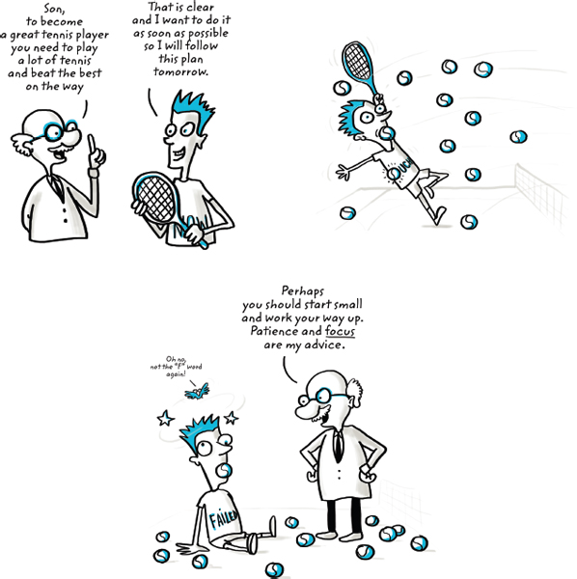
How to Become a Great Tennis Player?
Son, to become
a great tennis player
you need to play a lot of
tennis and beat
the best on the way
That is clear and I want to do it as soon as possible so I will follow this plan tomorrow.

Slide 15
How to Become a Great Tennis Player?
Son, to become
a great tennis player
you need to play a lot of
tennis and beat
the best on the way
That is clear and I want to do it as soon as possible so I will follow this plan tomorrow.

Slide 16
How to Become a Great Tennis Player?
Son, to become
a great tennis player
you need to play a lot of
tennis and beat
the best on the way
That is clear and I want to do it as soon as possible so I will follow this plan tomorrow.
Perhaps you should start small and work your way up. Patience and focus are my advice.
Oh, no; not the “F” word again!

Slide 17
Beachhead Market
In military operations, if an army wants to invade an enemy territory, the army may employ a beachhead strategy
A beachhead strategy entails planning and focusing all time and resources on wining a small strategic boarder area
This small area is called beachhead
The beachhead market then becomes the stronghold to land troops and supplies for the bigger invasion to the enemy territory
The 1944 invasion of Nazi-controlled Europe by the Allied forces is one of the most famous examples of a beachhead strategy

Slide 18
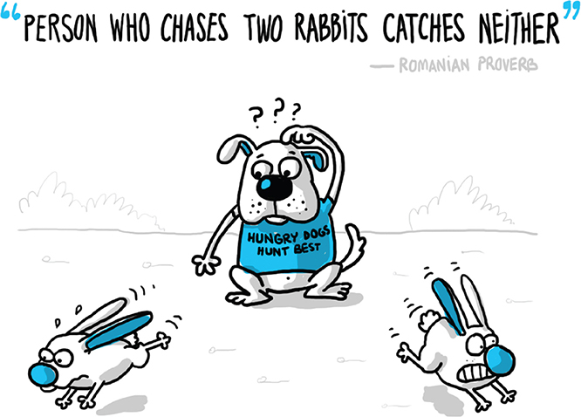
How to Select a Beachhead Market?
Select a beachhead market via selecting just ONE market opportunity from your market segmentation matrix

Slide 19
How to Select a Beachhead Market?
In many cases, there are multiple paths to success, hence, it is not imperative to choose the absolute best market
Alongside, it is better to avoid selecting the largest or very large markets, even if they seem to be the best markets
The first market you attack will be a significant learning experience (with perhaps a lot of failures) for you, so you are better off learning, persevering or pivoting in a smaller market
But, what are the criteria to select a beachhead market?

Slide 20
How to Select a Beachhead Market?
Here are some criteria that may prove useful in choosing your beachhead market:
Is the target customer well-funded? (affordability metric)
Is the target customer readily accessible to your sales force? (accessibility metric)
Does the target customer have a compelling reason to buy? (motivational level)
Can you today, with the help of partners, deliver a whole product? (readiness level)
Is there entrenched competition that could block you? (competition level)
Are there entrenched legalities that can block you? (legality barrier)
If you win this segment, can you leverage it to enter additional segments (i.e., proceed to the bigger invasion)? (scalability metric)
Is the market consistent with your passions, values, and goals? (adherence level)
What is the Total Addressable Market (TAM) size of this market? (TAM size)

Slide 21
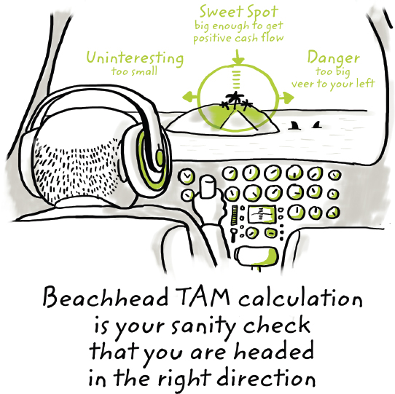
What is TAM?
TAM is the amount of annual revenue (in dollars) your company would earn if you achieved 100% market share in the chosen market

Slide 22
Next Class
Beachhead Markets (Continue)
Business Models (Part I)

