Slide 1
Entrepreneurship for Computer Science CS 15-390
The Lean Approach
Lecture 17, March 31, 2019
Mohammad Hammoud

Slide 2
Today…
Last Session:
COCA
Today’s Session:
The Lean Approach
Announcements:
PS3 is out. It is due on April 9 by midnight
Milestone 4 of the project is due on April 14 by midnight
Next lecture’s case study is “Away”

Slide 3
Value vs. Waste
Question: Which of our efforts are value-creating and which are wasteful?
Lean thinking defines value-creation as providing benefits to the customers; anything else is a waste!
But, how can you know whether you are providing benefits (i.e., creating value) to your potential customers?
Note: True startup productivity CANNOT be measured in terms of how much you are building every day, but rather in terms of systematically figuring out the right thing to build every day

Slide 4
Towards Value Creation
Success is not about delivering a product; success is about delivering a product (or a feature of a product) that customers will use
The way to do this is to continuously align your efforts with your customer’s real needs
Note: This is not about asking your customers what they need because customers typically do not know what they need
The Build-Experiment-Learn feedback loop allows you to discover your customers’ needs and methodically align with them

Slide 5
Build-Experiment-Learn Feedback Loop
Idea
Learn
Build
Data
Product
Experiment

Slide 6
Build-Experiment-Learn Feedback Loop
Idea
Learn
Build
The Build Phase
Data
Product
Experiment

Slide 7
The Build Phase: MVP
The build phase can be entered as quickly as possible with a Minimum Viable Product (MVP)
A MVP ranges in complexity from extremely simple smoke tests (little more than an advertisement) to early prototypes
Smoke Tests
Prototypes
No product is built yet!
A product with problems and missing features

Slide 8
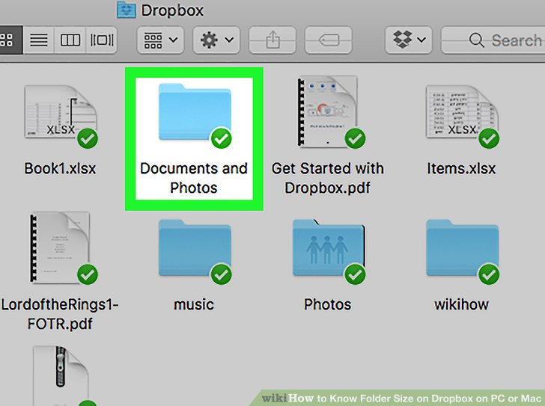
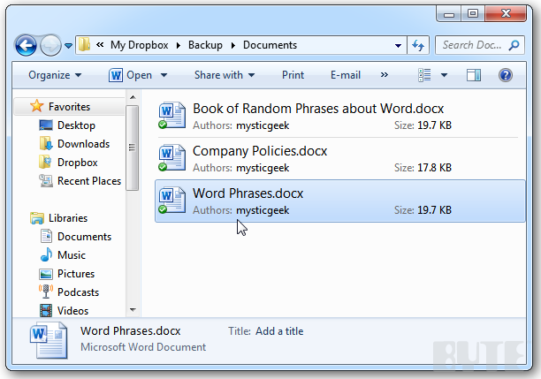
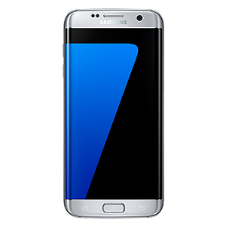
Example of MVP: Dropbox
Dropbox is an easy-to-use file sharing (or synchronization) tool, which uses a push-based caching (or full replication) technique
Push immediately to Dropbox service & all sharing devices

Slide 9
Example of MVP: Dropbox
Dropbox requires integration with a variety of computer platforms and OSs: Windows, Macintosh, iPhone, Android, and so on
It also necessitates deep distributed systems expertise (caching, replication, consistency, reliability, availability, etc.)
To avoid the risk of waking up after years of development with a product that nobody wanted, Drew Houston (founder & CEO of Dropbox) did something unexpectedly easy
He made a video!

Slide 10
Example of MVP: Dropbox
The video was a 3-minute demonstration of the technology as it is meant to work
It was narrated by Drew himself (it was really banal!)
It targeted early adopters, who do not need a perfect solution to get intrigued
Drew recounted: “It drove hundreds of thousands of people to the website. Our beta waiting list went from 5000 people to 75000 people literally overnight. It totally blew us away.”
Today, Dropbox is worth more than $10 billion

Slide 11
The Build Phase: MVP
Deciding how complex a MVP cannot be done formulaically
It requires judgment!
When in doubt, simplify
Avoid overbuilding and overpromising
Any additional work beyond what needs to get you starting the loop might be a waste
MVP does not only speak to product design and technical questions, but also serves in testing fundamental business hypotheses
It provides a needed dose of reality
It often results in seemingly bad (but actually good!) news initially

Slide 12
Build-Experiment-Learn Feedback Loop
Idea
Learn
Build
Data
Product
Experiment
The Experimentation Phase

Slide 13
Leap-of-Faith Assumptions
The riskiest elements of a startup’s plan (i.e., the parts on which everything depends) are called leap-of-faith assumptions
E.g., What was the main leap-of-faith assumption of Dropbox?
File synchronization is a problem
Note: Most people do not know about a certain solution (or even a problem); but once they experience the solution, they cannot imagine how they ever lived without it!

Slide 14
Leap-of-Faith Assumptions
The two most important assumptions of any startup are the value hypothesis and the growth hypothesis
The value hypothesis:
It tests whether the product is really delivering value to customers after they start using it
A testing metric: retention rate
The growth hypothesis:
It tests how new customers will discover the product
A testing metric: referral rate

Slide 15
Example: Facebook
In 2004, Facebook had 150,000 registered users with very little revenue
Yet, that summer they raised their first $500,000 in venture capital
Less than a year later, they raised an additional $12.7 million
How Facebook was able to raise so much money when its actual usage was small?

Slide 16
Example: Facebook
To answer this question, it suffices to look at Facebook’s value and growth hypotheses:
Validated value hypothesis:
More than half of the users came back to the site every single day
Validated growth hypothesis:
Facebook launched on Feb 4, 2004, and by the end of that month, almost ¾ of Harvard’s undergraduates were using it (without spending a dollar on marketing or advertising!)

Slide 17
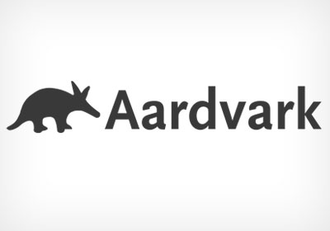
Experimenting: Aardvark
Google excels at answering factual questions
What is the tallest mountain in the world?
Who was the twenty third president of United States?
However, Google struggles with answering subjective questions
What is a good place to go out with a friend after a football game in my city?
Subjective questions are relatively easy for a person to answer
Imagine being at a cocktail party surrounded by friends; how likely would it be to get a high-quality answer for a subjective question?
Very high!

Slide 18
Experimenting: Aardvark
To “technically” solve this problem, Max Ventilla and Damon Horowitz created a product called Aardvark
Max and Damon built a very basic prototype with an instant messaging (IM) front-end and a human-driven back-end (NOT an AI-based engine)
A customer can send Aardvark questions via IM
Aardvark will tap into the customer’s social network via seeking out to the customer’s friends and friends-of-friends
A question about restaurants in San Francisco should not be routed to someone in Seattle
Once Aardvark gets a suitable answer, it reports back to the customer

Slide 19
Experimenting: Aardvark
The technique used by Aardvark is called Wizard of Oz Testing
I.e., Customers believe they are interacting with the actual product, but behind the scenes human beings are doing the actual work
This basic technique simply allowed Max and Damon to test their value and growth hypotheses
If the tough technical problems behind this artificial-intelligence-centric product can be solved, will people use and keep using it?
Will people tell their friends about it?
Aardvark was acquired for a reported $50 million by Google

Slide 20
A/B Testing
Another famous experimentation technique is called A/B (or split) testing
Different versions of a product (or feature) are offered to two different groups of customers at the same time
Changes in behavior are observed between the two groups and inferences are made about the impact of the different versions
If an extra feature does not change customer behavior, it gets questioned
A/B testing allows you to refine your understanding of what customers want and do not want

Slide 21
Build-Experiment-Learn Feedback Loop
Idea
The Learning Phase
Learn
Build
Data
Product
Experiment

Slide 22
The Learning Phase
Question: What do you want to learn?
You want to learn what customers really want, and NOT what they say they want or what you think they would want
Building a MVP and experimenting with it allows collecting real data, which can reveal the current status (or baseline) of your company
Without a clear-eyed picture of your company’s baseline, you cannot begin to track your progress and tune/alter your startup’s engine

Slide 23
The Learning Phase
The baseline could be zero, but it will allow you to create the motivation, context, and space for more qualitative and/or quantitative research
New ideas will be generated, which can be incorporated and tested again
The process repeats until reaching a decision point: pivot or persevere
For example, pivot can involve changing the:
Product (e.g., zoom-in or zoom-out pivots)
Customer segment
Business model
Engine of growth (e.g., paid, sticky, or viral)

Slide 24
Example: Votizen
In 2009, David Binetti started Votizen, a specialized social network for verified voters to learn about political issues and take collective actions
David built a MVP that costed over $1200 in ~3 months and launched it with an attempt to test 4 major leap-of-faith assumptions
Customers would be interested in Votizen and sign up
Defined metric: registration rate
Votizen will be able to verify them as registered voters
Defined metric: activation rate

Slide 25
Example: Votizen
In 2009, David Binetti started Votizen, a specialized social network for verified voters to learn about political issues and take collective actions
David built a MVP that costed over $1200 in ~3 months and launched it with an attempt to test 4 major leap-of-faith assumptions
Verified customers would engage over time
Defined metric: retention rate
Engaged customers would invite friends to join them into civic causes
Defined metric: referral rate

Slide 26
Example: Votizen
Three months after launching, the results were very low
David spent another $5000 optimizing and split testing the usability aspects of the platform
 | Initial MVP
Registration Rate | 5%
Activation Rate | 17%
Retention Rate | Too Low
Referral Rate | Too Low

Slide 27
Example: Votizen
Two months after these optimizations, the results improved
David knew he had to do more; hence, he talked to more customers, held focused group discussions, and did countless A/B experiments
 | Initial MVP | After Optimization
Registration Rate | 5% | 17%
Activation Rate | 17% | 90%
Retention Rate | Too Low | 5%
Referral Rate | Too Low | 4%

Slide 28
Example: Votizen
Three months later, the results nudged up only slightly
The platform was not living up to the growth model David has hoped for!
Time to pivot or persevere
 | After 1st Optimization | After 2nd Optimization
Registration Rate | 17% | 17%
Activation Rate | 90% | 90%
Retention Rate | 5% | 8%
Referral Rate | 4% | 6%

Slide 29
Example: Votizen
David’s direct contact with customers provided the following feedback:
“I always wanted to get more involved; this makes it so much easier”
“The fact that you prove I’m a voter matters”
“There’s no one here. What’s the point of coming back?”
David decided to undertake a zoom-in pivot, refocusing the platform on what previously was considered a feature of a larger whole
Customers can contact elected representatives digitally
Votizen translates that digital contact into old-fashioned printed letters and petitions, and mails them to representatives at Congress

Slide 30
Example: Votizen
Four months later and another $30,000, the results improved
David was stuck in an age-old entrepreneurial trap- i.e., metrics and product were improving, but not fast enough!
 | Before Pivot | After Pivot
Registration Rate | 17% | 42%
Activation Rate | 90% | 83%
Retention Rate | 8% | 21%
Referral Rate | 6% | 54%

Slide 31
Example: Votizen
David decided to undertake a customer segment pivot, keeping the functionality of his platform the same but changing the audience focus
He contacted large companies and professional fundraisers who have professional or business interests in political campaigning
The companies seemed extremely eager and David quickly signed Letters-of-Intent (LoI) to build the functionality they needed
On the basis of LoI, David increased his head count and built all the required functionality in 3 months
David went back to the companies, but none of them closed a real sale!

Slide 32
Example: Votizen
David decided to fire some staff and undertake a business-model pivot, allowing anyone to become a paid customer with just a credit card and rally any group of people
One month later, metrics started increasing
 | Before 2nd Pivot | After 2nd Pivot
Registration Rate | 42% | 51%
Activation Rate | 83% | 92%
Retention Rate | 21% | 28%
Referral Rate | 54% | 64%

Slide 33
Example: Votizen
Votizen’s system can now process voter identities in real time for > 47 states and has delivered 10s of thousands of messages to Congress
The Startup Visa campaign used Votizen’s tools to introduce the Startup Visa Act (S.565)
This was the first legislation introduced into the USA Senate solely as a result of social lobbying
On January 10, 2013, Votizen was acquired by Causes, an online civic engagement platform founded by Sean Parker

Slide 34
Next Lecture…
Product Development: Designing and Building Multi-tier (with front-end and back-end tiers) Systems

