Slide 1
Entrepreneurship for Computer Science CS 15-390
Business Models- Part III
Lecture 11, February 26, 2019
Mohammad Hammoud

Slide 2
Today…
Last Session:
Business models- Part I
Today’s Session:
Business models- Part II
Announcements:
Quiz grades are out
PS2 is due on March 02 by midnight

Slide 3
Outline
Business Models- Part III
Pricing Framework

Slide 4
The Freemium Model
A customer pays zero money for a basic functionality of your product, but pays for obtaining premium features
Many people can try your product
However, will these people (they are not customers until they pay) pay for the extra features available in your product?
Caveat: If people do not pay for your extra features, you do not have a business (recall the solo condition for having a business)
Is freemium a business model?
Can you not offer premium features and make money through a third party?

Slide 5
The Advertising Model
You can make your product free, but monetize your ability to attract and retain a desirable demographic via providing Ads for third parties who want access to them
E.g., Google’s AdWords
Appealing to users and third parties, especially that Ads are seamless (no banners!) and targeted
Caveat: many startups have fallen substantially short when they relied solely on Ads

Slide 6
The Reselling Model
You can make your product free, but monetize your ability to collect data via reselling data itself or corresponding analytics to third parties
E.g., LinkedIn’s recruiters package
Transparency is critical!
Users should know that some analytics or data about them are being sold to third parties
Interestingly, users might use your product just for this specific purpose (e.g., LinkedIn users)

Slide 7
The Franchise Model
You can obtain a percentage of sales (dynamic revenue) and/or a large initial startup fee (static revenue) in return of providing your knowledge and permission to use your known brand
Expand without investing on the ground!
You can also make money via selling your brand-name products to the franchisees to be distributed
Quality control might become a concern, but if done rightly, it can improve quality!
One study showed that franchisees outperformed their company-owned counterparts by an average of 10% to 30%
Notes:
Here is the article that refers to the above study: https://www.entrepreneur.com/article/202330

Slide 8
The Franchise Model
From a franchisor's standpoint, there are four pillars of quality:
Franchisee Selection
Here is where quality starts!
Franchisee Training
Not one-time (initially), but rather continuous
Ongoing Support
This shall span multiple domains, including marketing, public relations, and technology, among others
Compliance
A franchisor cannot fire a franchisee the way that she/he could fire an employee
However, she/he can enforce compliance via a well-crafted contract

Slide 9
A Taxonomy of Business Models: Summary
Business Model | Description
(1) The Up-Front Charge Model | A customer pays a large one-time, up-front amount of money to obtain a product/service
(2) The Transaction Fee Model | A customer pays a commission fee for a referral that leads to a sale
(3) The Parking Meter Model | A customer pays a small fee for a limited duration and “fined” high if she/he exceeds that duration
(4) The Usage-Based Model | A customer pays only for what she/he uses (no base or subscription fee)
(5) The Cell Phone Model | A customer pays a base fee for a limited amount of usage and high additional usage-based fee for exceeding that amount
(6) The Subscription Model | A customer pays a subscription fee at the end of every predetermined time period
(7) The Licensing Model | A seller licenses her/his product (or strong IP) to a business and receives in return a royalty on sales or a regular fixed amount of money
Business Model | Description
(1) The Up-Front Charge Model | A customer pays a large one-time, up-front amount of money to obtain a product/service
(2) The Transaction Fee Model | A customer pays a commission fee for a referral that leads to a sale
(3) The Parking Meter Model | A customer pays a small fee for a limited duration and “fined” high if she/he exceeds that duration
(4) The Usage-Based Model | A customer pays only for what she/he uses (no base or subscription fee)
(5) The Cell Phone Model | A customer pays a base fee for a limited amount of usage and high additional usage-based fee for exceeding that amount
(6) The Subscription Model | A customer pays a subscription fee at the end of every predetermined time period
(7) The Licensing Model | A seller licenses her/his product (or strong IP) to a business and receives in return a royalty on sales or a regular fixed amount of money
Business Model | Description
(1) The Up-Front Charge Model | A customer pays a large one-time, up-front amount of money to obtain a product/service
(2) The Transaction Fee Model | A customer pays a commission fee for a referral that leads to a sale
(3) The Parking Meter Model | A customer pays a small fee for a limited duration and “fined” high if she/he exceeds that duration
(4) The Usage-Based Model | A customer pays only for what she/he uses (no base or subscription fee)
(5) The Cell Phone Model | A customer pays a base fee for a limited amount of usage and high additional usage-based fee for exceeding that amount
(6) The Subscription Model | A customer pays a subscription fee at the end of every predetermined time period
(7) The Licensing Model | A seller licenses her/his product (or strong IP) to a business and receives in return a royalty on sales or a regular fixed amount of money
Business Model | Description
(1) The Up-Front Charge Model | A customer pays a large one-time, up-front amount of money to obtain a product/service
(2) The Transaction Fee Model | A customer pays a commission fee for a referral that leads to a sale
(3) The Parking Meter Model | A customer pays a small fee for a limited duration and “fined” high if she/he exceeds that duration
(4) The Usage-Based Model | A customer pays only for what she/he uses (no base or subscription fee)
(5) The Cell Phone Model | A customer pays a base fee for a limited amount of usage and high additional usage-based fee for exceeding that amount
(6) The Subscription Model | A customer pays a subscription fee at the end of every predetermined time period
(7) The Licensing Model | A seller licenses her/his product (or strong IP) to a business and receives in return a royalty on sales or a regular fixed amount of money
Business Model | Description
(1) The Up-Front Charge Model | A customer pays a large one-time, up-front amount of money to obtain a product/service
(2) The Transaction Fee Model | A customer pays a commission fee for a referral that leads to a sale
(3) The Parking Meter Model | A customer pays a small fee for a limited duration and “fined” high if she/he exceeds that duration
(4) The Usage-Based Model | A customer pays only for what she/he uses (no base or subscription fee)
(5) The Cell Phone Model | A customer pays a base fee for a limited amount of usage and high additional usage-based fee for exceeding that amount
(6) The Subscription Model | A customer pays a subscription fee at the end of every predetermined time period
(7) The Licensing Model | A seller licenses her/his product (or strong IP) to a business and receives in return a royalty on sales or a regular fixed amount of money
Business Model | Description
(1) The Up-Front Charge Model | A customer pays a large one-time, up-front amount of money to obtain a product/service
(2) The Transaction Fee Model | A customer pays a commission fee for a referral that leads to a sale
(3) The Parking Meter Model | A customer pays a small fee for a limited duration and “fined” high if she/he exceeds that duration
(4) The Usage-Based Model | A customer pays only for what she/he uses (no base or subscription fee)
(5) The Cell Phone Model | A customer pays a base fee for a limited amount of usage and high additional usage-based fee for exceeding that amount
(6) The Subscription Model | A customer pays a subscription fee at the end of every predetermined time period
(7) The Licensing Model | A seller licenses her/his product (or strong IP) to a business and receives in return a royalty on sales or a regular fixed amount of money
Business Model | Description
(1) The Up-Front Charge Model | A customer pays a large one-time, up-front amount of money to obtain a product/service
(2) The Transaction Fee Model | A customer pays a commission fee for a referral that leads to a sale
(3) The Parking Meter Model | A customer pays a small fee for a limited duration and “fined” high if she/he exceeds that duration
(4) The Usage-Based Model | A customer pays only for what she/he uses (no base or subscription fee)
(5) The Cell Phone Model | A customer pays a base fee for a limited amount of usage and high additional usage-based fee for exceeding that amount
(6) The Subscription Model | A customer pays a subscription fee at the end of every predetermined time period
(7) The Licensing Model | A seller licenses her/his product (or strong IP) to a business and receives in return a royalty on sales or a regular fixed amount of money

Slide 10
A Taxonomy of Business Models: Summary
Business Model | Description
(8) The Consumable Model | A customer pays an up-front amount of money for a product, but also pays ongoing fees while using it
(9) The Upsell Model | A customer pays low-margin fee for a product and high-margin fee for corresponding add-on products
(10) The Freemium Model | A customer pays zero money for a basic functionality of a product, but high fee for obtaining its premium features
(11) The Advertising Model | A customer (typically a third party) pays for having Ads directed and shown for a desirable demographic (or what is referred to as targeted Ads)
(12) The Reselling Model | A customer pays for obtaining analytics/reports generated from user data
(13) The Franchise Model | A customer pays a percentage of sales and/or a (large) initial startup fee in return of obtaining a permission to use a known brand
Business Model | Description
(8) The Consumable Model | A customer pays an up-front amount of money for a product, but also pays ongoing fees while using it
(9) The Upsell Model | A customer pays low-margin fee for a product and high-margin fee for corresponding add-on products
(10) The Freemium Model | A customer pays zero money for a basic functionality of a product, but high fee for obtaining its premium features
(11) The Advertising Model | A customer (typically a third party) pays for having Ads directed and shown for a desirable demographic (or what is referred to as targeted Ads)
(12) The Reselling Model | A customer pays for obtaining analytics/reports generated from user data
(13) The Franchise Model | A customer pays a percentage of sales and/or a (large) initial startup fee in return of obtaining a permission to use a known brand
Business Model | Description
(8) The Consumable Model | A customer pays an up-front amount of money for a product, but also pays ongoing fees while using it
(9) The Upsell Model | A customer pays low-margin fee for a product and high-margin fee for corresponding add-on products
(10) The Freemium Model | A customer pays zero money for a basic functionality of a product, but high fee for obtaining its premium features
(11) The Advertising Model | A customer (typically a third party) pays for having Ads directed and shown for a desirable demographic (or what is referred to as targeted Ads)
(12) The Reselling Model | A customer pays for obtaining analytics/reports generated from user data
(13) The Franchise Model | A customer pays a percentage of sales and/or a (large) initial startup fee in return of obtaining a permission to use a known brand
Business Model | Description
(8) The Consumable Model | A customer pays an up-front amount of money for a product, but also pays ongoing fees while using it
(9) The Upsell Model | A customer pays low-margin fee for a product and high-margin fee for corresponding add-on products
(10) The Freemium Model | A customer pays zero money for a basic functionality of a product, but high fee for obtaining its premium features
(11) The Advertising Model | A customer (typically a third party) pays for having Ads directed and shown for a desirable demographic (or what is referred to as targeted Ads)
(12) The Reselling Model | A customer pays for obtaining analytics/reports generated from user data
(13) The Franchise Model | A customer pays a percentage of sales and/or a (large) initial startup fee in return of obtaining a permission to use a known brand
Business Model | Description
(8) The Consumable Model | A customer pays an up-front amount of money for a product, but also pays ongoing fees while using it
(9) The Upsell Model | A customer pays low-margin fee for a product and high-margin fee for corresponding add-on products
(10) The Freemium Model | A customer pays zero money for a basic functionality of a product, but high fee for obtaining its premium features
(11) The Advertising Model | A customer (typically a third party) pays for having Ads directed and shown for a desirable demographic (or what is referred to as targeted Ads)
(12) The Reselling Model | A customer pays for obtaining analytics/reports generated from user data
(13) The Franchise Model | A customer pays a percentage of sales and/or a (large) initial startup fee in return of obtaining a permission to use a known brand
Business Model | Description
(8) The Consumable Model | A customer pays an up-front amount of money for a product, but also pays ongoing fees while using it
(9) The Upsell Model | A customer pays low-margin fee for a product and high-margin fee for corresponding add-on products
(10) The Freemium Model | A customer pays zero money for a basic functionality of a product, but high fee for obtaining its premium features
(11) The Advertising Model | A customer (typically a third party) pays for having Ads directed and shown for a desirable demographic (or what is referred to as targeted Ads)
(12) The Reselling Model | A customer pays for obtaining analytics/reports generated from user data
(13) The Franchise Model | A customer pays a percentage of sales and/or a (large) initial startup fee in return of obtaining a permission to use a known brand

Slide 11
Outline
Business Models- Part III
Pricing Framework

Slide 12
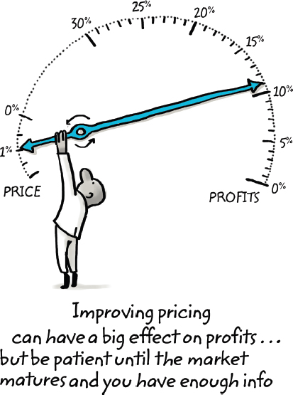
Pricing Framework
A price that is 1% higher, leads to
an 11% increase in overall profits
(“The 1% Windfall” by Rafi Mohammed)
Fine-tuning your pricing strategy can have a huge impact on your earnings!
PRICE
PROFITS
Improving pricing
can have a big effect on profits…
but be patient until the market
matures and you have enough info

Slide 13
Pricing Framework
Pricing is set based on your business model
Business model is “static” (i.e., it rarely changes)
Pricing framework is “dynamic”
Some businesses change pricing on a daily basis (e.g., gas stations)
Some businesses even change pricing on a real-time basis (e.g., airline tickets)
Getting pricing right is an iterative and ongoing process!
Start at some point that is the best guess for the moment, then spiral closer and closer to a better answer
Objective: strike a balance between maximizing revenue and maximizing customer base

Slide 14
Basic Pricing Concepts
Do not use cost as a factor in deciding the price of your product
Set your price based on the value that the customer gets from your product (which stems from your business model)
E.g., a subscription model allows pricing higher than an up-front charge model
Cost-based strategies almost always leave money on the table
In software, the marginal cost (the cost of producing one more copy of the software) is almost zero; hence, pricing based on cost would make it difficult to make any money
“My business is very simple. My customers give me $2 and they get back $10. That is why we are so successful” by Steve Walske

Slide 15
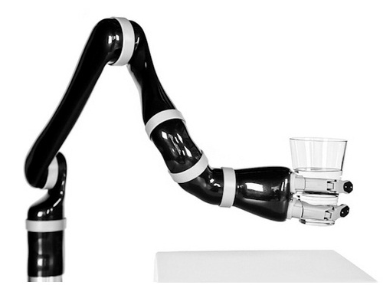
Basic Pricing Concepts
Use the Decision-Making Unit (DMU) and the process to acquire a paying customer as a way to identify key price points
Example: Kinova Robotics
Business Branch: Selling Jaco assistive robotic arm
One Market: Netherlands
Primary Market Research:
End-users: disabled people on wheelchairs
Economic-buyers: mainly health insurance companies, which reimburse up to only 28,000 euros
Decided Pricing: 28,000 euros
Results: Sales cycle length & Cost of Customer Acquisition (COCA) were dramatically decreased, which allowed Kinova to quickly ramp up sales and enjoy a large market share

Slide 16
Basic Pricing Concepts
Understand the prices of your customer’s alternatives
Are there alternative products available?
If so, how much the customer would pay for each?
What distinguishes your product from the available alternatives?
It might be better NOT to set the price of your product higher (not even initially!) than alternatives, although it might be more advanced
It is always easier to drop rather than raise the price
It is best to price high and offer discounts initially, rather than price too low and raise later
In Reality: each left segment in the “technology adoption life cycle” is willing to pay more than its neighboring right segment

Slide 17
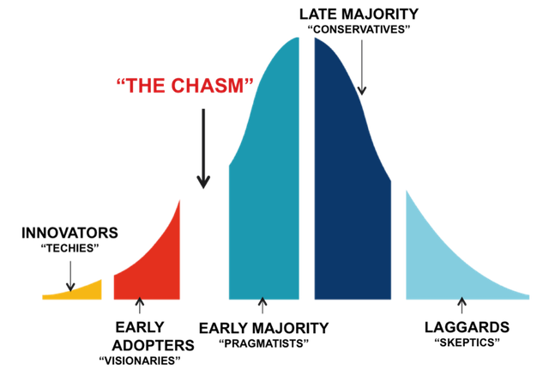
Basic Pricing Concepts
The Technology Adoption Life Cycle
LATE MAJORITY
“conservatives”
“THE CHASM”
Different types of customers
will pay different prices!
INNOVATORS
“techies”
EARLY ADOPTERS
“visionaries”
EARLY MAJORITY
“pragmatists”
LAGGARDS
“skeptics”

Slide 18
Basic Pricing Concepts
Be flexible with pricing for early adopters and “lighthouse customers”
On one hand, these customers can help you cross the chasm!
On the other hand, you do not want your early one-time-only deals to define your general pricing strategy
Options: Offer them discounts on up-front charges, or free or low-cost trial period; but have them sign an agreement where their pricing terms be kept confidential

Slide 19
Summary
Pricing is primarily about determining how much value your customer gets from your product and, accordingly, capturing a fraction of that value back for your business
You can charge higher price to early customers as opposed to later customers, but be flexible in offering special, one-time-only discounts to early testers and lighthouse customers
Unlike your business model, pricing will continually change (e.g., in response to market conditions)

Slide 20
Next Class
Calculate the Lifetime Value (LTV) of an Acquired Customer

