Slide 1
Entrepreneurship for Computer Science
CS 15-390
Market Segmentation and Research
Lecture 2, January 9, 2018
Mohammad Hammoud

Slide 2
Today…
Last Session:
  Definitions of startup, entrepreneurship, and entrepreneur
  Types of entrepreneurship
  Course overview
Today’s Session:
  Passion checklist
  Team
  Market Segmentation

Slide 3
Passion: the Necessary but Not Sufficient Condition
Starting a company is not easy- it is the exact opposite
Without a passion you will not be able to keep going through good and tough times (which will certainly happen, without question)
In fact, without passion you will never succeed in building a startup
Distinguish yourself from “entrepreneurial tourists” or “exploratory entrepreneurs” who are interested in learning entrepreneurship, but are not ready for a really difficult and humbling journey

Slide 4
Passion Checklist
 | I Understand That: | Yes | No
1 | Founding a startup will be really, really hard and I still want to do it
2 | It will be a lengthy process loaded with humiliating failures along the way, and I must learn from them and not take them personally
3 | I cannot do it alone
4 | The path to success is not an algorithm with set of rules to follow, but an iterative process where I can only increase or decrease the odds of success, but I cannot guarantee anything. Even if I achieve success, it is only temporary
5 | The goal is to make an “anti-fragile” organization– one that gets stronger over time when faced with problems, failures, uncertainty, and surprises
6 | When others provide advice, I will listen, but I will also recognize that it is up to me to choose which advice to implement, and how to implement it, since only I own the final results and accountability
7 | I will have to leave my comfort zone every day to grow and continue to be successful
8 | I am doing this for more than the money. I believe in my cause and my team
 | I Understand That: | Yes | No
1 | Founding a startup will be really, really hard and I still want to do it
2 | It will be a lengthy process loaded with humiliating failures along the way, and I must learn from them and not take them personally
3 | I cannot do it alone
4 | The path to success is not an algorithm with set of rules to follow, but an iterative process where I can only increase or decrease the odds of success, but I cannot guarantee anything. Even if I achieve success, it is only temporary
5 | The goal is to make an “anti-fragile” organization– one that gets stronger over time when faced with problems, failures, uncertainty, and surprises
6 | When others provide advice, I will listen, but I will also recognize that it is up to me to choose which advice to implement, and how to implement it, since only I own the final results and accountability
7 | I will have to leave my comfort zone every day to grow and continue to be successful
8 | I am doing this for more than the money. I believe in my cause and my team
 | I Understand That: | Yes | No
1 | Founding a startup will be really, really hard and I still want to do it
2 | It will be a lengthy process loaded with humiliating failures along the way, and I must learn from them and not take them personally
3 | I cannot do it alone
4 | The path to success is not an algorithm with set of rules to follow, but an iterative process where I can only increase or decrease the odds of success, but I cannot guarantee anything. Even if I achieve success, it is only temporary
5 | The goal is to make an “anti-fragile” organization– one that gets stronger over time when faced with problems, failures, uncertainty, and surprises
6 | When others provide advice, I will listen, but I will also recognize that it is up to me to choose which advice to implement, and how to implement it, since only I own the final results and accountability
7 | I will have to leave my comfort zone every day to grow and continue to be successful
8 | I am doing this for more than the money. I believe in my cause and my team
 | I Understand That: | Yes | No
1 | Founding a startup will be really, really hard and I still want to do it
2 | It will be a lengthy process loaded with humiliating failures along the way, and I must learn from them and not take them personally
3 | I cannot do it alone
4 | The path to success is not an algorithm with set of rules to follow, but an iterative process where I can only increase or decrease the odds of success, but I cannot guarantee anything. Even if I achieve success, it is only temporary
5 | The goal is to make an “anti-fragile” organization– one that gets stronger over time when faced with problems, failures, uncertainty, and surprises
6 | When others provide advice, I will listen, but I will also recognize that it is up to me to choose which advice to implement, and how to implement it, since only I own the final results and accountability
7 | I will have to leave my comfort zone every day to grow and continue to be successful
8 | I am doing this for more than the money. I believe in my cause and my team
 | I Understand That: | Yes | No
1 | Founding a startup will be really, really hard and I still want to do it
2 | It will be a lengthy process loaded with humiliating failures along the way, and I must learn from them and not take them personally
3 | I cannot do it alone
4 | The path to success is not an algorithm with set of rules to follow, but an iterative process where I can only increase or decrease the odds of success, but I cannot guarantee anything. Even if I achieve success, it is only temporary
5 | The goal is to make an “anti-fragile” organization– one that gets stronger over time when faced with problems, failures, uncertainty, and surprises
6 | When others provide advice, I will listen, but I will also recognize that it is up to me to choose which advice to implement, and how to implement it, since only I own the final results and accountability
7 | I will have to leave my comfort zone every day to grow and continue to be successful
8 | I am doing this for more than the money. I believe in my cause and my team
 | I Understand That: | Yes | No
1 | Founding a startup will be really, really hard and I still want to do it
2 | It will be a lengthy process loaded with humiliating failures along the way, and I must learn from them and not take them personally
3 | I cannot do it alone
4 | The path to success is not an algorithm with set of rules to follow, but an iterative process where I can only increase or decrease the odds of success, but I cannot guarantee anything. Even if I achieve success, it is only temporary
5 | The goal is to make an “anti-fragile” organization– one that gets stronger over time when faced with problems, failures, uncertainty, and surprises
6 | When others provide advice, I will listen, but I will also recognize that it is up to me to choose which advice to implement, and how to implement it, since only I own the final results and accountability
7 | I will have to leave my comfort zone every day to grow and continue to be successful
8 | I am doing this for more than the money. I believe in my cause and my team
 | I Understand That: | Yes | No
1 | Founding a startup will be really, really hard and I still want to do it
2 | It will be a lengthy process loaded with humiliating failures along the way, and I must learn from them and not take them personally
3 | I cannot do it alone
4 | The path to success is not an algorithm with set of rules to follow, but an iterative process where I can only increase or decrease the odds of success, but I cannot guarantee anything. Even if I achieve success, it is only temporary
5 | The goal is to make an “anti-fragile” organization– one that gets stronger over time when faced with problems, failures, uncertainty, and surprises
6 | When others provide advice, I will listen, but I will also recognize that it is up to me to choose which advice to implement, and how to implement it, since only I own the final results and accountability
7 | I will have to leave my comfort zone every day to grow and continue to be successful
8 | I am doing this for more than the money. I believe in my cause and my team
 | I Understand That: | Yes | No
1 | Founding a startup will be really, really hard and I still want to do it
2 | It will be a lengthy process loaded with humiliating failures along the way, and I must learn from them and not take them personally
3 | I cannot do it alone
4 | The path to success is not an algorithm with set of rules to follow, but an iterative process where I can only increase or decrease the odds of success, but I cannot guarantee anything. Even if I achieve success, it is only temporary
5 | The goal is to make an “anti-fragile” organization– one that gets stronger over time when faced with problems, failures, uncertainty, and surprises
6 | When others provide advice, I will listen, but I will also recognize that it is up to me to choose which advice to implement, and how to implement it, since only I own the final results and accountability
7 | I will have to leave my comfort zone every day to grow and continue to be successful
8 | I am doing this for more than the money. I believe in my cause and my team
If you did not answer “Yes” to all of the above questions, do not start a company today!

Slide 5
Team
Entrepreneurship is not a solo sport
A solid team should have at least 3 things:
  A common vision
  Shared values
  Complementary skills
Think about the balance, skills, and roles of your team in terms of the 3H model- Hacker, Hustler, and Hipster
  Who in your team is the “hacker”? (hacker is the one who will build the product)
  Who in your team is the “hustler”? (hustler is the business person)
  Who in your team is the “hipster”? (hipster is the one concerned with the customer experience and design)

Slide 6
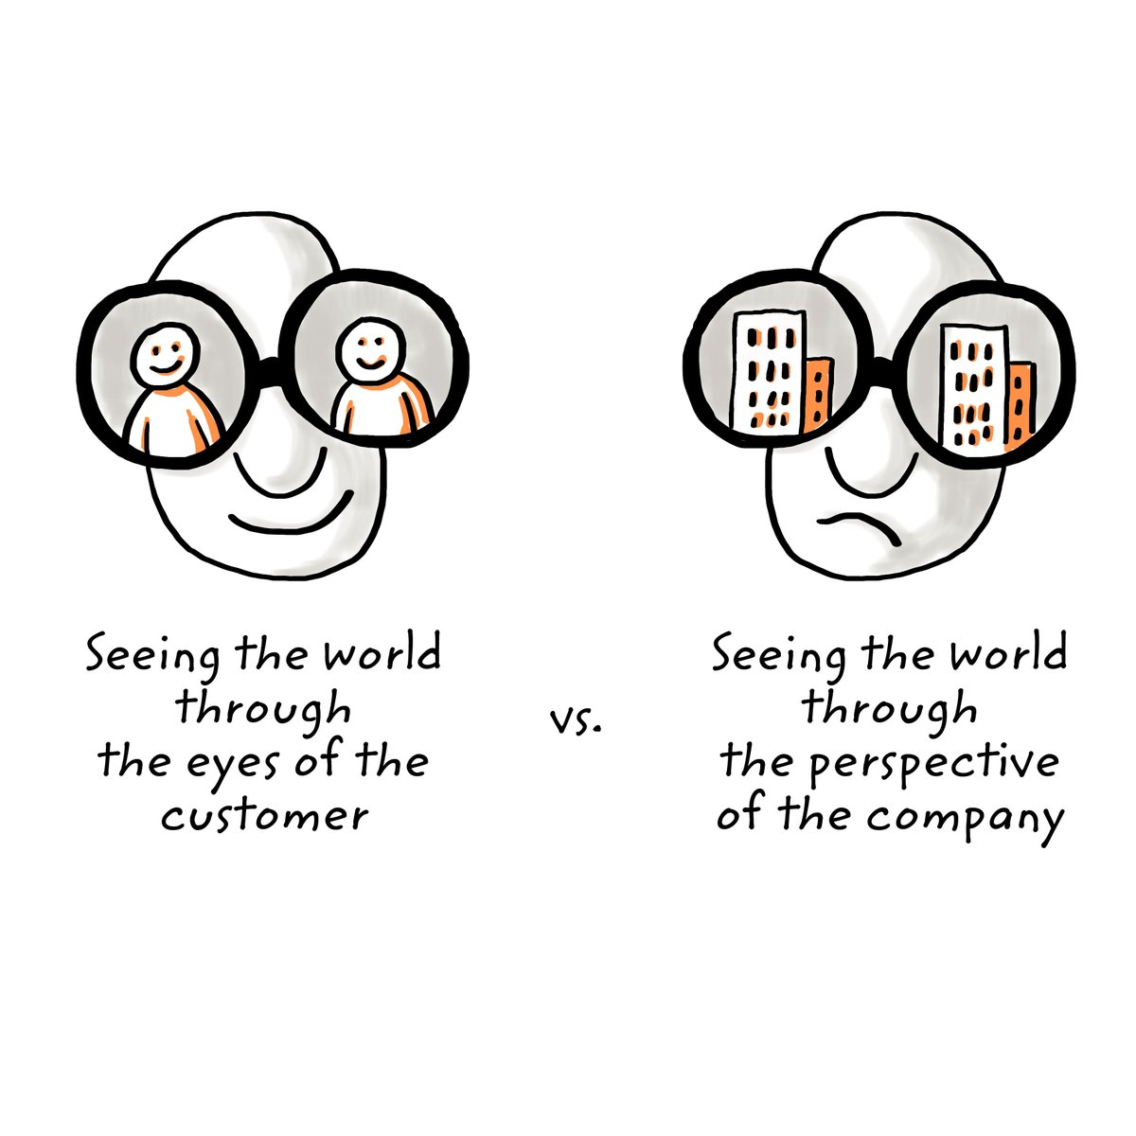
Market Segmentation
Market segmentation is the process of dividing a “broad” consumer or business market into sub-groups (or segments) in an aim to identify high yield segments.
It may also help you come up with an idea!

Slide 7
The Segmentation Process
Step 0: Identify your passions
  E.g., Technology (i.e., expertise) & Education (i.e., domain/market)
Step 1: Start with a “generic” idea
  E.g., I want to improve education through technology
Step 2: Identify potential “industries” of your selected domain
  E.g., Universities, schools, centers, etc.,
Step 3: Identify all “end-users” in your industries
  End-users are potential people who will use your potential product
    E.g., Teachers, Students, Administrators, Parents, etc.,

Slide 8
The Segmentation Process
Step 3 (Cont’d): Identify all “end-users” in your industries
  End-users are not necessarily “economic buyers”
    E.g., Schools do not use course or advising systems, but teachers do
Step 4: Identify different “tasks” your end-users perform
  E.g., Teachers teach, grade, advise, etc.,
Step 5: Identify different “specialties” of your end-users
...
You can follow
any logical order
and go as deep as you like

Slide 9
Example
Improve Education through Technology
Generic Idea
Universities
Schools
….
Education Centers
Industries
Students
Professors
….
Administrators
End-Users
Business
Computer Science
….
Sociology
Specialties
Teaching
Grading
….
Advising
Tasks
.
.
.

Slide 10
Market Segmentation
Technique:
  Start somewhere (passion can lead)
    One of the key things in founding a startup is to start; it is right there in the name!
  Come up with a generic idea and segment its domain (or market) constituents, following a logical order
  Open the aperture as wide as possible
    This helps in expanding the boundaries of possibilities to where some of the most interesting opportunities might exist

Slide 11

Market Segmentation
Technique:
  Identify the “sub-tree” on the tree that intrigues you the most and try to tap into your expertise to solve a seemingly (i.e., not yet confirmed) “pain” there
    No idea is too crazy at this point (and even later)! If you insist and prove it, people will follow.

Slide 12
Market Segmentation
Technique:
  Identify the “sub-tree” on the tree that intrigues you the most and try to tap into your expertise to solve a seemingly (i.e., not yet confirmed) “pain” there
    In fact, in the startup world, most good ideas are hidden down deep in the tree and/or “seem” bad initially. If they were “obviously” visible and good, someone would have already be doing them!
  Do not combine segments that seem similar without knowing more about your potential customers
  Build a “market segmentation matrix”

Slide 13
Market Segmentation Matrix: Row Definitions
 | Row | Definition
1 | Market Segment Name | This is the market opportunity that you will identify for your product
2 | End User | This is the person who will use your product and not the economic buyer. Even if you will sell to a company, list here the people who will use your product in that company
3 | Task | What exactly is it that the end users do that you will significantly affect or allow them to do that they could not do before?
4 | Benefit | What is the benefit that you believe the end users will get?
5 | Urgency of Need | What is the level of urgency to solve the problem or capture the new opportunity for the end user?
6 | Example End Users | Who are examples of end users that you can, have, or will talk to, so as to validate your perceptions of this market segment
7 | Lead Customers | Who are the influential customers (i.e., lighthouse customers) where, if they buy your product, others will take note and likely follow?
 | Row | Definition
1 | Market Segment Name | This is the market opportunity that you will identify for your product
2 | End User | This is the person who will use your product and not the economic buyer. Even if you will sell to a company, list here the people who will use your product in that company
3 | Task | What exactly is it that the end users do that you will significantly affect or allow them to do that they could not do before?
4 | Benefit | What is the benefit that you believe the end users will get?
5 | Urgency of Need | What is the level of urgency to solve the problem or capture the new opportunity for the end user?
6 | Example End Users | Who are examples of end users that you can, have, or will talk to, so as to validate your perceptions of this market segment
7 | Lead Customers | Who are the influential customers (i.e., lighthouse customers) where, if they buy your product, others will take note and likely follow?
 | Row | Definition
1 | Market Segment Name | This is the market opportunity that you will identify for your product
2 | End User | This is the person who will use your product and not the economic buyer. Even if you will sell to a company, list here the people who will use your product in that company
3 | Task | What exactly is it that the end users do that you will significantly affect or allow them to do that they could not do before?
4 | Benefit | What is the benefit that you believe the end users will get?
5 | Urgency of Need | What is the level of urgency to solve the problem or capture the new opportunity for the end user?
6 | Example End Users | Who are examples of end users that you can, have, or will talk to, so as to validate your perceptions of this market segment
7 | Lead Customers | Who are the influential customers (i.e., lighthouse customers) where, if they buy your product, others will take note and likely follow?
 | Row | Definition
1 | Market Segment Name | This is the market opportunity that you will identify for your product
2 | End User | This is the person who will use your product and not the economic buyer. Even if you will sell to a company, list here the people who will use your product in that company
3 | Task | What exactly is it that the end users do that you will significantly affect or allow them to do that they could not do before?
4 | Benefit | What is the benefit that you believe the end users will get?
5 | Urgency of Need | What is the level of urgency to solve the problem or capture the new opportunity for the end user?
6 | Example End Users | Who are examples of end users that you can, have, or will talk to, so as to validate your perceptions of this market segment
7 | Lead Customers | Who are the influential customers (i.e., lighthouse customers) where, if they buy your product, others will take note and likely follow?
 | Row | Definition
1 | Market Segment Name | This is the market opportunity that you will identify for your product
2 | End User | This is the person who will use your product and not the economic buyer. Even if you will sell to a company, list here the people who will use your product in that company
3 | Task | What exactly is it that the end users do that you will significantly affect or allow them to do that they could not do before?
4 | Benefit | What is the benefit that you believe the end users will get?
5 | Urgency of Need | What is the level of urgency to solve the problem or capture the new opportunity for the end user?
6 | Example End Users | Who are examples of end users that you can, have, or will talk to, so as to validate your perceptions of this market segment
7 | Lead Customers | Who are the influential customers (i.e., lighthouse customers) where, if they buy your product, others will take note and likely follow?
 | Row | Definition
1 | Market Segment Name | This is the market opportunity that you will identify for your product
2 | End User | This is the person who will use your product and not the economic buyer. Even if you will sell to a company, list here the people who will use your product in that company
3 | Task | What exactly is it that the end users do that you will significantly affect or allow them to do that they could not do before?
4 | Benefit | What is the benefit that you believe the end users will get?
5 | Urgency of Need | What is the level of urgency to solve the problem or capture the new opportunity for the end user?
6 | Example End Users | Who are examples of end users that you can, have, or will talk to, so as to validate your perceptions of this market segment
7 | Lead Customers | Who are the influential customers (i.e., lighthouse customers) where, if they buy your product, others will take note and likely follow?
 | Row | Definition
1 | Market Segment Name | This is the market opportunity that you will identify for your product
2 | End User | This is the person who will use your product and not the economic buyer. Even if you will sell to a company, list here the people who will use your product in that company
3 | Task | What exactly is it that the end users do that you will significantly affect or allow them to do that they could not do before?
4 | Benefit | What is the benefit that you believe the end users will get?
5 | Urgency of Need | What is the level of urgency to solve the problem or capture the new opportunity for the end user?
6 | Example End Users | Who are examples of end users that you can, have, or will talk to, so as to validate your perceptions of this market segment
7 | Lead Customers | Who are the influential customers (i.e., lighthouse customers) where, if they buy your product, others will take note and likely follow?

Slide 14
Market Segmentation Matrix: Row Definitions
 | Row | Definition
8 | Willingness to Change | How conservative is this market segment? How open are they to change? Is there something to force change (e.g., impending crisis)?
9 | Frequency of Buying | How often do they buy new products? What does their buying cycle look like at high level?
10 | Concentration of Buyers | How many different buyers are there in this market segment? Is it a monopoly? Oligopoly (a small number of buyers)? Or may competitive buyers?
11 | Other Relative Market Considerations | This allows for customization of your segment for your relevant considerations such as “high employee turnover”, “very low margins/commodity”, “high-growth industry”, “high virality effect” (i.e., word of mouth), etc.
12 | Size of Market (# of End Users) | Estimation of the number of end users to a relevant range (10s, 100s, 1Ks, 10Ks, 100Ks, 1Ms, etc.).
13 | Est. Value of End User ($1, $10, $100, $1K, etc.) | A first-pass estimate of the value of each end user, again to a relevant order of magnitude so you can make some relative decisions now (you will do a deep dive into this and other numbers later).
 | Row | Definition
8 | Willingness to Change | How conservative is this market segment? How open are they to change? Is there something to force change (e.g., impending crisis)?
9 | Frequency of Buying | How often do they buy new products? What does their buying cycle look like at high level?
10 | Concentration of Buyers | How many different buyers are there in this market segment? Is it a monopoly? Oligopoly (a small number of buyers)? Or may competitive buyers?
11 | Other Relative Market Considerations | This allows for customization of your segment for your relevant considerations such as “high employee turnover”, “very low margins/commodity”, “high-growth industry”, “high virality effect” (i.e., word of mouth), etc.
12 | Size of Market (# of End Users) | Estimation of the number of end users to a relevant range (10s, 100s, 1Ks, 10Ks, 100Ks, 1Ms, etc.).
13 | Est. Value of End User ($1, $10, $100, $1K, etc.) | A first-pass estimate of the value of each end user, again to a relevant order of magnitude so you can make some relative decisions now (you will do a deep dive into this and other numbers later).
 | Row | Definition
8 | Willingness to Change | How conservative is this market segment? How open are they to change? Is there something to force change (e.g., impending crisis)?
9 | Frequency of Buying | How often do they buy new products? What does their buying cycle look like at high level?
10 | Concentration of Buyers | How many different buyers are there in this market segment? Is it a monopoly? Oligopoly (a small number of buyers)? Or many competitive buyers?
11 | Other Relative Market Considerations | This allows for customization of your segment for your relevant considerations such as “high employee turnover”, “very low margins/commodity”, “high-growth industry”, “high virality effect” (i.e., word of mouth), etc.
12 | Size of Market (# of End Users) | Estimation of the number of end users to a relevant range (10s, 100s, 1Ks, 10Ks, 100Ks, 1Ms, etc.).
13 | Est. Value of End User ($1, $10, $100, $1K, etc.) | A first-pass estimate of the value of each end user, again to a relevant order of magnitude so you can make some relative decisions now (you will do a deep dive into this and other numbers later).
 | Row | Definition
8 | Willingness to Change | How conservative is this market segment? How open are they to change? Is there something to force change (e.g., impending crisis)?
9 | Frequency of Buying | How often do they buy new products? What does their buying cycle look like at high level?
10 | Concentration of Buyers | How many different buyers are there in this market segment? Is it a monopoly? Oligopoly (a small number of buyers)? Or many competitive buyers?
11 | Other Relative Market Considerations | This allows for customization of your segment for your relevant considerations such as “high employee turnover”, “very low margins/commodity”, “high-growth industry”, “high virality effect” (i.e., word of mouth), etc.
12 | Size of Market (# of End Users) | Estimation of the number of end users to a relevant range (10s, 100s, 1Ks, 10Ks, 100Ks, 1Ms, etc.).
13 | Est. Value of End User ($1, $10, $100, $1K, etc.) | A first-pass estimate of the value of each end user, again to a relevant order of magnitude so you can make some relative decisions now (you will do a deep dive into this and other numbers later).
 | Row | Definition
8 | Willingness to Change | How conservative is this market segment? How open are they to change? Is there something to force change (e.g., impending crisis)?
9 | Frequency of Buying | How often do they buy new products? What does their buying cycle look like at high level?
10 | Concentration of Buyers | How many different buyers are there in this market segment? Is it a monopoly? Oligopoly (a small number of buyers)? Or many competitive buyers?
11 | Other Relative Market Considerations | This allows for customization of your segment for your relevant considerations such as “high employee turnover”, “very low margins/commodity”, “high-growth industry”, “high virality effect” (i.e., word of mouth), etc.
12 | Size of Market (# of End Users) | Estimation of the number of end users to a relevant range (10s, 100s, 1Ks, 10Ks, 100Ks, 1Ms, etc.).
13 | Est. Value of End User ($1, $10, $100, $1K, etc.) | A first-pass estimate of the value of each end user, again to a relevant order of magnitude so you can make some relative decisions now (you will do a deep dive into this and other numbers later).
 | Row | Definition
8 | Willingness to Change | How conservative is this market segment? How open are they to change? Is there something to force change (e.g., impending crisis)?
9 | Frequency of Buying | How often do they buy new products? What does their buying cycle look like at high level?
10 | Concentration of Buyers | How many different buyers are there in this market segment? Is it a monopoly? Oligopoly (a small number of buyers)? Or many competitive buyers?
11 | Other Relative Market Considerations | This allows for customization of your segment for your relevant considerations such as “high employee turnover”, “very low margins/commodity”, “high-growth industry”, “high virality effect” (i.e., word of mouth), etc.
12 | Size of Market (# of End Users) | Estimation of the number of end users to a relevant range (10s, 100s, 1Ks, 10Ks, 100Ks, 1Ms, etc.).
13 | Est. Value of End User ($1, $10, $100, $1K, etc.) | A first-pass estimate of the value of each end user, again to a relevant order of magnitude so you can make some relative decisions now (you will do a deep dive into this and other numbers later).

Slide 15
Market Segmentation Matrix: Row Definitions
 | Row | Definition
14 | Competition/ Alternatives | What will be your competition from the end users’ perspective? Include the “do nothing” option as well as who else would be competitors if the end users analyzed their options
15 | Other Components Needed for a Full Solution | Since most customers will buy a full solution and not an individual component that they have to assemble into a full solution, what other elements are needed to construct a full solution to achieve the benefits above? These are the complementary assets that you do not currently have but would need to build or acquire to give the end user a full solution
16 | Important Partners | Who are the partners or distributors you will have to work with to fit into the end user’s workflow (e.g., data must come out of vendor A’s system and then be picked up at the end by vendor B’s system) or business processes (e.g., the end user gets all his or her product via distribution channel C)?
17 | Other Relevant Personal Considerations | In many market segmentation analyses, there are additional important factors that should be considered. These could be things like where the market segment is geographically centered, whether it matches the values of the founding team, existing knowledge and contacts in market, etc.
 | Row | Definition
14 | Competition/ Alternatives | What will be your competition from the end users’ perspective? Include the “do nothing” option as well as who else would be competitors if the end users analyzed their options
15 | Other Components Needed for a Full Solution | Since most customers will buy a full solution and not an individual component that they have to assemble into a full solution, what other elements are needed to construct a full solution to achieve the benefits above? These are the complementary assets that you do not currently have but would need to build or acquire to give the end user a full solution
16 | Important Partners | Who are the partners or distributors you will have to work with to fit into the end user’s workflow (e.g., data must come out of vendor A’s system and then be picked up at the end by vendor B’s system) or business processes (e.g., the end user gets all his or her product via distribution channel C)?
17 | Other Relevant Personal Considerations | In many market segmentation analyses, there are additional important factors that should be considered. These could be things like where the market segment is geographically centered, whether it matches the values of the founding team, existing knowledge and contacts in market, etc.
 | Row | Definition
14 | Competition/ Alternatives | What will be your competition from the end users’ perspective? Include the “do nothing” option as well as who else would be competitors if the end users analyzed their options
15 | Other Components Needed for a Full Solution | Since most customers will buy a full solution and not an individual component that they have to assemble into a full solution, what other elements are needed to construct a full solution to achieve the benefits above? These are the complementary assets that you do not currently have but would need to build or acquire to give the end user a full solution
16 | Important Partners | Who are the partners or distributors you will have to work with to fit into the end user’s workflow (e.g., data must come out of vendor A’s system and then be picked up at the end by vendor B’s system) or business processes (e.g., the end user gets all his or her product via distribution channel C)?
17 | Other Relevant Personal Considerations | In many market segmentation analyses, there are additional important factors that should be considered. These could be things like where the market segment is geographically centered, whether it matches the values of the founding team, existing knowledge and contacts in market, etc.
 | Row | Definition
14 | Competition/ Alternatives | What will be your competition from the end users’ perspective? Include the “do nothing” option as well as who else would be competitors if the end users analyzed their options
15 | Other Components Needed for a Full Solution | Since most customers will buy a full solution and not an individual component that they have to assemble into a full solution, what other elements are needed to construct a full solution to achieve the benefits above? These are the complementary assets that you do not currently have but would need to build or acquire to give the end user a full solution
16 | Important Partners | Who are the partners or distributors you will have to work with to fit into the end user’s workflow (e.g., data must come out of vendor A’s system and then be picked up at the end by vendor B’s system) or business processes (e.g., the end user gets all his or her product via distribution channel C)?
17 | Other Relevant Personal Considerations | In many market segmentation analyses, there are additional important factors that should be considered. These could be things like where the market segment is geographically centered, whether it matches the values of the founding team, existing knowledge and contacts in market, etc.

Slide 16
Market Segmentation Matrix Template
Market Segment Name
End User
Task
Benefit
Urgency of Need
. . .
Other Relevant Personal Considerations

Slide 17
Market Segmentation Matrix Template
Populate the cells using effective market research
Market Segment Name
End User
Task
Benefit
Urgency of Need
. . .
Other Relevant Personal Considerations

Slide 18
Effective Market Research
Conducting “effective” market research is a fundamental skill that underlies the entire process of starting a company
  Some Characteristics:
  Multi-dimensional: It spans various (potential) customer dimensions, including rational, emotional, economical, social, and cultural, among others
  Continuous:
    It informs every stage in starting and running a company
    Customers and markets change over time, so what is true one year may be invalid the next

Slide 19
Effective Market Research
  Some Characteristics:
  Non-tradable: It is dangerous to outsource market research, especially if it involves direct interactions with (potential) customers
    Hypothesis Validator: It plays a critical role in validating or invalidating hypotheses quickly, especially “before” starting product development (as a result, you can spend more time building products that customers want)
  Hypothesis Generator: It serves in generating new types of hypotheses that can be validated through experiments, especially when done qualitatively

Slide 20
Types of Market Research
Type | Definition
Primary Market Research | Involves “direct” interaction with (potential) customers to understand their situations and gain knowledge specific to your (potential) new venture
Secondary Market Research | Involves “indirect” investigations, especially via collecting information from reputable sources other than potential customers (e.g., standard industry and government reports)
Qualitative Market Research | An exploratory process that helps understanding qualitatively a subject matter, which might lead to new testable hypotheses (can be used in primary and secondary types of researches)
Quantitative Market Research | Focuses on gathering specific data, which prove or disprove a certain hypothesis
Type | Definition
Primary Market Research | Involves “direct” interaction with (potential) customers to understand their situations and gain knowledge specific to your (potential) new venture
Secondary Market Research | Involves “indirect” investigations, especially via collecting information from reputable sources other than potential customers (e.g., standard industry and government reports)
Qualitative Market Research | An exploratory process that helps understanding qualitatively a subject matter, which might lead to new testable hypotheses (can be used in primary and secondary types of researches)
Quantitative Market Research | Focuses on gathering specific data, which prove or disprove a certain hypothesis
Type | Definition
Primary Market Research | Involves “direct” interaction with (potential) customers to understand their situations and gain knowledge specific to your (potential) new venture
Secondary Market Research | Involves “indirect” investigations, especially via collecting information from reputable sources other than potential customers (e.g., standard industry and government reports)
Qualitative Market Research | An exploratory process that helps understanding qualitatively a subject matter, which might lead to new testable hypotheses (can be used in primary and secondary types of researches)
Quantitative Market Research | Focuses on gathering specific data, which prove or disprove a certain hypothesis
Type | Definition
Primary Market Research | Involves “direct” interaction with (potential) customers to understand their situations and gain knowledge specific to your (potential) new venture
Secondary Market Research | Involves “indirect” investigations, especially via collecting information from reputable sources other than potential customers (e.g., standard industry and government reports)
Qualitative Market Research | An exploratory process that helps understanding qualitatively a subject matter, which might lead to new testable hypotheses (can be used in primary and secondary types of researches)
Quantitative Market Research | Focuses on gathering specific data, which prove or disprove a certain hypothesis

Slide 21
Next Class
  Conclude with Effective Market Research
  Discuss How to Select a Beachhead Market

