Slide 1
Entrepreneurship for Computer Science CS 15-390
How to Build Your Product?
Lecture 8, October 02, 2023
Mohammad Hammoud

Slide 2
Today…
Last Lecture:
Project presentations
Today’s Lecture:
The lean approach for building a product
Announcements:
Student presentations are on Oct 04
Report 3 is due on Oct 04 by midnight (rubric will be shared today on Piazza)
Midterm exam will be on Oct 18 (all materials are included)

Slide 3
Entrepreneurship Paradigm: A System of Functions
Identify a Problem
Identify & Research a Market
Found or Co-found a Company
Build a Prototype
Build a Business Model
Bootstrap and/or Raise Angle Fund
Build a Culture
Build an MVP
Market & Operate
Raise Professional Money
Scale
Exit

Slide 4
Entrepreneurship Paradigm: A System of Functions
Identify a Problem
Identify & Research a Market
Found or Co-found a Company
Build a Prototype
Build a Business Model
Bootstrap and/or Raise Angle Fund
Build a Culture
Build an MVP
Market & Operate
Raise Professional Money
Scale
Exit

Slide 5
Lean Thinking
Which of our development efforts will create value and which will not?
The lean thinking defines value-creation as providing benefit to your (target) customers; anything else is a waste!
But how can you know whether you are providing benefit to your customers while you are developing your product (before you launch it)?
True startup productivity cannot be measured in terms of how much you are building every day, but rather how much you are building everyday that your customers will use

Slide 6
Towards Value Creation
Success is not about delivering a product but delivering a product that customers will use
The way to do this is to continuously align your efforts with your customers’ real needs
Recall principle 4: Don’t Ask, but Show People What they Want
Hence, this alignment process is not about asking your customers what they need because they typically do not know what they need
The build-experiment-learn feedback loop allows you to identify your customers’ needs and calibrate your development efforts accordingly

Slide 7
Build-Experiment-Learn Feedback Loop
Idea
Learn
Build
Data
Product
Experiment

Slide 8
Build-Experiment-Learn Feedback Loop
Idea
Learn
Build
Data
Product
Experiment

Slide 9
The Build Phase: MVP
The build phase can be entered as quickly as possible with a Minimum Viable Product (MVP)
An MVP ranges in complexity from extremely simple smoke tests (little more than an advertisement) to launchable products
Smoke Test
Launchable Product
A product with missing features and potentially some issues
No product is built yet!

Slide 10
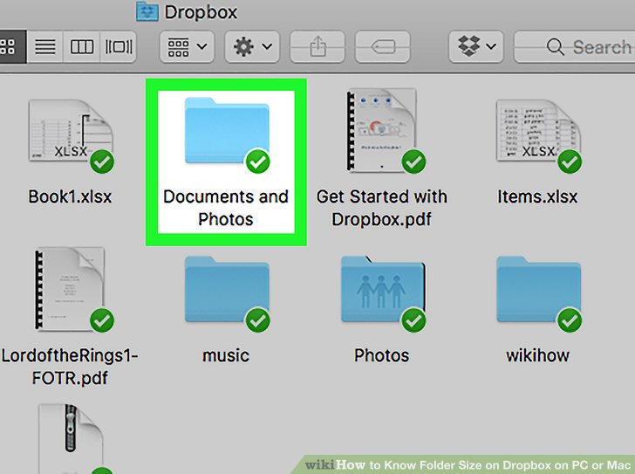
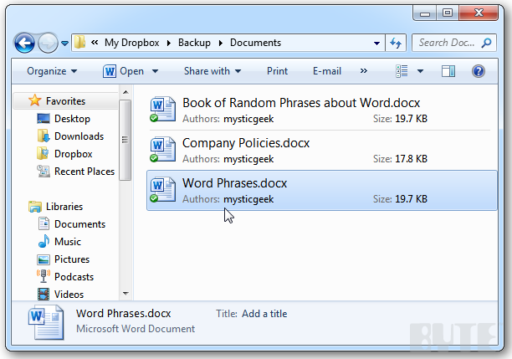
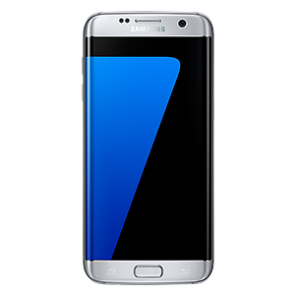
An MVP Example: Dropbox
Dropbox is an easy-to-use file sharing technology, which uses a push-based caching (or full replication) technique
Push immediately to Dropbox servers
Push immediately to all sharing devices

Slide 11
An MVP Example: Dropbox
Dropbox requires integration with a variety of computer platforms and OSs: Windows, Macintosh, iPhone, Android, and so on
It also necessitates deep distributed systems expertise (caching, replication, consistency, reliability, availability, etc.,)
To avoid the risk of waking up after years of development with a product that nobody wanted, Drew Houston (Founder & CEO of Dropbox) did something unexpectedly easy
He made a video!

Slide 12
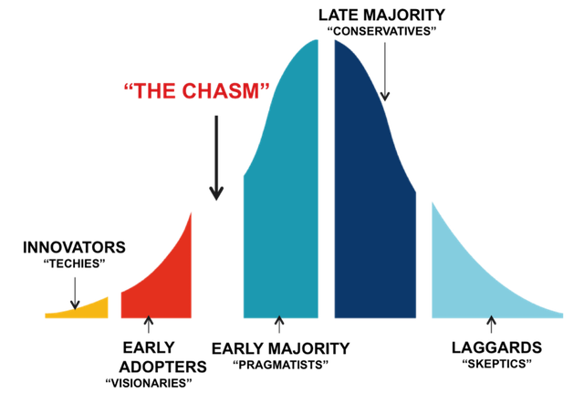
An MVP Example: Dropbox
The video was a 3-minute demonstration of the technology as it is meant to work
It was narrated by Drew himself (it was really banal!)
It targeted early adopters, who do not need a perfect solution to get intrigued
LATE MAJORITY
“conservatives”
The Technology Adoption Life Cycle
“THE CHASM”
INNOVATORS
“techies”
EARLY ADOPTERS
“visionaries”
EARLY MAJORITY
“pragmatists”
LAGGARDS
“skeptics”

Slide 13
An MVP Example: Dropbox
The video was a 3-minute demonstration of the technology as it is meant to work
It was narrated by Drew himself (it was really banal!)
It targeted early adopters, who do not need a perfect solution to get intrigued
Drew recounted: “It drove hundreds of thousands of people to the website. Our beta waiting list went from 5,000 people to 75,000 people literally overnight. It totally blew us away.”
Today, Dropbox is worth more than $10 billion

Slide 14
The Build Phase: MVP
Deciding how complex an MVP cannot be done formulaically
It requires judgment!
When in doubt, simplify
Avoid overbuilding and overpromising
Any additional work beyond what needs to get you starting the loop might be a waste
An MVP does not only speak to product design and technical questions, but also to fundamental business hypotheses
It provides a needed dose of reality
It often results in seemingly bad (but actually good!) news

Slide 15
Build-Experiment-Learn Feedback Loop
Idea
Learn
Build
Data
Product
Experiment

Slide 16
Build-Experiment-Learn Feedback Loop
Idea
Learn
Build
Data
Product
Experiment

Slide 17
Leap-of-Faith Assumptions
The riskiest elements of a startup’s plan (i.e., the parts on which everything depends) are called leap-of-faith assumptions
E.g., What was the main leap-of-faith assumption of Dropbox?
File sharing is a need and file synchronization is a problem
Note: Most people do not know about a certain solution, but once they experience it, they cannot imagine how they ever lived without it!

Slide 18
Leap-of-Faith Assumptions
The two most important assumptions of any startup are the value and growth hypotheses
The value hypothesis:
Is the product delivering value to customers after they start using it?
Key Performance Indicator (KPI): Retention Rate
The growth hypothesis:
How did the new customers know about the product?
KPI: Referral Rate

Slide 19
Example: Meta
In 2004, Facebook (now Meta) had 150,000 registered users with very little revenue
Yet, that summer it raised its first $500,000 in venture capital
Less than a year later, it raised an additional $12.7 million
How was Facebook able to raise so much money when its revenue was so little?

Slide 20
Example: Meta
This has to do with Facebook’s value and growth hypotheses:
Value hypothesis:
More than half of the users came back to the site every single day
Retention Rate > 50% (hypothesis is validated)
Growth hypothesis:
Facebook launched on Feb 4, 2004, and by the end of that month, almost ¾ of Harvard’s undergraduates were using it (without spending a dollar on marketing or advertising!)
Referral Rate was exponential (hypothesis is validated)

Slide 21
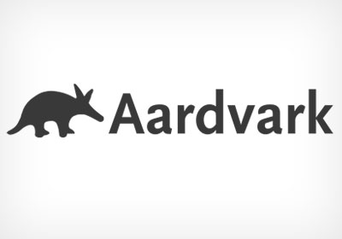
Experimenting: Aardvark
Google excels at answering factual questions
What is the tallest mountain in the world?
Who was the twenty third president of United States?
However, Google struggles with answering subjective questions
What is a good place to go out with a friend after a football game in my city?
Subjective questions are relatively easy for a person to answer
Imagine you’re at a cocktail party surrounded by friends; how likely would it be to get a good answer for your subjective question?
Very high!

Slide 22
Experimenting: Aardvark
To “technically” solve this problem, Max Ventilla and Damon Horowitz created a product called Aardvark
They built a very basic prototype with an instant messaging (IM) front-end and a human-driven back-end (NOT an AI-based engine)
A customer can send Aardvark questions via the IM front-end
Aardvark will tap into the customer’s social network via seeking out to the customer’s friends and friends-of-friends
A question about restaurants in San Francisco should not be routed to someone in Seattle
Once Aardvark gets a suitable answer, it reports back to the customer

Slide 23
Experimenting: Aardvark
The technique used by Aardvark is called the Wizard of Oz technique
I.e., Customers believe they are interacting with the actual product, but behind the scenes human beings are doing the actual work
This basic technique allowed Max and Damon to test their value and growth hypotheses
If the tough technical problems behind this aspired AI-based product can be solved, will people use and keep using it?
Will people tell their friends about it?
Aardvark was acquired in Feb 2010 for a $50M by Google

Slide 24
A/B Testing
Another famous experimentation technique is called A/B testing
Different versions of a product (or feature) are offered to two different groups of customers at the same time
Changes in behavior are observed between the two groups and inferences are made about the impacts of the different versions
If an extra feature does not change customer behavior, it gets questioned!
A/B testing allows you to refine your understanding of what customers want and do not want

Slide 25
Build-Experiment-Learn Feedback Loop
Idea
Learn
Build
Data
Product
Experiment

Slide 26
Learn and Apply
Avey:
Launched an app version where users needed to sign-up to be able to use the AI diagnostic feature
More than 1 million events were collected and user behavior was closely monitored using an in-house analytics system
Two observations:
The majority of people were not willing to sign-up
The majority (almost all) of people who signed up and used the feature came back
As a result, a new app version was launched that allowed users to use the feature without signing up (they can later sign-up if they wish- e.g., to book appointments with physicians that are recommended by the AI model)
Registration increased by 26%

Slide 27
Next Lecture…
Business Models - Part I

