Slide 1
Entrepreneurship for Computer Science CS 15-390
How to Calculate TAM and Conduct Revenue Projections?
Mohammad Hammoud

Slide 2
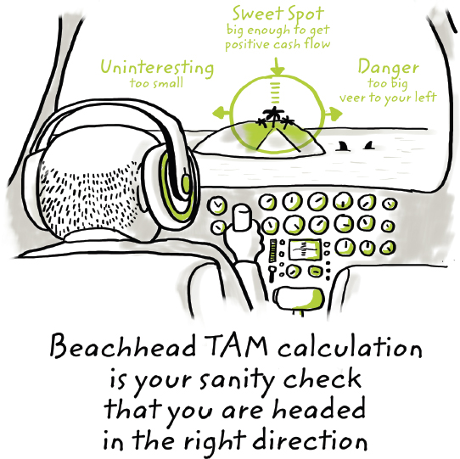
What is Total Addressable Market (TAM)?
TAM is the amount of annual revenue your company would make if it captures 100% share of the market in question
Sweet Spot
big enough to get positive cash flow
Danger
too big;
veer to your left
Uninteresting
too small
Beachhead TAM calculation is your sanity check that you are headed in the right direction

Slide 3
Calculating TAM
TAM is mainly based on the following two factors:
The total number of potential customers who may use your product per year
Depends on the number of potential customers and the average frequency of orders by any customer
E.g., For an app that enables patients to book appointments with physicians, you need to figure out the total number of patients that are likely to use the app and the average number of times patients visit doctors per year
The estimated average revenue per customer per year
Depends on the business model
E.g., For an app that enables patients to book appointments with physicians and uses a transaction-based model, you need to figure out the average price per session per physician and take a cut (e.g., 10%) out of it
TAM is simply the multiplication of the above two factors

Slide 4
Example: A Shoe E-Commerce Platform
Assume an e-commerce platform that sells shoes online
The platform does not own any inventory, but rather partners with existing shoe stores
The platform does not own a delivery fleet, but rather partners with existing delivery companies
Business model:
8% of any order (which may contain 1 or many shoes) as a transaction fee from every partner store
$5 convenience fee from any customer to deliver their order
Average Revenue Per Order = (0.08 × average order price) + $5

Slide 5
Example: A Shoe E-Commerce Platform
Two required factors:
The maximum possible number of orders
Can be calculated by multiplying:
The total number of people who may buy shoes (can be figured out through market research)
The expected number of orders per year per person (can be identified through market research)
Say, for example, it turned out to be 1,000,000 orders per year
The estimated average price per order
Say, for instance, $35

Slide 6
Example: A Shoe E-Commerce Platform
TAM = Estimated # of orders × Estimated revenue per order
= 1,000,000 × ((0.08 × 35) + 5))
= $7,800,000
Hint:
If TAM < $5 million, it is possible that your venture has not identified a big enough beachhead market
$5 million < TAM < $100 million is usually a reasonable TAM
Anything over $1 billion may (but not necessarily) raise flags

Slide 7
Example: A Shoe E-Commerce Platform
How much of the TAM would the platform capture every year (or how much revenue would the platform make every year)?
This is referred to as revenue projections, which can be fully formalized via developing a mathematical model and conducted over multiple future years
Factors and mathematical model (stemmed from the business model):
Estimated # of orders = N
Market share = α
Average order price = P
Transaction fee = β
Convenience fee = δ
Then, the mathematical model = (α × N) × (β × P + δ)

Slide 8
Example: A Shoe E-Commerce Platform
Alongside, you can vary the market share (α) and observe how the projected revenue will change accordingly
You can further vary any variable in the model and observe how the projected revenue will change accordingly
This is referred to as sensitivity analysis
 | Number of Orders (N) | Market Share (α) | Transaction Fee (β) | Order Price (P ) | Convenience Fee (δ) | Revenue Projection Model ((α × N) × (β × P + δ))
TAM | 1,000,000 | 1 | 0.08 | 35 | 5 | $7,800,000
 | 1,000,000 | 0.01 | 0.08 | 35 | 5 | $78,000
 | 1,000,000 | 0.02 | 0.08 | 35 | 5 | $156,000
 | 1,000,000 | 0.05 | 0.08 | 35 | 5 | $390,000
 | Number of Orders (N) | Market Share (α) | Transaction Fee (β) | Order Price (P ) | Convenience Fee (δ) | Revenue Projection Model ((α × N) × (β × P + δ))
TAM | 1,000,000 | 1 | 0.08 | 35 | 5 | $7,800,000
 | 1,000,000 | 0.01 | 0.08 | 35 | 5 | $78,000
 | 1,000,000 | 0.02 | 0.08 | 35 | 5 | $156,000
 | 1,000,000 | 0.05 | 0.08 | 35 | 5 | $390,000
 | Number of Orders (N) | Market Share (α) | Transaction Fee (β) | Order Price (P ) | Convenience Fee (δ) | Revenue Projection Model ((α × N) × (β × P + δ))
TAM | 1,000,000 | 1 | 0.08 | 35 | 5 | $7,800,000
 | 1,000,000 | 0.01 | 0.08 | 35 | 5 | $78,000
 | 1,000,000 | 0.02 | 0.08 | 35 | 5 | $156,000
 | 1,000,000 | 0.05 | 0.08 | 35 | 5 | $390,000
 | Number of Orders (N) | Market Share (α) | Transaction Fee (β) | Order Price (P ) | Convenience Fee (δ) | Revenue Projection Model ((α × N) × (β × P + δ))
TAM | 1,000,000 | 1 | 0.08 | 35 | 5 | $7,800,000
 | 1,000,000 | 0.01 | 0.08 | 35 | 5 | $78,000
 | 1,000,000 | 0.02 | 0.08 | 35 | 5 | $156,000
 | 1,000,000 | 0.05 | 0.08 | 35 | 5 | $390,000

Slide 9
Example: A Shoe E-Commerce Platform
Sensitivity Analysis:
When conducting revenue projections over multiple years, you would typically increase the market share every year by a certain %

Slide 10
The China Syndrome
You might be inclined to choose a big existing market, assuming that you can easily acquire a tiny fraction of it and reap the rewards!
This is referred to as the China Syndrome
For example, if you can capture 0.1% of the toothbrush market in China (population ~1.5 billion), would not you make a lot of money?
How would the logic go?

Slide 11
The China Syndrome
The logic goes as follows:
A reputable site on the Internet says that China has ~1.5 billion people
If 1 billion of these people have teeth, the market size would be 1 billion customers
You can build a toothbrush for the Chinese market and potentially capture 0.1% market share in the first year
If each person buys 3 toothbrushes per year, you could sell 3 million toothbrushes per year
If you sell each toothbrush for $1, you would have $3 million in sales the first year, with lots of room to grow!
Is there any problem with this logic?

Slide 12
The China Syndrome
This logic has several gaps:
It did not demonstrate in a compelling manner the reasons of why people will buy your toothbrush and not other toothbrushes
It assumed that you would capture 0.1% of the market share in the first year; how?
How can you distribute your toothbrushes in all China in the first year?
Have you sold any toothbrush so far?
If you are selling to wholesalers (who then sell to retailers), what have been your closing rate?
Even if you haven’t sold to any wholesaler, have you met with any and gotten a sense if they would buy from you?
What if the wholesaler buys, sells to retailers, and people end up not buying your toothbrush from the retailers?

Slide 13
Principle 9: Under-Project and Over-Deliver
If entrepreneurship is that easy, would not everyone sell toothbrushes in China?
Do not get ensnared by “The China Syndrome”
Do your revenue projections only after:
You do extensive primary & secondary market research
You test your product with target audience and evolve it (recall the lean approach)
You figure out the right business model for selling your product
You figure out the sales process and distribution channels in detail
Your projections will always be only estimations, but the harder you try to be accurate, the more you will be close to being accurate
Better to under-promise and over-deliver

