Slide 1
Origins of Computing – Pre 1900
Raj Reddy
Carnegie Mellon University
Jan 14, 2013
rr@cmu.edu

Slide 2
15-346 Schedule of Presentations Spring 2013
Jan 14 Raj Reddy Origins of Computers I – Pre 1900
Jan 16 Raj Reddy Origins of Computers II– Post 1900
Jan 21 Chuck Thacker Computer Architecture in the 20th century
Jan 23 Chuck Thacker Computer Architecture in the 21st century
Jan 28 & 30 Majd Sakr and Fetch & Execute, Pipelining & IL Parallelism
M Hammoud
Feb 4 Majd Sakr The Memory Hierarchy
Feb 6 M Hammoud Multicore Challenges
Feb 11 & 13 Gordon Bell Architectures from Digestible to the Largest
Feb 18 (VC) Dan Siewiorek Mobile Hardware Technologies
Feb 20 (VC) Dan Siewiorek End-to-End Application Considerations
Feb 25 & 27 Student Presentations

Slide 3
Necessary Conditions for The Evolution of Computers
Representation of Data and Logic
Text, Numbers, Procedures
Physical Technology
Mechanical, EM Relays, Electronic Devices
Control Unit and Arithmetic Logic Unit
I/O Devices
Manual, Paper Tape, Punch Cards, Teletype
Programmability
Flexible Automation: Most mechanical machines do just one task; A computer can do many tasks if they are programmable
A Language for Expression of Desired Computation
Automatic Sequencing of successive operations including
Conditional Branching: If…then statements
Iteration: Loops - going back to a previous instruction

Slide 4
Origins of Computers – Pre 1900 Steps towards Automation of Computation
Representation of Information
Symbols and Numbers
Tools for computation
Abacus
Slide Rule
Pascal and Leibniz: Early Pioneers of Automation of Computation
Boole: Logic as a language of thought
Precursor to Modern Programming Languages?
Babbage: Father of Modern Computer Architecture?
Designer of the First General Purpose Computer
Lady Lovelace: First Programmer?

Slide 5
Stages in Information Revolution
Invention of Writing 3000BCE
Hieroglyphs, Kanji Characters
Mesopotamia: Sumerian cuneiform writing on clay tablets
Egypt: writing in hieroglyphic script
Invention of Alphabet for simplified writing and learning, and communication with slaves
Invention of Printing 1450CE
Guttenberg Press
Democratization of knowledge
Invention of Computer 1950CE
Motivated by the desire to invent tools for creation of Mathematical Tables

Slide 6
Representing Numbers
Roman Indo-Arabic Binary
I 1 1
V 5 101
X 10 1010
L 50 110010
C 100 1100100
D 500 111110100
M 1000 1111101000
CXXVIII = 128 = 10000000

Slide 7
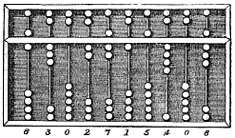
Tools for Calculation: Abacus
Representing Numbers in Abacus
Bi-Quinary Representation
(also used in early computers Colossus, IBM650 and Univac)

Slide 8
Video of Calculating using an Abacus

Slide 9
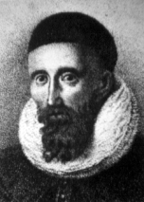
Tools for Calculation : Slide Rule
John Napier (1550-1617)
Discovered
Logarithms
Simplifying arithmetic computations
Popularized the use of
Decimal Point
Slide Rule: Represents Numbers
on a Logarithmic Scale
On a logarithmic scale an equal difference
in order of magnitude is represented by
an equal distance

Slide 10
Video of Calculating using a Slide Rule

Slide 11
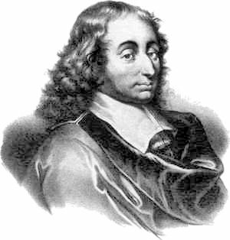
Blaise Pascal (1623-1662)
Known for
Co-Founder of Probability Theory
Pascal’s Triangle for Binomial Coefficients
Pascaline Mechanical Calculator
Pascal Programming Language
named after him

Slide 12
Pascal’s Mechanical Calculator for Addition and Subtraction

Slide 13
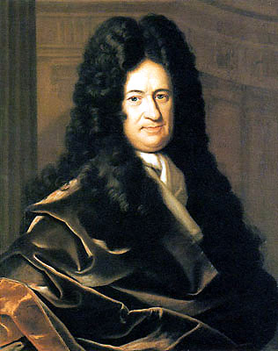
Gottfried Wilhelm Leibniz (1646-1714)
Known for
Co-Inventor of Calculus with Newton
Leibniz Pinwheel Calculator
Binary Number Systems (Explication de l'Arithmétique Binaire -1703)
Calculus Ratiocinator: Algebra of
Logic as a Calculus of Human
Reasoning
Formal Logic: Forerunner of
Symbolic Logic

Slide 14
Liebniz’s Multiplying Calculator

Slide 15
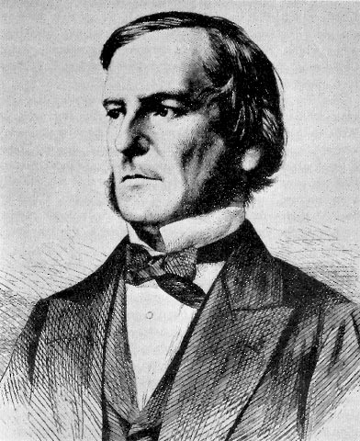
George Boole (1815-64)
Algebra of Numbers
Semantics of Addition, Subtraction, and Multiplication of Numbers are well understood
Algebra of Sets and Propositions (Boolean Algebra)
Semantics of Addition, Subtraction, and Multiplication in Boolean Algebra are sometimes different
If X=all men and Y=all women
X+Y is all men and women
If X = all people and Y = all children
then X-Y is all Adults
But
X+X=X not 2X
X.X = X not X²
Both Algebras Agree if X=0 or 1
0.X = 0 and 1.X = X
Claude Shannon Demonstrated in 1938
that Logic of Switching Circuits is
equivalent to Logic of Propositions

Slide 16
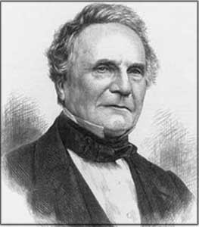
Babbage and Lovelace Inventors of the First Computer and Software
Known for
Lucasian Professor of Mathematics at Cambridge
Gold Medal of the Royal Astronomical Society
Difference Engine
Using Method of Finite Differences for Polynomial Evaluation
Analytic Engine
First Use of Punch Cards in Computation
First Use of Storage Registers
First Programmable General Purpose
Computer
First Software Program
by Lady Lovelace

Slide 17
Babbage and Lovelace’s Analytic Engine

Slide 18
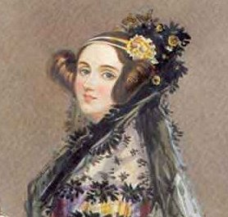
Babbage and Lovelace Inventors of the First Computer and Software (cont)
Babbage’s Analytical Engine was the first General Purpose Computer with
A Store (Memory)
Arithmetic Unit (ALU)
Sequential Control of Instructions (CPU)
With Conditional Branching and Iteration
Punch Card I/O System
Software on Punch Cards Replaced
Traditional Fixed Automation
by Programmable Automation
Missing Elements of Babbage’s Design
Not a stored program computer
Programs in punch cards i.e., Program and Data
are not stored in Internal Memory
No Binary Arithmetic
No Floating Point Representation
No Instructions with Numerical Addresses

Slide 19
Necessary Conditions for The Evolution of Computers
Representation of Data and Logic
Text, Numbers, Procedures
Physical Technology
Mechanical, EM Relays, Electronic Devices
Control Unit and Arithmetic Logic Unit
I/O Devices
Manual, Paper Tape, Punch Cards, Teletype
Programmability
Flexible Automation: Most mechanical machines do just one task; A computer can do many tasks if they are programmable
A Language for Expression of Desired Computation
Automatic Sequencing of successive operations including
Conditional Branching: If…then statements
Iteration: Loops - going back to a previous instruction

