Slide 1
Origins of Computing – Post 1900
Raj Reddy
Carnegie Mellon University
Jan 16, 2013
rr@cmu.edu

Slide 2
15-346 Schedule of Presentations
Spring 2013
Jan 14 Raj Reddy Origins of Computers I – Pre 1900
Jan 16 Raj Reddy Origins of Computers II– Post 1900
Jan 21 Chuck Thacker Computer Architecture in the 20th century
Jan 23 Chuck Thacker Computer Architecture in the 21st century
Jan 28 & 30 Majd Sakr Fetch & Execute, Pipelining & IL Parallelism
Feb 4 M Hammoud The Memory Hierarchy
Feb 6 M Hammoud Multicore Challenges
Feb 11 & 13 Gordon Bell Architectures from Digestible to the Largest
Feb 18 (VC) Dan Siewiorek Mobile Hardware Technologies
Feb 20 (VC) Dan Siewiorek End-to-End Application Considerations
Feb 25 & 27 Student Presentations

Slide 3
Necessary Conditions for
The Evolution of Computers
Representation of Data and Logic
  Text, Numbers, Procedures
Physical Technology
  Mechanical, EM Relays, Electronic Devices
Control Unit and Arithmetic Logic Unit
I/O Devices
  Manual, Paper Tape, Punch Cards, Teletype
Programmability
  Flexible Automation: Most mechanical machines do just one task; A programmable computer can do many tasks
  A Language for Expression of Desired Computation
  Automatic Sequencing of successive operations including
    Conditional Branching: If…then statements
    Iteration: Loops - going back to a previous instruction

Slide 4
Origins of Computers – Post 1900
Steps towards Automation of Computation
Alan Turing (1936 and 1945)
Pioneers in Computing Hardware (1939-45)
  George Stibitz
  Konrad Zuse
  John Atanasoff
  Howard Aiken
  Presper Eckert and John Mauchly
John von Neumann (1945)

Slide 5
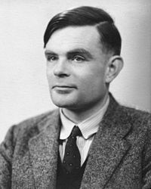
Alan M. Turing (1912-54)
Universal Turing Machine
Known for
  Proposed an Abstract Digital Computing Machine, now called a Universal Turing Machine (1936)
    Formalizing the Concepts of Algorithm and Computation
    Ten Years later, Stored Program Digital Computers along the principles envisaged by Turing were becoming a reality
  Designed Code Breaking Computers during WW II
    Application Specific Electro-Mechanical Computer “Bombe”
  Created the Design for ACE (1945)
    a Stored Program Electronic Computer later
    commercialized by Ferranti and English Electric
  One of the Founders of Artificial Intelligence
    In 1950, Proposed Turing Test and Construction
    and Teaching of a Child Machine
  An Pioneer of the field of Artificial Life 1952

Slide 6

Turing Machine Overview

Slide 7
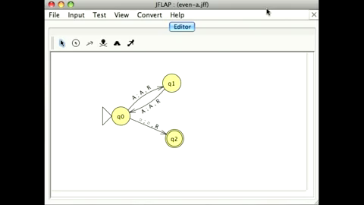
Turing Machine Example

Slide 8
Alan M. Turing
Father of Modern Computer?
Abstract “Turing Machine” (1936).
  Read, Write and Erase on Infinite Paper Tape
    In Modern Computers, one can also Read, Write and Erase, albeit with finite memory
  Concept of a Stored Program Computer
  Concept of a Universal Computer
  Concept of a Program
    and Programming
  Concept of a Subroutine
ACE Report (1945)
  Binary Representation
  Floating Point Arithmetic
  Symbolic Computation

Slide 9
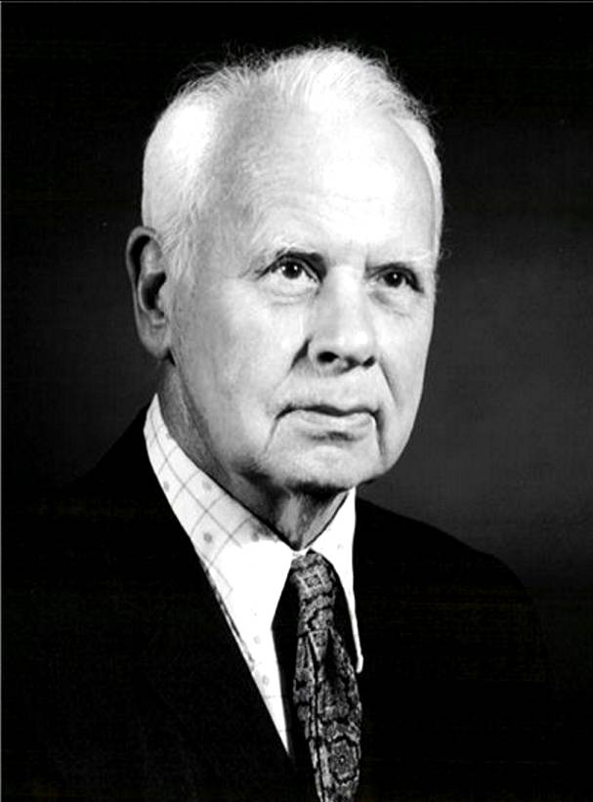
George Stibitz (1904-95)
BTL1 1939
Stibitz is a pioneer in the design of electro mechanical digital computers
BTL1 is known for
  Complex Multiplication and Division
    (x + yi)(u + vi) = (xu – yv) + (xv + yu)i
    Only 3 multiplications and 3 additions
    Needs a sequence of calculations and
    storing intermediate results
    Fixed Function – Not programmable
  First Computing Device ever used
  Remotely over Phone Lines
  Boolean Logic for Circuit Design

Slide 10

Bell Telephone Labs BTL1

Slide 11
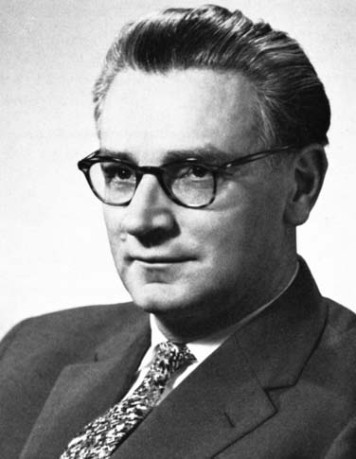
Konrad Zuse (1910-1995)
Z3 1941
Konrad Zuse is a pioneer in the design of electro mechanical digital computers
Z3 is known for
  First working program-controlled general-purpose computer
    Sequence of Instructions on Tape
    Conditional Branching missing
  First to use Binary Representation
  First use of Floating Point
  Single Address Instructions
    Operation, Operand
  First Programmable Computer

Slide 12
Z3

Slide 13
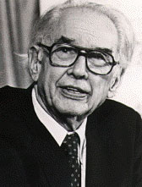
John Atanasoff (1903-95)
ABC 1942
John Atanasoff is a pioneer in the design of electronic digital computers
  Atanasoff-Berry Computer (ABC)
ABC is known for
  First Electronic Digital Computer
    arithmetic logic functions were fully electronic
    logic gates ranged from inverters to two
    and three input gates
  Binary digits represent all numbers
  and data
  Fixed Function – Not Programmable
    No Stored Program
  Mechanical Dram based Regenerative
  capacitor memory (slow?)

Slide 14

ABC

Slide 15
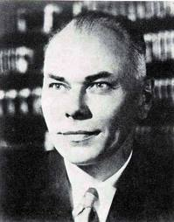
Howard Aiken
ASCC: Automatic Sequence Controlled Calculator
(Harvard Mark I) 1943
Howard Aiken is a pioneer in the design of electro mechanical digital computers
Harvard Mark I is known for
  One of the Largest Computers 51’x8’x2’
    Weighing 10,000 pounds
  Programmable
    Sequence of instructions from
    24 channel paper tape
    No conditional branching
  Decimal Arithmetic
  72 Storage Counters with 23 digit
  signed decimal numbers

Slide 16
ASSC – Harvard Mark I

Slide 17
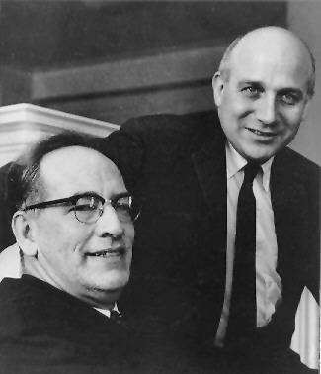
Eckert and Mauchly
ENIAC: Electrical Numerical Integrator and Computer 1945
Eckert and Mauchly are pioneers in the emergence of Electronic Digital Computer
Responsible for emergence of global digital computer industry along with IBM
  Eckert Mauchly Computer Corporation 1948
ENIAC Known for
  First Large Scale Electronic Computer
    First to become fully operational
    Far Faster than any another existing computer
  Programming by Plugboard
    Too slow
  Full Conditional Branching
  Decimal Arithmetic
    20 10-digit accumulators
  Punch Card I/O
  Led to EDVAC Report
    Training Ground for Many Successors

Slide 18
ENIAC

Slide 19
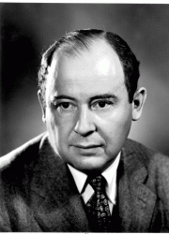
John von Neumann (1903-57)
IAS and Clones
Known for Contributions to
  Computer Science
    computer architecture
    self-replicating machines
    stochastic computing
  Mathematics
    set theory
    functional analysis
    numerical analysis
  Economics
    Game Theory
  Physics
    quantum mechanics
    Hydrodynamics
    fluid dynamics
EDVAC Report (1946): Electronic
Discrete Variable Automatic Computer

Slide 20
IAS Computer of Institute for Advanced Studies, Princeton

Slide 21
John von Neumann
Father of Modern Computer?
EDVAC Report (1946): Electronic Discrete Variable Automatic Computer
A Design Architecture for an Electronic Digital Computer
  a processing unit: an arithmetic logic unit and processor registers
  a control unit: an instruction register and program counter
  a memory to store both data and instructions
  external mass storage, and
  input and output mechanisms.[
Concept of a Stored Program
  Instructions and Data in same Memory
Concept of sequential flow of control
  A “program counter” that indicates the current point
  that has been reached in execution of a program
Concept of a variable
  “named” storage locations in which a value may be
  stored and subsequently referenced or changed

Slide 22
Early Computer Feature Matrix
  Name Date Number Rep Technology Programming
Turing UTM 1936 None Mechanical FSM: Stored Program?
Stibitz BTL1 1939 Decimal Relay Single App
Zuse Z3 1941 Binary Relay 35mm film
Atanasoff ABC 1942 Binary Electronic Single App
Aiken ASCC 1944 Decimal Relay Paper Tape
Eckert & ENIAC 1945 Decimal Electronic Plug Board Mauchly
John von IAS 1946 Binary Electronic Stored Program:
Neumann Instructions and Data in same Memory

Slide 23
Cambrian Explosion of Computers
List of Stored Program Computers 1946-1950
Manchester SSEM (UK)
  CRT memory Jun-48 Binary
Modified ENIAC (US)
  Read Only Memory Sep-48 Decimal
Cambridge EDSAC (UK)
  Mercury delay line memory May-49 Binary
Manchester Mark 1 (UK)
  CRT and magnetic drum memory Oct-49 Binary
Pilot ACE (UK)
  Mercury delay line memory May-50 Binary
Also CSIRAC, BINAC, UNIVAC, SEAC, Harvard MarkIII

Slide 24
Necessary Conditions for
The Evolution of Computers
Representation of Data and Logic
  Text, Numbers, Procedures
Physical Technology
  Mechanical, EM Relays, Electronic Devices
Control Unit and Arithmetic Logic Unit
I/O Devices
  Manual, Paper Tape, Punch Cards, Teletype
Programmability
  Flexible Automation: Most mechanical machines do just one task; A computer can do many tasks if they are programmable
  A Language for Expression of Desired Computation
  Automatic Sequencing of successive operations including
    Conditional Branching: If…then statements
    Iteration: Loops - going back to a previous instruction

Slide 25
Assignment: Essay and Presentation on Who is the Father of Modern Computer?
Babbage?
Turing?
Von Neumann?

