Slide 1
15-122: Principles of Imperative Computation
Lecture 05: Complexity
January 24, 2024

Slide 2
Today…
Last lecture:
Searching Arrays
Linear search, correctness, and unit testing
Today’s lecture:
Complexity
Cost functions, comparing cost functions, Big O, complexity classes, complexity of linear search, and towards a better search
Announcements:
Programming assignment 2 is due tomorrow by 9:00PM
Written assignment 3 is due on Monday, Jan 29 by 9:00PM

Slide 3
Cost

Slide 4
Final Code for search
int search(int x, int[] A, int n)
//@requires n == \length(A);
/*@ensures (\result == -1 && !is_in(x, A, 0, n))
|| (0 <= \result && \result < n && A[\result] == x);
@*/
{
for (int i = 0; i < n; i++)
//@loop_invariant 0 <= i && i <= n;
//@loop_invariant !is_in(x, A, 0, i);
{
if (A[i] == x) return i;
}
return -1;
}
How long does it take to run?
With contract-checking off

Slide 5
What Do We Mean By “How long”?
First idea: Wall-clock time
Or the time the code takes to run on a benchmark
Compiling with contracts disabled
The search function
main that generates random tests and runs them
Runs a.out 200 times on arrays of size 1000000
Linux Terminal
# cc0 search.c0 search-time.c0
# time ./a.out -r 200 -n 1000000
0
real 0.83
user 0.82
sys 0.00
Execution took 0.82 seconds
Unix utility that times execution

Slide 6
What Do We Mean By “How long”?
First idea: Wall-clock time
We get different times depending on
What else is running on the computer
What specific computer we are using
Different architectures & operating systems exhibit different performance
Linux Terminal
# cc0 search.c0 search-time.c0
# time ./a.out -r 200 -n 1000000
0
real 0.83
user 0.82
sys 0.00
# time ./a.out -r 200 -n 1000000
0
real 0.91
user 0.90
sys 0.00
# time ./a.out -r 200 -n 1000000
0
real 0.81
user 0.80
sys 0.00
Different runs of the same code take different times!
Different runs of the same code take different times!
Different runs of the same code take different times!

Slide 7
What Do We Mean By “How long”?
First idea: Wall-clock time
Time is about double when we double the length of the array
Not exactly double though
Is the wall-clock time a useful notion of “how long”?
Linux Terminal
# cc0 search.c0 search-time.c0
# time ./a.out -r 200 -n 1000000
0
real 0.83
user 0.82
sys 0.00
# time ./a.out -r 200 -n 2000000
0
real 1.62
user 1.61
sys 0.00
# time ./a.out -r 200 -n 4000000
0
real 3.17
user 3.15
sys 0.01

Slide 8
What Do We Mean By “How long”?
What “measure” are we looking for?
General
Applicable to a large class of programs (and algorithms)
Independent of particular hardware
Applicable to many types of resources
Time, space, energy, etc.,
Mathematically rigorous
Useful
Helps us select among various algorithms for the same problem
E.g., POW vs. mystery function for exponentiation
Wall clock?
yes
no
no
just time
no
result varies
unclear

Slide 9
What Do We Mean By “How long”?
Second idea: Count the number of execution steps
How many operations do we do to search an n-element array?
i = 0 1 step
loop
i < n 1 step
if (A[i] == x) 1 step
i++ 1 step
return -1 1 step
int search(int x, int[] A, int n) {
for (int i = 0; i < n; i++) {
if (A[i] == x) return i;
}
return -1;
}
Omitting contracts
n times
3n + 2 steps

Slide 10
What Do We Mean By “How long”?
Will we always take 3n + 2 steps to search an n-element array?
Only if element is not found
This is a worst-case analysis
Gives an upper bound on the number of steps
Depends only on n
Value of x doesn’t matter
Content of A doesn’t matter
n is a measure of the input size to the function
Let’s call the (upper bound on the) number of steps T(n):
T(n) = 3n + 2
int search(int x, int[] A, int n) {
for (int i = 0; i < n; i++) {
if (A[i] == x) return i;
}
return -1;
}

Slide 11
What Do We Mean By “How long”?
What is a step?
Is i++ 1 step? 2 steps? 3 steps?
What about if (A[i] == x) ?
… this gets complicated
Each instruction takes a constant number of steps
Exact number is tricky to tell, but it’s constant
In the worst case, search makes
A constant number of steps (say, b) outside the loop
A constant number of steps (say, a) in each iteration of the loop
So, T(n) = an + b
int search(int x, int[] A, int n) {
for (int i = 0; i < n; i++) {
if (A[i] == x) return i;
}
return -1;
}
i = 0
return -1
i < n
OOPS!!!
Loop guard runs n+1 times!
i < n
if (A[i] == x)
i++

Slide 12
What Do We Mean By “How long”?
Step count tells us “how long” a function takes to run
Time (here, number of steps) is a type of resource
Other resources of interest
Space: How much memory does the function use?
Energy: How much energy does running it consume?
Connectivity: How many network connections does it make?
The amount of resources a function uses is called its cost
T(n) = an + b is a cost function
In this course, we will focus on time
Argument is a measure of the input size
Computes the cost of executing it on an input of size n

Slide 13
Comparing Cost

Slide 14
Comparing Cost
Consider two C0 functions that solve the same problem
F has cost f(n)
G has cost g(n)
“Is f better than g?”
How do we define this?
f and g are functions wherein each
Takes a natural number as an input
Returns a natural number as an output
Cost
g
f
n
It is the “rate of growth” or the “order of growth” of the running time that really interests us (i.e., how does the cost of F or G increase as n increases?)
a non-negative integer

Slide 15
“Is f better than g?”
Attempt #1:
“f is better than g” if
for all n, f(n) ≤ g(n)
It’s ok if f(n) = g(n) for some (or all) n
Cost
g
Cost
g
f
f

n

n

Slide 16
“Is f better than g?”
Attempt #1:
“f is better than g” if
for all n, f(n) ≤ g(n)
But is this useful?
f is initially worse than g
But f is better beyond a certain point
For small inputs, both costs are low
0.12 ms vs. 0.23 ms doesn’t matter for most applications
For large inputs, we want lower cost
1.35 ms vs. 200 years matters for all applications
Solution: Ignore small inputs
Asymptotic notion of cost
g
Cost
f

n

Slide 17
“Is f better than g?”
Attempt #2:
“f is better than g” if
there exists a natural number n₀ such that
for all n ≥ n₀, f(n) ≤ g(n)
Cost
g
Cost
f
f
g
n₀

n
n₀

n

Slide 18
“Is f better than g?”

Attempt #2:
“f is better than g” if there exists a natural number n₀ s.t. for all n ≥ n₀, f(n) ≤ g(n)
But is this useful?
f and g are both linear functions
f(n) = a₁n and g(n) = a₂n
a₁ and a₂ summarize unknown instruction-level step constants
We can’t easily know if a₁ > a₂ or a₁ < a₂ or even a₁ = a₂
Solution: Scale g
Cost
there exists a natural number n₀ s.t.
for all n ≥ n₀, f(n) ≤ g(n)
f
g
n₀
n
Scaling factor
Cost
cg
f
× c
g
n₀
n

Slide 19
“Is f better than g?”
Final attempt:
“f is better than g” if
there exists a natural number n₀ and a real c > 0 s.t.
for all n ≥ n₀, f(n) ≤ c g(n)
cg
Cost
× c
Cost
f
cg
g
× c
f
g
n₀

n
n₀

n

Slide 20
Big O

Slide 21
Big-O
cg
Cost
× c
Rather than “f is better than g”, we say f ∈ O(g)
“f is in big-O of g”
O(g) is a set:
O(g) = { f s.t. there exists a natural number n₀ and a real c > 0 s.t. for all n ≥ n₀, f(n) ≤ c g(n) }
g
f
n₀
n
f ∈ O(g) if there exists a natural number n₀ and a real c > 0 s.t. for all n ≥ n₀, f(n) ≤ c g(n)

Slide 22
Big-O
cg
Cost
× c
g
f
Given two concrete functions f and g, how to tell if f ∈ O(g)?
Do the math
Find n₀ and c and show that the definition holds
Or show that the definition cannot hold for any n₀ or c
n₀
n

Slide 23
Big-O
Is 3n + 2∈ O(n)?
f(n) = 3n+2
g(n) = n
Cost
Cost
cg
f
Take c = 3.5 and n₀ = 4
f
× c
g
g
n
n₀
n

Any bigger values work too!

Slide 24
Big-O
cg
Cost
× c
g
f
Is n∈ O(3n + 2)?
n₀
n
f(n) = n
g(n) = 3n+2
Cost
g

Take c = 1.0 and n₀ = 0
f
n

Slide 25
Big-O
cg
Cost
× c
g
f
Every linear cost function is in O(n)
Every linear cost function is also in O(3n + 2)
As sets, O(n) = O(3n + 2)
O(n) is simpler
g(n) = n is the simplest linear function
We describe a cost function that is linear by saying that it is in O(n)
n₀
n
Notes:
Removed sub-bullet of bullet 1:
as long as the coefficient of n is not 0

Slide 26
Big-O
Similarly, every quadratic cost function is in O(n²)
g(n) = n² is the simplest quadratic function
We describe a cost function that is quadratic by saying that it is in O(n²)
In general, every polynomial cost function of degree p is in O(n^{p})
g(n) = n^{p} is the simplest polynomial of degree p
We describe a cost function that is polynomial of degree p by saying that it is in O(n^{p})
Notes:
Removed sub-bullet s of bullet 1:
as long as the coefficient of n² is not 0
the other coefficients don’t matter
Removed sub-bullet s of bullet 3:
as long as the lead coefficient of n^{p} is not 0

Slide 27
Big-O
Is 3n + 2 ∈ O(n²)?
f(n) = 3n + 2
g(n) = n²
cg
Cost
Cost
f
Take c = 1.5 and n₀ = 3
f
× c
g
g
n
Any bigger values work too!
n


Slide 28
Big-O
3n + 2 ∈ O(n) and 3n + 2 ∈ O(n²)
O(n) is tighter
Every linear function is in O(n²)
O(n) ⊆ O(n²)
In general, if p ≤ q
O(n^{p}) ⊆ O(n^{q})

Slide 29
Big-O
Is n² ∈ O(3n + 2)?
n² eventually dominates c(3n+2) irrespective of the scaling factor c
n² ∉ O(3n + 2)
Quadratic functions are not in O(n)
O(n²) ⊄ O(n)
O(n) ⊂ O(n²)
Cost
f
f(n) = n²
g(n) = 3n + 2
cg
× c
??
g
n


Slide 30
Complexity Classes

Slide 31
Complexity Classes
We learned that
O(n) ⊆ O(n²)
But O(n²) ⊄ O(n)
O(n) and O(n²) are called complexity classes
Simplest and tightest expressions for sets of cost functions
We always write complexity classes in
simplest and tightest forms

Slide 32
Complexity Classes
Examples of complexity classes:
Complexity class | Common name
O(1) | Constant
O(log n) | Logarithmic
O(n) | Linear
O(n log n) | (just “n log n”)
O(n²) | Quadratic
O(2^{n}) | Exponential
O(1) ⊂ O(log n) ⊂ O(n) ⊂ O(n log n) ⊂ O(n²) ⊂ O(2^{n})

Slide 33
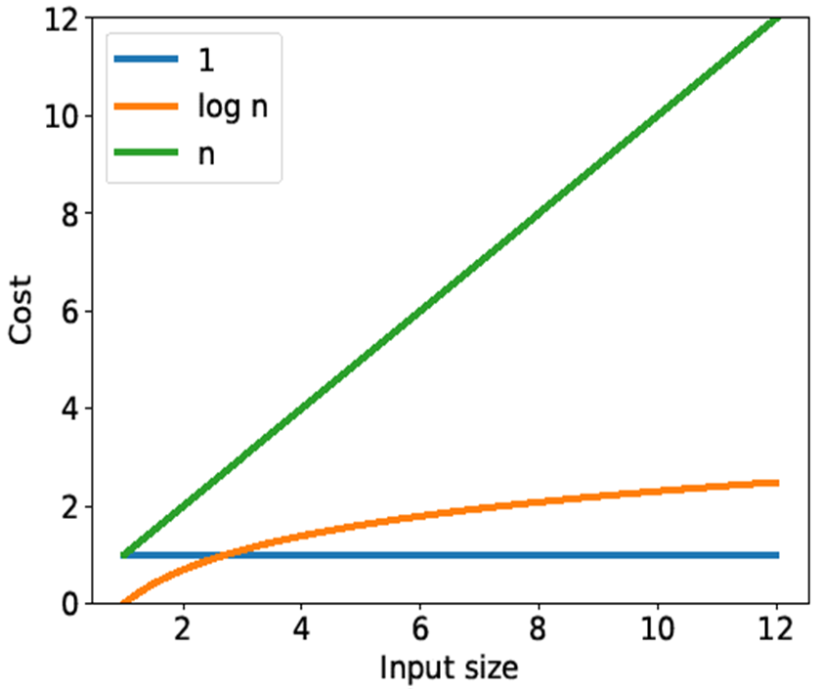
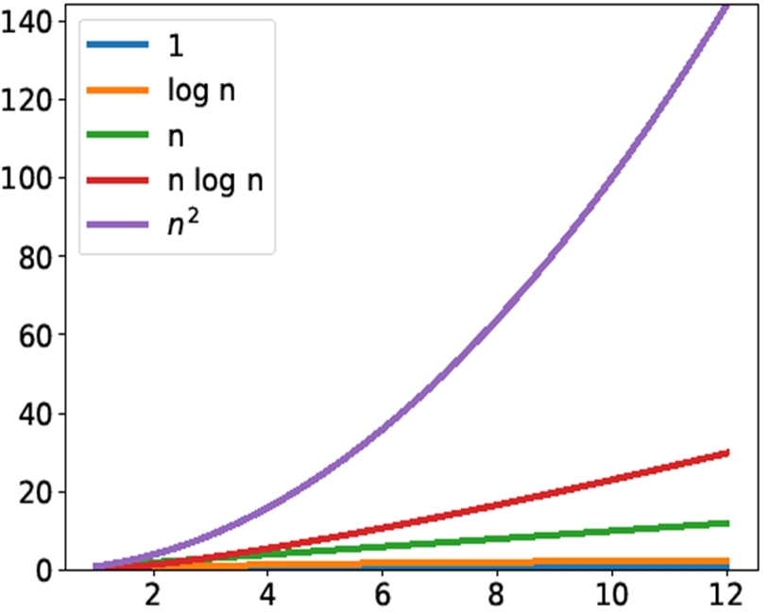
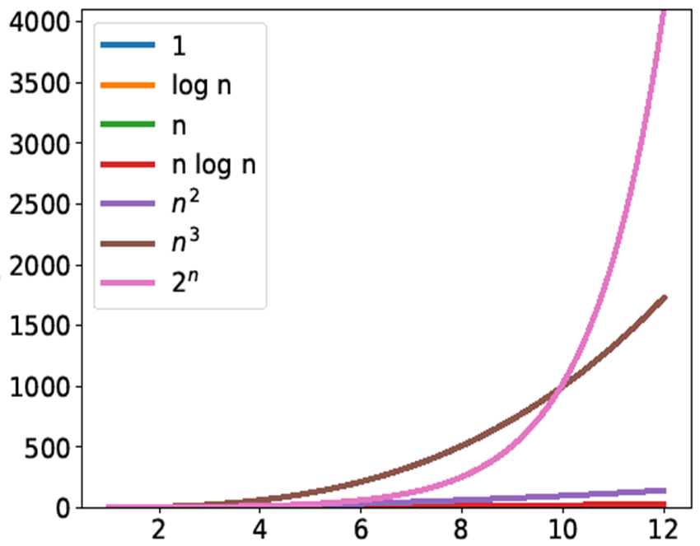
Complexity Classes

Slide 34
Complexity of Linear Search

Slide 35
What Do We Mean By “How long”?
int search(int x, int[] A, int n) {
for (int i = 0; i < n; i++) {
if (A[i] == x) return i;
}
return -1;
}
T(n) = an + b
So, T(n) ∈ O(n)
Linear search has worst case complexity O(n)
It has linear complexity in the size n of its input
That’s why it is caller linear search
Simplest and tightest class

Slide 36
Big-O
int search(int x, int[] A, int k) {
for (int i = 0; i < k; i++) {
if (A[i] == x) return i;
}
return -1;
}
There is nothing special about “n”
If we use k for the input size parameter
Then this function has cost O(k)
Still linear

Slide 37
Big-O
An input may have multiple size parameters
E.g., An image has a width w and a height h
To brighten an image, we need to change every one of its w × h pixels
To put a border around an image, we need to touch about 2(w + h) pixels
➔ O(wh)
➔ O(w+h)
h
h
h
w
w
w

Slide 38
Towards a Better Search

Slide 39
Algorithms vs. Problems
int search(int x, int[] A, int n) {
for (int i = 0; i < n; i++) {
if (A[i] == x) return i;
}
return -1;
}
Linear search has cost O(n)
But this is only one of many algorithms to search an array
Can a different algorithm find an element faster?
No: The problem of searching a generic n-element array has complexity O(n)
Some algorithms have worse complexity
But no algorithm has better complexity
Unless we radically change what we mean by “step”
Can we do better if we make (reasonable) assumptions?
Say, the array is sorted

Slide 40
Searching Sorted Arrays
int search(int x, int[] A, int n)
//@requires n == \length(A);
//@requires is_sorted(A, 0, n);
/*@ensures (\result == -1 && !is_in(x, A, 0, n))
|| (0 <= \result && \result < n && A[\result] == x);
@*/
{
for (int i = 0; i < n; i++)
//@loop_invariant 0 <= i && i <= n;
//@loop_invariant !is_in(x, A, 0, i);
{
if (A[i] == x) return i;
}
return -1;
}
A is sorted
The segment A[0,n) is sorted
Useful for later
Idea:
If we find an element larger than x, we can stop searching
All elements after it will also be larger than x
x: 4
0 | 1 | 2 | 3 | 4
3 | 5 | 7 | 8 | 12
A:
5 > 4

Slide 41
Searching Sorted Arrays
int search(int x, int[] A, int n)
//@requires n == \length(A);
//@requires is_sorted(A, 0, n);
/*@ensures (\result == -1 && !is_in(x, A, 0, n))
|| (0 <= \result && \result < n && A[\result] == x);
@*/
{
for (int i = 0; i < n; i++)
//@loop_invariant 0 <= i && i <= n;
//@loop_invariant !is_in(x, A, 0, i);
{
if (A[i] == x) return i;
if (x < A[i]) return -1;
//@assert A[i] < x;
}
return -1;
}
If A[i] is not equal to x and not larger than x then it must be smaller than x

Slide 42
Searching Sorted Arrays
int search(int x, int[] A, int n)
//@requires is_sorted(A, 0, n);
{
for (int i = 0; i < n; i++) {
if (A[i] == x) return i;
if (x < A[i]) return -1;
//@assert A[i] < x;
}
return -1;
}
What is the cost of this search?
Still O(n)
Worst case is when searching an element bigger than anything in A
But that’s just one algorithm for searching in a sorted array
Can we do better?
Next lecture

Slide 43
Searching Sorted Arrays
int search(int x, int[] A, int n)
//@requires n == \length(A);
//@requires is_sorted(A, 0, n);
/*@ensures (\result == -1 && !is_in(x, A, 0, n))
|| (0 <= \result && \result < n && A[\result] == x);
@*/
{
for (int i = 0; i < n; i++)
//@loop_invariant 0 <= i && i <= n;
//@loop_invariant !is_in(x, A, 0, i);
{
if (A[i] == x) return i;
if (x < A[i]) return -1;
//@assert A[i] < x;
}
return -1;
}
Is this code safe?
Yes, no new array accesses
Is it correct?
We have one extra return
Is it correct?

Slide 44
Searching Sorted Arrays
int search(int x, int[] A, int n)
//@requires n == \length(A);
//@requires is_sorted(A, 0, n);
/*@ensures (\result == -1 && !is_in(x, A, 0, n))
|| (0 <= \result && \result < n &&
A[\result] == x); @*/
{
for (int i = 0; i < n; i++)
//@loop_invariant 0 <= i && i <= n;
//@loop_invariant !is_in(x, A, 0, i);
{
if (A[i] == x) return i;
if (x < A[i]) return -1;
//@assert A[i] < x;
}
return -1;
}
What do we know at iteration i?
Let’s draw a picture!
A[0, i) < x: Every element in segment A[0,i) is less than x
A[0, i) ≤ A[i, n): Everything in A[0,i) is ≤ everything in A[i, n)
0 | i | n
A:
A[0, i) < x
A[0, i) ≤ A[i, n)

Slide 45
Reasoning About Array Segments
A[0, i) < x and other variations are useful to reason about array segments
Implement them as specification functions: arrayutil
A[lo, hi) is sorted is_sorted(A, lo, hi)
x ∈ A[lo, hi) is_in(x, A, lo, hi)
x < A[lo, hi) lt_seg(x, A, lo, hi)
x ≤ A[lo, hi) le_seg(x, A, lo, hi)
x > A[lo, hi) gt_seg(x, A, lo, hi)
x ≥ A[lo, hi) ge_seg(x, A, lo, hi)
A[lo₁, hi₁) < B[lo₂, hi₂) lt_segs(A, lo1, hi1, B, lo2, hi2)
A[lo₁, hi₁) ≤ B[lo₂, hi₂) le_segs(A, lo1, hi1, B, lo2, hi2)
A[lo₁, hi₁) > B[lo₂, hi₂) gt_segs(A, lo1, hi1, B, lo2, hi2)
A[lo₁, hi₁) ≥ B[lo₂, hi₂) ge_segs(A, lo1, hi1, B, lo2, hi2)
math
code
Includes contracts
See arrayutil.c0 file

Slide 46
Reasoning About Sorted Arrays
If an array (segment) is sorted, what do we know?
For every element A[i]
lo ≤ i < hi
A[lo, i) ≤ A[i] ≤ A[i+1, hi)
A[lo, i) and A[i+1, hi) are sorted
A[lo, hi) is sorted
0 ≤ | lo ≤ | i | < | hi ≤ | \length(A)
… |  |  |  | …
A:
A[lo, i) ≤ A[i] ≤ A[i+1, hi)
A[lo, hi) can’t be empty

Slide 47
Searching Sorted Arrays
int search(int x, int[] A, int n)
//@requires n == \length(A);
//@requires is_sorted(A, 0, n);
/*@ensures (\result == -1 && !is_in(x, A, 0, n))
|| (0 <= \result && \result < n &&
A[\result] == x); @*/
{
for (int i = 0; i < n; i++)
//@loop_invariant 0 <= i && i <= n;
//@loop_invariant gt_seg(x, A, 0, i);
//@loop_invariant le_segs(A,0, i, A, i, n);
{
if (A[i] == x) return i;
if (x < A[i]) return -1;
//@assert A[i] < x;
}
return -1;
}
What do we know at iteration i?
Let’s draw a picture!
Candidate loop invariants
gt_seg(x, A, 0, i): That is, A[0, i) < x
This implies !is_in(x, A, 0, i), i.e., x ∉ A[0, i)
le_segs(A, 0, i, A, i, n): That’s A[0, i) ≤ A[i, n)
0 | i | n
A:
A[0, i) < x
A[0, i) ≤ A[i, n)

Slide 48
Searching Sorted Arrays
int search(int x, int[] A, int n)
//@requires n == \length(A);
//@requires is_sorted(A, 0, n);
/*@ensures (\result == -1 && !is_in(x, A, 0, n))
|| (0 <= \result && \result < n &&
A[\result] == x); @*/
{
for (int i = 0; i < n; i++)
//@loop_invariant 0 <= i && i <= n;
//@loop_invariant gt_seg(x, A, 0, i);
//@loop_invariant le_segs(A,0, i, A, i, n);
{
if (A[i] == x) return i;
if (x < A[i]) return -1;
//@assert A[i] < x;
}
return -1;
}
Is this code correct?
To show: !is_in(x, A, lo, hi)
(assuming invariants are valid)
A[0, i) < x by line 10 (LI 2)
x ∉ A[0, i) by math on A
x < A[i] by line 14 (conditional)
x < A[i, n) by math on C and line 3 (precondition)
x ∉A[0, n) by math on B, D

Slide 49
Searching Sorted Arrays
int search(int x, int[] A, int n)
//@requires n == \length(A);
//@requires is_sorted(A, 0, n);
/*@ensures (\result == -1 && !is_in(x, A, 0, n))
|| (0 <= \result && \result < n &&
A[\result] == x); @*/
{
for (int i = 0; i < n; i++)
//@loop_invariant 0 <= i && i <= n;
//@loop_invariant gt_seg(x, A, 0, i);
//@loop_invariant le_segs(A,0, i, A, i, n);
{
if (A[i] == x) return i;
if (x < A[i]) return -1;
//@assert A[i] < x;
}
return -1;
}
x > A[0, i) is a valid loop invariant
INIT
To show: x > A[0, i) initially
i = 0 by line 7
x > A[0, 0) by definition of gt_seg
A[0,0) is the empty array segment
Nothing is in it
PRES
To show: if x > A[0, i), then x > A[0, i’)
x > A[0, i) by assumption
x > A[i] by line 15 (math on lines 13 and 14)
x > A[0, i+1) by math on A and B
i’ = i+1 by line 8
x > A[0, i’) by math on C and D

Slide 50
Searching Sorted Arrays
int search(int x, int[] A, int n)
//@requires n == \length(A);
//@requires is_sorted(A, 0, n);
/*@ensures (\result == -1 && !is_in(x, A, 0, n))
|| (0 <= \result && \result < n &&
A[\result] == x); @*/
{
for (int i = 0; i < n; i++)
//@loop_invariant 0 <= i && i <= n;
//@loop_invariant gt_seg(x, A, 0, i);
//@loop_invariant le_segs(A,0, i, A, i, n);
{
if (A[i] == x) return i;
if (x < A[i]) return -1;
//@assert A[i] < x;
}
return -1;
}
A[0,i) ≤ A[i,n) is a valid loop invariant
INIT
To show: A[0, i) ≤ A[i,n) initially
i = 0 by line 7
A[0, 0) ≤ A[i,n) by definition of le_segs
A[0,0) is the empty array segment
All the (zero) things in A[0,0) are ≤ everything in A[i,n)
PRES
To show: if A[0, i) ≤ A[i, n), then A[0, i’) ≤ A[i’, n)
A[0, i) ≤ A[i, n) by assumption
A[0, n) sorted by line 3 (precondition)
A[0, i+1) ≤ A[i+1, n) by math on B
i’ = i+1 by line 8
A[0, i’) ≤ A[i’, n) by math on C and D

Slide 51
Next Lecture…
Selection & Binary Searches

