Slide 1
15-122: Principles of Imperative Computation
Lecture 20: Types in C
April 03, 2023

Slide 2
Today…
Last session:
Midterm 2 exam
Today’s lecture:
Types in C
Integer Types, Casting Integers, Fixed-size Numbers, Floating Point Numbers, and Union and Enum Types
Announcements:
Midterm 2 grades are out
Written assignment 10 is due today by 9PM

Slide 3
Balance Sheet … So far
Lost | Gained
Contracts Safety Garbage collection Memory initialization Well-behaved arrays Fully-defined language Strings | Preprocessor Undefined behavior Explicit memory management Separate compilation Pointer arithmetic Stack-allocated arrays and structs Generalized address-of

Slide 4
Undefined Behavior
Memory | Reading/writing to non-allocated memory Reading uninitialized memory even if correctly allocated Use after free Double free Freeing memory not returned by malloc/calloc Writing to read-only memory
Numbers
Today

Slide 5
The type int

Slide 6
int Sizes
In C0/C1, the size of values of type int is 32 bits
And pointers are 64 bits
In C, the size of an int has evolved over time
And pointers too
Pointer size | 8 | 16 | 32 | 64
int size | 8 | 16 | 32 | 32
 | ‘70s | ‘80s | ‘90s | Today
Typical
Typical

Slide 7
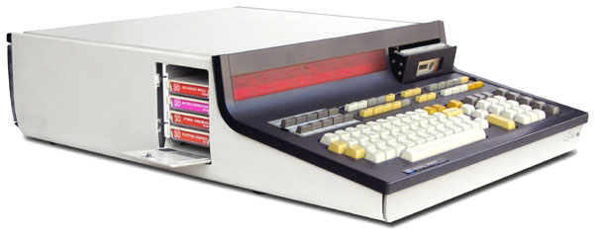
int Sizes
In C, the size of an int has evolved over time
And pointers too
Early computers had 8-bit addresses
256 bytes of memory
RAM was very expensive
ints ranged from -128 to 127
Pointer size | 8 | 16 | 32 | 64
int size | 8 | 16 | 32 | 32
 | ‘70s | ‘80s | ‘90s | Today
HP 9830A
‘60s
The computer that sent Apollo 11 to the moon

Slide 8
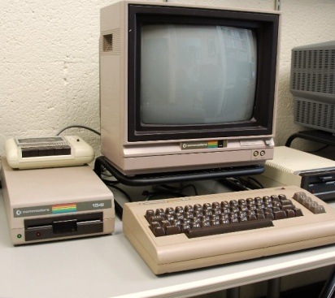
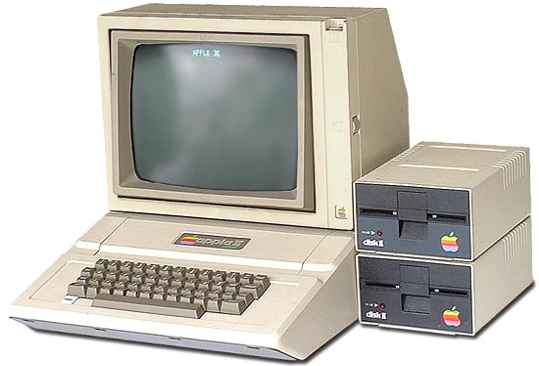
int Sizes
In C, the size of an int has evolved over time
And pointers too
16-bit addresses
(Up to) 64 kilobytes of memory
The Commodore 64
ints ranged from -32768 to 32767
Pointer size | 8 | 16 | 32 | 64
int size | 8 | 16 | 32 | 32
 | ‘70s | ‘80s | ‘90s | Today
Commodore 64
Apple II

Slide 9
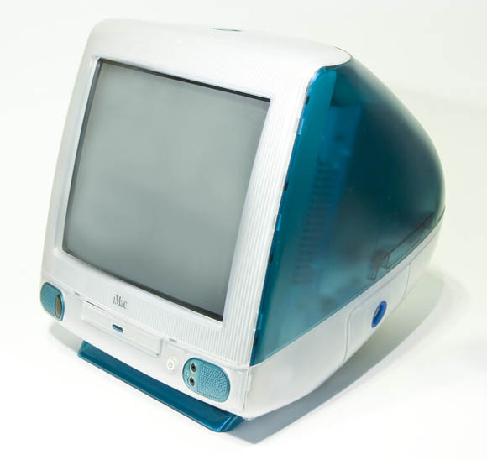
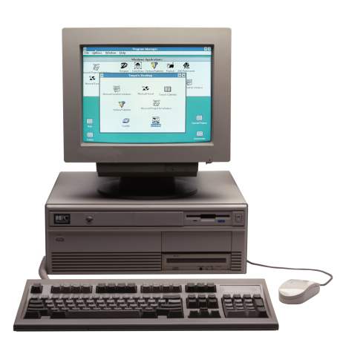
int Sizes
In C, the size of an int has evolved over time
And pointers too
32-bit addresses
(Up to) 4 gigabytes of memory
ints ranged in the billions
Pointer size | 8 | 16 | 32 | 64
int size | 8 | 16 | 32 | 32
 | ‘70s | ‘80s | ‘90s | Today
iMac
PC

Slide 10
int Sizes
In C, the size of an int has evolved over time
And pointers too
64-bit addresses
Nobody has 2⁶⁴ bytes memory
Billions are still Ok for ints
Pointer size | 8 | 16 | 32 | 64
int size | 8 | 16 | 32 | 32
 | ‘70s | ‘80s | ‘90s | Today

Slide 11
Implementation-defined Behavior
The C standard says that it is for the compiler to define the size of an int
With some constraints
It is implementation-defined; the compiler decides, but:
It remains fixed
The programmer can find out how big an int is
The file <limits.h> defines the values of INT_MIN and INT_MAX
And therefore the size of an int
Undefined behavior ≠ implementation-defined behavior
Undefined behavior does not have to be consistent
The programmer has no way to find out from inside the program

Slide 12
Implementation-defined Behavior
Most programmers don’t need to know how big an int is
Just write code normally, possibly using INT_MIN and INT_MAX
The compiler will use whatever internal size it has chosen
Same thing for pointers
Code written in the 1970s still works on today’s computers
As long as the code doesn’t depend on the size of an int
And the programmer used sizeof inside malloc
This is not true of code that uses
the bits of an int to encode data: bit patterns (e.g., pixels)

Slide 13
int’s Undefined Behaviors
Safety violations in C0 are undefined behavior in C
Division/modulus by 0, or INT_MIN divided/mod’ed by -1
Shifting by more than the size of an int
Overflow!
C programs do not necessarily use two’s complement
This makes it essentially impossible to reason about ints in a C program
n + n - n and n may produce different results
gcc provides the flag -fwrapv to force the use of two’s complement for ints
And a few more
E.g., Left-shifting a negative value
In 1972, a lot of computers didn’t use 2’s complement
Notes:
Mathematically speaking, i+1 should always be greater than i for any integer i. However, for a 32-bit int, there is one value of i that makes that statement false, which is 2147483647 (i.e. 0x7FFFFFFF, i.e. INT_MAX). Adding one to that number will cause an overflow and the new value, according to the 2's compliment representation, will wrap-around and become -2147483648. Hence, i+1>i becomes -2147483648>2147483647 which is false.
When you compile without -fwrapv, the compiler will assume that the overflow is 'non-wrapping' and it will optimize that function to always return 1 (ignoring the overflow case).
When you compile with -fwrapv, the function will not be optimized, and it will have the logic of adding 1 and comparing the two values, because now the overflow is 'wrapping' (i.e. the overflown number will wrap according to the 2's compliment representation).

Slide 14
Other Integer Types

Slide 15
Signed Integer Types
C0 has a single type of integers: int
C has many more
long: Integers that are larger than int
64 bits nowadays
short: Integers that are smaller than int
16 bits nowadays
char: Integers that are smaller than short
8 bits nowadays
But always 1 byte
… And there are more
char is a number!
'a' is convenience syntax
The placeholder %c in printf displays it as a character
C99 defines a byte as at least 8 bit

Slide 16
Unsigned Integer Types
Lots of code doesn’t use negative numbers
C provides unsigned variants of each integer type
Same number of bits but sign bit can be used to represent more numbers
Twice as many numbers
unsigned long
unsigned int
unsigned short
unsigned char
Overflow on unsigned numbers is defined to wrap around
Unsigned numbers do follow the laws of modular arithmetic
The most significant bit is not special for them

Slide 17
Unsigned Integer Types
size_t is used to hold pointer and offsets
The argument of malloc and calloc
Array indices
Return type of sizeof
Etc.,
The size of size_t is the size of a memory address
Notes:
size_t a type which is used to represent the size of objects in bytes and is therefore used as the return type by the sizeof operator. It is guaranteed to be big enough to contain the size of the biggest object the host system can handle. Basically the maximum permissible size is dependent on the compiler; if the compiler is 32 bit then it is simply a typedef(i.e., alias) for unsigned int but if the compiler is 64 bit then it would be a typedef for unsigned long long. The size_t data type is never negative.
Therefore many C library functions like malloc, memcpy and strlen declare their arguments and return type as size_t. For instance,
// Here argument of 'n' refers to maximum blocks that can be
// allocated which is guaranteed to be non-negative.
void *malloc(size_t n);
// While copying 'n' bytes from 's2' to 's1'
// n must be non-negative integer.
void *memcpy(void *s1, void const *s2, size_t n);
// strlen() uses size_t because the length of any string
// will always be at least 0.
size_t strlen(char const *s);

Slide 18
Implementation-defined Integers
Whether char is signed or unsigned is implementation-defined
signed | unsigned | C99 constraints | Today’s size
signed char | unsigned char | exactly 1 byte | 8 bits
short | unsigned short | range at least (-2¹⁵, 2¹⁵) | 16 bits
int | unsigned int | range at least (-2¹⁵, 2¹⁵) | 32 bits
long | unsigned long | range at least (-2³¹, 2³¹) | 64 bits
 | size_t |  | 64 bits
And there are several more …

Slide 19
Casting Integers

Slide 20
Integer Casts
We go back and forth between different number types with casts
int x = 3;
long y = (long)x;
Literal numbers have always type int
3
The compiler introduces implicit casts as needed
long x = 3;
Is implicitly turned into:
long x = (long)3;
x is 0x00000003
y is 0x0000000000000003
This is an int

Slide 21
Integer Casts
This can lead to unexpected outcomes
long x = 1 << 40;
is undefined behavior
This is implicitly turned into:
long x = (long)(1 << 40);
Fix: long x = ((long)1) << 40;
1 is an int
This shift 1 by 40 positions
But 1 has only 32 bits!

Slide 22
Casting Rules
Rule 1: If the new type can represent the value, the value is preserved
signed char x = 3; // x is 3 (= 0x03)
unsigned char y = (unsigned char)x; // y is 3 (= 0x03)
signed char x = 3; // x is 3 (= 0x03)
unsigned int y = (unsigned int)x; // y is 3 (= 0x00000003)
signed char x = -3; // x is -3 (= 0xFD)
int y = (int)x; // y is -3 (= 0xFFFFFFFD)
unsigned char x = 253; // x is 253 (= 0xFD)
unsigned int y = (unsigned int)x; // y is 253 (= 0x0000000FD)
int x = -3; // x is -3 (= 0xFFFFFFFD)
signed char y = (signed char)x; // y is -3 (= 0xFD)

Slide 23
Casting Rules
Rule 2: If the new type can’t represent the value, but is unsigned:
Case 1: The new type is smaller or the same, the least significant bits are retained
int x = INT_MAX; // x is 2147483647 (= 0x7FFFFFFF)
unsigned char y = (unsigned char)x; // y is 255 (= 0xFF)
signed char x = -3; // x is -3 (= 0xFD)
unsigned char y = (unsigned char)x; // y is 253 (= 0xFD)
Case 2: The new type is bigger, the bits are sign-extended
signed char x = -3; // x is -3 (= 0xFD)
unsigned int y = (unsigned int)x; // y is 4294967293 (= 0xFFFFFFFD)
INT_MAX doesn’t fit into a char
An unsigned type can’t represent negative numbers
An unsigned type can’t represent negative numbers

Slide 24
Casting Rules
Rule 3: If the new type can’t represent the value, but is signed, the result is implementation-defined
int x = INT_MAX; // x is 2147483647 (= 0x7FFFFFFF)
signed char y = (signed char)x; // y is ??
int x = -241; // x is -241(= 0xFFFFFF0F)
signed char y = (signed char)x; // y is ??
Many compilers discard the most significant bits
… often -1= (0xFF)
… often 15= (0x0F)

Slide 25
Casting Summary
(new_type) exp
exp of type old_type
new_type can represent the value of exp?
Rule 1
Yes
The value of exp is preserved
No
new_type is signed?
Rule 3
Yes
Implementation-defined
(often discard the most significant bits)
No
new_type is larger than old_type?
Rule 2 (Case 2)
Yes
The bits are sign-extended
No
Rule 2 (Case 1)
The least-significant bits are retained

Slide 26
Fixed-size Numbers

Slide 27
Fixed-size Integers
For bit patterns, the program needs the number of bits to remain the same as C evolves
Header file <stdint.h> provides fixed-size integer types
In signed and unsigned variants
Fixed-size signed | Today’s signed equivalent | Today’s unsigned equivalent | Fixed-size unsigned
int8_t | signed char | unsigned char | uint8_t
int16_t | short | unsigned short | uint16_t
int32_t | int | unsigned int | uint32_t
int64_t | long | unsigned long | uint64_t
That’s the number of bits

Slide 28
Floating Point Numbers

Slide 29
float
The type float represents floating point numbers
Nowadays 32 bits
float x = 0.1;
float y = 2.0235E-27;
float and int use the same number of bits, but float has a much larger range
Some numbers with a decimal point are not representable
The larger range comes at the cost of precision
Operations on floats may cause rounding errors
Numbers with a decimal point
That’s 2.0235 * 10⁻²⁷

Slide 30
float
Danger
Operations on floats may cause rounding errors
Example 1
#include <math.h>
#define PI 3.14159265
float x = sin(PI);
Example 2
float y = (10E20 / 10E10) * 10E10;
We expect y to be equal to 10E20
But it isn’t always
It depends on the compiler
Defines sin, cos, log, …
Any more decimals would be ignored
In math, sin(π) is 0
but sin(PI) is not 0.0
That’s (10²⁰/10¹⁰) * 10¹⁰

Slide 31
float
Danger
Operations on floats may cause rounding errors
Example 3
for (float res = 0.0; res != 5.0; res += 0.1)
printf("res = %f\n", res);
We expect the loop to terminate after 50 iterations
Instead it runs for ever
That’s because 0.1 decimal is a periodic number in binary: 0.00011
This is how we convert 0.1 to binary
0.1 | * 2 = | 0.2
0.2 | * 2 = | 0.4
0.4 | * 2 = | 0.8
0.8 | * 2 = | 1.6
0.6 | * 2 = | 1.2
0.2
At this point, it repeats

Slide 32
float
Operations on floats may cause rounding errors
This makes it impossible to reason about programs
This is why there are no floats in C0
Adding more bits does not solve the problem
The type double of double-precision floating point numbers has typically 64 bits nowadays
Similar issues

Slide 33
Union and Enum Types

Slide 34
Sample Problem
Print a message based on the season
How to encode seasons?
Use strings …
Testing which season we are in is costly
Use integers
Drawbacks
The encoding is not mnemonic
We will make mistakes
A whole int for 4 values seems wasteful
// 0 = Winter
// 1 = Spring
// 2 = Summer
// 3 = Fall
int today = 3;
if (today == 0)
printf("snow!\n");
else if (today == 3)
printf("leaves!\n");
else
printf("sun!\n");

Slide 35
Enum Types
The encoding is not mnemonic
A whole int for 4 values seems wasteful
An enum type lets
The programmer choose mnemonic values
no need to remember the encoding – just use the names
The compiler decide how to implement them
What actual type to map them to
What values to use
The compiler optimizes space usage
By convention, enum values are written in all caps
enum season { WINTER, SPRING, SUMMER, FALL };
enum season today = FALL;
if (today == WINTER)
printf("snow!\n");
else if (today == FALL)
printf("leaves!\n");
else
printf("sun!\n");
The compiler maps enum names to some numerical values

Slide 36
Switch Statements
A switch statement is an alternative to cascaded if-elses for numerical values
Including union types
They make the code more readable
Each value considered is handled by a case
The execution of a case continues till the next break or the end of the switch statement
It exits the switch statement
The default case handles any remaining value
enum season { WINTER, SPRING, SUMMER, FALL };
enum season today = FALL;
switch (today) {
case WINTER:
printf("snow!\n");
break;
case FALL:
printf("leaves!\n");
break;
default:
printf("sun!\n");
}
a case
another case
the default case

Slide 37
Switch Statements
If a break is missing, the execution continues with the next case
Danger
enum season { WINTER, SPRING, SUMMER, FALL };
enum season today = FALL;
switch (today) {
case WINTER:
printf("snow!\n");
break;
case FALL:
printf("leaves!\n");
break;
default:
printf("sun!\n");
}
a case
another case
the default case
This the source of many bugs!
Recent versions of gcc issue a warning when this happens

Slide 38
Another Sample Problem
Define a type for binary trees with int data only in their leaves
And where the empty tree is not represented as NULL
A leafy tree could be
An inner node with pointers to two children
A leaf with int data
An empty tree
Then:
An inner node
The empty tree
A leaf
empty
42
enum nodekind = { INNER, LEAF, EMPTY };
struct ltree {
enum nodekind kind;
int data;
leafytree *left;
leafytree *right;
};
typedef struct ltree leafytree;
We now know about enum types!
We now know about enum types!

Slide 39
Sample Problem
This representation wastes memory
The compiler will pick a small numerical type for kind
Probably a char
but
The remaining 3 fields are never fully utilized for any node type
Inner nodes do not make use of the data field
Leaves do not use left and right
The empty tree does not need any
enum nodekind = { INNER, LEAF, EMPTY };
struct ltree {
enum nodekind kind;
int data;
leafytree *left;
leafytree *right;
};
typedef struct ltree leafytree;



Slide 40
Union Types
A union type allows using the same space in different ways
Consider the space needed for a node, aside from its type
left | data
right
space
An inner node uses the space to store two pointers
A leaf uses part of the space to store an int
The empty tree does not use any space

Slide 41
Union Types
left | data
right
space
A union type allows using the same space in different ways
enum nodekind { INNER, LEAF, EMPTY };
struct innernode {
leafytree *left;
leafytree *right;
};
union nodecontent {
int data;
struct innernode node;
};
struct ltree {
enum nodekind kind;
union nodecontent content;
};
typedef struct ltree leafytree;
An inner node consists of two pointers
The content of a generic node is
either an int (the data of a leaf)
or an inner node
There is no need to have an option for the empty tree since it uses no space
C11 supports a much more compact syntax

Slide 42
Building a Tree
enum nodekind { INNER, LEAF, EMPTY };
struct innernode {
leafytree *left;
leafytree *right;
};
union nodecontent {
int data;
struct innernode node;
};
struct ltree {
enum nodekind kind;
union nodecontent content;
};
typedef struct ltree leafytree;
Let’s write code that creates this tree
An inner node
The empty tree
A leaf
empty
42
leafytree *T = malloc(sizeof(leafytree));
T->kind = INNER;
T->content.node.left = malloc(sizeof(leafytree));
T->content.node.left->kind = EMPTY;
T->content.node.right = malloc(sizeof(leafytree));
T->content.node.right->kind = LEAF;
T->content.node.right->content.data = 42;
INNER
EMPTY
LEAF
 | 42
Whenever not following a pointer,
we must use the dot notation

Slide 43
Adding up a Leafy Tree
We use a switch statement to write clear code
We discriminate on T->kind
It has three possible values
INNER, LEAF and EMPTY
int add_tree(leafytree *T) {
int n = 0;
switch (T->kind) {
case INNER:
n += add_tree(T->content.node.left);
n += add_tree(T->content.node.right);
break;
case LEAF:
n = T->content.data;
break;
default:
n = 0;
}
return n;
}

Slide 44
Summary

Slide 45
Undefined Behavior
Memory | Reading/writing to non-allocated memory Reading uninitialized memory even if correctly allocated Use after free Double free Freeing memory not returned by malloc/calloc Writing to read-only memory
Numbers | Division/mod by zero INT_MIN divided/mod’ed by -1 Shift by more than the number of bits Signed overflow

Slide 46
Alternative presentation of the casting rules

Slide 47
Casting Rules
When casting between signed and unsigned integers of the same size, the bit pattern is preserved
Example 1
signed char x = 3; // x is 3 (= 0x03)
unsigned char y = (unsigned char)x; // y is 3 (= 0x03)
Example 2
signed char x = -3; // x is -3 (= 0xFD)
unsigned char y = (unsigned char)x; // y is 253 (= 0xFD)
This is actually implementation-defined
(but commonplace)

Slide 48
Casting Rules
When casting small to big integers of the same signedness, the value is preserved
signed char x = 3; // x is 3 (= 0x03)
int y = (int)x; // y is 3 (= 0x00000003)
signed char x = -3; // x is -3 (= 0xFD)
int y = (int)x; // y is -3 (= 0xFFFFFFFD)
unsigned char x = 253; // x is 253 (= 0xFD)
unsigned int y = (unsigned int)x; // y is 253 (= 0x0000000FD)
It does sign extension on signed types
It does sign extension on signed types

Slide 49
Casting Rules
When casting big to small unsigned integers, the most significant bits are discarded
casting unsigned integers leverages modular arithmetic
Example 1
unsigned int x = 3; // x is 3 (= 0x00000003) unsigned char y = (unsigned char)x; // y is 3 (= 0x03)
Example 2
unsigned int x = UINT_MAX; // x is 4294967295 (= 0xFFFFFFFF) unsigned char y = (unsigned char)x; // y is 255 (=0xFF)

Slide 50
Casting Rules
When casting big to small signed integers, the value is preserved if it is representable
implementation-defined otherwise
int x = 3; // x is 3 (= 0x00000003) signed char y = (signed char)x; // y is 3 (= 0x03)
int x = -3; // x is -3 (= 0xFFFFFFFD)
signed char y = (signed char)x; // y is -3 (= 0xFD)
int x = INT_MAX; // x is 2147483647 (= 0x7FFFFFFF)
signed char y = (signed char)x; // y is ??
Many compilers discard the most significant bits
… often -1= (0xFF)

Slide 51
Casting across Signedness and Size
How may the compiler apply the rules?
unsigned char x = 0xFD; // x is 253
int y = (int)x; // y is …
is y 253 or -3?
253
0xFD
cast to unsigned int preserves value
cast to signed char preserves bit pattern
253
-3
0x000000FD
0xFD
cast to (signed) int preserves bit pattern
cast to (signed) int preserves value
253
-3
0x000000FD
0xFFFFFFFD

Slide 52
Casting across Signedness and Size
How may the compiler apply the rules?
unsigned char x = 0xFD; // x is 253
int y = (int)x; // y is …
Is y -3 or 253?
the order of casts is actually defined
but who remembers it?
Solution: be explicit
Write either
int y = (int)(unsigned int)x; // y is 253
to change first the size and then the signedness
or
int y = (int)(signed char)x; // y is -3
to change first the signedness and then the size
Danger

