Slide 1
15-110: Principles of Computing
Functions- Part II
Lecture 4, September 11, 2018
Mohammad Hammoud
Carnegie Mellon University in Qatar

Slide 2
Today…
Last Session:
  Functions- Part I
Today’s Session:
  Functions- Part II:
    The software development process
    The Python math library
Announcement:
  Homework Assignment (HA) 01 is due on Thursday, Sep 13, 2018
  by 10:00AM

Slide 3
The Software Development Process
Writing programs requires a systematic approach to problem solving, which incorporates 7 major steps
  Problem analysis, which involves studying deeply the problem at hand
  Program specification, which involves deciding exactly “what” (NOT “how”) your program will do
    What is the input?
    What is the output?
    What is the relationship between the input and the output?
  Design, which involves writing an algorithm in pseudocode
    This is where the “how” of the program gets worked out

Slide 4
The Software Development Process
Writing programs requires a systematic approach to problem solving, which incorporates 7 major steps
  Implementation, which involves translating your pseudocode into code (e.g., using Python)
  Debugging, which involves finding and fixing errors (or what are often referred to as bugs) in your program
    Bugs can be of two types, syntax and semantic (or logical) bugs
  Testing, which involves trying your program with an extensive set of test cases so as to verify that it works correctly

Slide 5
The Software Development Process
Writing programs requires a systematic approach to problem solving, which incorporates 7 major steps
  Maintenance, which involves keeping your program up-to-date with technology and the evolving needs of your users
    Most programs are never really finished!

Slide 6
Example
Problem: Write a program that translates temperatures from degrees Celsius to Fahrenheit
Solution:
  Problem Analysis:
    Pretty clear; some people do not understand temperatures in Celsius; there is a mathematical formula to convert Celsius to Fahrenheit
  Program Specification:
    Input: temperature in degrees Celsius (say, C)
    Output: temperature in degrees Fahrenheit (say, F)

Slide 7
Example
Solution:
  Program Specification:
    Relationship between input and output:
      We can do some quick figuring, after which we will realize that 0 Celsius is equal to 32 Fahrenheit and 100 Celsius is equal to 212 Fahrenheit
      With this information, we can compute the ratio of Fahrenheit to Celsius; I.e., (212 – 32)/(100 - 0) = 9/5
      The conversion formula will then have the form F = 9/5C + k
        Plugging in 0 and 32 for C and F, we can immediately see that k = 32
        Thus, the final formula will be F = 9/5C + 32

Slide 8
Example
Solution:
  Design:
    Pseudocode:
Input: C
Calculate F as (9/5) * C + 32
Output: F

Slide 9
Example
Solution:
  Implementation:
    Python Code:
def main():
celsius = eval(input("What is the Celsius temperature? "))
fahrenheit = 9/5 * celsius + 32
print("The temperature is", fahrenheit, "degrees Fahrenheit")
main()
Let us run, debug, and test this code together!

Slide 10
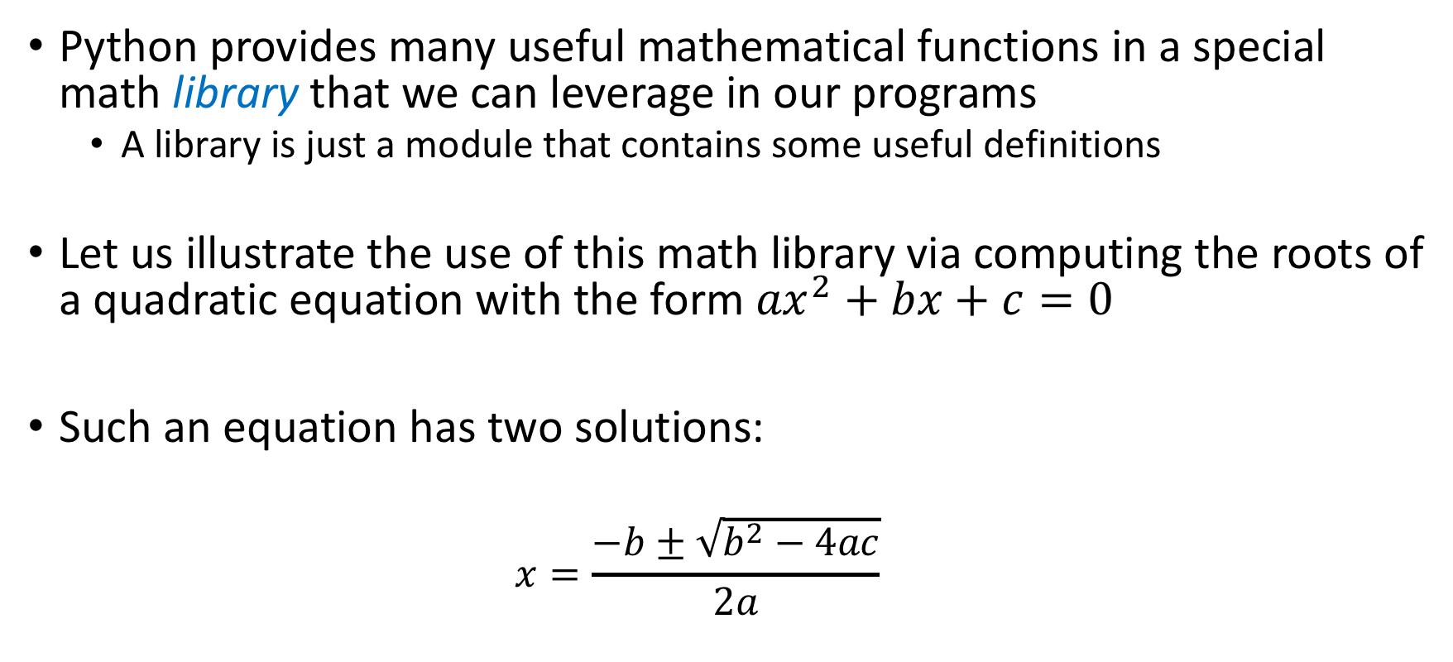
Using the Math Library
Python provides many useful mathematical functions in a special math library that we can leverage in our programs
  A library is just a module that contains some useful definitions
Let us illustrate the use of this math library via computing the roots of a quadratic equation with the form ${ax}^{2}+bx+c=0$
Such an equation has two solutions:
  $$x=\frac{−b±\sqrt{b^{2}−4ac}}{2a}$$

Slide 11
Using the Math Library: An Example
#The following line will make the math library in Python available for us.
import math
def rootsQEq():
print("This program finds the real solutions to a quadratic.")
print()
a = eval(input("Enter the value of coefficient a: "))
b = eval(input("Enter the value of coefficient b: "))
c = eval(input("Enter the value of coefficient c: "))

Slide 12
Using the Math Library: An Example
#To call a function from the math library, we can use the
#dot operator as follows:
s_root_val = math.sqrt(b*b - 4 * a * c)
root1 = (-b + s_root_val)/(2*a)
root2 = (-b - s_root_val)/(2*a)
print()
print("The solutions are: ", root1, root2)
#Call the function rootsQEq()
rootsQEq()

Slide 13
Using the Math Library: An Example
One sample run:
This program finds the real solutions to a quadratic.
Enter the value of coefficient a: 3
Enter the value of coefficient b: 4
Enter the value of coefficient c: -2
The solutions are: 0.38742588672279316 -1.7207592200561266

Slide 14
Using the Math Library: An Example
Another sample run:
This program finds the real solutions to a quadratic.
Enter the value of coefficient a: 1
Enter the value of coefficient b: 2
Enter the value of coefficient c: 3
Traceback (most recent call last):
File "/Users/mhhammou/Desktop/CMU-Q/Courses/15-110/Programs/Lecture4/RootsQE.py", line 22, in <module> rootsQEq()
File "/Users/mhhammou/Desktop/CMU-Q/Courses/15-110/Programs/Lecture4/RootsQE.py", line 14, in rootsQEq
s_root_val = math.sqrt(b*b - 4 * a * c)
ValueError: math domain error
What is the problem?

Slide 15
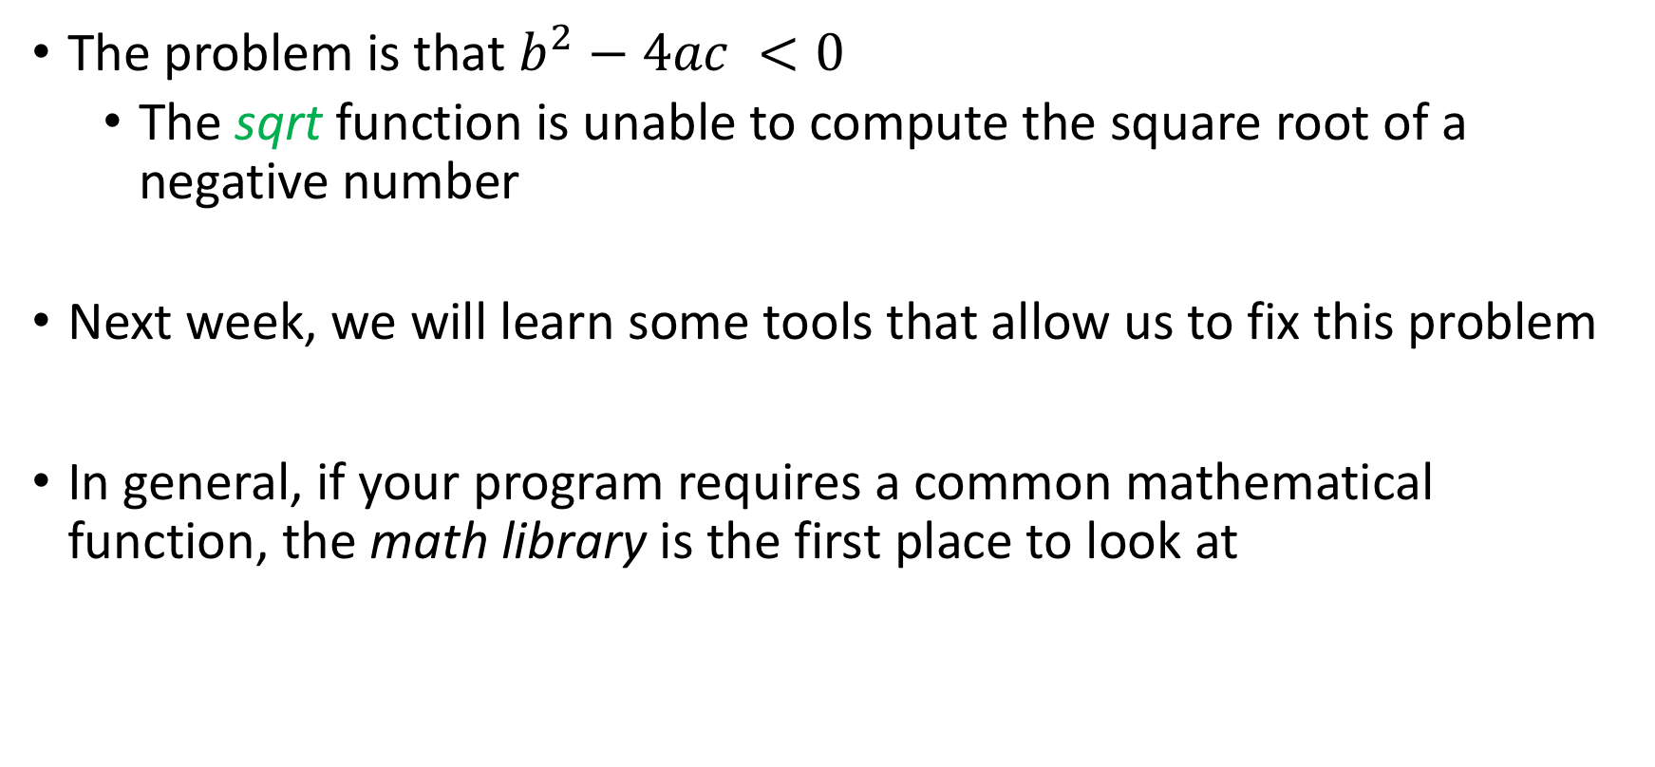
Using the Math Library: An Example
The problem is that $b^{2}−4ac <0$
  The sqrt function is unable to compute the square root of a negative number
Next week, we will learn some tools that allow us to fix this problem
In general, if your program requires a common mathematical function, the math library is the first place to look at

Slide 16
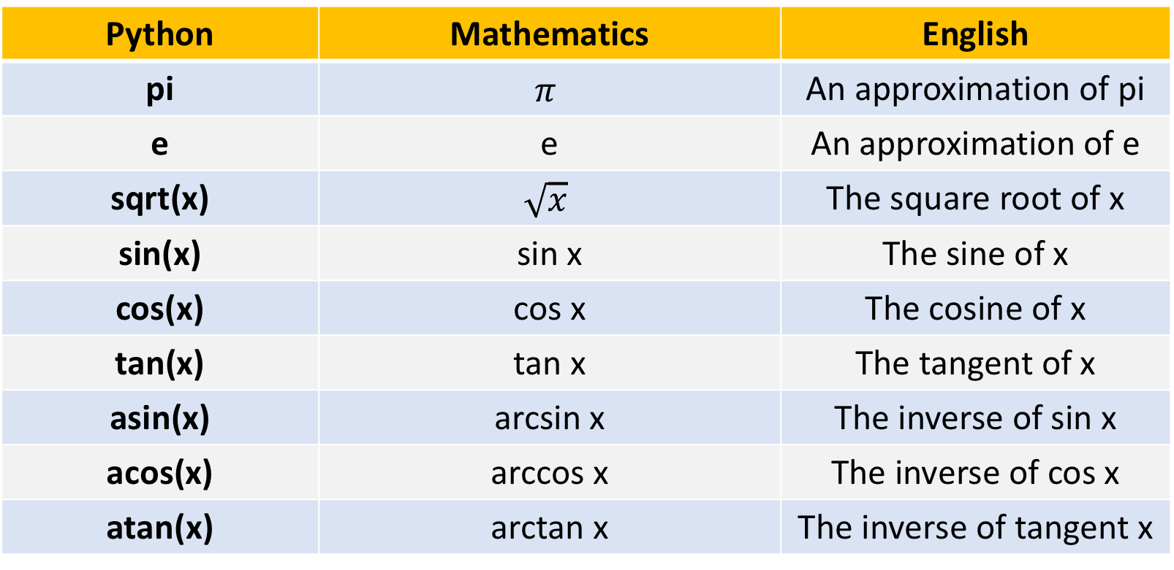
Some Functions in the Math Library
Python | Mathematics | English
pi | $$π$$ | An approximation of pi
e | e | An approximation of e
sqrt(x) | $$\sqrt{x}$$ | The square root of x
sin(x) | sin x | The sine of x
cos(x) | cos x | The cosine of x
tan(x) | tan x | The tangent of x
asin(x) | arcsin x | The inverse of sin x
acos(x) | arccos x | The inverse of cos x
atan(x) | arctan x | The inverse of tangent x

Slide 17
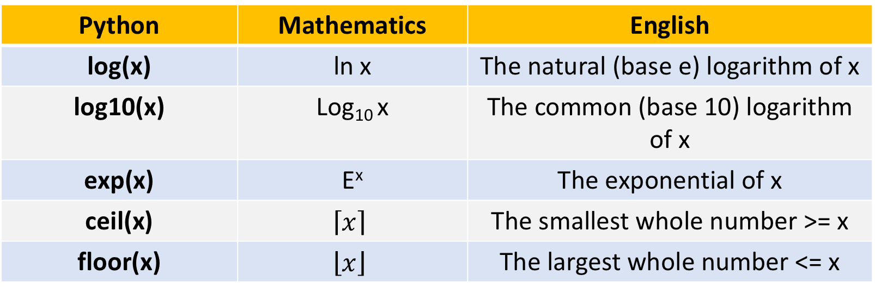
Some Functions in the Math Library
Python | Mathematics | English
log(x) | ln x | The natural (base e) logarithm of x
log10(x) | Log₁₀ x | The common (base 10) logarithm of x
exp(x) | E^{x} | The exponential of x
ceil(x) | $$\left\lceil x\right\rceil$$ | The smallest whole number >= x
floor(x) | $$\left\lfloor x\right\rfloor$$ | The largest whole number <= x

Slide 18
Summary
Programmers use functions to reduce code duplication and structure (or modularize) programs
The basic idea of a function is to write a sequence of statements that together can achieve a certain specification and give that sequence
a name
Once a function is defined, it can be called over and over again
Parameters allow functions to receive different input values

Slide 19
Summary
The scope of a variable is the area of the program where it may be referenced
Formal parameters and other variables (which are not labeled as global) inside a function are local to the function (i.e., can be accessed only within that function)
Local variables are distinct from variables of the same name that may be defined elsewhere in the program

Slide 20
Summary
A function can communicate information back to a caller through returning a value (or multiple values– more on this later)
Python passes parameters by value
Writing programs requires a systematic approach to problem solving, which involves analysis, specification, design, implementation, testing, debugging, and maintenance

Slide 21
Summary
Python programmers can use common mathematical functions defined in the math library
  To use any of these functions, you must first import the math library in your program

Slide 22
Next Lecture…
Decision Structures- Part I

