Slide 1
Outlier Description and Interpretation
Jian Pei
JD.com & Simon Fraser University

Slide 2

Outlier Detection: Beauty and the Beast in Data Analytics
Because of …
Subjectivity

Slide 3
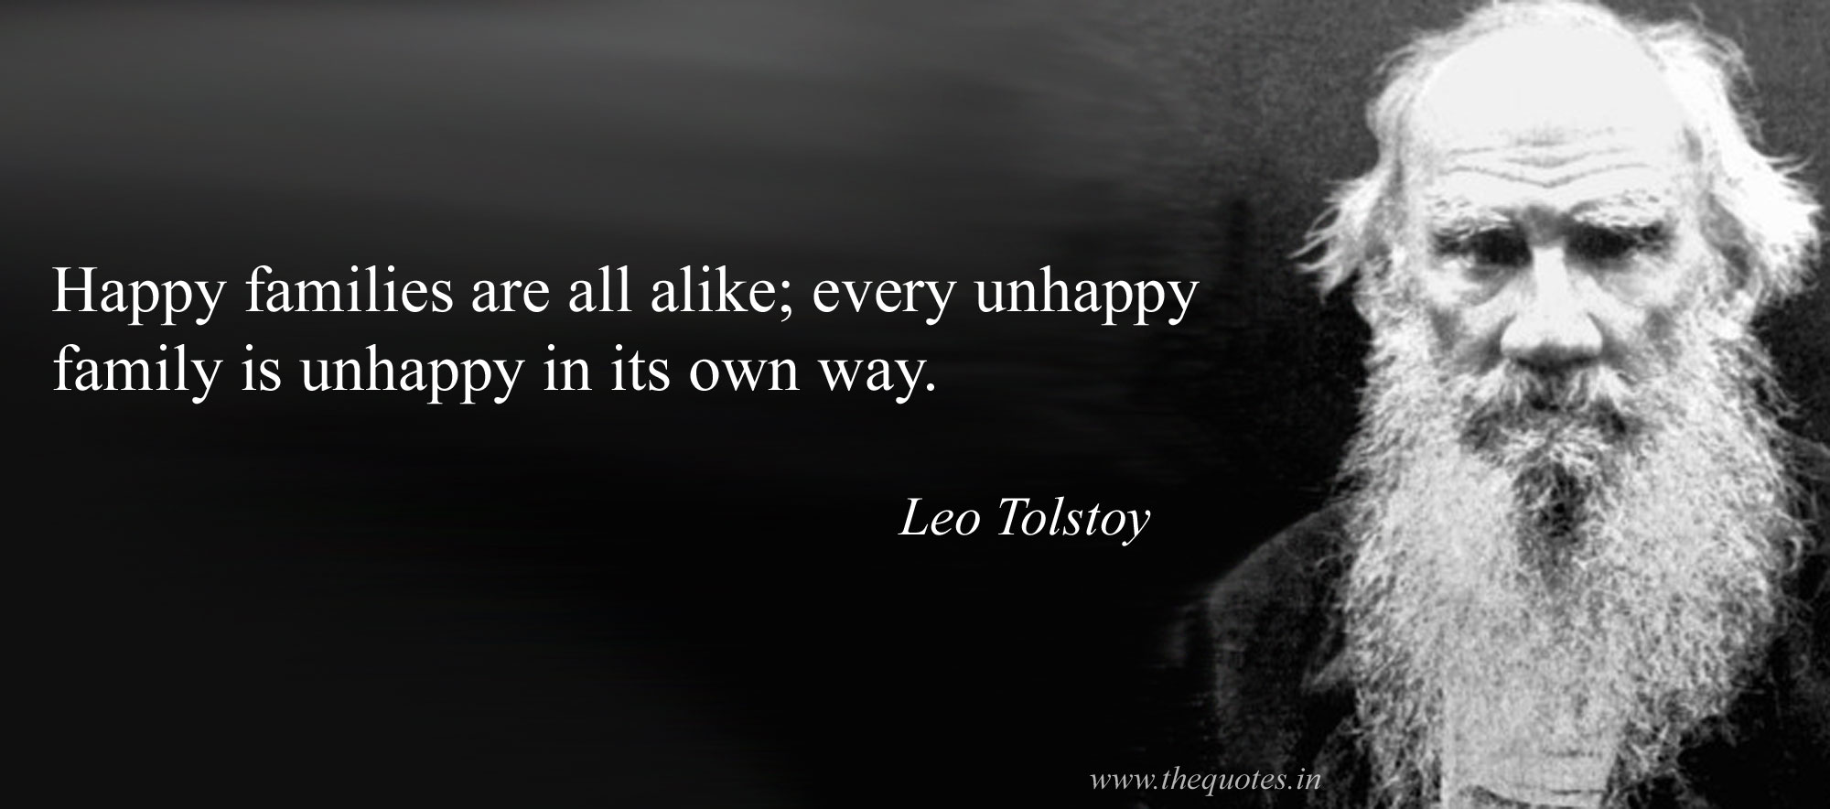
Finding Only Outliers Is Not Useful
Every outlier detection algorithm bears some “model(s)” in mind

Slide 4
Making Outlier Detection Meaningful
Description: what is the outlier?
  A courier customer requesting for postponing the shipment of a 24 hour delivery package for 2 days
Interpretation: why is it outlying?
  Customers pay for fast delivery
  Only 0.2% customers make requests for delivery rescheduling

Slide 5
How to Produce Description & Interpretation?
Comparison with inlying data as well as confirmed outlying data
Many possible ways of comparison
  Data level: comparing with individual data objects
  Feature level: using features to summarize reference inlying data
  Model level: deliberating how an outlier deviates from a model producing inlying objects

Slide 6
Data Level Description & Interpretation
Description: an outlier in the data set
Interpretation: using other points in the data set to provide interpretation
  The nearest neighbors that are still far away
  Known outliers that are similar
  Distribution evidence
  …

Slide 7
Example

Slide 8
Advantages
Simple, intuitive for business users
Visualize-able and friendly to visual analytics
Often actionable

Slide 9
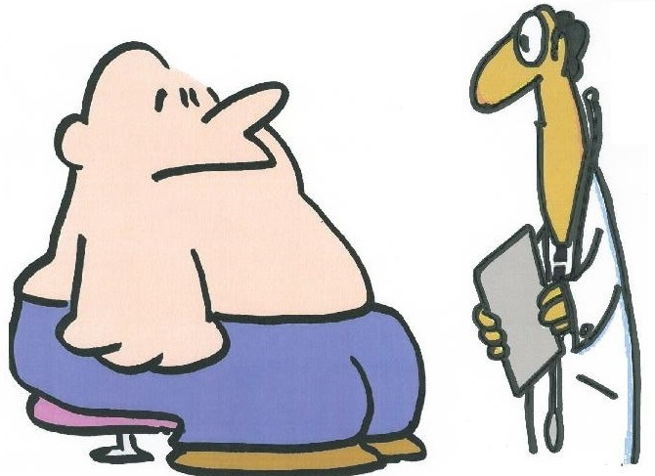
In what aspect is he most similar to cases of coronary artery disease and, at the same time, dissimilar to adiposity?
Symptoms:
overweight,
high blood pressure,
back pain,
short of breadth,
chest pain,
cold sweat
…
Notes:
clogged arteries are among the top-5 most commonly misdiagnosed diseases
Coronary artery: 冠状动脉
Adiposity: 肥胖

Slide 10
Fraud Suspect Analysis
An insurance analyst is investigating a suspicious claim
How is the claim compared with the normal and fraud claims?
  In what aspects the suspicious case is most similar to fraudulent cases and different from normal claims?

Slide 11
Contrast Subspace Finding
Given a set of labeled objects in two classes
For a query object q that is also labeled, the contrast subspace is the one where q is most likely to belong to the target class against the other class

Slide 12
Problem Formulation
Find subspaces maximizing
To avoid triviality, consider only subspaces where

Slide 13
Complexity
MAX SNP-hard
  Reduction from the emerging pattern mining problem
Impossible to design a good approximation algorithm

Slide 14
From Outlier Detection to Outlyingness Detection
Outlier detection finds objects that are different from the rest of the data
In some situations one may want to investigate the outlyingness of an object

Slide 15
In Which Aspects Johnson Is Good?
Notes:
Joe Johnson

Slide 16
Fraud Investigation
Given a set of claims in an insurance company
For a claim c, in which aspects c is most different from the other claims?

Slide 17
Outlying/Outstanding Aspect Mining
Given a set of objects in a multi-dimensional space
For an object q, find the subspaces where q is most unusual compared to the rest of the data

Slide 18
Problem Formulation
A set of objects O in full space
Query object q
The density of q measures how outlying (uncommon) q is
  Density estimation
Find a subspace where the density of q is lowest?

Slide 19
Why Rank Statistics?
Densities in different subspaces are not comparable
We compare the same set of objects in different subspaces
Rank statistics

Slide 20
Unsupervised Problem Formulation

Slide 21
Outliers against Models
Among the 3200 patients using narcotic drugs under study, 10 claimed purchases from over 60 different pharmacies while the reference group is 3000 patients claiming purchases from less than 5 pharmacies

Slide 22
Description & Interpretation Using Models
Learn models popular in data
  Preferably interpretable models, such as rules
Identify instances again popular models
  Optionally, generalize outliers using models, too

Slide 23
Summary
Description and interpretation of outliers are essential components of outlier detection
Different ways of outlier description and interpretation
  Data level, feature level, model level, …
Challenges
  Efficiency and scalability
  Inference on top of description and interpretation

Slide 24
Outlier Detection: Beauty and the Beast in Data Analytics
Description and interpretation of outliers may provide a key to learning subjective information and knowledge
Subjectivity

