Slide 1
EarphoneTrack: Involving Earphones into the Ecosystem of Acoustic Motion Tracking
Gaoshuai Cao*, Kuang Yuan*, ${\text{Jie} \text{Xiong}}^{†}$, Panlong Yang*, Yubo Yan*, Hao Zhou*, Xiang-Yang Li*
* University of Science and Technology of China $†$ University of Massachusetts Amherst
Notes:
Hi everyone, welcome to my presentation. My name is Kuang Yuan, a senior undergraduate student from the University of Science and Technology of China. I’m presenting our work EarphoneTrack: Involving Earphones into the Ecosystem of Acoustic Motion Tracking.
This is a joint work with Gaoshuai, Panlong, Yubo, Hao and Xiang-Yang from USTC, and Jie from University of Massachusetts Amherst.

Slide 2
Introduction
Notes:
First, let me introduce you the motivation of this work.

Slide 3
Acoustic motion tracking
Advantage of acoustic tracking: Fine granularity and High accuracy
Device-based motion tracking
Device-free motion tracking
Notes:
Acoustic motion tracking has unique advantages in fine granularity and high accuracy due to the low sound speed in the air. Promising progress has been achieved in this area and the proposed systems can be broadly divided into two categories: device based and device-free.

Slide 4
Motivation – Limitations of smartphones
Limitation 1
Mic
Smartphone-based acoustic sensing
Mic
Speaker
The positions of build-in mics and speakers are fixed
Limit the flexibility!
Notes:
The majority of these systems are based-on smartphones. However, there are several limitations in smartphone-based motion tracking systems. The first one is that, the positions of build-in microphones and speakers are fixed, which greatly limit the tracking flexibility.

Slide 5
Motivation – Limitations of smartphones
Limitation 2
Smartphone-based acoustic sensing
Too big to hold in hand
Fatigue easily!
Notes:
The second limitation is that the smartphone is too big to hold in hand. Other systems proposed to write in the air using a smartphone as a big pen. However, people fatigue easily when doing that.

Slide 6
Motivation – Limitations of smartphones
Limitation 3
Smartphones need to serve display function
Smartphone-based acoustic sensing
Notes:
The third limitation is that in many application scenarios such as gaming, the smartphones need to serve display function. In the VR application, the smartphone needs to be tucked into the VR glasses, preventing it from being held in hand for tracking purposes.

Slide 7
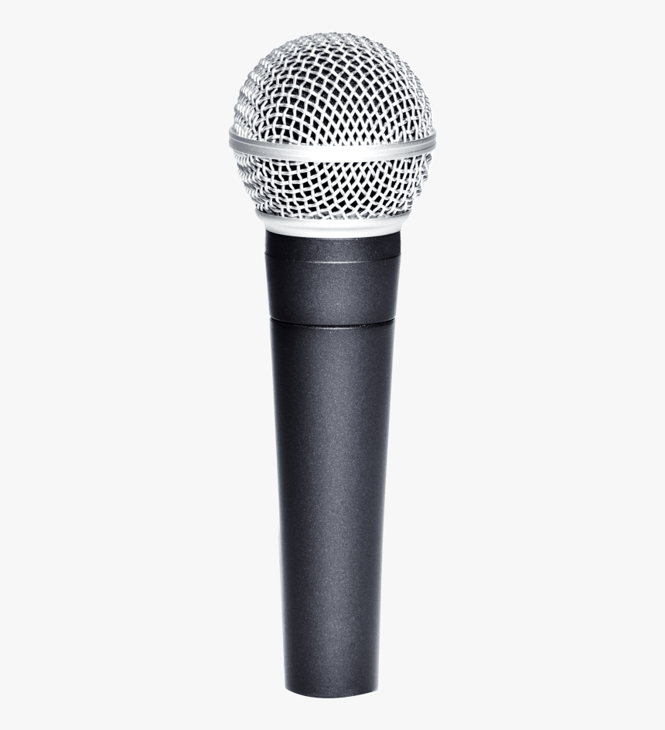
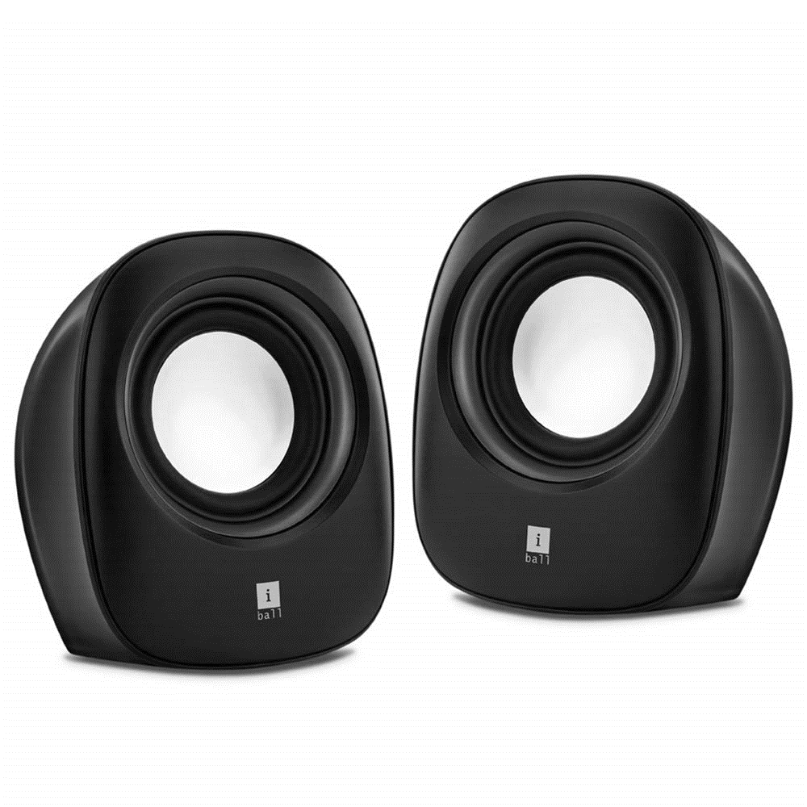
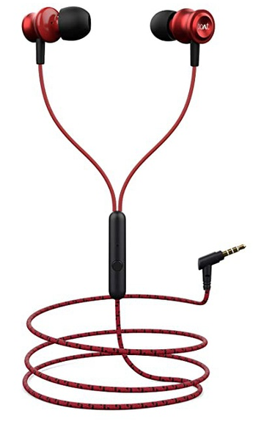
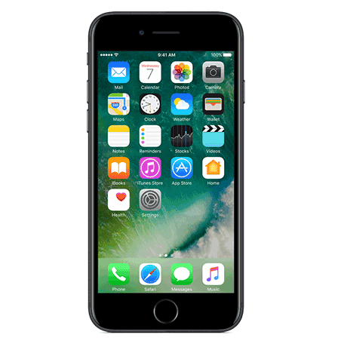
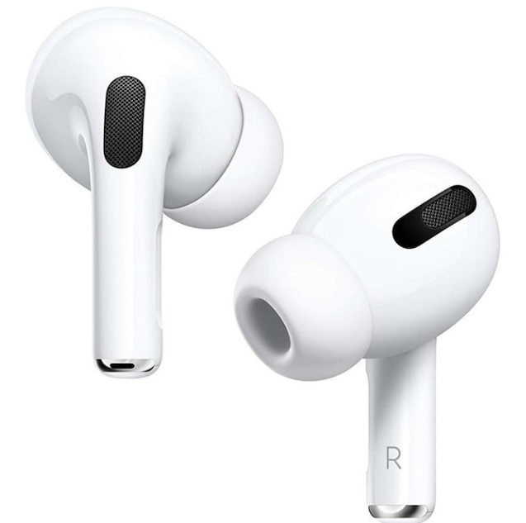
Earphone-based motion tracking
Speakers
Smartphones
Earphones
Microphone (arrays)
Acoustic motion tracking devices
Notes:
Commercial earphones, including both wireless and wired earphones, are now becoming more powerful and popular. Therefore, for the first time, we propose to involve earphones into the ecosystem of acoustic motion tracking.

Slide 8
Earphone-based motion tracking
Limitation 1
Mic
Extend the tracking area!
Snake game
Mic
Speaker
The positions of build-in mics and speakers are fixed
Limit the flexibility!
Notes:
Earphones could serve as an extra acoustic sensing component that can be separated from smartphone. With earphone, we could extend the tracking area from a small region in front of the phone to meters away with great flexibility.

Slide 9
Earphone-based motion tracking
Limitation 2
Smaller
Lighter
Easier to hold
Mic
Too big to hold in hand
Fatigue easily!
Track two hands simultaneously
Notes:
Compared with smartphone, earphones are smaller, lighter and easier to hold in hand. With two earbuds, we can track two hands simultaneously.

Slide 10
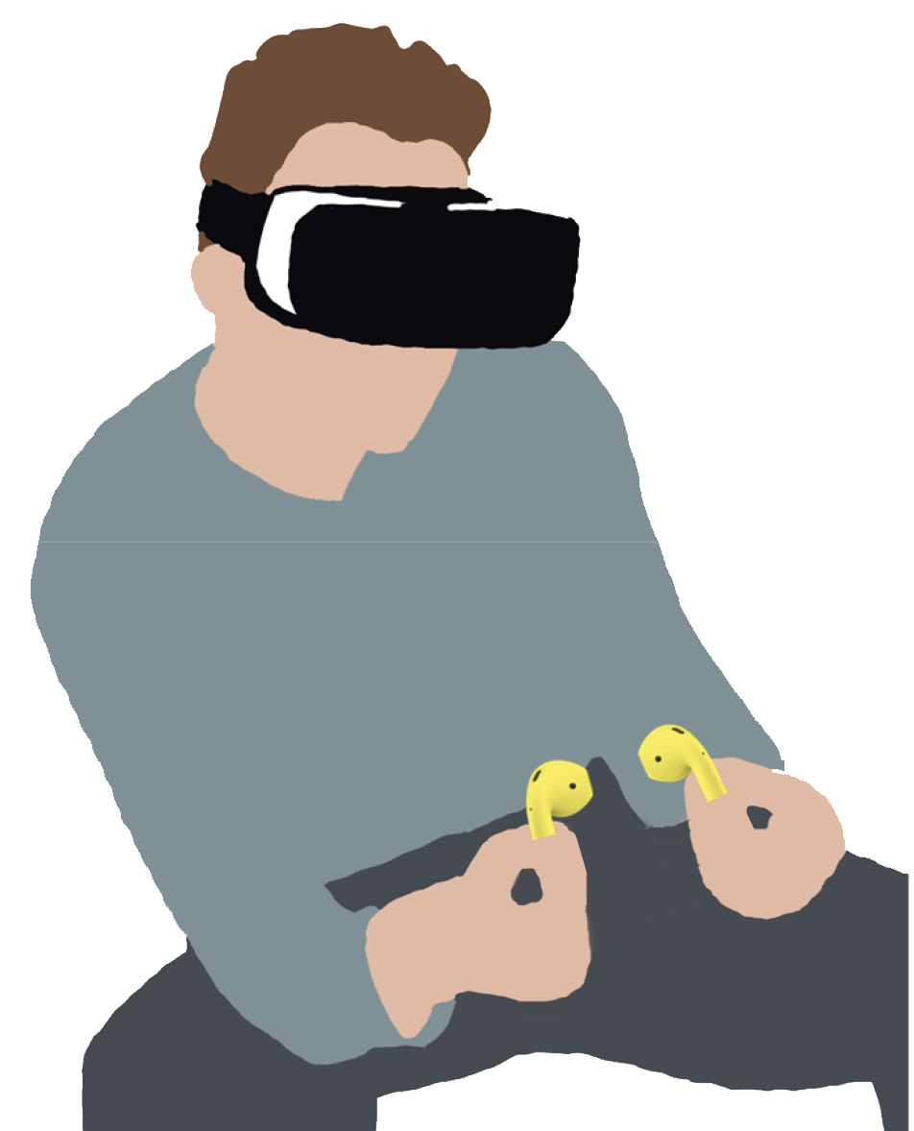
Earphone-based motion tracking
Limitation 3
Smartphones need to serve display function
Use earphones to track motion!
Notes:
Also, when using earphone to track user’s motion. The smartphone can be reserved for the display function and the earphones can be used to track motion.

Slide 11
Challenges
& Solutions
Notes:
The basic idea sounds exciting. However, it is non-trivial to realize EarphoneTrack due to the following challenges.

Slide 12
Challenges
Strong self-interference in wired earphone
Large frequency offset in wireless earphone
Narrow bandwidth
Notes:
The first challenge is strong self-interference in wired earphones

Slide 13
Challenge 1: Self-interference
Changing Current
Changing Magnetic Field
Electromotive
Force
Maxwell Equation describes:
i
$$H$$
$$\frac{dH}{dt}$$
ε
Changing Current
t
t
t
Changing Magnetic Field
GND
i
Electromotive Force
Notes:
We start from the view of longitudinal slice of the earphone plug. The circuit structure of this longitudinal section looks like this. It is composed of parallel circuits, connected to the microphone, ground and speakers. When there is a changing current in the circuit connected to the speaker, it will cause changes of the magnetic flux in the closed loop, so that it would generate an induced electromotive force in the microphone circuit.

Slide 14
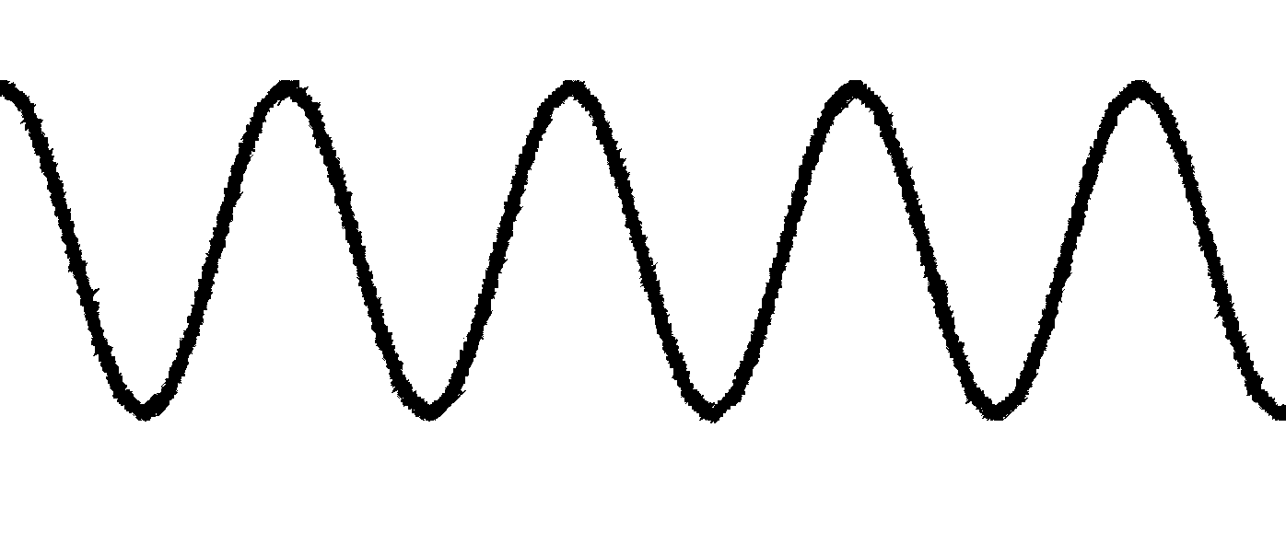
Challenge 1: Self-interference
Signal from Mic
Leakage signal
Received signal of microphone:
ε
ε
Leakage signal
t
t
(Self-interference)
Signal from Mic
_{Air}
GND
(Motion related)
i
Notes:
Therefore, when the earphone works as the transmitter and receiver at same time, the received signal consists of two parts. One part is the leakage signal, the other part is through air propagation. Only the air-propagation part contains the target motion information and the leakage needs to be removed.

Slide 15
Challenge 1: Self-interference
S = Asin(2πft + φ)
Leakage signal
Solution:
ε
0
Reverse of leakage signal
t
Soundproof
Measure
Soundproof material
GND
i
Remove
Notes:
To remove the leakage, we take the following steps.
First, we keep the distance between the microphone and the speaker as far as possible to minimize the strength of the signal arriving at the microphone through the air. We further employ soundproof material to attenuate the signal propagation through the air. With these two measures, the signal component through the air is small enough to be neglected and the received signal is just the leakage component.
then we measure the amplitude and phase information.
Once the leakage is measured, we can cancel it by transmitting an inverse of the leakage.

Slide 16
Challenges
Strong self-interference in wired earphone
Large frequency offset in wireless earphone
Narrow bandwidth
Notes:
The second challenge is the large frequency offset in wireless earphones

Slide 17
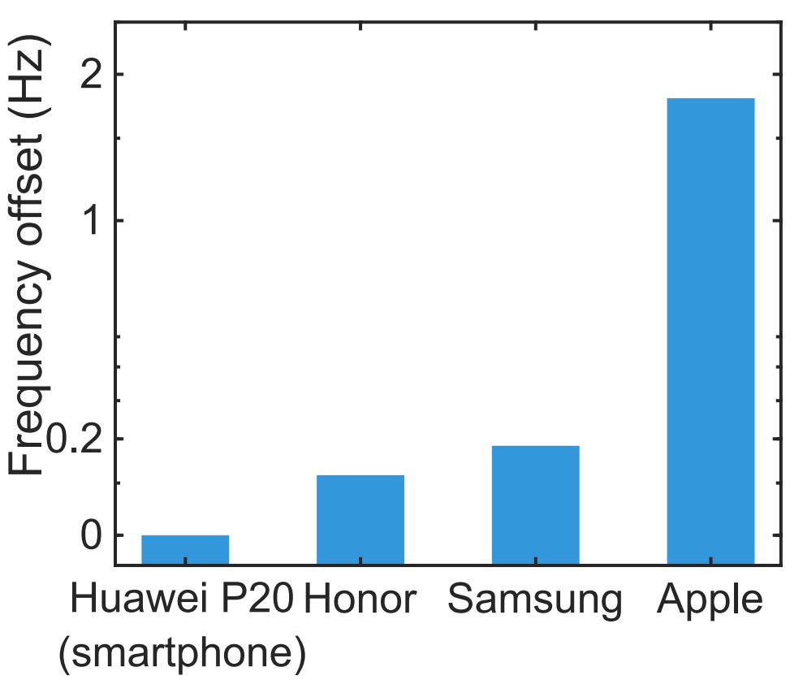
Challenge 2: Frequency Offset
Expected output signal
Input drive signal
Real output signal
Earphone
Δf
Energy
Δf
Frequency
Notes:
For wireless earphone, we find that there exists large frequency offset between the expected signal and the actually generated signal due to imperfect hardware.
Most of the smartphones and wired earphones have very small frequency offsets which can be neglected. However, the frequency offsets of wireless earphones are significantly larger. We can see that the frequency offset of the smartphone is very close to 0. On the other hand, the frequency offsets of Honor Flypods Pro and Samsung Galaxy Buds+ are in the range of 0.1 Hz - 0.2 Hz. Surprisingly, Apple Airpods 2 has a much larger frequency offset which is around 1.8 Hz.

Slide 18
Challenge 2: Frequency Offset
Tracking Error
time
0
Notes:
Fortunately, the frequency offset is stable in each power ON/OFF cycle of the device and the tracking error varies linearly with time. So, we can generate an inverse of the error to cancel the effect of frequency offset.

Slide 19
Challenges
Strong self-interference in wired earphone
Large frequency offset in wireless earphone
Narrow bandwidth
Notes:
Another challenge is narrow bandwidth.

Slide 20
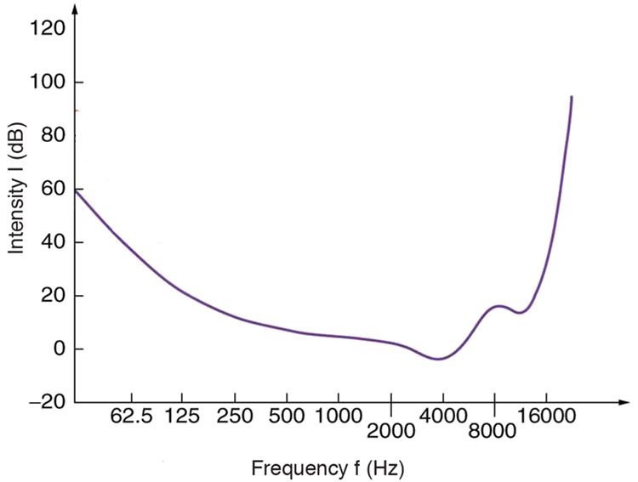
Challenge 3: Narrow bandwidth
Inaudible
bandwidth
Audible bandwidth
Smartphone
Earphones
Even less than 1 kHz
kHz
Threshold of hearing curve
Inaudible bandwidth of earphones
Notes:
The human ear has different sensitivity to different frequencies. In fact, with 16khz as the dividing line, the frequency band can be divided into audible and non-audible parts.
Inaudible frequency bands are often used for sensing. Existing acoustic motion tracking systems employ FMCW chirp signal for accurate range estimate. The tracking performance is linearly related to the bandwidth of the chirp signal. For smartphone, the inaudible band which can be utilized for tracking is around 6 kHz. This is enough to support highly accurate estimates. However, this large inaudible band does not exist at most wireless earphones. Samsung Galaxy Buds+ is able to support only 1 kHz band while Apple Airpod 2 can only support around 0.5 kHz band.

Slide 21
How to achieve accurate motion tracking
only with narrow bandwidth?
f
f
bandwidth
t
t
FMCW
CW
Notes:
So, how to achieve accurate motion tracking only with narrow bandwidth?
We adopt single-frequency continuous wave for motion tracking instead of FMCW.

Slide 22
Principle of distance measurement
Transmission time
Δt₁
Travel time
Δt₂
Reception time
Δt₃
time
Speaker
Microphone
Δt₁ = Δt₃, speaker and microphone are relatively stationary
Notes:
Let’s first introduce the main principles of distance measurement. A sound signal transmitted by the speaker travels through the air and is received at the microphone. When both speaker and microphone are static, the time period taken for signal transmission at the speaker is exactly the same as the time period taken for signal reception at the microphone.

Slide 23
Principle of distance measurement
Transmission time
Δt₁
Travel time
Δt₂
Reception time
Δt₃
time
Δd
Estimated Moving distance: Δd= c(Δt₁ – Δt₃)
Note: c is the speed at which sound signals travel through the air.
Notes:
If the microphone remains static and the speaker moves towards the microphone, the time period taken for signal transmission is larger than the time period taken for signal reception. In this case, if we compare the received signal with the transmitted signal, the received sinusoidal wave is compressed because the same signal is now contained in a smaller time window. The speaker displacement can be calculated as Δd= c(Δt1 – Δt3) where c is the signal propagation speed in the air.

Slide 24
Principle of distance measurement
Transmission time
Δt₁
Travel time
Δt₂
Reception time
Δt₃
time
Δd
Estimated Moving distance: Δd= c(Δt₃ – Δt₁)
Note: c is the speed at which sound signals travel through the air.
Notes:
In contrast, if the speaker moves away from the microphone, the time period taken for reception is larger than that for transmission. In this case, the received signal is stretched compared to the transmitted signal.

Slide 25
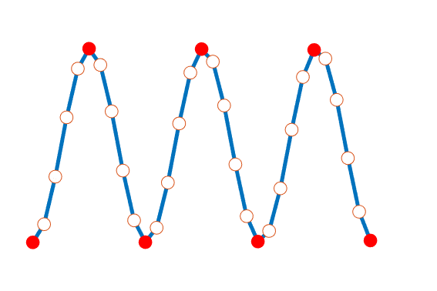
Principle of motion tracking
time
Δd₄
Δd₃
Δd₂
Δd₁
1D tracking
2D tracking
CW
Sample point
Peak / Valley
Notes:
We think about how to achieve tracking with continuous waves. We select a slice containing a fixed number of peaks/valleys from the continuous wave as the moving window and estimate moving distance based on the principle mentioned earlier. By constantly sliding the window, we can continuously estimate distance the speaker moves, namely 1D tracking.
With more microphones and speakers, we can achieve 2D and 3D tracking.

Slide 26
Evaluation
Notes:
Next, let’s move on to the evaluation part of our work.

Slide 27
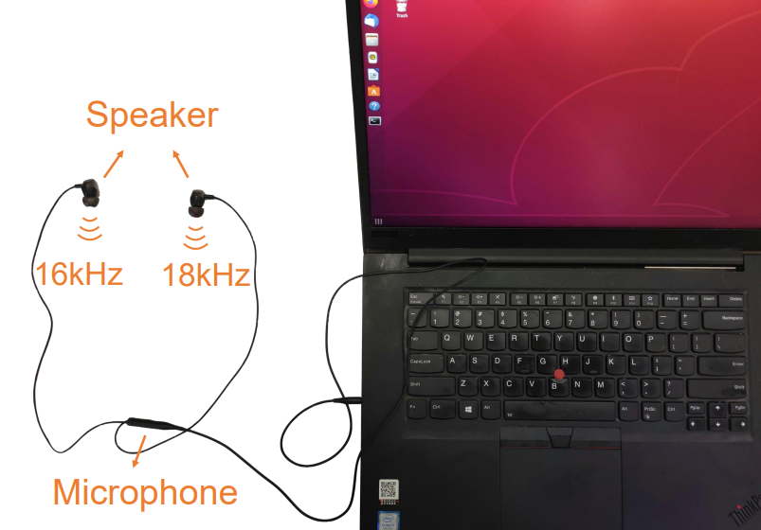
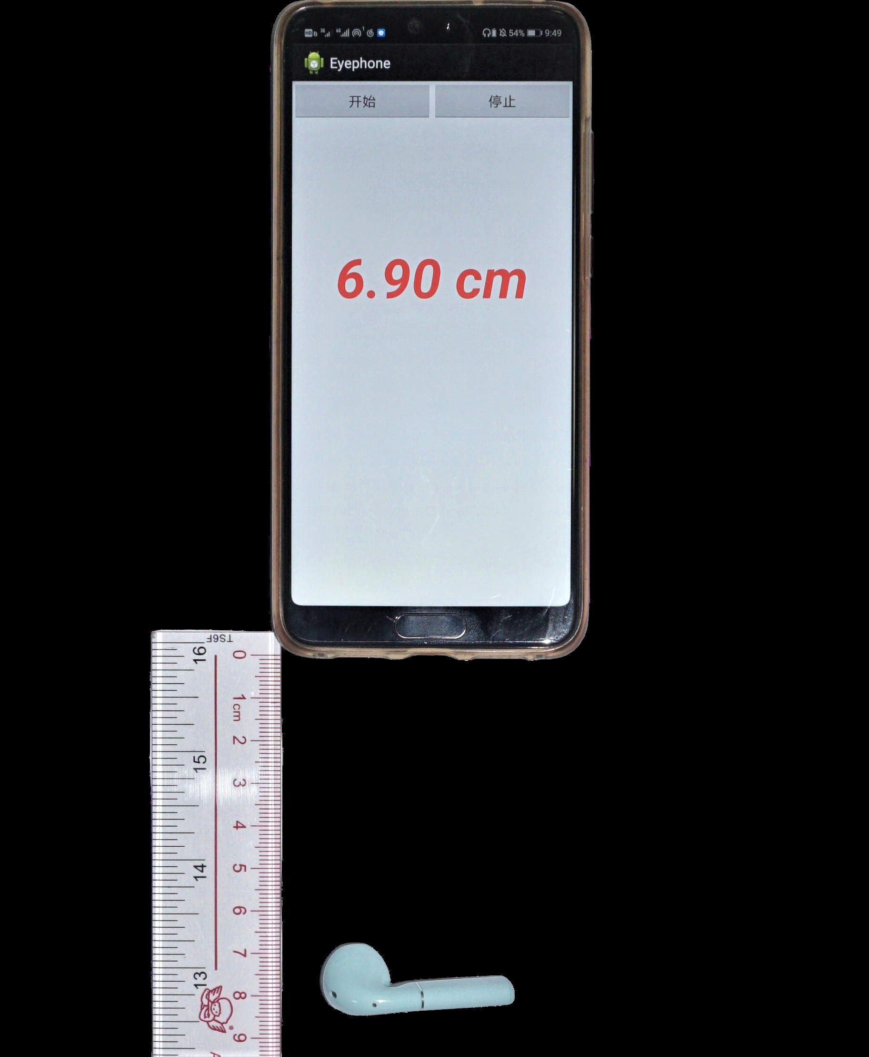
Implementation
Android Platform
Linux Platform
Huawei P20
Lenovo Thinkpad P1 Gen2
Intel i7 CPU, 16G memory
Support 1D & 2D tracking
Support 1D & 2D & 3D tracking
Wireless earphones: Samsung Galaxy Bud+, HONOR Flypods Pro, Apple Airpods 2
Wired earphones: Sony MDR-XB75AP, Philips PRO6105BK, Moshi Mythro, ATH-CK350IS
Notes:
We implement our system on both Android platform and Linux platform. For android platform, we implement an app on Huawei P20 smartphone to perform signal processing, which can support 1D&2D motion tracking with wireless and wired earphones. For linux platform, we use the Lenovo Thinkpad P1 laptop to perform signal processing, which can support 1d&2d&3d tracking. We evaluate our system on 3 types of wireless earphones and 4 types of wired earphones, covering the popular brand including …

Slide 28
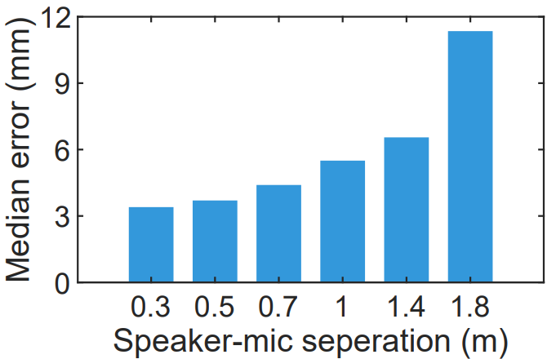
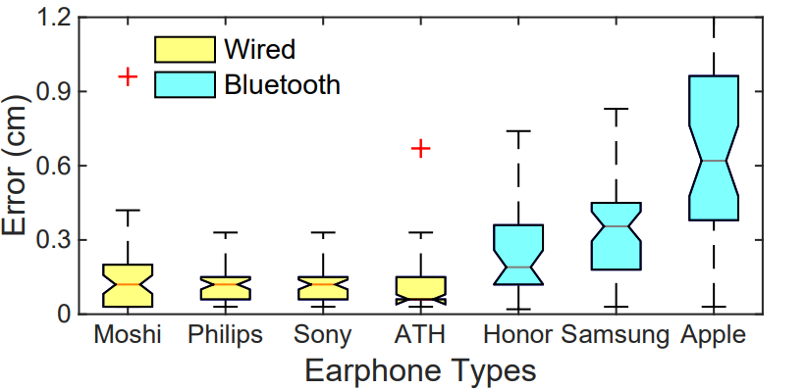
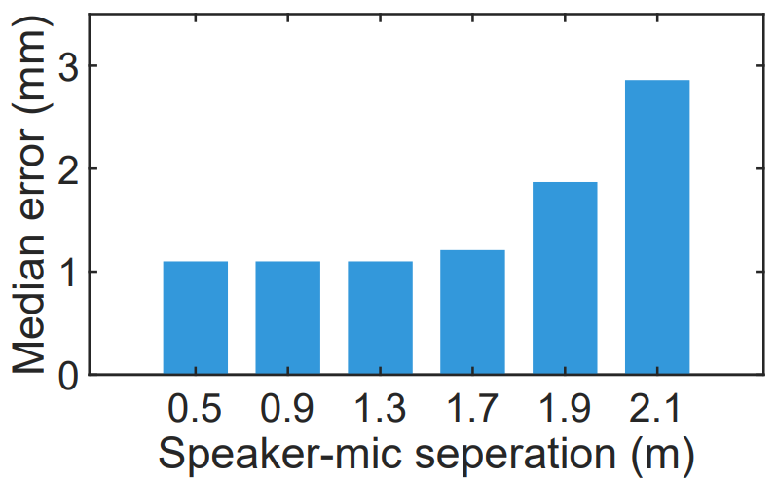
Tracking accuracy
Wireless earphone:
Impact of earphone diversity:
Wired earphone:
Enable mm-level tracking in 2m range
Median error of most wireless earphones is under 4mm
Median error of wired earphones is under 2mm
Notes:
First, we evaluate the tracking accuracy. We evaluate the 1D tracking accuracy on both wireless and wired earphones. The result shows that our system can enable mm-level tracking in 2m range. We further evaluate the system performance using different types of earphones. For all the wireless earphones except Apple, the median error is under 4mm. For wired earphones, the median error is under 2mm.

Slide 29
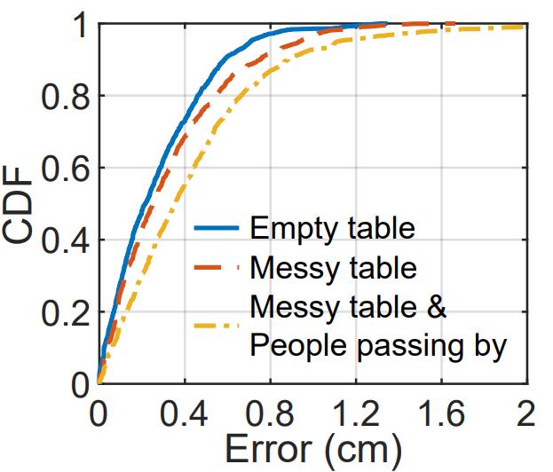
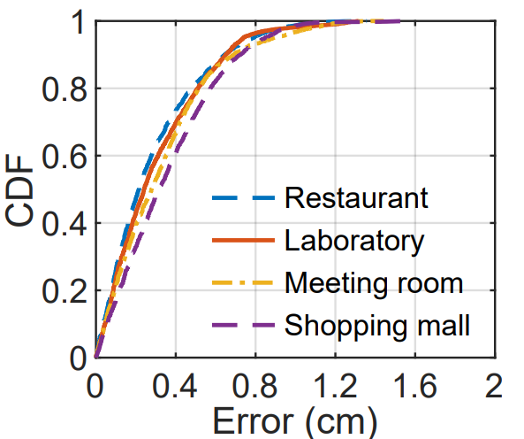
Tracking robustness
Impact of multipath:
Impact of ambient sound:
Environments with different types and different levels of noise
Low, medium and rich multipath
Median error are 2.1mm, 2.5mm and 3.5mm
No significant differences among the error
Notes:
We also evaluate the robustness of our system in 2D tracking scenario.
To evaluate the performance against multipath, we perform 2D tracking in 3 different environments. The first one is an empty table with no other objects. For the second environment, we put books and bottles on the table. For the third environment, we further ask two volunteers to walk around near the table continuously to create multipath reflections. The three different environments have low, medium and rich multipath, respectively. (corresponding to different multipath interference)The median error are 2.1 mm, 2.5 mm and 3.5 mm respectively for the three environments.
To evaluate the robustness of the proposed system against ambient sound noise, We evaluate the 2D tracking performance in four different environments with different types and different levels of sound noise, including a restaurant, a laboratory, a meeting room and a shopping mall. We do not observe a significant performace difference among the four environments.

Slide 30
Video demo of 2D tracking
Notes:
Here is a video to demonstrate 2D tracking of our system. We can see that the drawn rabbit match the ground-truth very well. The result shows that the accuracy achieved by EarphoneTrack in real time is fine enough to enable a lot of HCI applications.

Slide 31
Conclusion
Notes:
Finally, let me conclude this work

Slide 32
Conclusion
Involved earphones into the ecosystem of acoustic motion tracking
Proposed solutions to address unique challenges associated with earphone motion tracking
Implemented EarphoneTrack on Android and Linux
Conducted comprehensive experiments
Notes:
In this work, …

Slide 33
Thanks for your listening!
Notes:
With all of that, I finish my presentation. Thank you for time and patience.

