Slide 1
SQL, NoSQL, MongoDB
CSE-291 (Distributed Systems) Winter 2017
Gregory Kesden

Slide 2
“SQL” Databases
Really better called “Relational Databases”
Key construct is the “Relation”, a.k.a. the table
  Rows represent records
  Columns represent attribute sets
Find things within tables by brute force or indexes, e.g. B-Trees or Hash Tables
Cross-reference tables via shared keys, basically an optimized cross-product, known as a “join”
  Expensive operation

Slide 3
“SQL” Databases
Backbone of modern apps
Very, very high throughput can be achieved
Scaling is challenging because there is no good way to partition tables while still achieving semantics
Amazing work-arounds are possible – virtualize SANS to large storage devices, etc
But, the model is what it is.

Slide 4
NoSQL Databases
Any of the more modern databases that essentially give up the ability to do joins in order to be able to avoid huge monolith tables and scale
  Key-Value (Dynamo or basic Cassandra)
  Column-based (Hbase)
  Document-based (MongoDB)
Usually has more flexible scheme (no rigid tables means no rigid NxM structure)

Slide 5
MongoDB
Document-based NoSQL database
  Max 16MB per document
Documents are rich BSON (Binary JSON) key-value documents
Collections hold documents and can share indexes
  Some like to suggest they are analogous to tables, but not all documents in a collection must have the same structure.
  They just have some of the same keys
Databases hold collections hold documents

Slide 6
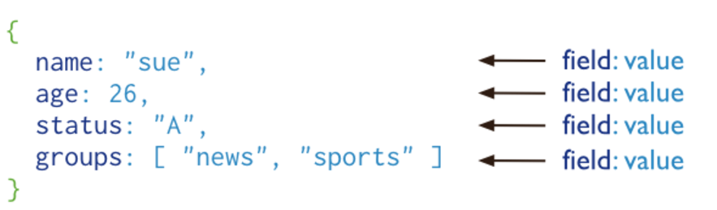
MongoDB Document
Note field:value tuples
https://docs.mongodb.com/manual/_images/crud-annotated-document.png

Slide 7
Embedded Documents
var mydoc = {
_id: ObjectId(“1abcd45b123456754321abcd"),
name: { first: “Gregory", last: “Kesden" },
classes: [ “CSE-291", “CSE-110", “CSE-500" ],
contact: { phone: { type: "cell", number: “412-818-7813" } },
}
Array access: classes.0
Embedded doc access: contact.phone.number

Slide 8
Join Operations?
In general, not a MongoDB thing
  Get data from different places
  Slow and expensive operation
Much better to take advantage of denormalized structure to embed related things
Can also “chase pointers” by chasing an id from one document into another document via another query. (More like using a foreigh key in SQL than a join)
Worst case? Multiple passes using shared key.

Slide 9
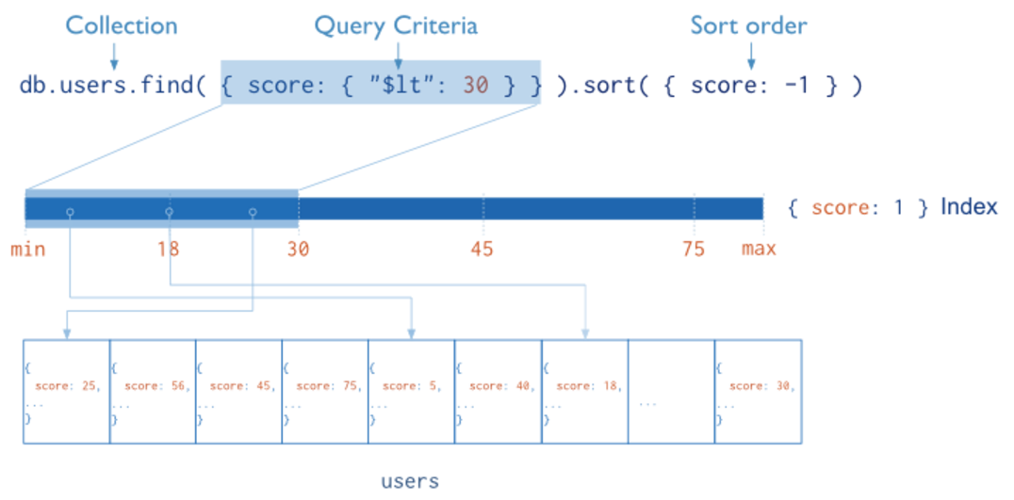
Indexes (Much like any other DB)
https://docs.mongodb.com/manual/indexes/

Slide 10
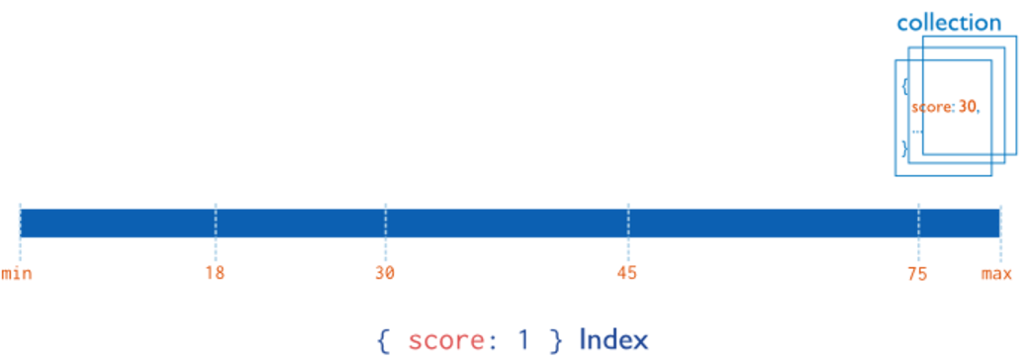
Single Field Indexes
https://docs.mongodb.com/manual/indexes/

Slide 11
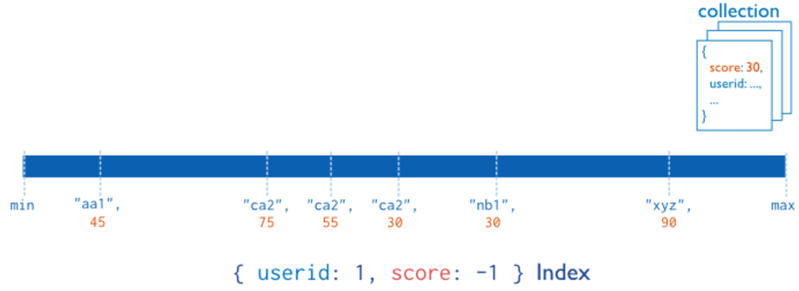
Compound Indexes
https://docs.mongodb.com/manual/indexes/

Slide 12
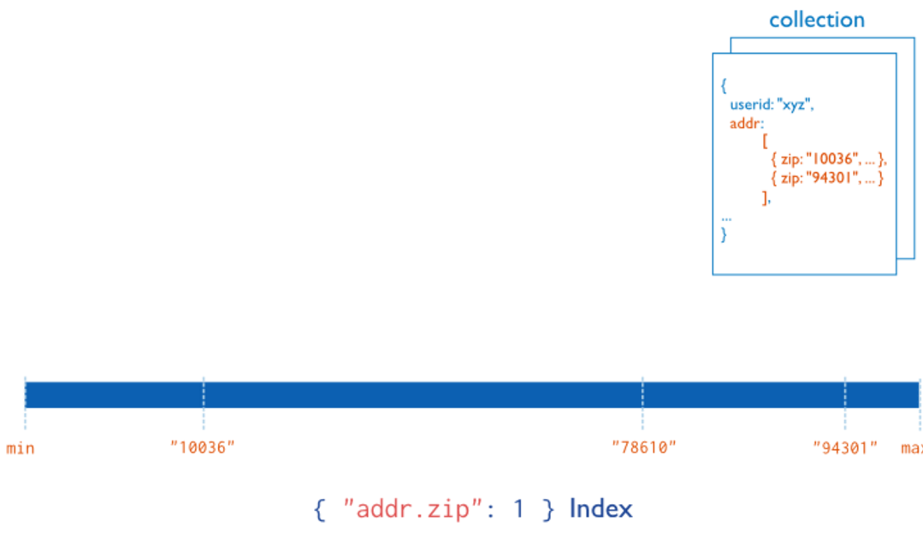
Multi-Key (Array Field) Indexes
Note: One index for each element of the array
https://docs.mongodb.com/manual/core/index-multikey/

Slide 13
More About Indexing
Matches, Range-based results, etc
Geospatial searches
Text searches, language based, includes only meaningful words
Partial indexes filter and only index matching documents
TTL indexes, internally used to age out documents, where desired
Covered queries are queries that can be answered directly from indexes, without scanning
Intersection of indexes.

Slide 14
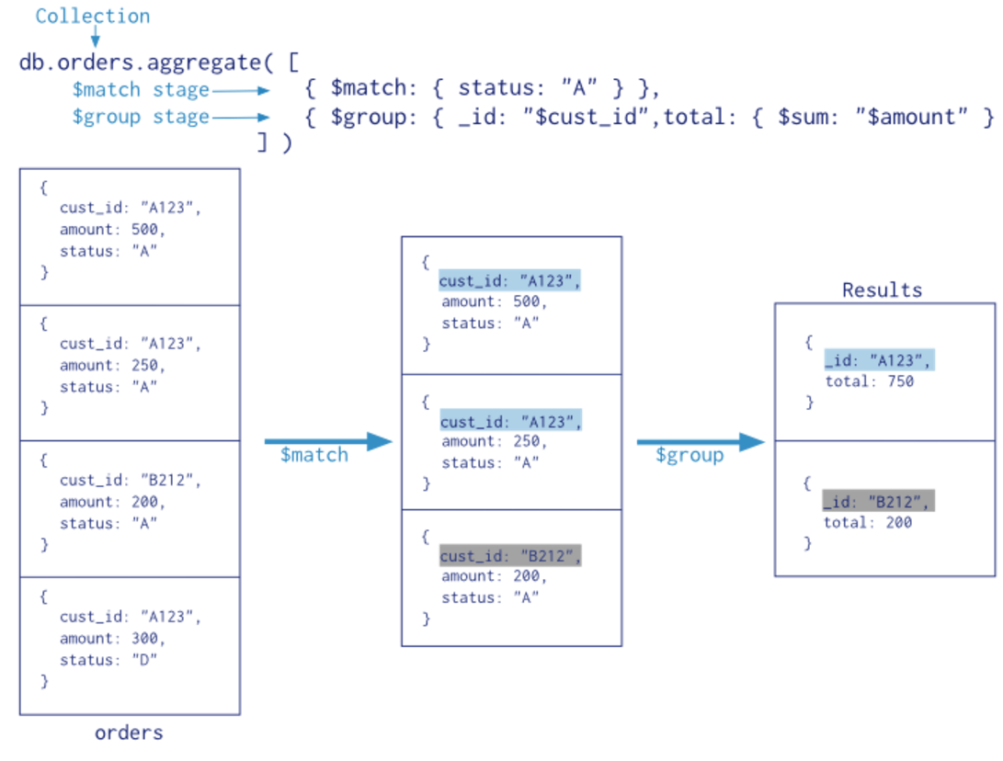
Aggregation Pipeline: Filter, Group, Sort, Ops (Average, Concatenation, etc)
https://docs.mongodb.com/manual/aggregation/

Slide 15
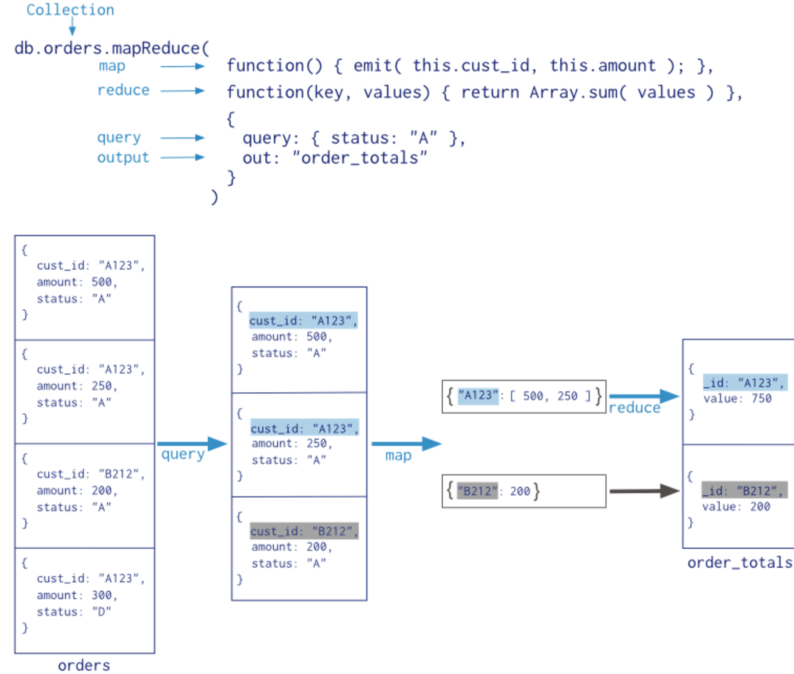

Map-Reduce
https://docs.mongodb.com/manual/aggregation/

Slide 16
Concurrency
Multiple options, WiredTiger the default
Document-level concurrency control for write operations. As a result, multiple clients can modify different documents of a collection at the same time.
For most read and write operations, WiredTiger uses optimistic concurrency control. WiredTiger uses only intent locks at the global, database and collection levels. When the storage engine detects conflicts between two operations, one will incur a write conflict causing MongoDB to transparently retry that operation.
Some global operations, typically short lived operations involving multiple databases, still require a global “instance-wide” lock. Some other operations, such as dropping a collection, still require an exclusive database lock.
https://docs.mongodb.com/manual/core/wiredtiger/

Slide 17
Snapshots and Checkpoints
At the start of an operation, WiredTiger provides a point-in-time snapshot of the data to the transaction. A snapshot presents a consistent view of the in-memory data.
When writing to disk, WiredTiger writes all the data in a snapshot to disk in a consistent way across all data files. The now-durable data act as a checkpoint in the data files. The checkpoint ensures that the data files are consistent up to and including the last checkpoint; i.e. checkpoints can act as recovery points.
MongoDB configures WiredTiger to create checkpoints at intervals of 60 seconds or 2 gigabytes of journal data.
During the write of a new checkpoint, the previous checkpoint is still valid.
The new checkpoint becomes accessible and permanent when WiredTiger’s metadata table is atomically updated to reference the new checkpoint. Once the new checkpoint is accessible, WiredTiger frees pages from the old checkpoints.
Journaling needed to recover changes ahead of checkpoints
https://docs.mongodb.com/manual/core/wiredtiger/

Slide 18
Journaling
Compressed write-ahead log (WAL)
Used to recover state more recent than most recent checkpoint
Buffered in memory, synced every 50ms
Deleted upon clean shutdown
Depending on file system, can preallocate log to avoid slow allocation

Slide 19
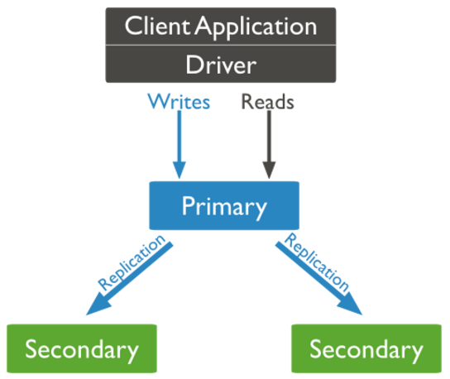
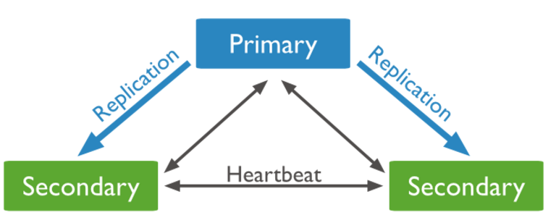
Replica Sets: Asynchronous Replication
https://docs.mongodb.com/manual/replication/

Slide 20
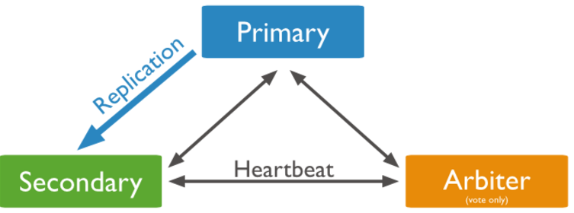
Arbiters for Quorums:
Real World Student-Like Move
https://docs.mongodb.com/manual/replication/

Slide 21
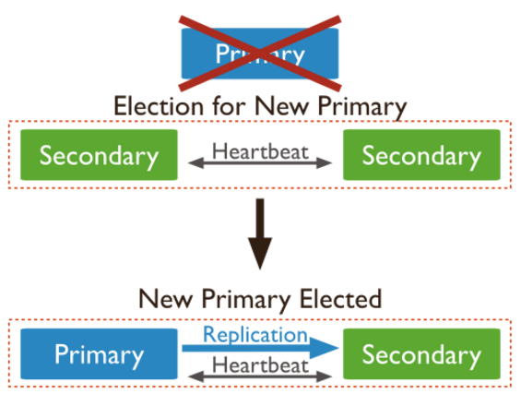
Automatic Failover
Missing heartbeats for 10sec? Call election
Secondary with most votes becomes new primary, temporarily
But, uses bully-like primary to agree on top dog in the end
Can be non-voting secondaries. Can be read, but not elected or voting.
Read-only during election
https://docs.mongodb.com/manual/replication/

Slide 22
Supporting Scale
Vertical – bigger host
Horizontal -- Sharding
  More hosts
  Higher throughput
  Greater capacity

Slide 23
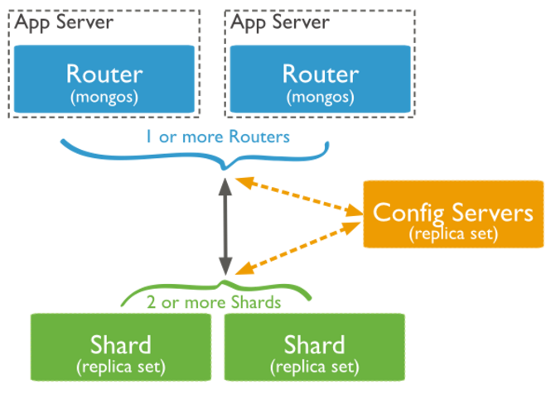
Sharding
Documents w/in sharded collection have shard key
  Immutable, sued for sharding
  Choice is very important, because key must be found in range by index. Can be bottleneck
Collection partitioned by shard key range into chunks
Chunks are distributed and replicated (replica sets)

Slide 24
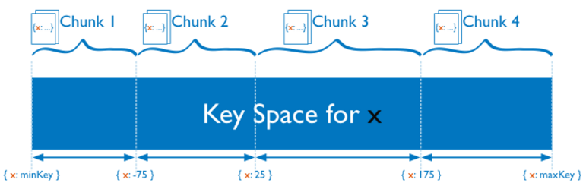
Chunks
Sharded into chunks by shard key
Can be migrated manually or balancer
Can be split if too large

