Slide 1

ZFS The Future Of File Systems
C Sanjeev Kumar
Charly V. Joseph
Mewan Peter D’Almeida
Srinidhi K.

Slide 2

Introduction

Slide 3
What is a File System?
File systems are an integral part of any operating systems with the capacity for long term storage
present logical (abstract) view of files and directories
facilitate efficient use of storage devices
Example-NTFS,XFS,ext2/3…etc

Slide 4
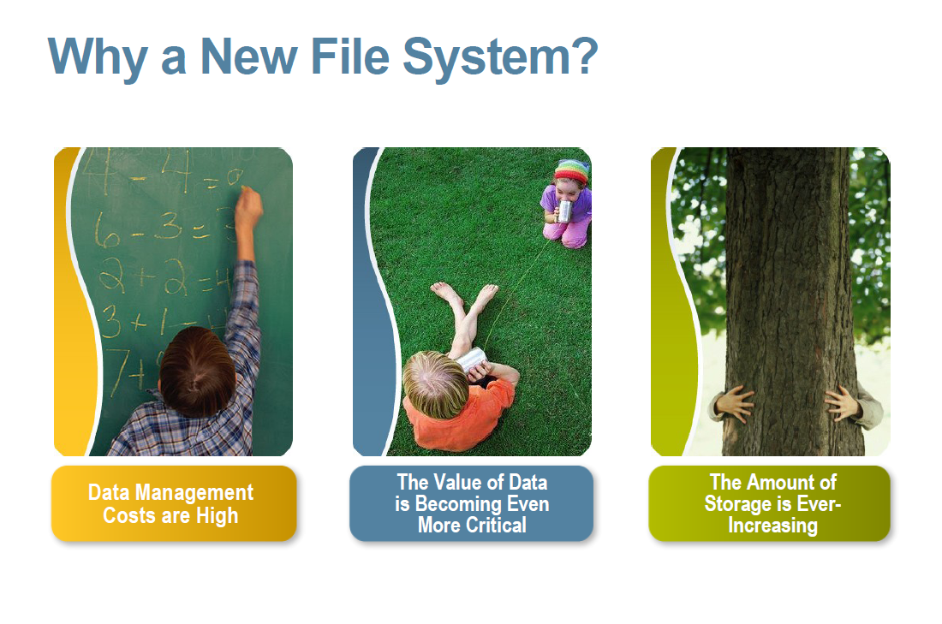

Slide 5
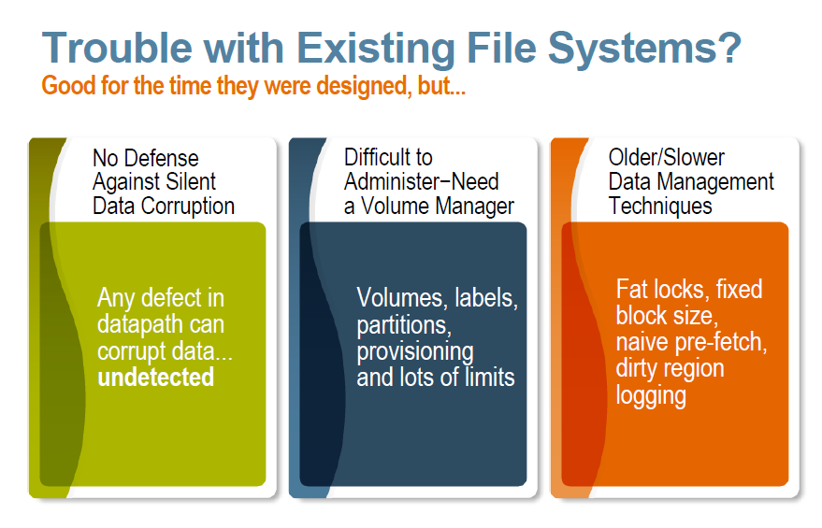

Slide 6
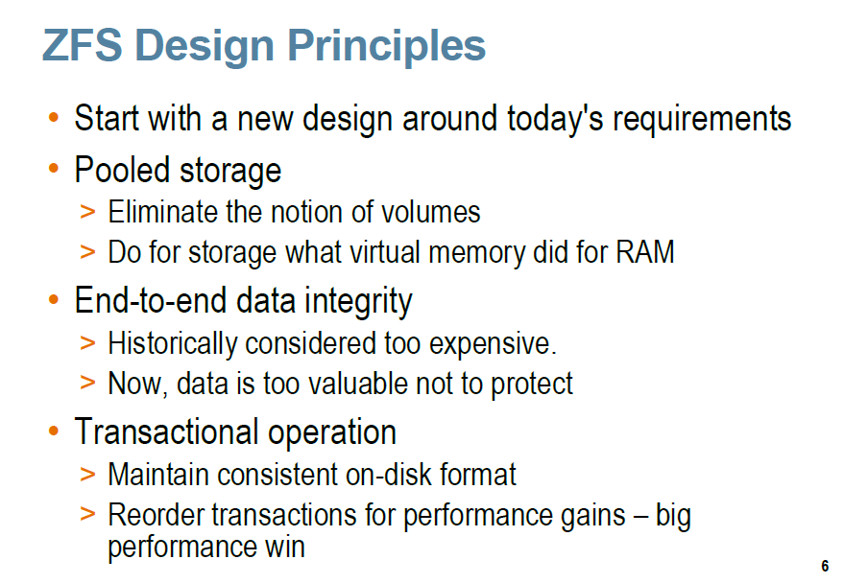

Slide 7
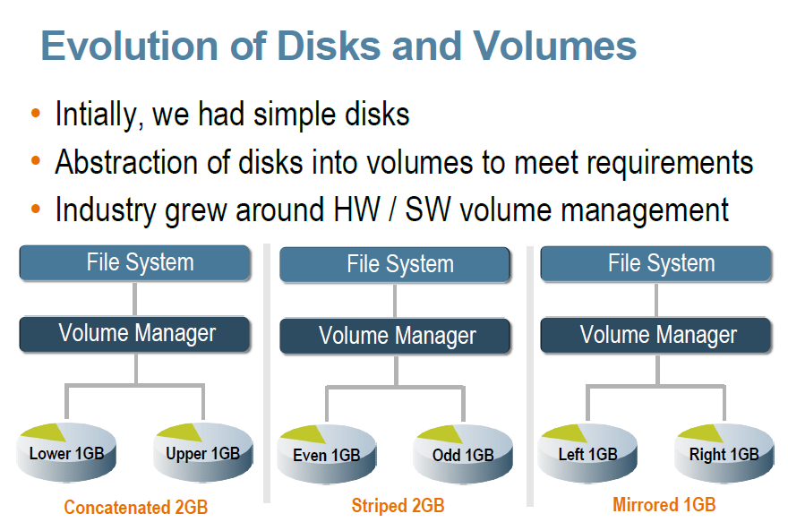

Slide 8
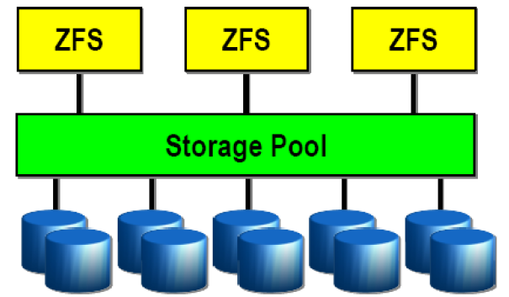
Zpool
ZFS file systems are built on top of virtual storage pools called zpools.
A zpool is constructed of devices, real or logical.
They are constructed by combining block devices using either mirroring or RAID-Z.

Slide 9
Traditional Volumes | ZFS Pooled Storage
Partitions/volumes exist in traditional file Systems. | With ZFS’s common storage pool, there are no partitions to manage.
With traditional volumes, storage is fragmented and stranded. Hence storage utilization is poor. | File systems share all available storage in the pool, thereby leading to excellent storage utilization.
Since traditional file systems are constrained to the size of the disk, so growing file systems and volume is difficult. | Size of zpools can be increased easily by adding new devices to the pool. Moreover file systems sharing available storage in a pool, grow and shrink automatically as users add/remove data.

Slide 10
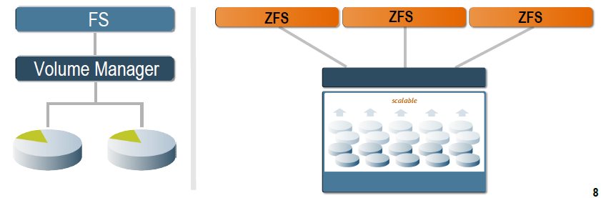
Traditional Volumes | ZFS Pooled Storage
Each file system has limited I/O bandwidth. | The combined I/O bandwidth of all the devices in the storage pool is always available to each file system.
Configuring a traditional file system with volumes involves extensive command line or graphical user interface interaction and takes many hours to complete. | Creation of a similarly sized Solaris ZFS file system takes a few seconds.

Slide 11
Data Integrity

Slide 12
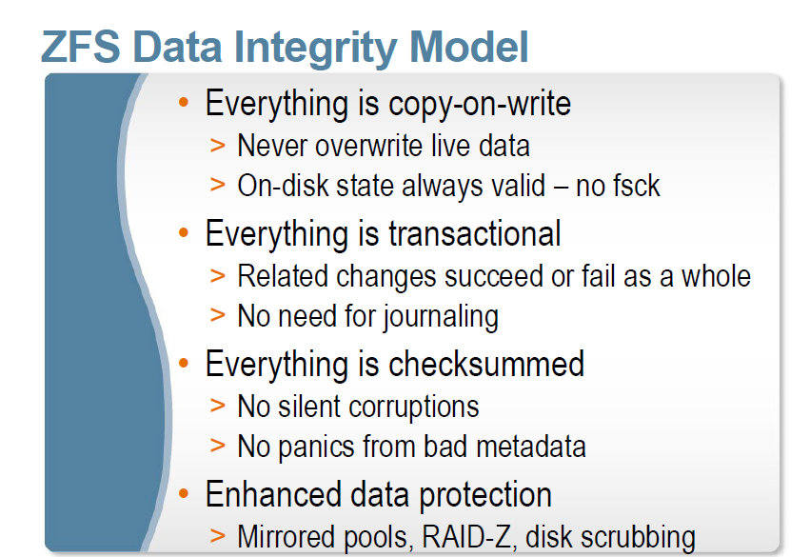

Slide 13
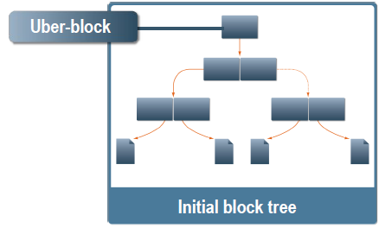
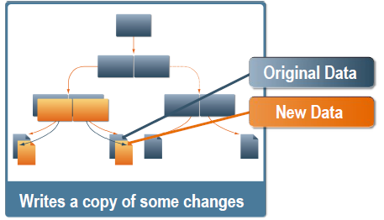
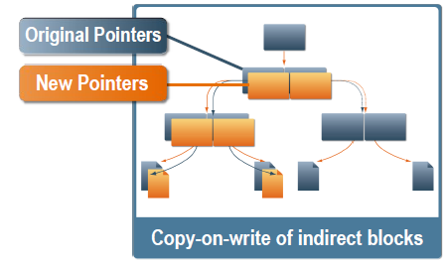
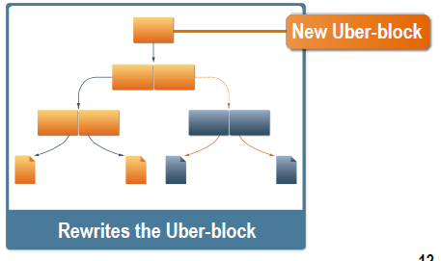

Slide 14
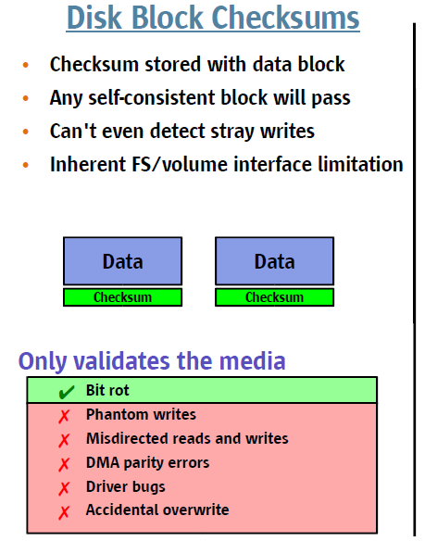
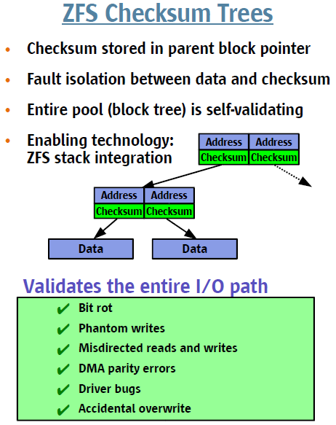
End-to-End Checksums

Slide 15
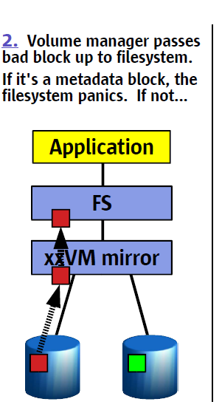
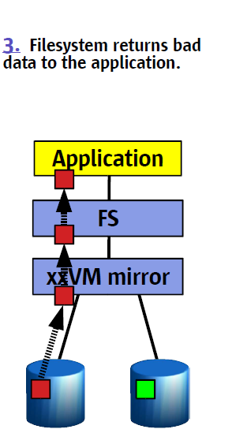
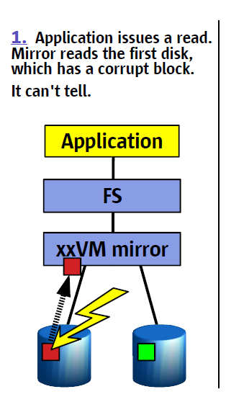
Traditional Mirroring

Slide 16
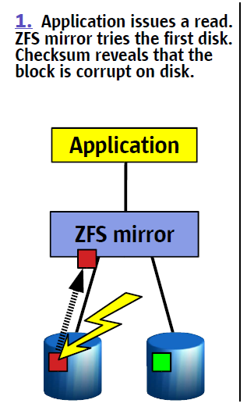
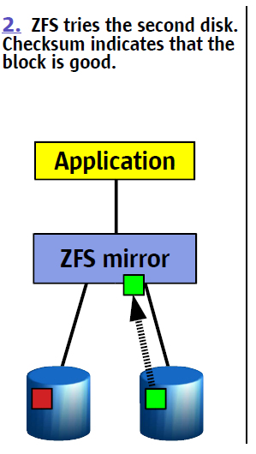
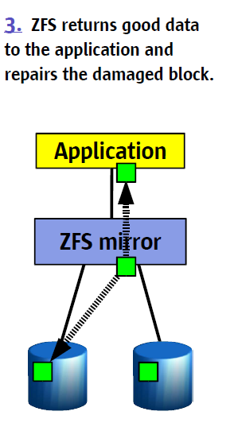
Self-Healing data in ZFS

Slide 17
Mirroring
The easiest way to get high availability
Half the size
Higher read performance
Striping
Higher performance
Distributed across disks
Work in parallel

Slide 18
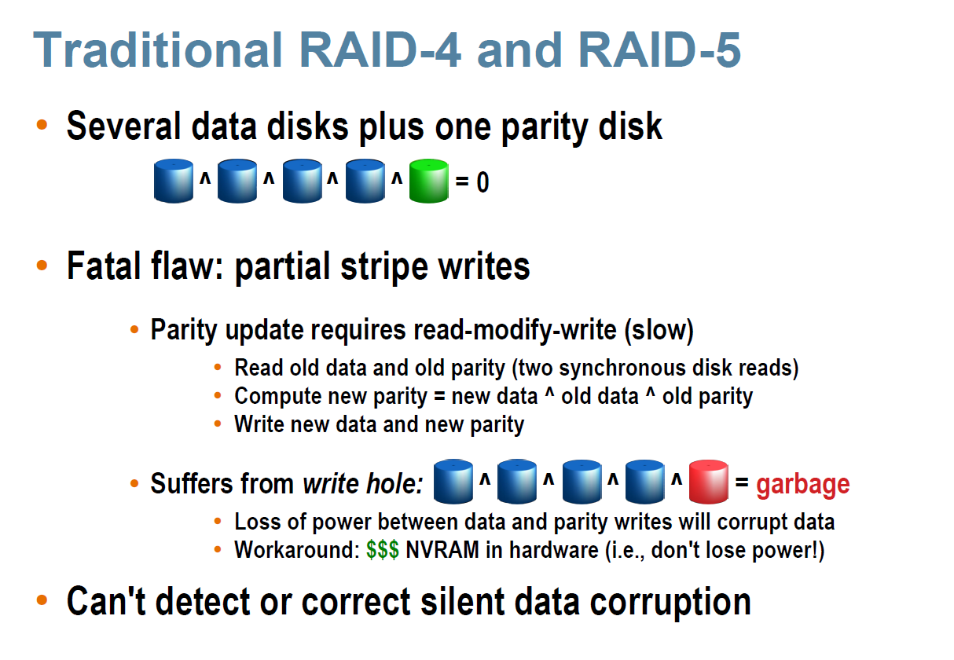

Slide 19

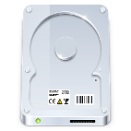
RAID-Z

Slide 20
RAID-Z

Slide 21
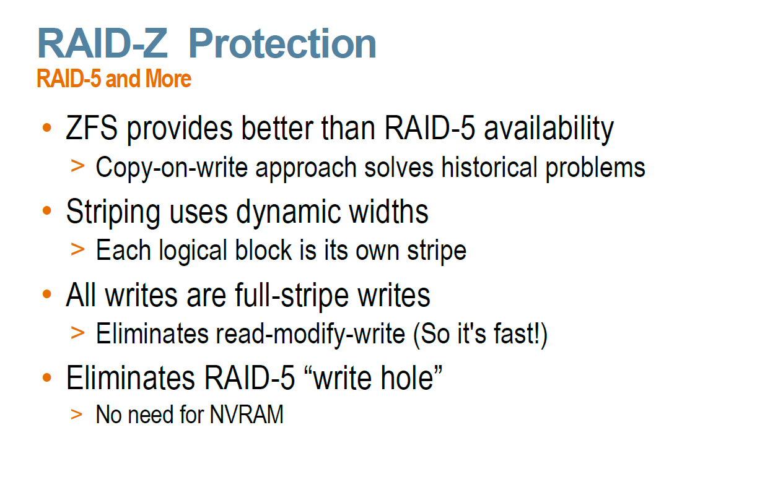

Slide 22
Easier Administration

Slide 23
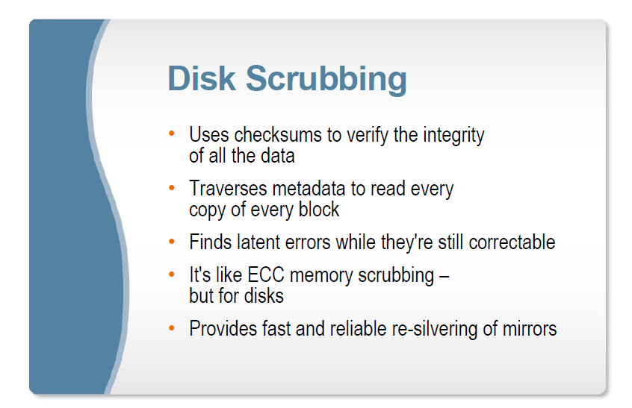

Slide 24
Resilvering of mirrors
Resilvering (AKA resyncing, rebuilding, or reconstructing) is the process of repairing a damaged device using the contents of healthy devices.
For a mirror, resilvering can be as simple as a whole-disk copy. For RAID-5 it's only slightly more complicated: instead of copying one disk to another, all of the other disks in the RAID-5 stripe must be XORed together.

Slide 25
Resilvering of mirrors
The main advantages of this feature are as follows:
ZFS only resilvers the minimum amount of necessary data.
The entire disk can be resilvered in a matter of minutes or seconds,
Resilvering is interruptible and safe. If the system loses power or is rebooted, the resilvering process resumes exactly where it left off, without any need for manual intervention.
Transactional pruning. If a disk suffers a transient outage, it's not necessary to resilver the entire disk -- only the parts that have changed.
Live blocks only. ZFS doesn't waste time and I/O bandwidth copying free disk blocks because they're not part of the storage pool's block tree.

Slide 26
Resilvering of mirrors
Types of resilvering:
Top-down resilvering-the very first thing ZFS resilvers is the uberblock and the disk labels. Then it resilvers the pool-wide metadata; then each file system's metadata; and so on down the tree.
Priority-based resilvering-Not yet implemented in ZFS.

Slide 27
Create ZFS Pools
Create a ZFS pool
# zpool create tank c0d1 c1d0 c1d1
# zpool list
NAME SIZE USED AVAIL CAP HEALTH ALTROOT
tank 23.8G 91K 23.8G 0% ONLINE -
Destroy a pool
# zpool destroy tank
Create a mirrored pool
# zpool create mirror c1d0 c1d1
  Mirror between disk c1d0 and disk c1d1
  Available storage is the same as if you used only one of these disks
  If disk sizes differ, the smaller size will be your storage size

Slide 28
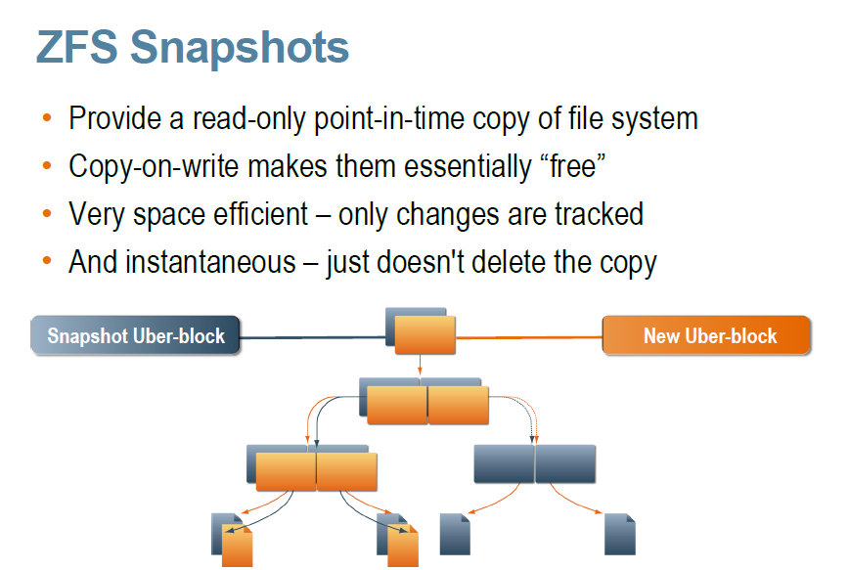
View of a file system as it was at a particular point in time.
A snapshot initially consumes no disk space, but it starts to consume disk space as the files it references get modified or deleted.
Constant time operation.

Slide 29
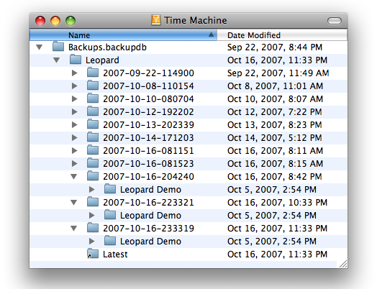
Presence of snapshots doesn’t slow down any operation
Deleting snapshots takes time proportional to the number of blocks that the delete will free
Snapshots allow us to take a full back-up of all files/directories referenced by the snapshot
Independent of the size of the file system that it references to
Independent of the size of the file system that it references to.
Presence of snapshots doesn’t slow down any operation.
Snapshots allow us to take a full back-up of all files/directories referenced by the snapshot.
View of a file system as it was at a particular point in time.
A snapshot initially consumes no disk space, but it starts to consume disk space as the files it references get modified or deleted.
Constant time operation.

Slide 30
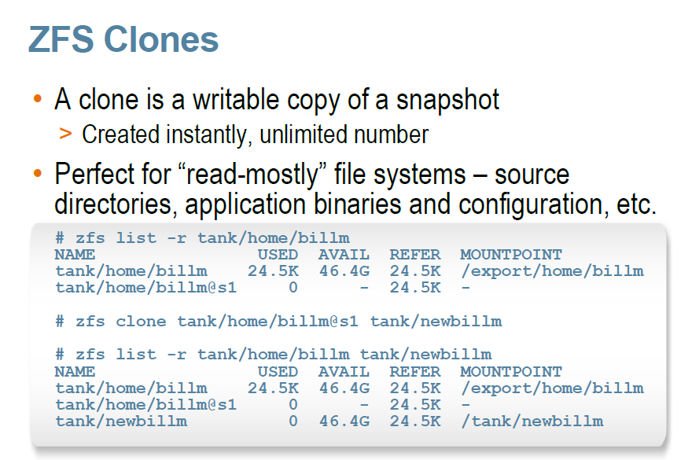

A clone is a writable volume or file system whose initial contents are the same as the
dataset from which it was created
A clone is a writable volume or file system whose initial contents are the same as the dataset from which it was created.
Constant time operation.
ZFS clones do not occupy additional disk space when they are created.
Clones can only be created from a snapshot.
An implicit dependency is created between the clone and the snapshot.

Slide 31
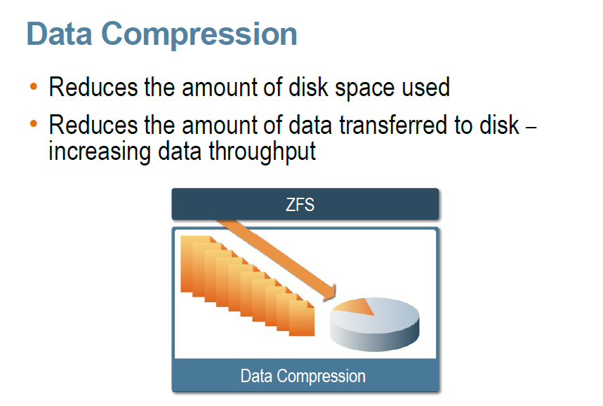

Slide 32
Unparalleled Scalability
The limitations of ZFS are designed to be so large that they will not be encountered in practice for some time. Some theoretical limitations in ZFS are:
Number of snapshots of any file system - 2⁶⁴
Number of entries in any individual directory - 2⁴⁸
Maximum size of a file system - 2⁶⁴ bytes
Maximum size of a single file - 2⁶⁴ bytes
Maximum size of any attribute - 2⁶⁴ bytes
Maximum size of any zpool - 2⁷⁸ bytes
Number of attributes of a file - 2⁵⁶
Number of files in a directory - 2⁵⁶
Number of devices in any zpool - 2⁶⁴
Number of zpools in a system - 2⁶⁴
Number of file systems in a zpool - 2⁶⁴

Slide 33
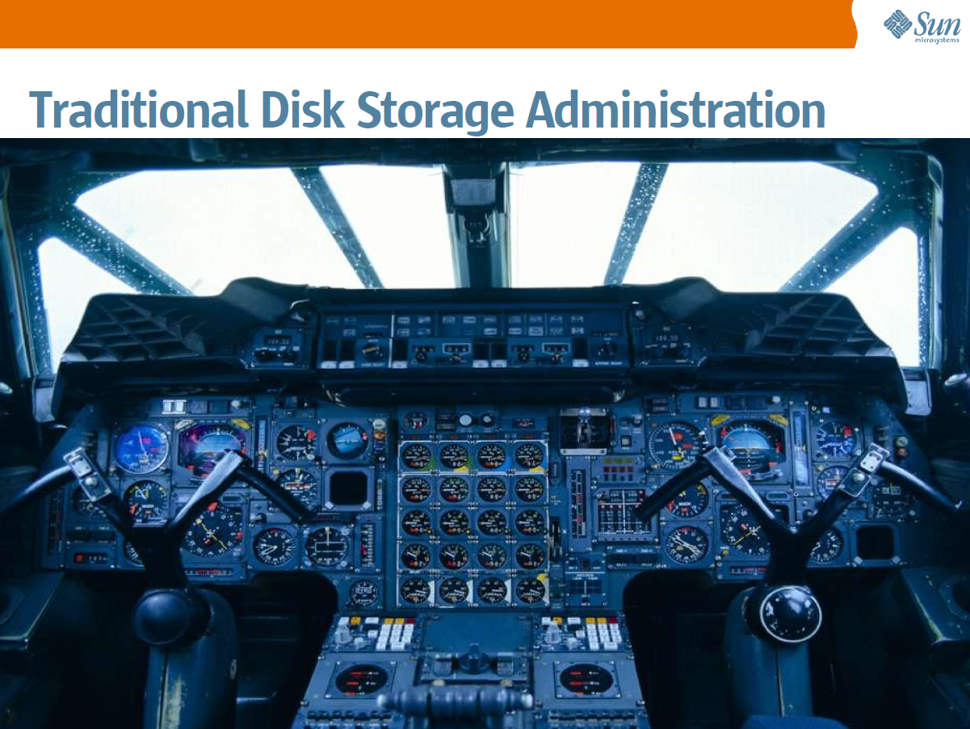

Slide 34
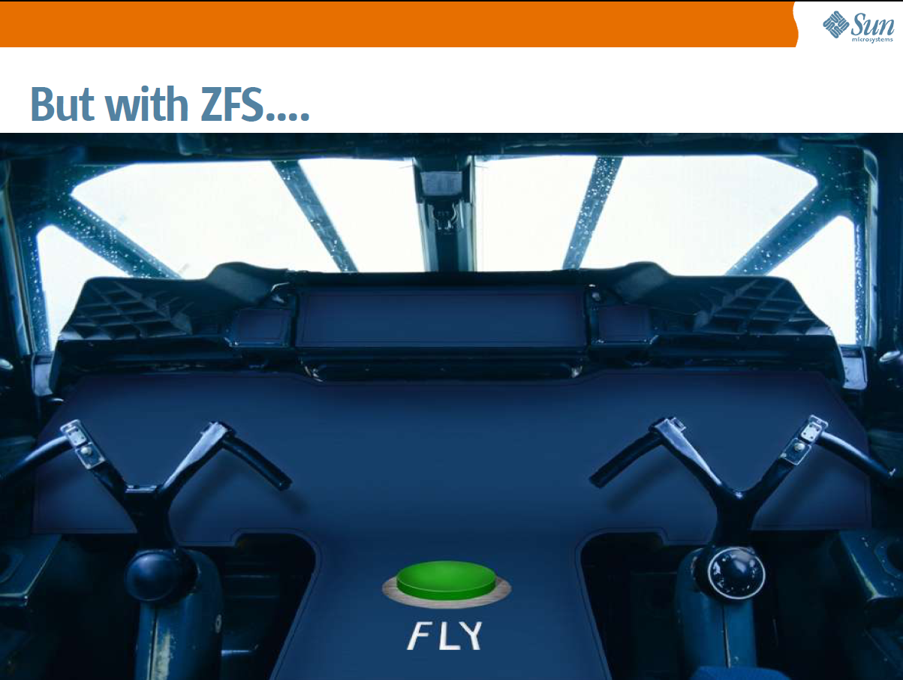

Slide 35
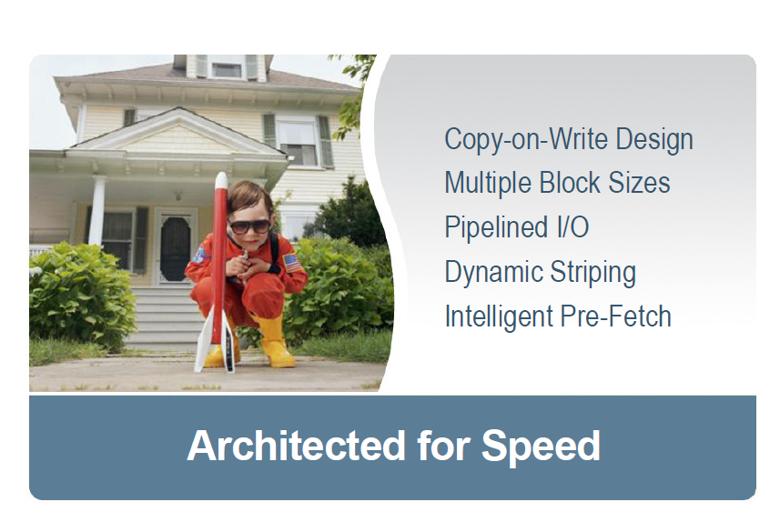


Slide 36
Multiple Block Size
No single value works well with all types of files
Large blocks increase bandwidth but reduce metadata and can lead to wasted space
Small blocks save space for smaller files, but increase I/O operations on larger ones
FSBs are the basic unit of ZFS datasets, of which checksums are maintained
Files that are less than the record size are written as a single file system block (FSB) of variable size in multiples of disk sectors (512B)
Files that are larger than the record size are stored in multiple FSBs equal to record size

Slide 37
Pipelined I/O
Reorders writes to be as sequential as possible
App #1 writes:
App #2 writes:
If left in original order, we
waste a lot of time waiting
for head and platter
positioning:
Move Head
Spin Head
Move Head
Move Head
Move Head

Slide 38
Pipelined I/O
Reorders writes to be as sequential as possible
App #1 writes:
App #2 writes:
Pipelining lets us examine
writes as a group and
optimize order:
Move Head
Move Head

Slide 39
Dynamic Striping
Load distribution across devices
Factors determining block allocation include:
  Capacity
  Latency & bandwidth
  Device health

Slide 40
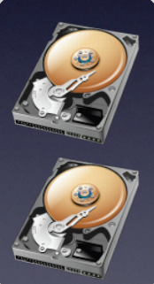
Dynamic Striping
Writes striped across both mirrors.
Reads occur wherever data was
written.
New data striped across three mirrors.
No migration of existing data.
Copy-on-write reallocates data over time,
gradually spreading it across all three mirrors.
+
# zpool create tank \
mirror c1t0d0 c1t1d0 \
mirror c2t0d0 c2t1d0
# zpool add tank \
mirror c3t0d0 c3t1d0

Slide 41
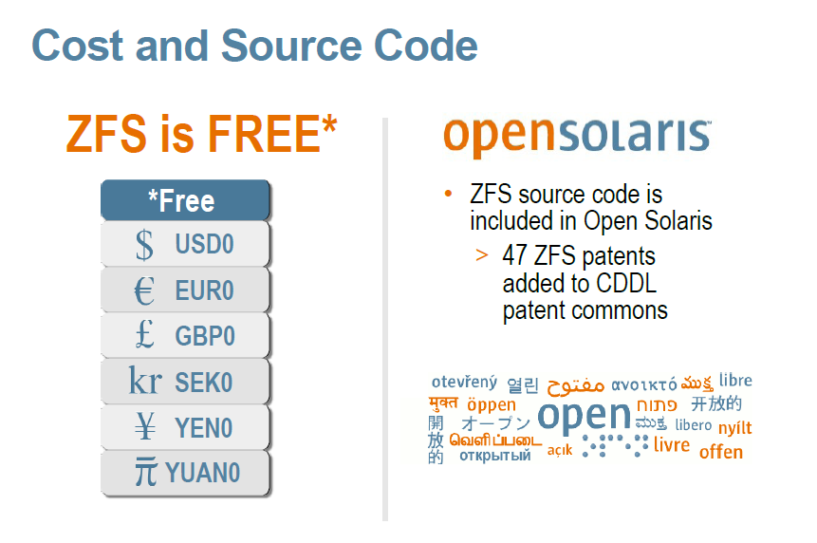

Slide 42

Disadvantages
ZFS is still not widely used yet.
RAIDZ2 has a high IO overhead- ZFS is slow when it comes to external USB drives
Higher power consumption
No encryption support
ZFS lacks a bad sector relocation plan.
High CPU usage

Slide 43
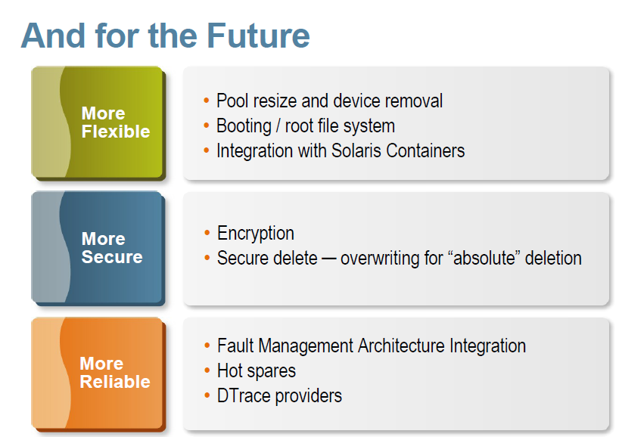

Slide 44



