Slide 1
Dynamo: Amazon’s Highly Available Key-value Store
Giuseppe DeCandia, Deniz Hastorun,
Madan Jampani, Gunavardhan Kakulapati,
Avinash Lakshman, Alex Pilchin, Swaminathan Sivasubramanian, Peter Vosshall
and Werner Vogels

Slide 2
Motivation
Build a distributed storage system:
  Scale
  Simple: key-value
  Highly available
  Guarantee Service Level Agreements (SLA)

Slide 3
System Assumptions and Requirements
Query Model: simple read and write operations to a data item that is uniquely identified by a key.
ACID Properties: Atomicity, Consistency, Isolation, Durability.
Efficiency: latency requirements which are in general measured at the 99.9th percentile of the distribution.
Other Assumptions: operation environment is assumed to be non-hostile and there are no security related requirements such as authentication and authorization.

Slide 4
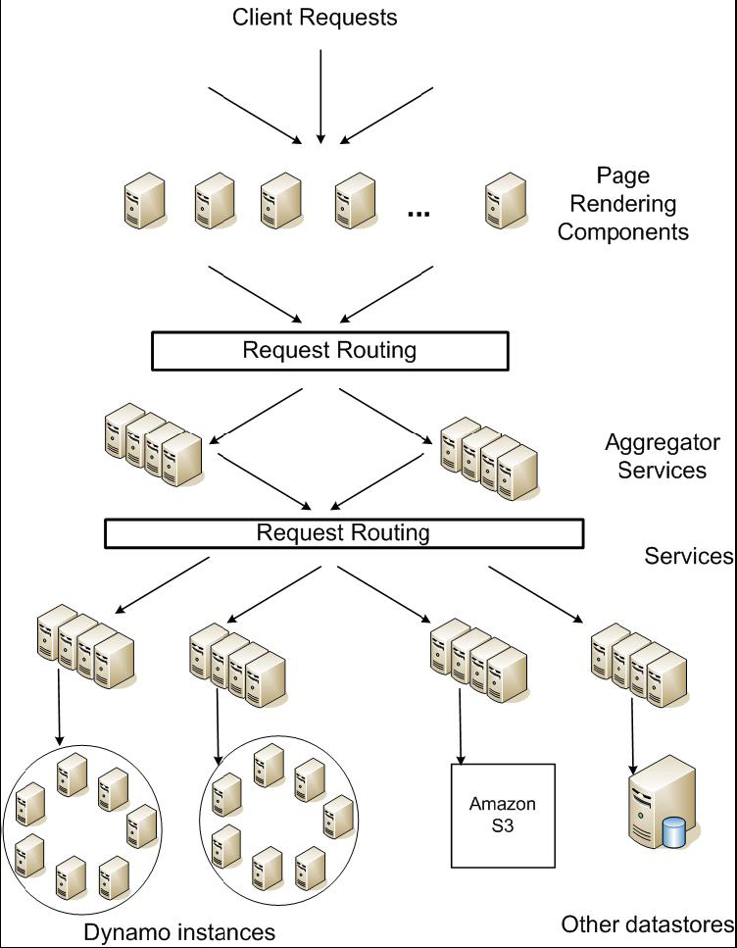
Service Level Agreements (SLA)
Application can deliver its functionality in a bounded time: Every dependency in the platform needs to deliver its functionality with even tighter bounds.
Example: service guaranteeing that it will provide a response within 300ms for 99.9% of its requests for a peak client load of 500 requests per second.
Service-oriented architecture of
Amazon’s platform

Slide 5
Design Consideration
Sacrifice strong consistency for availability
Conflict resolution is executed during read instead of write, i.e. “always writeable”.
Other principles:
  Incremental scalability.
  Symmetry.
  Decentralization.
  Heterogeneity.

Slide 6
Summary of techniques used in Dynamo and their advantages
Problem | Technique | Advantage
Partitioning | Consistent Hashing | Incremental Scalability
High Availability for writes | Vector clocks with reconciliation during reads | Version size is decoupled from update rates.
Handling temporary failures | Sloppy Quorum and hinted handoff | Provides high availability and durability guarantee when some of the replicas are not available.
Recovering from permanent failures | Anti-entropy using Merkle trees | Synchronizes divergent replicas in the background.
Membership and failure detection | Gossip-based membership protocol and failure detection. | Preserves symmetry and avoids having a centralized registry for storing membership and node liveness information.

Slide 7
Partition Algorithm
Consistent hashing: the output range of a hash function is treated as a fixed circular space or “ring”.
”Virtual Nodes”: Each node can be responsible for more than one virtual node.

Slide 8
Advantages of using virtual nodes
If a node becomes unavailable the load handled by this node is evenly dispersed across the remaining available nodes.
When a node becomes available again, the newly available node accepts a roughly equivalent amount of load from each of the other available nodes.
The number of virtual nodes that a node is responsible can decided based on its capacity, accounting for heterogeneity in the physical infrastructure.

Slide 9
Replication
Each data item is replicated at N hosts.
“preference list”: The list of nodes that is responsible for storing a particular key.

Slide 10
Data Versioning
A put() call may return to its caller before the update has been applied at all the replicas
A get() call may return many versions of the same object.
Challenge: an object having distinct version sub-histories, which the system will need to reconcile in the future.
Solution: uses vector clocks in order to capture causality between different versions of the same object.

Slide 11
Vector Clock
A vector clock is a list of (node, counter) pairs.
Every version of every object is associated with one vector clock.
If the counters on the first object’s clock are less-than-or-equal to all of the nodes in the second clock, then the first is an ancestor of the second and can be forgotten.

Slide 12
Vector clock example

Slide 13
Execution of get () and put () operations
Route its request through a generic load balancer that will select a node based on load information.
Use a partition-aware client library that routes requests directly to the appropriate coordinator nodes.

Slide 14
Sloppy Quorum
R/W is the minimum number of nodes that must participate in a successful read/write operation.
Setting R + W > N yields a quorum-like system.
In this model, the latency of a get (or put) operation is dictated by the slowest of the R (or W) replicas. For this reason, R and W are usually configured to be less than N, to provide better latency.

Slide 15
Hinted handoff
Assume N = 3. When A is temporarily down or unreachable during a write, send replica to D.
D is hinted that the replica is belong to A and it will deliver to A when A is recovered.
Again: “always writeable”

Slide 16
Other techniques
Replica synchronization:
  Merkle hash tree.
Membership and Failure Detection:
  Gossip

Slide 17
Implementation
Java
Local persistence component allows for different storage engines to be plugged in:
  Berkeley Database (BDB) Transactional Data Store: object of tens of kilobytes
  MySQL: object of > tens of kilobytes
  BDB Java Edition, etc.

Slide 18
Evaluation

Slide 19
Evaluation

