Slide 1
Finding a needle in Haystack:
Facebook’s photo storage
OSDI 2010
Doug Beaver, Sanjeev Kumar, Harry C. Li, Jason Sobel, Peter Vajgel
Facebook.com
An Overview Presented in CSE-291 (Storage Systems), Spring 2017
Gregory Kesden

Slide 2
Overview
Facebook is the world’s largest photosharing site
As of 2010:
  260 billion images
  20 petabytes of data
  1 billion photos, 60 terabytes uploaded each week
  Over 1 million images/second served at peak
  News feed and albums are 98% of photo requests
Images are written once, read often, never modified, and rarely deleted

Slide 3
Why Not Use a Traditional Filesystem?
No need for most metadata (directory tree, owner, group, etc)
  Wastes space
  More importantly, slows access to read, check, and use it
  Turned out to be bottleneck
What cost? Seems small?
  Multiplied a lot
  Think about steps: Map name to inode (name cache, directory files), read inode, read data
  Latency is in access, itself, not tiny transfer

Slide 4
Haystack Goals
High throughput, low latency
Fault-tolerance
Cost-effective (It is hugely scaled, right?)
Simple (Means matures to robustness quickly, low operational cost)

Slide 5
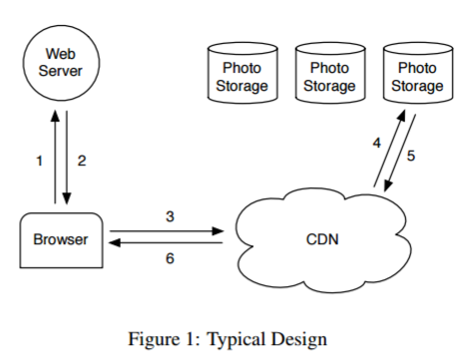
Typical Design

Slide 6
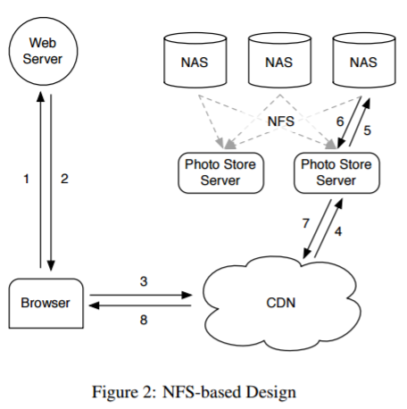
“Original” Facebook NFS-based Design

Slide 7
Lessons Learned from “Original”
CDNs serve “hottest” photos, e.g. profile pictures, but don’t help with “Long tail” of requests for older photos generated by such a large volume site
  Significant amount of traffic, hitting backing store
  Too many possibilities, too few used to keep in memory cache of any kind, not just via CDN
Surprising complexity
  Directories of thousands of images ran into metadata data inefficiencies in NAS, ~10 access/image
  Even when optimized to hundreds of images/directory, still took 3 access: metadata, inode, file

Slide 8
Why Go Custom?
Needed better RAM:Disk ratio
Unachievable, because would need too much RAM
Had to reduce demand for RAM by reducing metadata

Slide 9
Reality and Goal
Reality: Can’t keep all files in memory, or enough for long-tail
Achievable Goal: Shrink metadata so it can fit in memory
Result: 1 disk access per photo, for the photo, itself (not metadata)

Slide 10
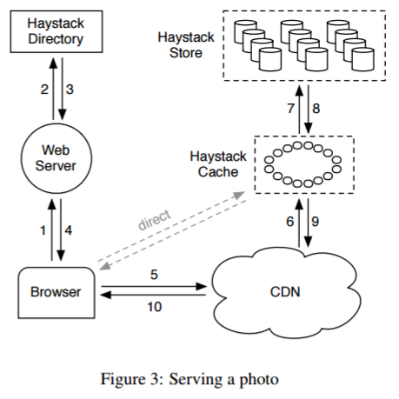
Haystack’s Design

Slide 11
Photo URL
http://<CDN>/<Cache>/<Machine id>/<Logical volume, Photo>
Specifies steps to retrieving the photos
  CDN Looks up <Logical volume, Photo>. If hit, great. If not,
  CDN strips <CDN> component, and asks the Cache. If Cache hits, great. If not,
  Cache strips <Cache> component and asks back-end Haystack Store machine
  If not in CDN just starts at second step.

Slide 12
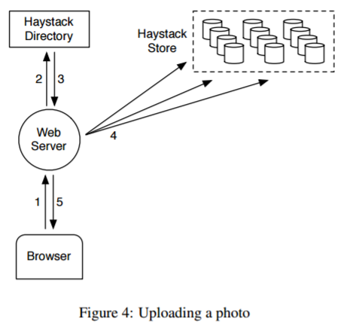
Photo Upload
Request goes to Web server
Web server requests a write-enabled logical volume from the Haystack Directory
Web server assigns unique ID to photo and uploads it to each physical volume associated with logical volume

Slide 13
Haystack Directory
Functions:
  Logical volume to physical volumes mapping
  Load balances writes across logical volumes and reads across physical volumes
  Determines if the request should be handed by CDN or Cache
  Makes volumes read-only, if full, or for operational reasons (Machine-level granularity)
  Removes failed physical volumes, replaces with new Store
  Replicated database with memcache

Slide 14
Haystack Cache
Distributed hash table with photo ID as key
Cache photo iff
  Request is from end user (not CDN) – CDN much bigger than cache. Miss there, unlikely to hit in smaller Cache.
  Volume is write-enabled
    Volumes perform better when reading or writing, but not mix, so doing one or the other is helpful
    Shelter reads, letting focus on writes (No need to shelter, once volume is full – no more writes)
    Could pro-actively push newly uploaded files into cache.

Slide 15
Haystack Store
Store needs logical volume id and offset (and size)
  This needs to quick to get, given the photo id – no disk operations
Keeps open file descriptors for each physical volume (preloaded fd cache)
Keeps in-memory mapping of photo ids to fs metadata (file, offset, size)
Needle represents a file stored within Haystack
  In memory mapping from <photoid, type (size)> to <flags, size, offset>

Slide 16
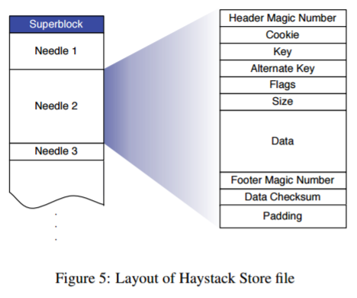
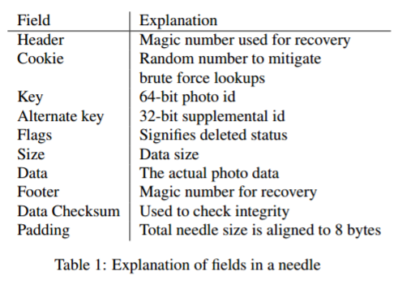
Needle and Store File

Slide 17
Reads from Store
Cache machine requests <logical volume id, key, alternate key, cookie>
Cookie is random number assigned/maintained by Directory upon upload.
  Prevents brute-force lookups via photo ids
  Store machines looks this up in in-memory metadata, if not deleted
    Seeks to offset in volume file and reads entire needle from disk
    Verifies cookie and data integrity
    Returns photo to cache

Slide 18
Photo Write
Web server provides <logical volume id, key, type (size), cookie, data> to store machines (all associated with logical volume)
Store machines synchronously appends needle to physical volume and updates mapping
  The append makes this much happier
  But, if files are updated, e.g. rotated, needle can’t be changed, new one must be appended – if multiple, greatest offset wins. (Directory can update for logical volumes)

Slide 19
Delete
Just a delete flag – long live those party photos!

Slide 20
Index File
Asynchronously updated checkpoint of in-memory data structures, in event of reboot
  Possible to reconstruct, but much data would need to be crunched
  Can be missing recent files and/or delete flags
Upon reboot
  Load checkpoint
  Find last needle
  Add needles after that from volume file
  Restore checkpoint
Store machines re-verify deleted flag after read form storage, in case index file was stale

Slide 21
Host Filesystem
Store machines should use file system that:
  Requires little memory for random seeks within a large file
  E.g., blockmaps vs B-trees for logical to physical block mapping

Slide 22
Recovering From Failure
Failure detection
  Proactively test Stores: Connected? Each volume available? Each volume readable?
    Fail? Mark logical volumes on store read only and fix.
    In worst case, copy over from other replicas (slow = hours)

Slide 23
Optimizations
Compaction
  Copies over used needles, ignoring deleted ones, locks, and atomically swaps
  25% of photos deleted over course of a year, more likely to be recent ones
Batch Uploads
  Such as when whole albums uploaded
  Improves performance via large, sequential writes

Slide 24
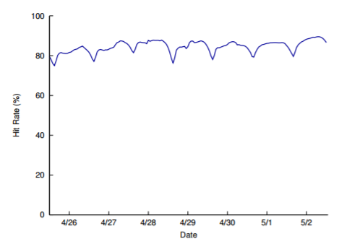
Cache Hit Rate

Slide 25
Why Did We Talk About Haystack
All the fun bits
  Classical Browser-Server-Directory-CDN-Cache-Store Layering
Simple, Easy Example, By Design (Simple = Robust Fast)
Optimizes for use cases
Memory-Disk Trade
Focus on fitting metadata into memory
Real-world storage concerns

