Slide 1
HDFS Architecture
Gregory Kesden, CSE-291 (Storage Systems) Fall 2017
Based Upon: http://hadoop.apache.org/docs/r3.0.0-alpha1/hadoop-project-dist/hadoop-hdfs/HdfsDesign.html

Slide 2
Assumptions
At scale, hardware failure is the norm, not the exception
  Continued availability via quick detection and work-around, and eventual automatic rull recovery is key
Applications stream data for batch processing
  Not designed for random access, editing, interactive use, etc
  Emphasis is on throughput, not latency
Large data sets
  Tens of millions of files many terabytes per instance

Slide 3
Assumptions, continued
Simple Coherency Model = Lower overhead, higher throughput
  Write Once, Read Many (WORM)
  Gets rid of most concurrency control and resulting need for slow, blocking coordination
“Moving computation is cheaper than moving data”
  The data is huge, the network is relatively slow, and the computation per unit of data is small.
  Moving (Migration) may not be necessary – mostly just placement of computation
Portability, even across heterogeneous infrastructure
  At scale, things can be different, fundamentally, or as updates roll-out

Slide 4
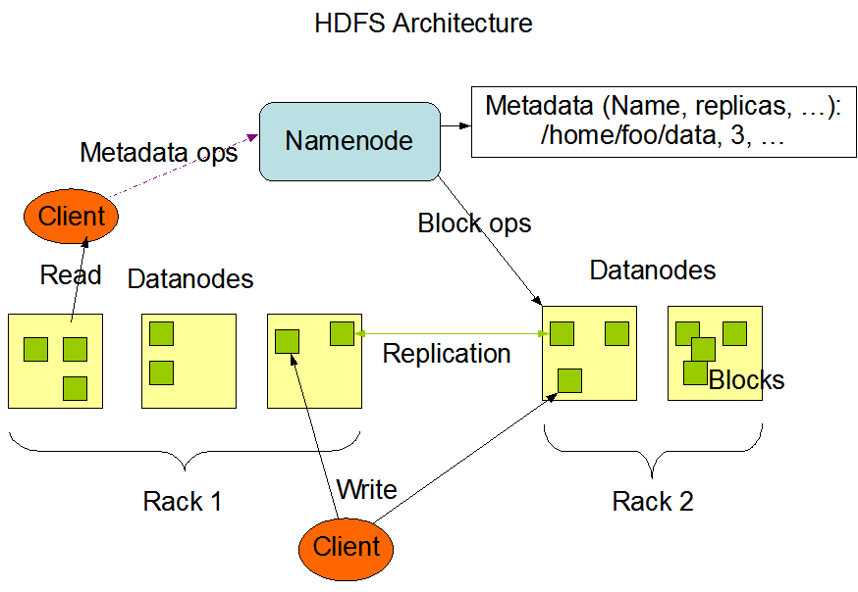
Overall Architecture

Slide 5
NameNode
Master-slave architecture
1x NameNode (coordinator)
  Manages name space, coordinates for clients
  Directory lookups and changes
  Block to DataNode mappings
Files are composed of blocks
  Blocks are stored by DataNodes
Note: User data never comes to or from a NameNode.
  The NameNode just coordinates

Slide 6
DataNode
Many DataNodes (participants)
  One per node in the cluster. Represent the node to the NameNode
  Manage storage attached to node
  Handles read(), write() requests, etc for clients
  Store blocks as per NameNode
    Create and Delete blocks, Replicate Blocks

Slide 7
Namespace
Hierarchical name space
  Directories, subdirectories, and files
Managed by NameNode
Maybe not needed, but low overhead
  Files are huge and processed in entirety
  Name to block lookups are rare
  Remember, model is streaming of large files for processing
  Throughput, not latency, is optimized

Slide 8
Access Model
(Just to be really clear)
Read anywhere
  Streaming is in parallel across blocks across DataNodes
Write only at end (append)
Delete whole file (rare)
No edit/random write, etc

Slide 9
Replication
Blocks are replicated by default
  Blocks are all same size (except tail)
  Fault tolerance
  Opportunities for parallelism
NameNode managed replication
  Based upon heartbeats, block reports (per dataNode report of available blocks), and replication factor for file (per file metadata)

Slide 10
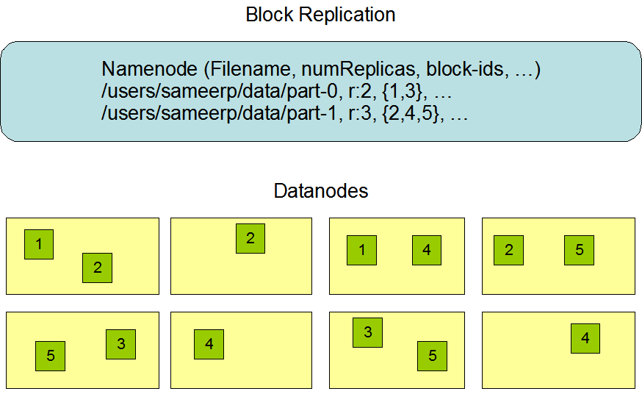
Replication

Slide 11
Location Awareness
Site + 3-Tier Model is default

Slide 12
Replica Placement and Selection
Assume bandwidth within rack greater than outside of rack
Default placement
  2 nodes on same rack, one different rack (Beyond 3? Random, below replicas/rack limit)
  Fault tolerance, parallelism, lower network overhead than spreading farther
Read from closest replica (rack, site, global)

Slide 13
Filesystem Metadata Persistence
EditLog keeps all metadata changes.
  Stored in local host FS
FSImage keeps all FS metadata
  Also stored in local host FS
FSImage kept in memory for use
  Periodically (time interval, operation count), merges in changes and checkpoints
  Can truncate EditLog via checkpoint
Multiple copies of files can be kept for robustness
  Kept in sync
  Slows down, but okay given infrequency of metadata changes.

Slide 14
Failure of DataNodes
Disk Failure, Node Failure, Partitioning
  Detect via heartbeats (long delay, by default), blockmaps, etc
  Re-Replicate
Corruption
  Detectable by client via checksums
  Client can determine what to do (nothing is an option)
Metadata

Slide 15
Datablocks, Staging
Data blocks are large to minimize overhead for large files
Staging
  Initial creation and writes are cached locally and delayed, request goes to NameNode when 1st chunk is full.
  Local caching is intended to support use of memory hierarchy and throughput needed for streaming. Don’t want to block for remote end.
  Replication is from replica to replica, “Replication pipeline”
    Maximizes client’s ability to stream

