Slide 1
Deformation-Invariant Sparse Coding for Modeling Spatial Variability of Functional Patterns in the Brain
George Chen, Evelina Fedorenko, Nancy Kanwisher, Polina Golland

Slide 2
Talk Outline
Finding correspondences between functional regions in the brain
A new generative model
Results for language fMRI study

Slide 3
Functional Region Correspondences
Given stimulus, get functional activation regions
group-level parcels
Parcel: contiguous region in brain
Biology:
brain compartmentalized into functional modules
→ parcels represent these modules
Functional variability!
Subject 1
Align to common anatomical space
contiguous region in brain
Goal: Find correspondences between “parcels”
Subject 2

Slide 4
Functional Variability
Standard approach: just average in common anatomical space
space
space
Subject 1
Average
space
space
Subject 2
Aligned
Functional variability → less pronounced activation in group average

Slide 5
Previous Work
Thirion et al. 2007: treat parcels as discrete objects and find parcel correspondences across subjects by matching
Xu et al. 2009: generative, hierarchical model representing activation regions as Gaussian mixtures
Sabuncu et al. 2010: groupwise functional registration

Slide 6
Previous Work
Thirion et al. 2007: treat parcels as discrete objects and find parcel correspondences across subjects by matching
Xu et al. 2009: generative, hierarchical model representing activation regions as Gaussian mixtures
Sabuncu et al. 2010: groupwise functional registration

Slide 7
Our Generative Model
$$n=1,…,N$$
$$w_{n}$$
To generate image for a subject:
Choose weights for each group-level parcel
Form weighted sum of group-level parcels
e.g. (0.2, 1)
1:
i.i.d. $exp⁡(λ_{k})$ prior
i.i.d. $𝒩(0,σ^{2})$ entries
$$y_{n}=\left(\sum_{k=1}^{K}{w_{nk}}D_{k}\right)∘Φ_{n}^{−1} +noise$$
$$D_{1}$$
$$0.2×$$
$$+ 1×$$
$$=$$
2:
$p\left(y,w | D,Φ\right)=\prod_{n}{p(y_{n},w_{n}|D,Φ_{n})}$
$w_{n}$ sparse, no deformations → sparse coding
Pre-image
Deform pre-image and add noise
$$D_{2}$$
$${… D}_{K}$$
Group-level parcels
Goal: Estimate group-level parcels and deformations
Deformation: $Φ_{n}$
$$y_{n}$$

Slide 8
Estimating Group-level Parcels and Deformations
Priors on group-level parcels and deformations
$p\left(Φ_{n}\right)∝\exp\left(−Reg\left(Φ_{n}\right)\right)$ →$Reg(Φ_{n})$ from image registration
Want $D_{k}$ to be parcel, have sparse support, and smooth
Want MAP estimate:
Use generalized EM algorithm for MAP estimation
$$p\left(D_{k}\right)∝\exp\left(−ξ{\left\|D_{k}\right\|}_{1}−ηD_{k}^{T}LD_{k}\right)𝕝\{D_{k} is unimodal and {\left\|D_{k}\right\|}_{2}≤1\}$$
sparsity
smoothness
parcel
identifiability
$$\underset{D,Φ}{argmax} p\left(D,Φ | y\right)=\underset{D,Φ}{argmax} p\left(y,D,Φ\right)$$
$$=\underset{D,Φ}{argmax} p\left(D\right)p(Φ)\sum_{w}{p\left(y,w | D,Φ\right)}$$
Don’t get to observe $w_{nk}$’s!

Slide 9
Language fMRI Study
Data
Substantial functional variability!
33 subjects
Contrast: reading sentences vs. pronounceable nonwords
$y_{n}$ are t-statistic images from standard fMRI preprocessing
All images initially brought into common anatomical space
What we’ll show
Estimated group-level parcels correspond to language processing regions
Estimated deformations improve fMRI group analysis

Slide 10
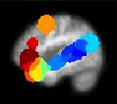
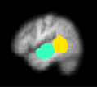
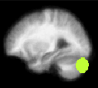
Estimated Group-level Parcels
Correspond to known language processing regions
Spatial support of group-level parcels
Left frontal lobe
Right temporal lobe
Right cerebellum
Left temporal lobe
Example group-level parcels

Slide 11
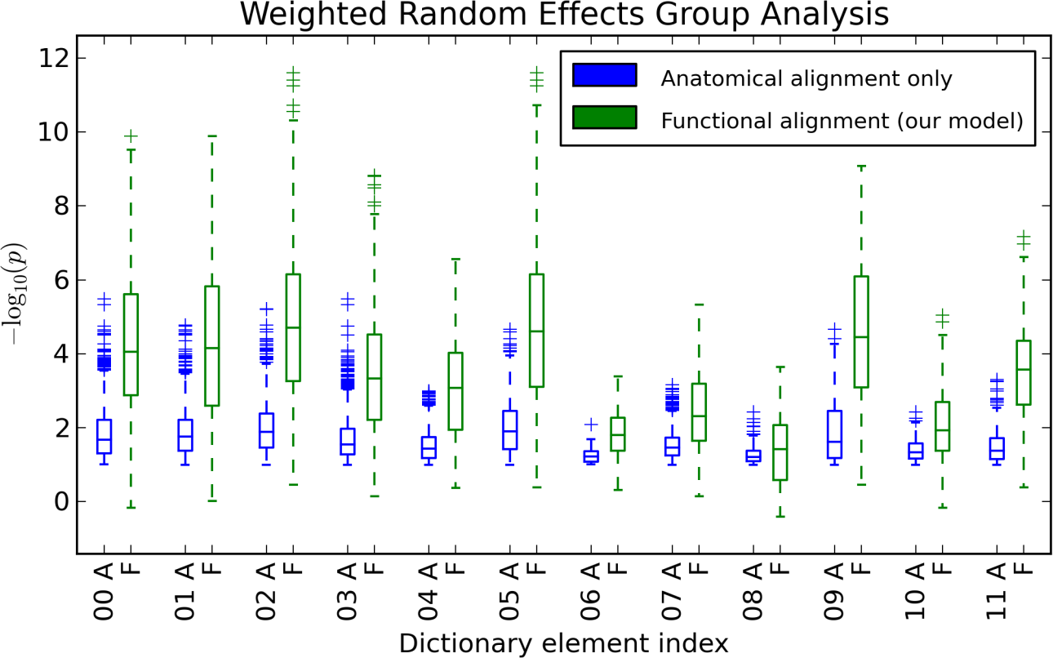
Improving fMRI Group Analysis with Estimated Deformations
Apply estimated deformation to fMRI data for each subject and redo standard fMRI group analysis on separate data
Negative log p-value
Group-level Parcel Index
Modeling functional variability increases statistical significance in each group-level parcel

Slide 12
Improving fMRI Group Analysis with Estimated Deformations
Why is the variance so high for statistical significance values for our model?
space
space
Subject 1
Average
space
space
Subject 2
Aligned

Slide 13
Improving fMRI Group Analysis with Estimated Deformations
Why is the variance so high for statistical significance values for our model?
Variation using anatomical alignment only
Variation using our model
space
Average
Group-level parcel support

Slide 14
Improving fMRI Group Analysis with Estimated Deformations
Apply estimated deformation to fMRI data for each subject and redo standard fMRI group analysis
Negative log p-value
Group-level Parcel Index
Modeling functional variability increases statistical significance in each group-level parcel

Slide 15
Contributions
Generative model for finding group-level parcels
Represent discrete set of parcels as images
Model implicitly represents correspondences → Just look at where $k$-th group-level parcel shows up in each subject!
Get deformations out of model, not just parcel correspondences! → Improves fMRI group analysis
Future directions
Use estimated parcels in other fMRI studies as markers for language processing (and other stimuli!)

