Slide 1
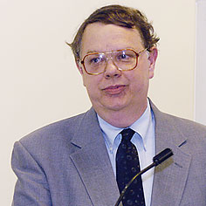
Project Delta
10 + α meetings
Faculty advisor: Prof. William Hrusa
Prof. William Hrusa
Professor of Mathematics Department
Taught 21-270 Intro to Math Finance, and a number of other MSCF classes
Continuation of Fall 2012 Project Delta
Wrap up our discussion of negative swap spread
Study concepts of fixed income to gain further fundamental understanding of above topic

Slide 2
Previous works
Basics of Fixed Income
Arbitrage Strategy on Negative Swap Spreads using…
Unsecure loans at LIBOR rates
Repo markets (secured loan)
Arbitrage Assumptions and Realistic Limitations
Notes:
Basics of Fixed Income
- Concepts like LIBOR, diff Tsy bonds
Arbitrage Strategy on Negative Swap Spreads using…
Unsecure loans at LIBOR rates
Repo markets (secured loan)
Arbitrage Assumptions and Realistic Limitations

Slide 3
Swap

Slide 4
Negative Swap Spread
Notes:
We wrapped up

Slide 5
Goals
Finish examining the peculiarity of negative swap spreads
Gain basic literacy in fixed income products and market
Gain holistic understanding of proposed strategy in real market setting
Notes:
Specific extent of fixed income theory that we will study needs more consideration and feedback from the members

Slide 6
Thank you☺
Notes:
Looking for a couple of new members:
Interested in this sector of the financial market (background knowledge not mandatory)
Significant time commitment in the beginning (need to catch up, might schedule more meetings)

