Slide 1
Project Delta
By: Brandon Ngiam, Shiyan Gan, Eric Bae, Bo Li,
Chad Trice, Tiffany Chen, Sunny Liu, Keonwoo Kim

Slide 2
Contents
Basics of Fixed Income
Arbitrage Strategy on Negative Swap Spreads
Arbitrage Assumptions and Realistic Limitations

Slide 3
Fixed Income Basics

Slide 4
LIBOR
An interest rate at which banks can borrow funds, in marketable size, from other banks in the London interbank market.
Average of the world's most creditworthy banks' interbank deposit rates
LIBOR is a benchmark for other bonds and loans.
Notes:
An interest rate at which banks can borrow funds, in marketable size, from other banks in the London interbank market.
Derived from a filtered average of the world's most creditworthy banks' interbank deposit rates for larger loans with maturities between overnight and one full year.
World's most widely used benchmark for short-term interest rates.
First used in financial markets in 1986.
Today, LIBOR has reached such stature that the rate is published daily.
LIBOR is set by 16 international member banks and, by some estimates, places rates on a staggering $360 trillion of financial products across the globe
LIBOR is important because it is the rate at which the world's most preferred borrowers are able to borrow money.
Also the rate upon which rates for more or less preferred borrowers are based.
LIBOR can dilute the effects of Fed rate cuts. Most investors think it's good when the Fed cuts rates.
If LIBOR rates are high, the Fed cuts are really not that great.
High LIBOR rates restrict people from getting loans, making a lower Fed discount rate a nonevent for the average person.
Countries that rely on the LIBOR for a reference rate:
United States, Canada, Switzerland and the United Kingdom.

Slide 5
Treasury Bonds
There are three types of treasury bonds:
T-bills
Short term (< 1 year)
Receive as a lump sum (No regular payments)
T-notes
Mid (1 to 10 years)
Interest payments every 6 months
T-bonds
Long term (< 10 years)
Interest payments semi-annually
All only taxed federally
T-notes are most popular (secondary market)
Notes:
A short-term debt obligation backed by the U.S. government with a maturity of less than one year.
Sold in denominations of $1,000 up to a maximum purchase of $5 million and commonly have maturities of 1 month, 3 months, or 6 months.
You will not receive regular payments as you would with a coupon bond.
For example, let's say you buy a 13-week T-bill priced at $9,800. Essentially, the U.S. government writes you an IOU for $10,000 that it agrees to pay back in three months.
In this case, the T-bill pays a 2.04% interest rate ($200/$9,800 = 2.04%) over a three-month period.
A marketable U.S. government debt security with a fixed interest rate
Maturity between one and 10 years.
Treasury notes can be bought either directly from the U.S. government or through a bank.
When buying Treasury notes from the government, you can either put in a competitive or noncompetitive bid.
With a competitive bid, you specify the yield you want; however, this does not mean that your bid will be approved.
With a noncompetitive bid, you accept whatever yield is determined at auction.
Extremely popular investments
Large secondary market - adds to their liquidity
Interest payments on the notes are made every six months until maturity.
The income for interest payments is not taxable on a municipal or state level but is federally taxed.
A marketable, fixed-interest U.S. government debt security with a maturity of more than 10 years
Makes interest payments semi-annually.
Income only taxed at the federal level.
Minimum denomination of $1,000.
Initially sold through auction
maximum purchase amount is $5 million if the bid is non-competitive
A non-competitive bid ensures that the bidder will get the bond but he or she will have to accept the set rate.
35% of the offering if the bid is competitive
A competitive bid states the rate that the bidder is willing to accept; it will be accepted depending on how it compares to the set rate of the bond.
After the auction, the bonds can be sold in the secondary market.

Slide 6
Competitive vs. Non-competitive Bid
When buying Treasury notes and bonds from the government, you can either put in a competitive or noncompetitive bid.
With a competitive bid, you specify the yield you want; however, this does not mean that your bid will be approved.
With a noncompetitive bid, you accept whatever yield is determined at auction.

Slide 7
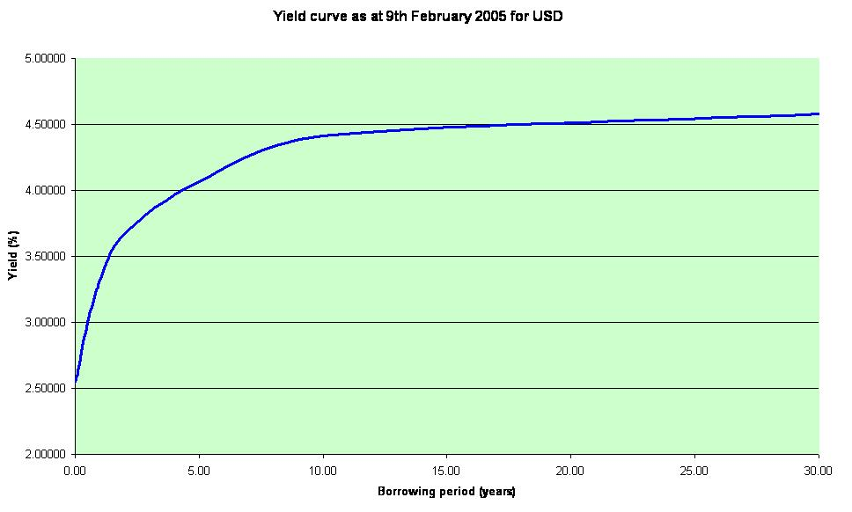
Yield Curve
What is a yield curve?
Shape of a yield curve
Notes:
A yield curve a graph showing yields or interest rates VS time on a graph as the time it takes for a bond to mature increases. It shows the yield for short time bonds (2 months, 2 years, etc.) to long time bonds (10 years, 20 years, 30 years).
Yield curves are typically upward sloping and increase with a decreasing rate, reaching an asymptote.
Yield curves assume this shape because risks and random processes increase as time goes on. This shape is also based on inflation as investors normally expect the economy to grow and thus for inflation to occur.

Slide 8
Repo
What is a repo?
Difference between repo and Libor?
Notes:
Repos, short for repurchase agreements, are contracts for the sale and future repurchase of a financial asset, most often Treasury securities. On the termination date, the seller repurchases the asset at the same price at which he sold it, and pays interest for the use of the funds. Although legally a sequential pair of sales, in effect a repo is a short-term interest-bearing loan against collateral.
repo markets allows short term financing. Unlike Libor, it is a secured loan, i,e, the borrower has to provide collateral. To borrow money, a borrower sells an asset (ex treasuries) and promises to purchase it back at a later date at a higher price to account for the interest from borrowing.

Slide 9
Swap

Slide 10
Negative Swap Spread

Slide 11
Arbitrage Strategy on Negative Swap Spreads

Slide 12
Arbitrage- Libor
Set-up
Borrow money at 3 month Libor to finance treasury purchase
Buy 30 year treasury at par with coupon equal to the 30 year yield
Enter a 30-year swap (with notional equal to the face value of the purchased treasuries) to pay fix and receive floating

Slide 13
Arbitrage- Libor
Results
Cash flow from the floating leg can be used to pay back the initial financing at 3 month Libor
Profit is the difference between 30-year treasury coupon and the 30-year swap rate.
Since the 30-year swap spread is negative, i.e. swap rate – treasury yield < 0, we have a profit

Slide 14
Arbitrage- Libor
Assumptions
We can borrow at LIBOR
Treasury trades at par
There was a 30-year auction or a longer tenor treasury rolled down the curve.
We do not have to post collateral for the swap
No counterparty risk for the swap, treasury is risk-free but the bank account is not.

Slide 15
Arbitrage - Repo
Setup
Borrow money at the repo markets to finance 30-year treasury purchase.
Use the treasury for collateral
Enter into a swap transaction paying fix and receiving Libor.

Slide 16
Arbitrage - Repo
Result
Every 3 months, use the Libor payments from the swap to pay the repo interest.
Refinance for another 3 months using repo markets, using the same treasury as collateral.
Every 6 months, receive the spread of the swap rate over the treasury coupon.
On expiration, use the principal from the treasury to return the repo loan.

Slide 17
Arbitrage - Repo
Assumptions
No bid-ask spreads
We are able to roll over the repo agreement every 3 months
30-year treasury bond trades at par.
No collateral is required for the swap,
The repo transaction does not require a haircut on the collateral,
No counterparty risk

Slide 18
Arbitrage Assumptions and Realistic Limitations

Slide 19
Illiquidity of 30-year Treasury
Principle notation of 30-year treasury is the largest of all treasury bonds.
Longer the tenor, less liquid
On-the-run vs. Off-the-run
Off-the-run less liquid, and thus traded below par
On-the-run auctioned quarterly

Slide 20
30-year Swap Contracts
Likewise, as tenor increases, liquidity drops notably
Swap contracts are OTC, thus we should customized to match the dates we receive floating interest payments and pay back our interbank loan or repo rates.

Slide 21
Notable Financing Costs
Only entities with credit rating tantamount to large banks can borrow at LIBOR
ASSUMPTION: we are a large bank (if not, we pay commissions to bank for borrowing through them)
Otherwise, our arbitrage profit might narrow and even vanish
Repo haircut (margin call) is paid when entering the contract, and also when the value of collateral posted falls.
Otherwise, repo rate might be adjusted upward.
Typical haircut for Treasury is about 2%

Slide 22
Thank you

