Slide 1
Financial Crises Analysis

Slide 2
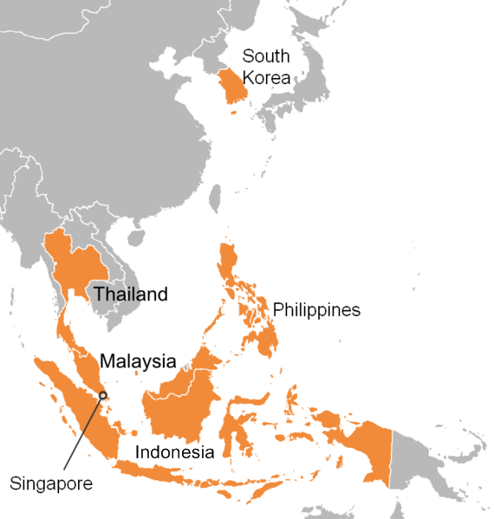
Overview
Asian Financial Crisis
July 1997-1999
Mainly South East Asian Countries
Started in Thailand
2008 Financial Crisis
US housing bubble burst
Bailout of banks
Led to 2008-2012 global recession

Slide 3
Causes: Asian Financial Crisis
Financial sector weaknesses
Large PE ratio in market
Borrowing in foreign currency
Poor supervision
Problems in external sectors
Large current-account deficits
Dependency on exports
Unsound investments
Real Estate bubbles
Contagion effect
“Wake-up call” hypothesis

Slide 4
Causes: 2008 Financial Crisis
Subprime lending
Mortgage lenders relaxed standards to lend to risky borrowers
Housing bubble- peak 2006
Risky borrowers drove prices up
Easy credit conditions
Lower interest rates
2000- Low fed funds rate- 1%
Foreign funds
Deregulation of banking
1970s onward- government policy:
Lack of supervision

Slide 5
Timeline of Economic/Political Policies: Asian Financial Crisis
Thailand
July 2, 1997: Thai government forced to float baht
August 5, 1997: Adopts IMF measures for $17 billion loan
Dec 8, 1997: Government closes 56 insolvent finance companies
South Korea
Nov 17, 1997: Bank of Korea allows won to drop- 1000 to USD
Dec 3, 1997: IMF approves $57 billion bailout
Dec 23, 1997: World Bank gives $3 bill
Jan 28, 1998: International banks agree with SK to exchange $24 bill of short-term debt to longer-term loans
Indonesia
Oct 31, 1997: IMF gives loan package of $40 bill. Gove closes 16 banks
Jan 8, 1998: Rupiah divas with President Suharto’s state budget plan
March 9, 1998: IMF delays $3 bill installment of loan package because of Suharto
May 5, 1998: Student riots against Suharto
May 22, 1998: Suharto resignns

Slide 6
Timeline of Economic/Political Policies: 2008 US Financial Crisis
South Korea
Sept 26, 2008: Bank of Korea injects into currency swap market
Jan 2009: Government delivers massive fiscal programme
Quarter of program for tax cuts and income/labour support
Indonesia
Sept 15, 2008: Gov reduces overnight repo rate to 10.25%
China
Sept 15, 2008: Government cuts interest rate for first time since 2002
Nov 9, 2008: Chinese economic stimulus plan- 4 trillion RMB
Nov 28, 2008: Rise in export tax rebates
Government trying to spur economic expansion

Slide 7
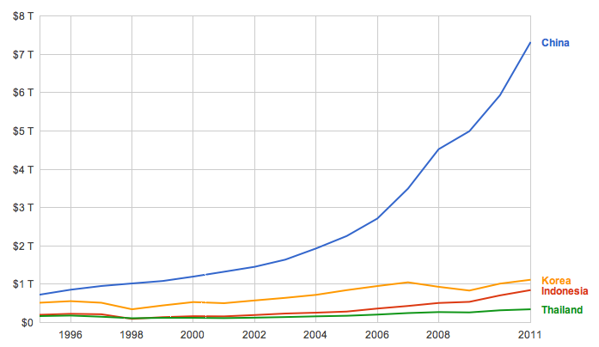
Statistics
GDP

Slide 8
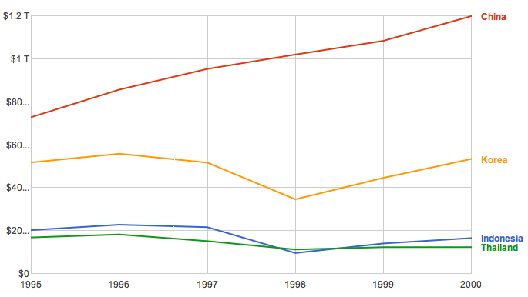
Statistics: Asian Financial Crisis

Slide 9
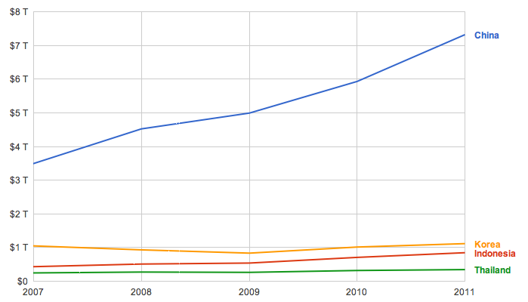
Statistics: 2008 Financial Crisis

Slide 10
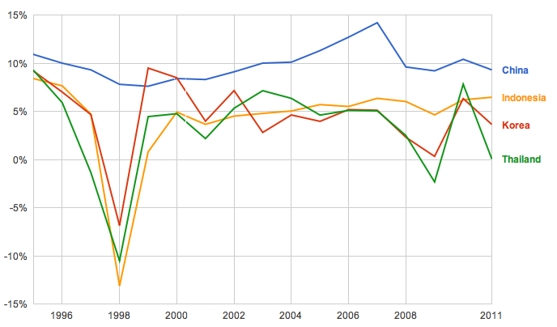
Statistics
GDP Growth Rate

Slide 11
Effects: Asian Financial Crisis
Thailand:
Large unemployment rates
Devalue of real estate and construction
Baht devalued
South Korea
Bank failures/bank takeovers
Moody downgrade- A1 to A3
Stock market fell
Indonesia
Rupiah put on floating exchange rate
Rupiah drops

Slide 12
Effects: II Asian Financial Crisis
China
Forced to devalue currency for competitiveness
Became largest exporter
Fixed many issues of financial weakness

Slide 13
Recovery: Asian Financial Crisis
Thailand
2001- Thailand’s economy recovered
Balanced budget
2003- repaid IMF debts
South Korea
GDP per capita tripled
Nation debt-to-GDP ratio more than doubled
Indonesia
Rupiah never recovered- Dec 1998- 8,000 rupiah to 1 USD
China
Unaffected by crisis

Slide 14
Economic Forecast
Only Thailand experienced recession
China, South Korea, Indonesia experience slowdowns
Dependant on exports to US
Forecast:
2012- 3.5% growth in world GDP
2013- 4.1% growth in world GDP
Emerging Asia to be economic leaders in growth
China:
Trade balance decreased greatly from crisis- 2009 decreased by 10%
China to shift from export production to export for domestic consumption
Domestic consumption needs to rise as share of GDP
12th 5-year plan- boosting consumption and household income

Slide 15
Graphs of Economic Recovery

